Slide 1
Project: IEEE P802.15 Working Group for Wireless Personal Area Networks(WPANs)
Submission Title: Delay Spreads for TG4m Multipath Channel Models
Date Submitted: March 2012
Source: Sangsung Choi(ETRI) and Soo-Young Chang (CSUS)
Contact: Sangsung Choi(ETRI) and Soo-Young Chang (CSUS)
Voice: +82 42 860 6722, E-Mail: sschoi@etri.re.kr, sychang@ecs.csus.edu
Re: Delay spreads and fading rates of multipath channel models for TG4m proposals
Abstract: Two key parameters of multipath channel models are reviewed to judge whether existing channel models are feasible or not for TG4m white space channel models.
Purpose: Information to 802.15 WG
Notice: This document has been prepared to assist the IEEE P802.15. It is offered as a basis for discussion and is not binding on the contributing individual(s) or organization(s). The material in this document is subject to change in form and content after further study. The contributor(s) reserve(s) the right to add, amend or withdraw material contained herein.
Release: The contributor acknowledges and accepts that this contribution becomes the property of IEEE and may be made publicly available by P802.15.
Slide 1

Slide 2
Delay Spreads for TG4m Multipath Channel Models
RMS delay spreads and fading rates

Slide 3
INTRODUCTION
For the TG4m Technical Guidance Document (TGD), some multipath channel impulse models need to be defined for system evaluation.
For these models, the worst case should be considered.
Each technology does not need to satisfy requirements for all these multipath channel models in TGD.
Each proposer will choose some of the models from TGD to evaluate his/her technology.
A concern is that there should be at least one model which can be applied for each of use cases of TG4m.
Amount of delay spread and fading rate should be reviewed to judge whether a model can be applied for a specific use case.
This point needs to be checked.
Slide 3

Slide 4
BANDWIDTH RELATED CHANNEL MODELS
Bandwidth related channel models
Small-scale fading
Additional variations of the signal attenuation led by multipath wave propagation
With rapid changes when moving the antenna positions locally or there are moving objects between a transmitter and a receiver.
Dispersion in the time domain and in a frequency selectivity of the channel
Dispersion led by multipath for broadband transmission
The dispersion of the transmitted signal induced by the channel is modelled by a convolution with the channel impulse response.
For this impulse response, statistical models can be defined.
→ time disperse models
Slide 4

Slide 5
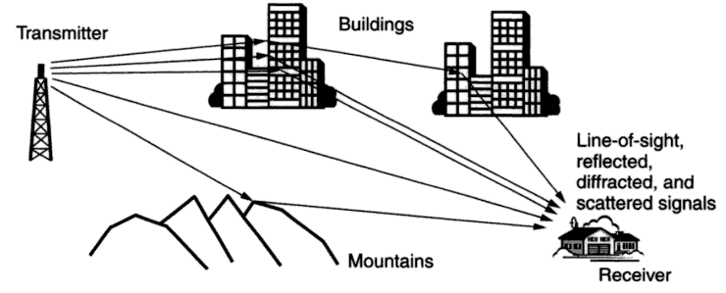
MULTIPATH PROPAGATION ENVIRONEMNT
Multipath propagation environment
Fixed broadband wireless system design, Harry R. Anderson, Wiley Publishers, 2003
Slide 5

Slide 6
DISCRETE TIME MULTIPATH CHANNEL MODEL
The discrete-time impulse response model suitable for baseband Monte Carlo simulations is given by
,
where t_{Δ} is the sampling interval.
The complex-valued coefficients h₀, h₁, … for the tapped-delay-line model are randomly generated. It is reasonable to assume uncorrelated scattering, i.e., E[h_{k} (h_{l})*] = 0 for k ≠ l. Also, a zero-mean complex Gaussian distribution is assumed for each coefficient with the variance given by
,
, k = 1,2,….
The complex Gaussian distribution of all tap coefficients leads to a Rayleigh fading characteristic in the absence of a direct path (i.e. c₀ = 0), whereas otherwise a Rician fading results. Taking the location variability into account, the parameters c₀ and c₁ are also random variables having a log-normal distribution.
Slide 6

Slide 7
POWER DELAY PROFILE (PDP)
PDP provides statistical a-priori information about the impulse response.
PDP provides the expected signal energy arriving at a specific delay from the transmission of a Dirac impulse.
The earliest arriving contribution is assigned delay zero and normally originates from the signal part travelling in a direct transmitter-receiver path, resulting in a peak in the PDP.
The energies in the indirect, reflected or scattered signal parts typically decay exponentially in the mean. This leads to the common spike-plus-exponential shape of the PDP, given by
, τ ≥ 0,
where δ(·) is the Dirac delta function.
c₀ and c₁ determine the mean energies in the direct and indirect signal parts, respectively, and τ₁ specifies the exponential decay in the indirect components.
The mean total signal energy returning from a transmitted unit energy pulse equals c₀+c₁.
Slide 7

Slide 8
DELAY SPREAD AND K-FACTOR
K-factor
power ratio between the direct path component and scattered multipath components
Both the delay spread and the K-factor
heavily depend on the environment and the antenna types.
In LOS scenarios
the K-factor is much larger than for NLOS scenarios even with omnidirectional antennas.
In NLOS scenarios,
K₀ is determined by the presence and strength of a dominant signal path. If the area between the transmitter and the receiver is totally obstructed, K₀ is close to zero.
Clearly, the K-factor also increases when narrowing the terminal station antenna beamwidth
because of increased fading of reflected signal parts arriving from “blind” angles.
Slide 8

Slide 9
CALCULATION OF RMS DELAY SPREAD
c₀ and c₁ values
For LOS scenarios
,
For NLOS scenarios and wide angle terminal station antennas
.
K-factor K₀
The ratio c₀/c₁ is referred to as the, providing information about the presence and strength of the direct propagation path.
power ratio between the direct path component and scattered multipath components
Root mean square (RMS) delay spread τ_{RMS}
The RMS delay spread τ_{RMS} of the PDP defined in the previous equation
Slide 9

Slide 10
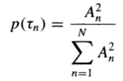
ANOTHER CALCULATION OF RMS DELAY SPREAD
RMS delay spread σ_{τ},
where the mean value of the power delay profile is
and
Indicative of the amount of time dispersion in the channel
RMS delay spread is modeled by
σ_{τ} = T₁d^{α}u
where
T₁: the mean value of RMS delay spread at 1 km that equals 400 ns for urban microcells, 400 to 1000 ns for urban macrocells, 300 ns for suburban areas, 100ns for rural areas, and >500 ns for mountainous areas
α: equal to 0.5 for urban, suburban, and rural areas, and 1.0 for mountainous areas
u: a zero mean lognormal variate with a standard deviation falling in a range of 2 to 6 dB
Fixed broadband wireless system design, Harry R. Anderson, Wiley Publishers, 2003
Slide 10

Slide 11
FADING RATES TIME VARIANT CHANNEL AND STATIC CHANNEL
Static channel model ← slow fading
If the transmitter and the receiver are fixed in place and nothing in the propagation environment moves and changes (not even the atmosphere)
Mainly for broadband system types, this assumption can be made, or it can be assumed that the channel is quasi-static.
Time variant channel model ← fast fading
It is assumed that the propagation environment changes with time.
Mainly for mobile communication systems
Doppler frequencies should be considered.
Fixed broadband wireless system design, Harry R. Anderson, Wiley Publishers, 2003
Slide 11

Slide 12
FADING RATES SLOW FADING AND FAST FADING
Slow fading
complicates simulations because it seriously extends the length of the simulations required to get representative results.
→ a quasi-static channel
the I and Q components of each tap are chosen from independent normal distributions at the start of each burst, and average the performance over several hundred bursts.
This gives the required Rayleigh distributed envelope, and is equivalent to an average of the performance over a population of several hundred receivers at the same nominal link distance.
The resulting average PER is strongly related to the probability of link success over all locations at a given link distance.
Fast fading
caused by passing vehicles with an assumption that there is a constant stream of cars passing by, as one might expect on a busy road or freeway.
This fast fading can be ignored for our purposes.
→ Many scenarios have an element of slow fading because of the stationarity of the end points.
15-09-0263-01-004g-channel-characteristics-4g
Slide 12

Slide 13
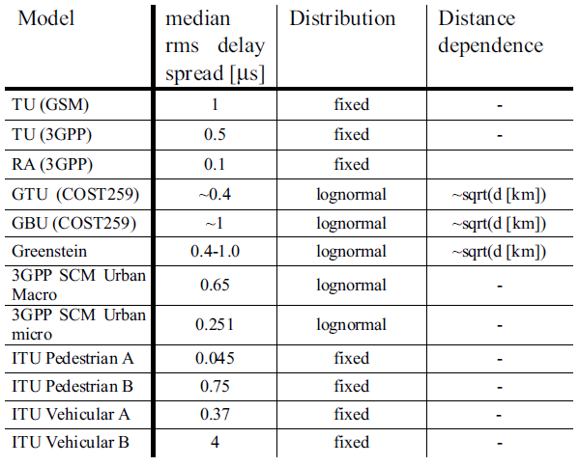
DELAY SPREAD VALUES OF SOME CHANNEL MODELS
Delay spread characteristics of some commonly used channel models
Henrik Asplund, Kjell Larsson and Peter Okvist, How typical is the "Typical Urban" channel model? - Mobile-based Delay Spread and Orthogonality Measurements
Slide 13

Slide 14
MULTIPATH PROFILES 802.15.4m TGD DRAFT
For indoor scenario (to be included)
 | Path 1 | Path 2 | Path 3 | Path 4 | Path 5 | Path 6
Indoor-B as defined in ITU-R M.1225
Path Delay (us) | 0 | 0.1 | 0.2 | 0.3 | 0.5 | 0.7
Avg PathGain | 0 | -3.6 | -7.2 | -10.8 | -18.0 | -25.2
15-11-0684-08-004m-tg4m-technical-guidance-document
Slide 14

Slide 15
MULTIPATH PROFILES 802.15.4m TGD DRAFT
For outdoor scenario
 | Path 1 | Path 2 | Path 3 | Path 4 | Path 5 | Path 6
d=1.5 km Profile A
Path Delay (us) | 0 | 0.7 | 1.2 | 3.2 | 5.5 | 6.8
Avg Path Gain | 0 | -34.9 | -25.9 | -22.7 | -24.8 | -34.6
d=2.7 km Profile B
Path Delay | 0 | 0.9 | 1.7 | 3.1 | 3.8 | 7.5
Avg Path Gain | 0 | -18.2 | -20.6 | -25 | -26.5 | -19.6
d=6.1 km Profile C
Path Delay | 0 | 0.6 | 5.3 | 6.2 | 7.5 | 19.5
Avg Path Gain | 0 | -12.1 | -25.2 | -22.2 | -18.5 | -21.8
COST 207 Profile D
Path Delay | 0 | 0.2 | 0.5 | 1.6 | 2.3 | 5
Avg Path Gain | -3 | 0 | -2 | -6 | -8 | -10
15-11-0684-08-004m-tg4m-technical-guidance-document
Slide 15

Slide 16
CONCLUSIONS
RMS delay spread of around 1 us and less than 2 us will be reasonable for all TG4m use cases.
← from conclusions of the two TG4g documents
All the multipath impulse models in TGD have RMS delay spreads of less than 1 us.
These models can be used for TG4m applications.
It can be assumed that all the TG4m multipath channel is quasi-static.
Slide 16

