Slide 1
Project: IEEE P802.15 Working Group for Wireless Personal Area Networks (WPANs)
Submission Title: Korean Regulation for 917 MHz
Date Submitted: 12 March, 2012
Source: Tae-Joon Park, Juderk Park, Wun-Cheol Jeong, Chang-Sub Shin, Hoyong Kang
Company: ETRI
Address: 161 Gajeong-dong, Yuseong-gu, Daejeon, KOREA
Voice: +82-42-860-6902, FAX: +82-42-860-4197, E-Mail: tjpark@etri.re.kr
Re:
Notice: This document has been prepared to assist the IEEE P802.15. It is offered as a basis for discussion and is not binding on the contributing individual(s) or organization(s). The material in this document is subject to change in form and content after further study. The contributor(s) reserve(s) the right to add, amend or withdraw material contained herein.
Release: The contributor acknowledges and accepts that this contribution becomes the property of IEEE and may be made publicly available by P802.15.

Slide 2
Korean Regulation for 917 MHz
Tae-Joon Park,
Wun-Cheol Jeong, Chang-Sub Shin,
Juderk Park, Hoyong Kang
ETRI

Slide 3
Regulation
Frequency band :
The unlicensed band 917 MHz ~ 923.5 MHz is assigned for RFID/USN.
Center frequencies of 200 KHz channel :
32 channels
Fc = 917.1 + (n-1) x 0.2MHz, n= 1,2,3, …,32
n : channel number
Frequency tolerance : within ±40x10⁻⁶
Permitted output power :
10mW for 20 channels ( n= 2,5,8,11,14,17,19,20,21,…,32 )
3mW for 12 channels ( n= 1,3,4,6,7,9,10,12,13,15,16,18 )

Slide 4
Regulation
Spectrum sharing for unlicensed bands
Case 1) Frequency hopping
Use at least 16 or more non-duplicated channels
Maximum hopping time : 0.4 sec
Case 2) Listen before transmission(Carrier sense)
Carrier sense 5ms or more, received signal power -65dBm or less
Sending duration : 4sec or less
Pause duration : 50ms or more
Case 3) Otherwise
Duty cycle : below 2% in 20sec duration

Slide 5
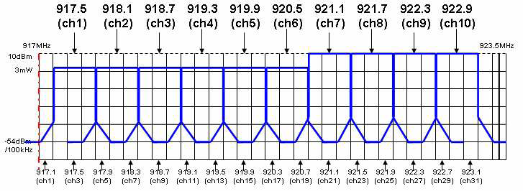
Local standard
600 KHz channel :
10 channels
Fc = 917.5 + (n-1) x 0.6MHz, n= 1,2,3, …,6
n : channel number
TTA(Telecommunications Technology Associations)
900 MHz Physical Layer (PHY) Specification for Low-Rate Wireless Personal Area Networks (LR-WPANs)

Slide 6
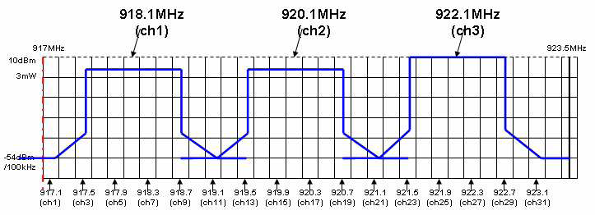
Local standard
2 MHz channel :
3 channels
Fc = 918.1 + (n-1) x 2MHz, n= 1,2,3
n : channel number
TTA(Telecommunications Technology Associations)
900 MHz Physical Layer (PHY) Specification for Low-Rate Wireless Personal Area Networks (LR-WPANs)

Slide 7
Thank you very much for your attention.
Any Questions?

