Slide 1
Project: IEEE P802.15 Working Group for Wireless Personal Area Networks(WPANs)
Submission Title: Link Budget for 802.15.4m
Date Submitted: 5 March 2012
Source: Eldad Zeira (InterDigital)
Contact: Eldad Zeira (InterDigital)
Voice: E-Mail: eldad.zeira@interdigital.com
Re: Technical Guidance Document
Abstract: Contribution discusses link budget relevant to 15.4m
Purpose: TV White Space Amendment to IEEE 802.15.4m
Notice: This document has been prepared to assist the IEEE P802.15. It is offered as a basis for discussion and is not binding on the contributing individual(s) or organization(s). The material in this document is subject to change in form and content after further study. The contributor(s) reserve(s) the right to add, amend or withdraw material contained herein.
Release: The contributor acknowledges and accepts that this contribution becomes the property of IEEE and may be made publicly available by P802.15.

Slide 2
Link Budget Analysis for 802.15.4m

Slide 3
Overview
802.15.4m has defined a set of applications for the amendment; each application has an agreed operating scenario and required data rates
This contribution analyzes the data rates that 15.4m may be able to support and compares them to the requirement
The analysis does not assume any particular waveforms or modulation techniques
We see that in many cases the desired data rates cannot be supported without some MAC or PHY enhancements.
We propose that such techniques are evaluated as a part of the 15.4m amendment development

Slide 4
Key TVBD Parameters
Operational frequencies:
54MHz to 862 MHz
Fixed devices:
Operational channels: 2 – 51 (54-698MHz), except 3, 4, 37
Maximum transmitter output power = 1 W; Maximum antenna gain = 6 dBi
Maximum of 4 W Effective Isotropic Radiated Power (EIRP)
Maximum height of a directional antenna is 30 m above ground.
While operation in channels adjacent to TV occupied channels is allowed the transmission power is low (50mW).
Mode I and Mode II personal/portable devices
Operational channels: 21 – 51 (512-698MHz), except 37
Maximum transmitter output power = 100 mW (= 40 mW if on the first adjacent channel)
Maximum antenna gain = 0 dBi
Maximum of 100 mW EIRP (50 mW if device uses spectrum sensing only)
Strict out-of-band emission
55 dB below the highest in-band average power (500kHz segments)

Slide 5
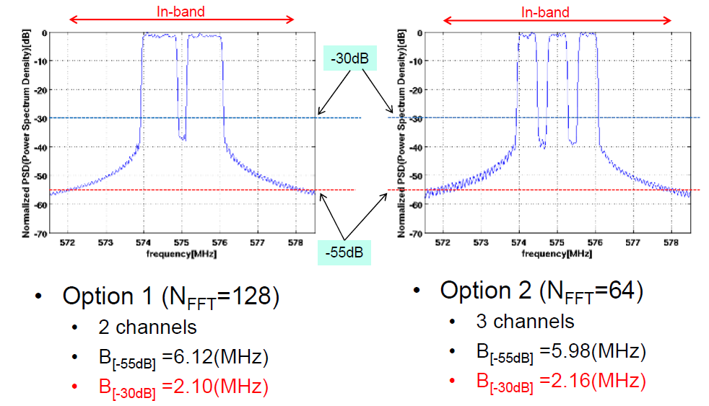
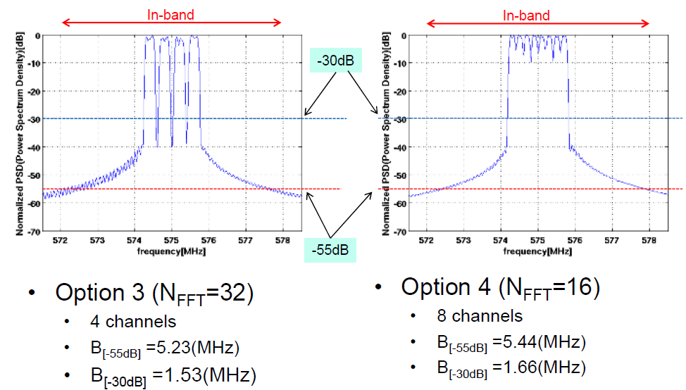
 | Option 1 | Option 2 | Option 3 | Option 4
FFT Size | 128 | 64 | 32 | 16
B[-30dB](MHz) | 2.1 | 2.16 | 1.53 | 1.66
B[-30dB]/6MHz | 35% | 36% | 26% | 28%
Very low utilization
Ref. [3]

Slide 6
Methodology of Analysis
Okumura – Hata propagation (ITU cannot be used for UL)
Capacity based on Shannon limit, therefore technology agnostic

Slide 7
Parameters
Assumptions:
BS: Fixed TVBD
UT: Portable TVBD
Operation in non-adjacent channels
35% Bandwidth utilization
System configurations
BS antenna heights = 30m (lowest supportable by propagation model)
UT antenna heights = 1.5m
Receiver noise figure (NF) = 7 dB
Thermal noise density = -174 dBm/Hz
Receiver interference density = -182 dBm/Hz
Shadow fading margin = 6 dB (suburban environment)
Penetration loss = 0 (outdoors) or 16 dB (outdoor to indoor)
Other loss margin = 1 dB
Receiver antenna gain = 0 dBi (UT side) or 6 dBi (BS side) (similar to TX antenna gain)

Slide 8
Achievable data rates for 15.4m
 | Required Mbps & Range | Actual | Outdoors |  |  |  | Penetration loss 16dB
 |  |  | 512MHz |  | 698MHz |  | 512MHz |  | 698MHz
App | Rate distance | km | UL | DL | UL | DL | UL | DL | UL | DL
SUN | <1Mb <several km | 3 | .12 | 1 | .05 | .49 | .003 | .03 | .001 | .013
Transportation | <1Mb Up to 10 <1km | 1 | 3.2 | 9 | 1.83 | 6.8
Surveillance | <2Mb <1km | 1 | 3.2 | 9 | 1.83 | 6.8 | .14 | 1.2 | .06 | .58
Infrastructure | <.1Mb <several km | 3 | .12 | 1 | .05 | .49
Local M2M | .04-2 <several km | 3 | .12 | 1 | .05 | .49 | .003 | .03 | .001 | .013
Signage | 2MB typical, to 10 <several km | 3 | .12 | 1 | .05 | .49 | .003 | .03 | .001 | .013
All rates in Mbps

Slide 9
Observations
As the frequency increases, the maximum achievable rate decreases
Penetration loss has a significant impact on the achievable data rate
Downlink supports higher link data rates than the uplink (high TX power)
The achievable rates on TVWS channels is lower than the target data rate in some use cases
In some cases much lower
The low per-link data rate will also limit the number of devices that can be supported

Slide 10
Proposed text
MAC and PHY enhancements to 802.15.4m should be considered in order to improve individual link data rates as well as areal capacity

Slide 11
References
[1] 15-11-0684-6-004m-tg4m-technical-guiidance-document
[2] ITU Recommendation, ITU-R P.1546-1
[3] IEEE 802.15.4 document: 15-1-0061-00-004m

Slide 12
Appendix: Link Budget Analysis Details

Slide 13
Okumura – Hata Model
(for d ≤ 20km [2])
dB
where:
E: field strength (dB(μV/m)) for 1kW e.r.p
f : frequency (MHz)
H₁: base station effective antenna height above ground (m) in the range 20 to 200m
H₂: mobile station antenna height above ground (m) in the range 1 to 10m
d: distance (km)

Slide 14
Path loss on TVWS Channels
The basic transmission loss equivalent to a given field strength is given by[2]:
Lb =139.3−E+20log10(f) dB
where:
Lb : basic transmission loss (dB)
E : field strength (dB(μV/m)) for 1 kW e.r.p.
f : frequency (MHz).
Field Strength & Transmission Loss (dB) vs. Distances
(Base station antenna height: 30m, user terminal antenna height is 1.5m)
Frequency (MHz) | Field Strength (dB μv/m) @ 1km | Transmission Loss (dB) @ 1km | Field Strength (dB μv/m) @ 3km | Transmission Loss (dB) @ 3km
54 | 79.47 | 94.48 | 62.66 | 111.29
512 | 73.54 | 119.95 | 56.73 | 136.75
600 | 73.12 | 121.74 | 56.31 | 138.55
698 | 72.72 | 123.46 | 55.91 | 140.26

Slide 15
Link Budget Derivation

Slide 16
TVWS Channel Capacity
Channel capacity (without partitioning):
The effective BW is equal to BW * Spectral Utilization
Spectral utilization: 35% (or 36%) for FFT size of 128 (or 64)[3]: 35% used for calculation
Channel capacity achieved

