Slide 1
Project: IEEE P802.15 Working Group for Wireless Personal Area Networks (WPANs)
Submission Title: [Tutorial: Chinese Healthcare Internet of Things Development Opportunities ]
Date Submitted: [March 10, 2012]
Source: [YanJie Gao, Liang Li, ] Company [Ministry of Health (Dept of Info Tech), Vinno]
Address [1 Xizhimen South Rd, Beijing , China]
Voice:[8610－68792498 ], FAX: [8610- 68792961], E-Mail:[wshb_xxb@126.com]
[Abstract: Introduction of Chinese Healthcare IOT Development}.
Purpose: Discussion on WNG
Notice: This document has been to assist the IEEE P802.15. It is offered as a basis for discussion and is not binding on the contributing individual(s) or organization(s). The material in this document is subject to change in form and content after further study. The contributor(s) reserve(s) the right to add, amend or withdraw material contained herein.
Release: The contributor acknowledges and accepts that this contribution becomes the property of IEEE and may be made publicly available by P802.15.

Slide 2
Chinese Healthcare Internet of Things
Development Opportunities
China Ministry of Health, Dept of Info
Dr. Gao, Yanjie 高燕婕
March 2012

Slide 3
  INDEX:
  Self – Introduction
  Interesting Issues of Dept. of Information, China Ministry of Health
  Internet of Things (IOT) Healthcare Application Areas
  Wireless Tech Specification
3

Slide 4
Self-Introduction
Dr. Yanjie Gao Staff Engineer & Professor of Statistician
Professional:
Computer Science, Bio-statistics, Economic management
Technical positions:
Deputy director of the information office of Ministry of Health.
Chairman of hospital information & statistics professional committee of Chinese Hospital Association.
Vice president of the Chinese Medicine Information Association.
Expert of Chinese management committee for Health Assessment.
，
4

Slide 5
Major Articles :
  《The Study of standard of electronic medical records》
  《The Study of Chinese Hospital Information Standards》
  《The Study of China Medical Imaging Standard -PACS》
  《Major Research Projects about Digital Hospitals in China>>
Academic Awards
  Top 10 Excellent Women in IT applications of China,2006
  John Nuveen Center scholar award, University of Illinois, U.S.A.
5

Slide 6
  INDEX:
  Self – Introduction
  Interesting Issues of Dept. of Information, China Ministry of Health
  Internet of Things (IOT) Healthcare Application Areas
  Wireless Tech Specification
6

Slide 7
  Emergent Issues for Dept of Information
Develop city emergency and community healthcare networking standards, based on International convention and Chinese conditions.
Provide the staff training and certification for HealthCare Networking
Promote wide applications of HealthCare IOT
Support typical IOT projects
7

Slide 8
“E-Health” Benefits Chinese HealthCare
E-Health introduces
affordable wireless networks
of medical devices to
deduce service costs
Speed up Chinese
Medicare Service
Reforms
Four Major
Benefits on
Healthcare
Service
Share medical info/resource
among Healthcare
/Medicare servicers
Building Tele/self –
Medicine system to
release resource pressure.
8

Slide 9
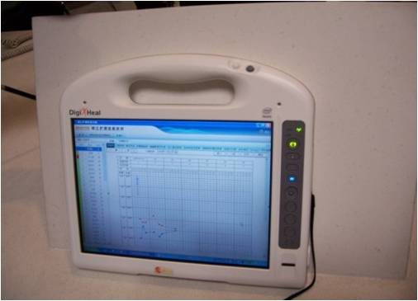
Promoting HealthCare Networking
Tele-Medicine collaboration and medical special network construction
Family and senior cares
Improve healthcare safety
Intelligent management of the hospital equipment and staff
9

Slide 10
  INDEX:
  Self – Introduction
  Interesting Issues of Dept. of Information, China Ministry of Health
  Internet of Things (IOT) Healthcare Applications in China
  Wireless Tech Specification
10

Slide 11
Internet of Things and Health/Medical Care
Internet of Things Includes:
“The Internet of Things” and “Sensing Internet”
Modern Healthcare
Demands
IOT
Medicare
Supports
Modern Health/Medicare demands ubiquitous info from Patients, Staff, Medical/Health instrument, mobile device and various sensors.
  More thorough perception
  More comprehensive interoperability
  More Intelligence
11

Slide 12
Values Added from Healthcare IOT
Values
Work efficiency
Improve service quality
Innovative service models
Control of medical defects
Protect health safety
Management to achieve fine
12

Slide 13
  Internet of Things Tech Upgrading HealthCare Management
IOT Tech on Diagnostic Processing Management
IOT Tech on Hospital Pharmacy Management
IOT Tech on Medical Safety Information
13

Slide 14
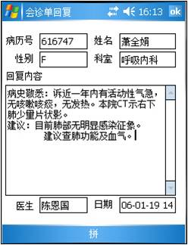
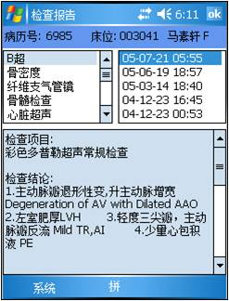
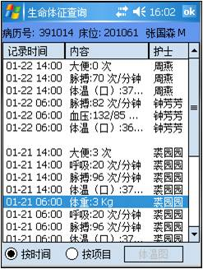
Emergent IOT Applications on Health Sensing
Remote monitoring Chronic Disease continually
Monitoring and manage Acute infectious
Monitoring of ECG, Vital Signs in Hospital
14

Slide 15
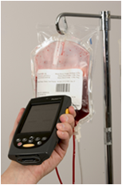
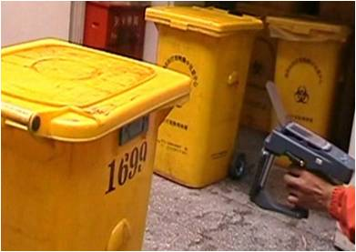
IOT Applications on Medicare Management
Hospital Property Management
Blood Management
Medical Waste Management
Hospital Disinfection Materials Management
15

Slide 16
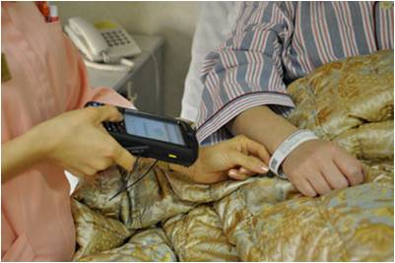
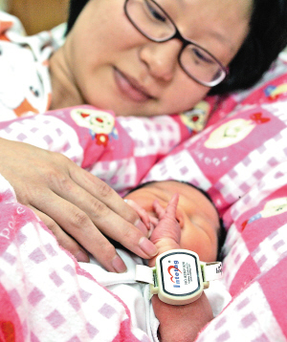
IOT on Patient Management
Treatment management of patients
Two-way location of doctors and patients
Identification and management of maternal and babies
Care on Alzheimer's sufferers and more
16

Slide 17
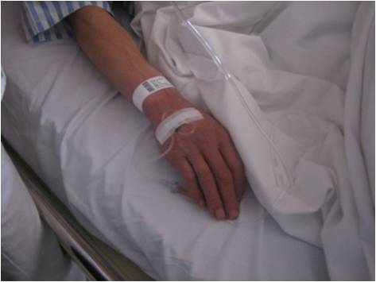
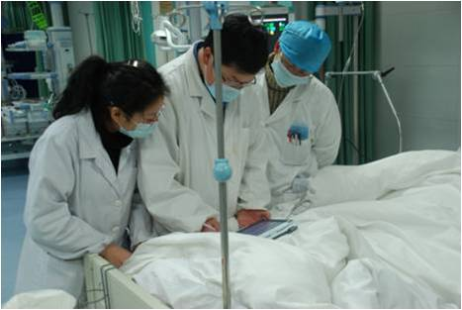
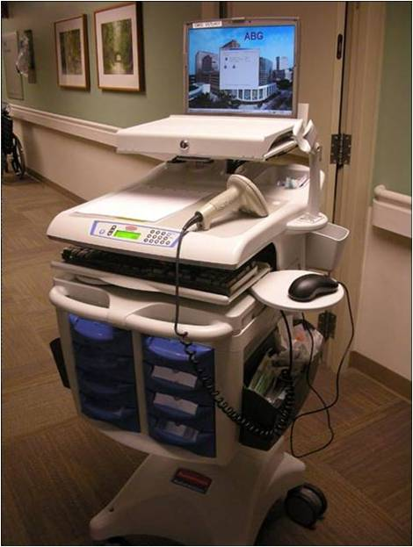
Wireless Access in Hospital
Wireless Nurse Care
Ward Wireless Checking
Wireless ECG Acquisition
Wireless Property Management
17

Slide 18
IOT Application for Hospital Environment Management
Medicare Environment Application
Hospital Lab management, Smart Operating Room
Medicare Area Management
Building Automation, Energy management, Access management and more
18

Slide 19
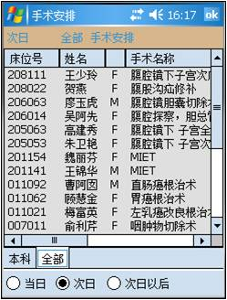
IOT in Operating Rooms
Operating Rooms are critical areas in hospitals. IOT/Sensing Networks may run for
Operation Reserve
Operation Room Environment Management
Operation Treatment Management
including smart Gases, temperature, humidity, lighting monitoring
including instrument/medicine checking, Surgical staff locating, and even Monitoring operating procedure during surgery
19

Slide 20

IOT Applications on Pharmaceutical Production and Safety
Manufacture Procedure Management
Full E-tracing on raw materials and Products, including Producing environmental monitoring, Product Batch Tracking.
RFID application on Medicine distribution.
Medicine Safety Oversight
Personal Medication and Medical Recording
And EPR
20

Slide 21
IOT and Disease Control Networks
Environment Sensing Network
Sensing air, water, bacteria and more
Acute Communicable Disease Surveillance
Sensing the ward temperature state and vital signs of patients
E-Tracking on infection patients. Stop animal escaping
Tracking path of pathogens
21

Slide 22
IOT and Rescue Medical Procedure for Disaster
Collecting medical data on disaster site
General commanding all of medical resources
Cooperation of IOT and rescue
Including Networking multiple medical devices
Including locating medical devices and rescuers
22

Slide 23
Build Medical Info Special Networks
Functions of Medical Info Special Networks
A high-speed , stable network provides the possibilities for Clinical management and remote diagnostics.
Tele-medicine family care and reduce hospital loads.
Protecting Transmission of Critical Disease Control Data
Including on-site data transmission for disease control, national emergent rescues
On-time Search and Access Disease info and Data
23

Slide 24
  INDEX:
  Self – Introduction
  Interesting of Dept. of Information, China Ministry of Health
  Internet of Things (IOT) Healthcare Applications in China
  Wireless Tech Specification
24

Slide 25
Wireless Tech in HealthCare
RFID Tech has been adopted in HealthCare applications
Mobile (3G) are applied for medical info transmission and Mobile communications
Wireless Access, such as Wireless Sensor Network and Zigbee, are new tech for HealthCare
Some trial projects with Zigbee are proposed
25

Slide 26
Wireless Tech Specification
Chinese Healthcare expects the wireless tech specifications. The critical conditions are:
Safety and legality : Wireless access must operate on permitted frequency bands and be based on international and domestic standards
High Reliable and tolerate the unexpected influence
Harmless: No harm to patients and staff. Minimum influences to other device
Securities and Privatizes
Easy Operations and Maintain.
26

Slide 27
Internet of Things Speeds Up HealthCare Reforms
Demand:
On-Time, Intelligent, Mutual-connected Services
Upgrade urban and rural
Health/social security system
Reform Healthcare/Medicare
Systems
IOT Application
on Medicare for
High Quality Healthcare,
Medical Resources Sharing
and ubiquitous Networking
27

Slide 28
Thanks！
Contact Info：
Email：wshb_xxb@126.com
Tel：8610－68792498 68792961
Address: 1 Xizhimen South Rd, Beijing , China

