Slide 1
Project: IEEE P802.15 Working Group for Wireless Personal Area Networks (WPANs)
Submission Title: [Standardization Will Drive PTC Success]
Date Submitted: [1 March 2012]
Source: [Jon Adams] Company [Lilee Systems]
Address [2905 Stender Way, Suite 78, Santa Clara CA, 95054 USA]
Voice:[+1 480.628.6686], FAX: [Add FAX number], E-Mail:[jonadams@ieee.org]
Re: [If this is a proposed revision, cite the original document.]
[If this is a response to a Call for Contributions, cite the name and date of the Call for Contributions to which this document responds, as well as the relevant item number in the Call for Contributions.]
[Note: Contributions that are not responsive to this section of the template, and contributions which do
not address the topic under which they are submitted, may be refused or consigned to the “General Contributions” area.]
Abstract: [Overview of the 802.15 PTC Group for presentation at PTC World Congress.]
Purpose: [Intention of this document is to inform participants at PTC World Congress about the IEEE PTC activities and to solicit participation.]
Notice: This document has been prepared to assist the IEEE P802.15. It is offered as a basis for discussion and is not binding on the contributing individual(s) or organization(s). The material in this document is subject to change in form and content after further study. The contributor(s) reserve(s) the right to add, amend or withdraw material contained herein.
Release: The contributor acknowledges and accepts that this contribution becomes the property of IEEE and may be made publicly available by P802.15.

Slide 2
Interoperability Will Drive PTC Success PTC World Congress 2012 Orlando, FL
Jon Adams, MSEE
Senior Member, IEEE
Chair, IEEE 802.15 Positive Train Control Study Group
jonadams@ieee.org
http://www.ieee802.org/15/pub/SGptc.html
Notes:
2
2

Slide 3
New Technologies Breed Innovation
Broad Interoperability Drives New Applications
3GPP (worldwide cellular standard)
First 3G specification in 2000, 7 full specification releases since then
IEEE 802.11
First release in 1997, growth of application space has driven 25 amendments in 14 years
Many others (ZigBee, Wired/Wireless HART, CANbus, Ethernet, and more)
Impossible to predict future use based on current expectation
Average service life of radio equipment in rail and transit applications is in excess of 10-15 years
System design may remain in place for 20-25 years
Open forum allows interested parties to vet independently quality and performance, and to propose to improve
Standards are good for the customer, good for the vendor

Slide 4
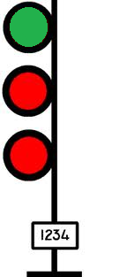
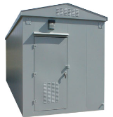
Where IEEE Work Fits In
Interoperable communications between
Train and Wayside
Train and Network Infrastructure
Wayside and Network Infrastructure
Network Control Center

Slide 5
Institute of Electrical and Electronic Engineers (IEEE)
World’s largest professional association
Over 400,000 members in 160 countries
Over 100,000 student members
333 sections in 10 geographic regions
45 Societies and Councils
1,300 standards and projects under development
More than 150 transactions, journals and magazines
Nearly 3 million documents in online library
Over 125 years of driving interoperability

Slide 6
IEEE 802 LAN/MAN Standards Committee (LMSC)
Local Area and Metropolitan Area Networks
32-year history of creating world’s most successful, interoperable, networked wired and wireless data standards
Formal, coordinated, transparent, open and consensus-based process
Participation is by individual contributor
Six face-to-face meetings per year to allow sufficient vetting and promote timely development
Voting rights maintained with active participation
Broad international participation
Primarily physical and link layers of network stack
OSI Reference
Model
Application
Presentation
Session
Transport
Network
Data Link
IEEE
802
Physical
Medium

Slide 7
A Few of Those Dots
Working Group | Used For
IEEE 802.3 | Ethernet (billions of units deployed)
IEEE 802.11 a/b/g/n… | Wireless Ethernet (Wi-Fi) (billions of units deployed)
IEEE 802.15 | Wireless PAN (ZigBee, Smart Grid) (hundreds of millions of units deployed)
IEEE 802.16 | Broadband Wireless Access (WiMAX) (tens of millions of units deployed)
IEEE 802.22 | Wireless Regional Area Network (TV White Spaces) (just starting, but promises to be large)

Slide 8
IEEE 802.15.4
Over 200 million units deployed for industrial, commercial and residential control and sensing
Accepted as ISO/IEC Standard 8802-15-4
Used by the ZigBee Alliance, ISA-100, Wireless HART, IETF (6LoWPAN), others
Hundreds of participants working on new functions and performance enhancement

Slide 9
Recent 802.15.4 Enhancements
802.15.4e MAC Enhancements
Industrial process control, Smart grid, Factory automation
802.15.4g Smart Utility Network
Wireless connectivity for secure, large-scale, wide-area utility networks
802.15.4k Low-Energy Critical Infrastructure Monitoring
Point to multi-thousands of point for critical infrastructure monitoring (bridges, buildings, highways, canals, etc.)
802.15.4m TV White Space Devices
Adds new functionality meeting TV white space regulatory requirements

Slide 10
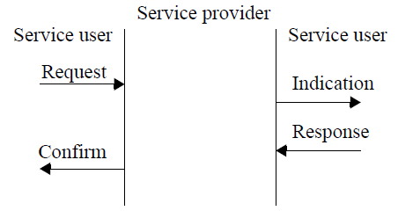
IEEE 802.15.4 Basic Architecture
Unique 64-bit extended IEEE address or allocated 16-bit short address
Deterministic time slotting or CSMA-CA
High reliability and robustness
Selection of bandwidths, data rates, modulation methods, coding, error correction or detection
Very power-efficient
Ability for precision ranging and location
Designed for interoperability
Layered Structure
Service Primitives
Frame Structure

Slide 11
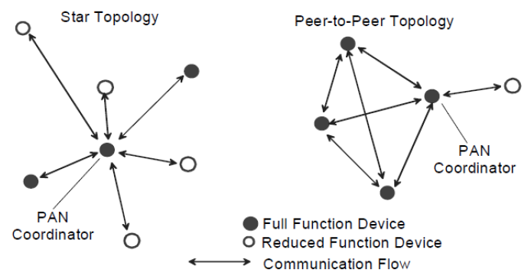
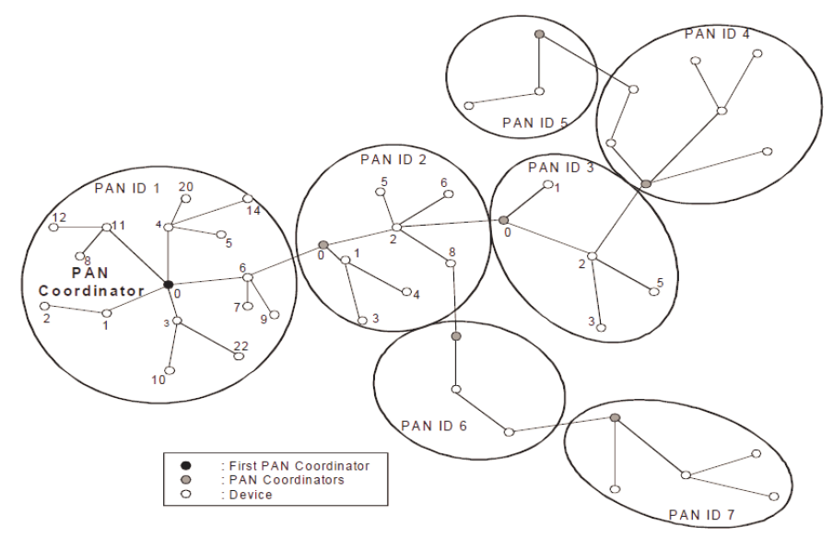
Basic Network Primitives

Slide 12
Substantive and Growing Participation
Siemens
US DOT
Sunrise Micro
US DOT FTA
Samsung Information Systems America
The Ohio State University
Electronics and Telecommunications Research Institute (Korea)
US DOT Volpe
Safetran (Invensys Rail)
Union Pacific RR
LG Electronics
Notor Research
CalAmp
Rail Safety Consulting
Institute for Infocomm Research
National Taiwan University
Qualcomm
Freescale
Kyocera
Interdigital
Tensorcom
Analog Devices
CSX
National Technical Systems
Parsons Brinckerhoff
Bombardier Transportation
Rohde and Schwarz
Korea Railroad Research Institute
Lilee Systems
The Boeing Company
Semtech
Vinnotech
Noblis
Tohoku University REIC (Japan)
Beijing Univ of Posts and Telecommunications
NXP
Verizon
Authentec
Sensus
TU Braunschweig
Via Technologies
Halcrow
US DOT FRA
Philips
Astrin Radio
China Academy of Telecomm Research
Gannett Fleming
GE
APTA
Semaphore Group

Slide 13
Active Meeting Schedule
Teleconferences
Open to all, no cost to participate or monitor
http://www.ieee802.org/15/ or jonadams@ieee.org
Face-to-Face Meetings in 2012
IEEE 802 Plenaries
March (Waikoloa); July (San Diego); November (San Antonio)
IEEE 802.15 Interims
May (Atlanta); September (Palm Springs); January (2013) (Vancouver BC)

Slide 14
Summary
Standards Drive Interoperability
Good for the customer and for the vendor
Simplifies product development
Speeds time-to-market
Easier to understand and compare competing products
IEEE
Over 1,300 standards and projects
Tens of billions of devices use IEEE standards for mission-critical, industrial, commercial, and consumer spaces
IEEE 802.15.4 PTC Group
IEEE 802.15.4 already ISO/IEC standard with over 200 million units deployed
PTC functionality will be added rapidly
Over 70 participants from nearly 50 entities, and growing
JOIN WITH US!

