Slide 1
Project: IEEE P802.15 Working Group for Wireless Personal Area Networks (WPANs)
Submission Title: [IEEE 802.15 Positive Train Control Activities]
Date Submitted: [15 February 2012]
Source: [Jon Adams] Company [Lilee Systems]
Address [2905 Stender Way, Suite 78, Santa Clara CA, 95054 USA]
Voice:[+1 480.628.6686], FAX: [Add FAX number], E-Mail:[jonadams@ieee.org]
Re: []
Abstract: [Overview of the 802.15 PTC Group and the IEEE process, for presentation to the Association of American Railroads’ Wireless Communications Committee. ]
Purpose: [Intention of this document is to inform AAR WCC of the IEEE PTC activities and to solicit participation.]
Notice: This document has been prepared to assist the IEEE P802.15. It is offered as a basis for discussion and is not binding on the contributing individual(s) or organization(s). The material in this document is subject to change in form and content after further study. The contributor(s) reserve(s) the right to add, amend or withdraw material contained herein.
Release: The contributor acknowledges and accepts that this contribution becomes the property of IEEE and may be made publicly available by P802.15.

Slide 2
IEEE Positive Train Control Activities
Association of American Railroads Wireless Communications Committee
26 January 2012
Jon Adams, MSEE
Senior Member, IEEE
Chair, IEEE 802.15 Positive Train Control Study Group
jonadams@ieee.org
Notes:
2
2

Slide 3
New Technologies Breed Innovation
March 2012
Broad Interoperability Drives New Applications
  3GPP (worldwide cellular standard)
    First 3G specification in 2000, 7 full specification releases since then
  IEEE 802.11
    First release in 1997, growth of application space has driven 25 amendments in 14 years
  Many others (ZigBee, Wired/Wireless HART, CANbus, Ethernet, and more)
Impossible to predict future use based on current expectation
Average service life of radio equipment in rail and transit applications is in excess of 10-15 years
System design may remain in place for 20-25 years
Open forum allows interested parties to vet independently quality and performance, and to propose to improve
Standards are good for the customer, good for the vendor
Jon Adams, Lilee Systems

Slide 4


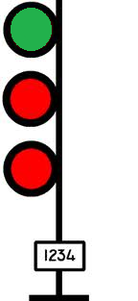
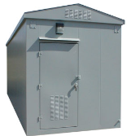

Where IEEE Work Fits In
Communications between
  Train and Wayside
  Train and Network Infrastructure
  Wayside and Network Infrastructure
Network Control Center

Slide 5
What are Standards?
Fundamental building blocks for product development by establishing consistent protocols that can be universally understood and adopted
Published documents that establish specifications and procedures designed to ensure the interoperability and reliability of the materials, products, methods, and/or services
Standards are good for the customer
  Help fuel compatibility and interoperability
  Simplify system deployment and maintenance
  Make it easier to understand and compare competing products
Standards are good for the vendor
  Don’t have to waste resources creating multiple custom solutions
  Allows focus of resources on value-added functions and features that differentiate
  Can reduce cost of fabrication, test, certification, marketing and support
Standards help ensure that the requirements of interconnectivity and interoperability can be met
Standards allow interested parties to vet independently quality and performance, and to propose to to improve
The best standards are the ones created in the light, by a variety of experts, with full transparency

Slide 6
What is the IEEE?
Institute of Electrical and Electronic Engineers
  World’s largest professional association
    Over 400,000 members in 160 countries
    Over 100,000 student members
    333 sections in 10 geographic regions
  45 Societies and Councils
  1,300 standards and projects under development
  More than 150 transactions, journals and magazines
  Nearly 3 million documents in online library
  Over 125 years of driving technical standards

Slide 7
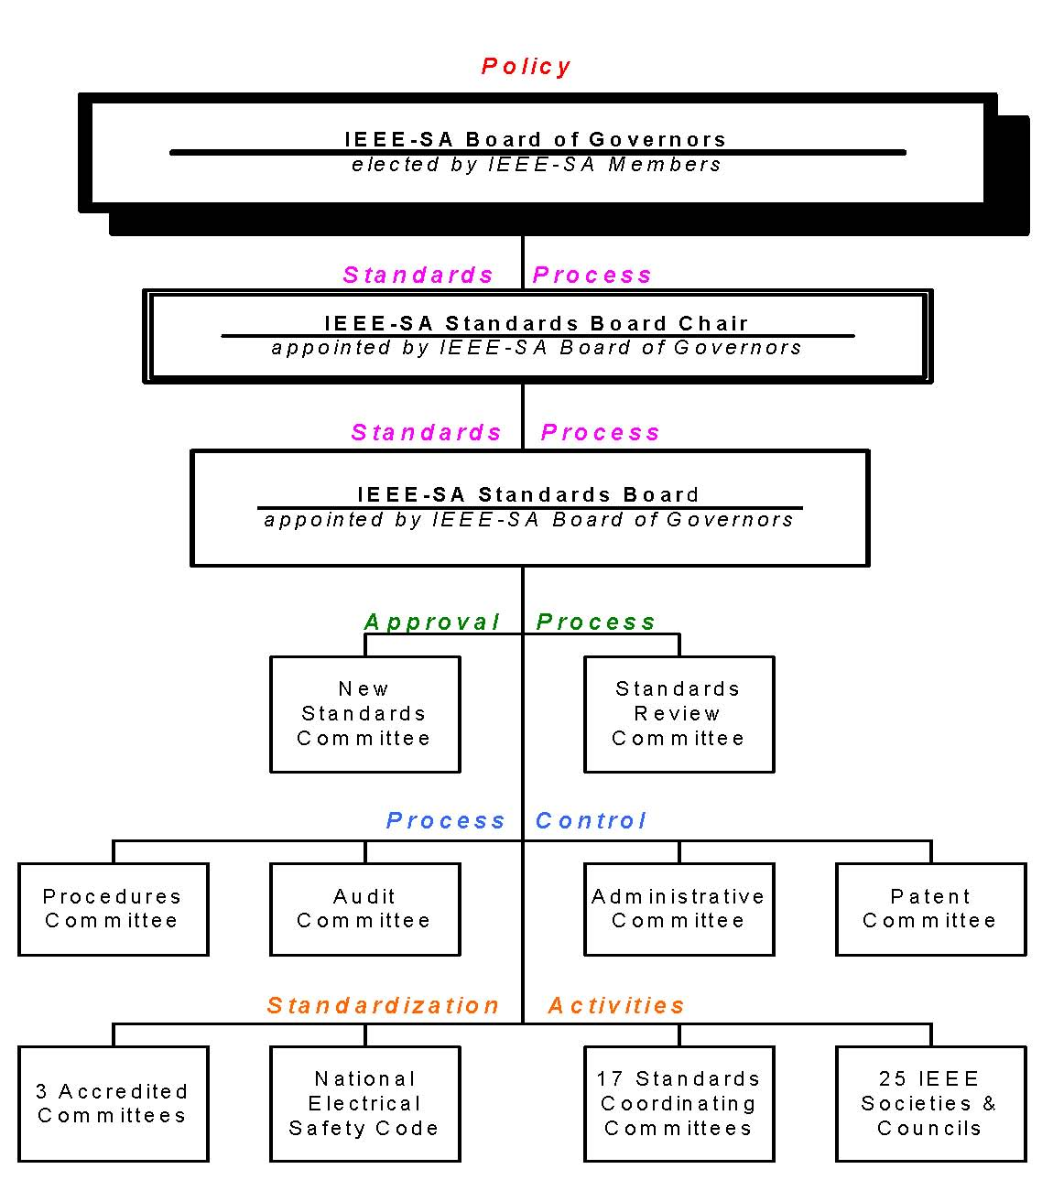
IEEE Standards
Organization
aka NesCom
aka RevCom
IEEE 802 is here:
a standards committee
formed by the
Computer Society
Notes:
7
7

Slide 8
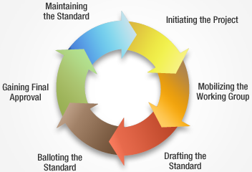
Standards Development Lifecycle
IEEE groups maintain hundreds of active standards

Slide 9
Principles of the Process
Due process – procedures are publicly available and followed consistently
Consensus – requiring agreement of a majority or supermajority – for technical decisions generally 75%
Openness – ensuring materially interested and affected parties can participate
Balance – representation from all interested parties without overwhelming influence from any one party
Right of appeal – ensures due process
Process and Procedures at http://grouper.ieee.org/groups/802/15/pub/Rules.html
Notes:
9
9

Slide 10
IEEE 802 LAN/MAN Standards Committee
LAN (Local Area Network) and MAN (Metropolitan Area Network) focus
32-year successful history of creating world’s most used networked wired and wireless standards
Formal, coordinated, transparent, open and consensus-based process
Participation is by individual contributor, not by company
Six face-to-face meetings per year to allow sufficient vetting and promote timely development
Voting rights maintained only through active participation
Broad international participation
Primarily physical and link layers of network stack
OSI Reference
Model
Application
Presentation
Session
Transport
Network
Data Link
IEEE
802
Physical
Medium

Slide 11
A Few of Those Dots
March 2012
Working Group | Used For
IEEE 802.3 | Ethernet (billions of units deployed)
IEEE 802.11 a/b/g/n… | Wireless Ethernet (Wi-Fi) (billions of units deployed)
IEEE 802.15 | Wireless PAN (ZigBee, Smart Grid) (hundreds of millions of units deployed)
IEEE 802.16 | Broadband Wireless Access (WiMAX) (tens of millions of units deployed)
IEEE 802.22 | Wireless Regional Area Network (TV White Spaces) (just starting, but promises to be large)
Jon Adams, Lilee Systems

Slide 12
IEEE 802.15.4
802.15.4 (2003, 2006, 2009, 2011)
  Has become the most used standard for industrial, commercial control and sensing applications
  Accepted as ISO/IEC Standard 8802-15-4
  Used by the ZigBee Alliance, ISA-100, Wireless HART, IETF (6LoWPAN), others
  Released version IEEE 802.15.4 (2009), with (2011) coming soon

Slide 13
Recent 15.4 Amendments
802.15.5e MAC Enhancements
  Industrial process control, Smart grid, Factory automation
  Highly deterministic wireless systems with sophisticated timeslotting methods
802.15.4g Smart Utility Network
  Wireless connectivity for secure, large-scale, wide-area utility networks
  Licensed and license-free bands, flexibility in channel widths, bandwidths, data rates
  Ranges of tens of km
802.15.4k Low-Energy Critical Infrastructure Monitoring
  Point to multi-thousands of point for critical infrastructure monitoring (bridges, buildings, canals, etc.)
  Large number of widely dispersed end points with challenging propagation environments
  Low energy operation for energy harvesting, minimizes network traffic and device wake durations
802.15.4m TV White Space Devices
  Chartered to specify new PHY to add functionality meeting TV white space regulatory requirements
  Supports typical data rates from 40 to 2000 kb/s
  Designed for optimal and power efficient device command and control applications

Slide 14
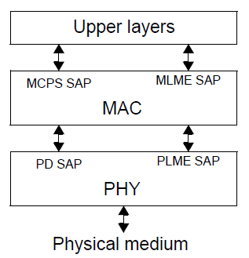
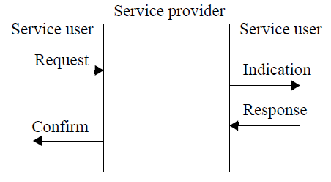
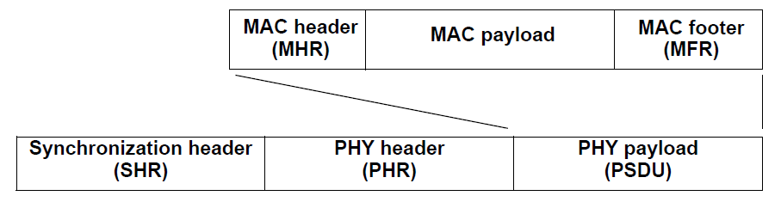
IEEE 802.15.4 Basic Architecture
Unique 64-bit extended IEEE address or allocated 16-bit short address
Deterministic time slotting
Ability for network beacons
Carrier sense multiple access with collision avoidance (CSMA-CA)
Fully acknowledged protocol for transfer reliability
Channel energy detection
Link quality indication
Selection of bandwidths, data rates, modulation methods, coding, error correction or detection
Tools for network formation and management
Node and service discovery
Fast handoff, accommodates rapidly changing network membership
Ability for precision ranging and location
Layered Structure
Service Primitives
Frame Structure

Slide 15
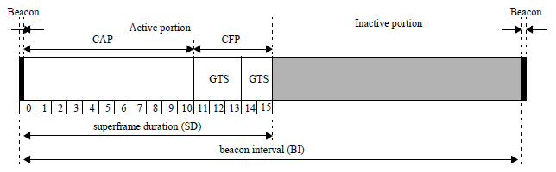
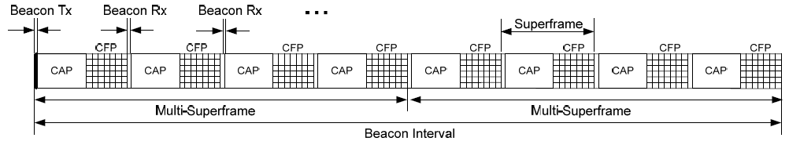
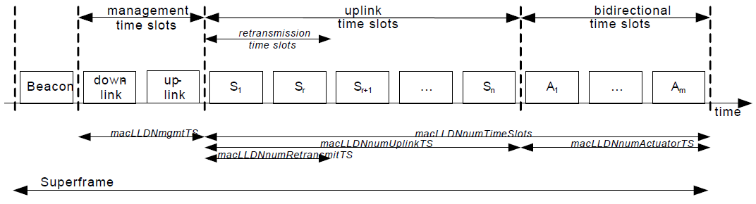
Included Deterministic Frame Structures
Traditional Superframe
DSME Multi-Superframe
Low Latency Deterministic

Slide 16
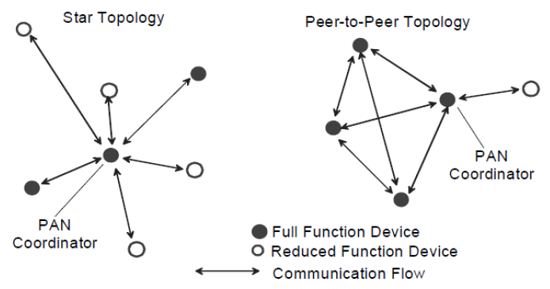
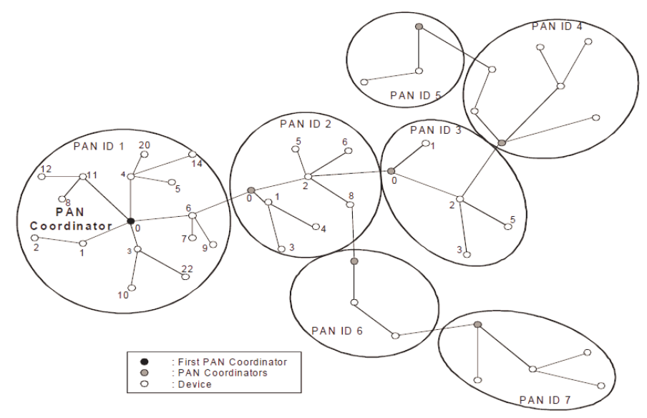
Basic Network Primitives

Slide 17
Standards Development Lifecycle
4 Months

Slide 18
Substantive and Growing Participation
March 2012
Siemens
US DOT
Sunrise Micro
US DOT FTA
Samsung Information Systems America
The Ohio State University
Electronics and Telecommunications Research Institute (Korea)
US DOT Volpe
Safetran (Invensys Rail)
Union Pacific RR
LG Electronics
Notor Research
CalAmp
Rail Safety Consulting
Institute for Infocomm Research
National Taiwan University
Qualcomm
Freescale
Kyocera
Interdigital
Tensorcom
Analog Devices
CSX
National Technical Systems
Parsons Brinckerhoff
Bombardier Transportation
Rohde and Schwarz
Korea Railroad Research Institute
Lilee Systems
The Boeing Company
Semtech
Vinnotech
Noblis
Tohoku University REIC (Japan)
Beijing Univ of Posts and Telecommunications
NXP
Verizon
Authentec
Sensus
TU Braunschweig
Via Technologies
Halcrow
US DOT FRA
Philips
Astrin Radio
China Academy of Telecomm Research
Gannett Fleming
GE
APTA
Semaphore Group
Anritsu
Jon Adams, Lilee Systems

Slide 19
Purpose
To add new operating frequency bands and address mobility requirements for IEEE 802.15.4 wireless networks intended for information exchange, and command and control applications
May be used to establish an open standard for the wireless link for locomotive-wayside, locomotive-network infrastructure, and network infrastructure-wayside communications on rail signal and control systems

Slide 20
Scope
This amendment specifies a physical layer (PHY) for IEEE 802.15.4, and medium access control (MAC) changes needed to support this PHY, for use in equipment intended to address industry needs and to meet the United States (US) Positive Train Control regulatory requirements and similar regulatory requirements in other parts of the world
  Enables operation in licensed or license-free radio frequency bands below 6 GHz
  Accommodates transmit power levels greater than the 1 W typical of Part 15 devices
  Meets performance requirements at speeds up to 600 km/h
  Supports radio ranges on the order of 70 km
  Allows operation in contiguous or non-contiguous channel bandwidths as narrow as 5 kHz
  Supports data rates up to 1 Mbps with flexible and robust quality of service
  Provides modulation methods and spectral characteristics consistent with local regulatory requirements
  Accommodates rapidly changing network membership

Slide 21
PTC Schedule
Study Group
  Approval of Study Group Nov 2011
  Completion of PAR/5C Docs Jan 2012
  Approval of PAR/5C Docs Jan 2012
Preparation for Task Group Phase
  Call for Applications Dec 2011
  Completion of Call for Applications Mar 2012
  Approval of PAR/5C by NESCOM and 802 EC Apr 2012
Proposal Effort
  Technical Guidance Document May 2012
  Call for Proposals May 2012
  Preliminary Proposals July 2012
  Final Proposals Sep 2012
  Adopt Baseline Nov 2012
Drafting
  Preliminary draft Jan 2013
  Final draft (ready for WG Letter Ballot) July 2013
ON PLAN
ON PLAN
DRAFTING

Slide 22
Active Meeting Schedule
March 2012
Teleconferences
  Open to all, no cost to participate or monitor
  http://www.ieee802.org/15/ or jonadams@ieee.org
Face-to-Face Meetings in 2012
  IEEE 802 Plenaries
    March (Waikoloa); July (San Diego); November (San Antonio)
  IEEE 802.15 Interims
    May (Atlanta); September (Palm Springs); January (2013) (Vancouver BC)
Jon Adams, Lilee Systems

Slide 23
Summary
March 2012
Standards Drive Interoperability
  Good for the customer and for the vendor
  Simplifies product development
  Speeds time-to-market
  Easier to understand and compare competing products
IEEE
  Over 1,300 standards and projects
  Tens of billions of devices use IEEE standards for mission-critical, industrial, commercial, and consumer spaces
IEEE 802.15.4 PTC Group
  IEEE 802.15.4 already ISO/IEC standard with over 200 million units deployed
  PTC functionality will be added rapidly
  Over 70 participants from nearly 50 entities, and growing
JOIN WITH US!
Jon Adams, Lilee Systems

Slide 24
Backup Material

Slide 25
Voting and membership
Voters have responsibility to vote on letter ballots
Three levels of voting occur in IEEE 802 standards development:
  Sponsor ballot
    Open to all interested parties
      Via IEEE SA-membership or paying a per ballot fee
    Participation requires an IEEE Web Account
  Working group
    Requirements on next page
  Task force or task group
    Requirements vary – consult Working group
Notes:
25

Slide 26
Acquiring Working Group voting membership
Participating at a meeting = at least 75% presence.
For a new Working Group, persons participating in the initial meeting become members.
For an existing Working Group, after attending 2 of last 4 plenary sessions or 1 plenary and 1 interim, membership starts at the next plenary attended.
  May require submitting a letter of intent.
Notes:
26
26

Slide 27
Retaining Working Group voting membership
Participate in 2 of the last 4 plenary sessions
  An interim may substitute for one of the 2 plenary sessions
Return working Group letter ballots
  Membership may be lost for failing to respond or responding abstain for reason other than “lack of technical expertise” to 2 of the last 3 ballots
Notes:
27
27

Slide 28
Affiliation
IEEE-SA Standards Board By-Laws, Section 5.2.1.5
  http://standards.ieee.org/guides/bylaws/sect5.html
Disclosure of Affiliation
  “Every member and participant in a working group, Sponsor ballot, or other standards development activity shall disclose his or her affiliation.”
What is “Affiliation”
  “An individual is deemed "affiliated" with any individual or entity that has been, or will be, financially or materially supporting that individual's participation in a particular IEEE standards activity. This includes, but is not limited to, his or her employer and any individual or entity that has or will have, either directly or indirectly, requested, paid for, or otherwise sponsored his or her participation.”
Affiliation and participation
  “Failure to disclose every such affiliation may result in complete or partial loss of rights to participate in IEEE-SA activities. An individual is not excused from compliance with this policy by reason of any claim of a conflicting obligation (whether contractual or otherwise) that prohibits disclosure of affiliation.”
Notes:
28
28

Slide 29
Ground rules
Respect … give it, get it
NO product pitches
NO corporate pitches
NO prices
NO restrictive notices – presentations must be openly available
Notes:
29
29

Slide 30
IEEE 802 standards development life cycle – part 1
Call for Interest
(CFI)
NesCom &
Standards Board
review
Adequate interest?
Standards Board
approval
Study Group
Investigates forming
a project
Produce PAR and
5 Criteria
Start work in
Working Group
Working Group
and EC review
EC approves
Forward PAR to NesCom
Notes:
30

Slide 31
IEEE 802 standards development life cycle – part 2
Review proposals
Review ballot
Comments
modify draft
as needed
Changes or new disapproves?
Material selected?
Create and
refine draft
Recirculate changes
and disapprove
comments
Draft complete?
No changes and no new
disapproves, 75% approve and
Working Group approves,
forward to sponsor ballot
Working Group
ballot
Notes:
31

Slide 32
IEEE 802 standards development life cycle – part 3
Request EC
approve forward
to sponsor ballot
Request EC approve
forward to RevCom
EC approval?
RevCom approval
Sponsor ballot
Changes or new disapproves?
Standards Board
approval
Review ballot
comments, modify
draft as needed
No changes and no new
disapproves, 75% approve
Prepare for
publication
Published standard
Notes:
32

Slide 33
Standards life cycle – part 4
Maintain the standard
  Keep the standard current by producing amendments and corrigenda (corrections)
  Renew the life of the standard with reaffirmation or revision
  If standard becomes out of date or disused, withdraw it
Notes:
33
33

