Slide 1
Project: IEEE P802.15 Working Group for Wireless Personal Area Networks (WPANs)
Submission Title: Impact of out-of-band emission limit in TVWS to OFDM signals
Date Submitted: January 19, 2012
Source: Shigenobu Sasaki, Takuya Inoko, and Yutaro Fukaishi (Niigata University)
Address: 8050 Ikarashi 2-no-cho, Nishi-ku, Niigata, 950-2181, Japan
Voice: 81-25-262-6737, FAX: 81-25-262-6737, E-Mail: shinsasaki@ieee.org
Re: Call for Contribution (IEEE802.15.4m)
Abstract: This contribution discusses an impact of out-of-band emission limit in TV white space for consideration of the technical guidance document.
Purpose: Technical Contribution for discussion in IEEE802.15.4m
Notice: This document has been prepared to assist the IEEE P802.15. It is offered as a basis for discussion and is not binding on the contributing individual(s) or organization(s). The material in this document is subject to change in form and content after further study. The contributor(s) reserve(s) the right to add, amend or withdraw material contained herein.
Release: The contributor acknowledges and accepts that this contribution becomes the property of IEEE and may be made publicly available by P802.15.

Slide 2
Introduction
Impact of out-of-band emission limit in TVWS for FSK and OFDM signal is presented in [1].
This contribution presents impact of out-of-band emission limit to the OFDM signals based on the IEEE802.15.4g specification.
Notes:
FCC Second MO&O FCC-10-174A1 paragraph 84(Second RO&O), 85(petitions & replies), 86(decision)

Slide 3
Out-of-band emission limit in TVWS
FCC (unlicensed)
See the right figure.
Canada (licensed)
Out of band emission: more than 27dB reduction
UK Ofcom (unlicensed)
Not specified yet
Fig. 1 RF spectrum mask in USA (Source: IEEE Std 802.22TM-2011, Annex A)

Slide 4
Simulation Parameters
Common parameters
Band of interest: 572-578 [MHz] (31ch in US)
QPSK modulation
Parameters | Option1 | Option2 | Option3 | Option4
Bandwidth[kHz] | 1094 | 552 | 281 | 156
Channel spacing[kHz] | 1200 | 800 | 400 | 200
FFT size(N_{FFT}) | 128 | 64 | 32 | 16
# of active tones | 104 | 52 | 26 | 14
# of data tones | 96 | 48 | 24 | 12
# of pilot tones | 8 | 4 | 2 | 2
Guard tones | 24 | 12 | 6 | 2

Slide 5
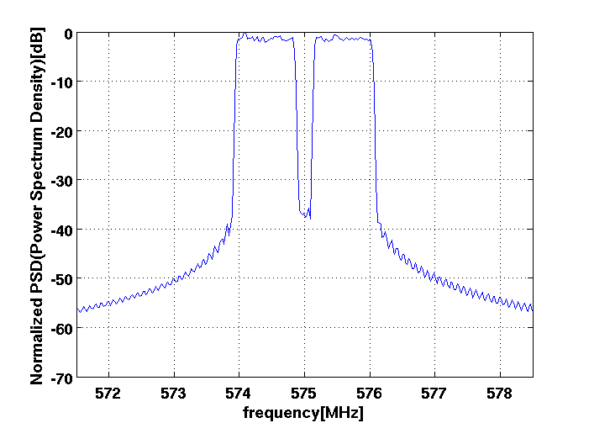
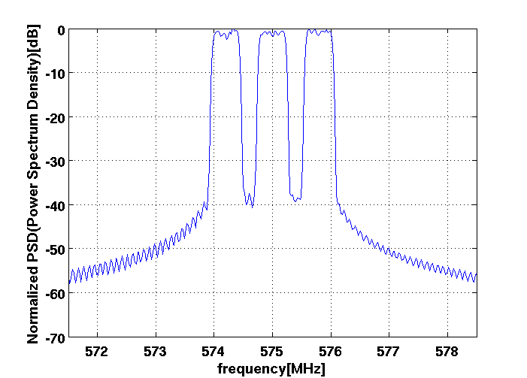
Spectrum Example (Option 1 and 2)
In-band
In-band
-30dB
-55dB
Option 1 (N_{FFT}=128)
2 channels
B_{[-55dB]} =6.12(MHz)
B_{[-30dB]} =2.10(MHz)
Option 2 (N_{FFT}=64)
3 channels
B_{[-55dB]} =5.98(MHz)
B_{[-30dB]} =2.16(MHz)

Slide 6
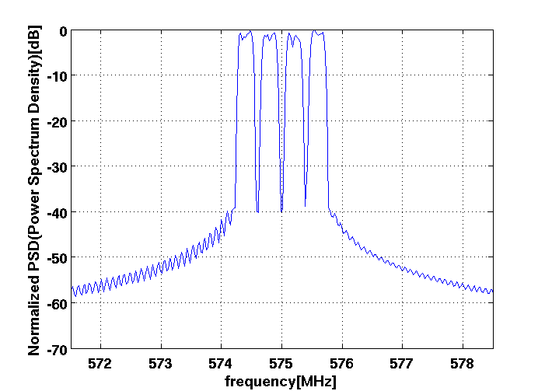
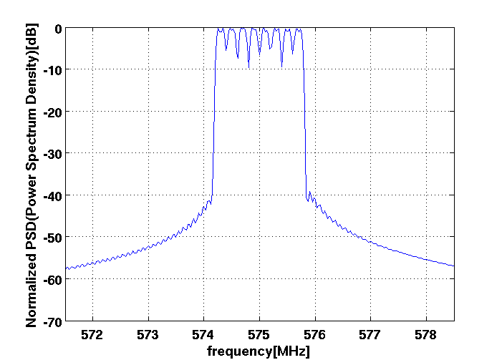
Spectrum Example (Option 3 and 4)
In-band
In-band
-30dB
-55dB
Option 3 (N_{FFT}=32)
4 channels
B_{[-55dB]} =5.23(MHz)
B_{[-30dB]} =1.53(MHz)
Option 4 (N_{FFT}=16)
8 channels
B_{[-55dB]} =5.44(MHz)
B_{[-30dB]} =1.66(MHz)

Slide 7
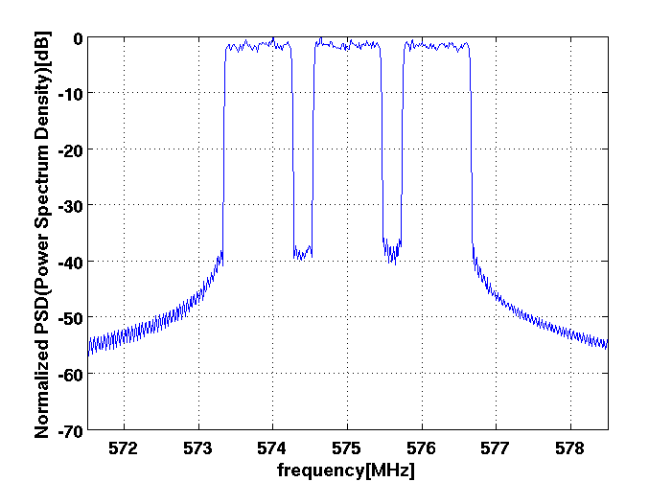
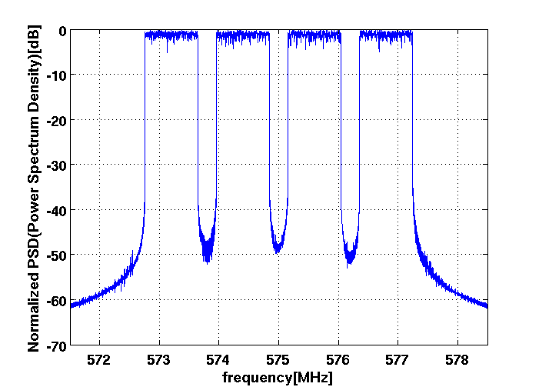
Spectrum Example in different parameters (Same bandwidth and channel spacing as in option 1)
In-band
In-band
-30dB
-55dB
N_{FFT}=256, QPSK
192 data + 16 pilot carriers
3 channels
B_{[-55dB]} =6.86(MHz), B_{[-30dB]} =3.37(MHz)
N_{FFT}=2048, QPSK
1536 data + 128 pilot carriers
4 channels
B_{[-55dB]} =5.22(MHz), B_{[-30dB]} =4.50(MHz)

Slide 8
Observations and Conclusions
A couple of channels can be accommodated within one TV channel (6MHz) in the case of OFDM signals based on the IEEE802.15.4g specifications .
Spectrum efficiency is limited due to stringent spectrum mask
More channels may be accommodated by using larger number of FFT points, however, further investigation will be necessary, e.g. impact of nonlinear devices.

Slide 9
References
TG4m Technical Guidance Document, Doc. IEEE 802.15-11-0684-00-004m, Sept. 2011
FCC Second MO&O, FCC-10-174, Sep. 2010.
IEEE802.22-2011, Annex A, July 2011
S. Sasaki, T. Inoko, and Y. Fukaishi, Doc. IEEE 802.15-11-0820-00-004m, Nov. 2011

