Slide 1
IEEE 802.21 MEDIA INDEPENDENT HANDOVER
DCN: 21-12-0009-01-0000
Title: Group Management and Routing Issues in Heterogeneous Networks
Date Submitted: January 18, 2012
Presented at IEEE802.15 WNG session #48 in Jacksonville
Authors or Source(s):
Antonio de la Oliva (UC3M), Yoshihiro Ohba (Toshiba), Stephen Chasko and Ruben Salazar (Landis+Gyr), Kiyoshi Fukui and Noriyuki Sato (OKI), Subir Das (ACS)
Abstract: This document describes high-level issues on group management in mesh networks and routing in heterogeneous networks

Slide 2
  IEEE 802.21 presentation release statements
This document has been prepared to assist the IEEE 802.21 Working Group. It is offered as a basis for discussion and is not binding on the contributing individual(s) or organization(s). The material in this document is subject to change in form and content after further study. The contributor(s) reserve(s) the right to add, amend or withdraw material contained herein.
The contributor grants a free, irrevocable license to the IEEE to incorporate material contained in this contribution, and any modifications thereof, in the creation of an IEEE Standards publication; to copyright in the IEEE’s name any IEEE Standards publication even though it may include portions of this contribution; and at the IEEE’s sole discretion to permit others to reproduce in whole or in part the resulting IEEE Standards publication. The contributor also acknowledges and accepts that this contribution may be made public by IEEE 802.21.
The contributor is familiar with IEEE patent policy, as stated in Section 6 of the IEEE-SA Standards Board bylaws <http://standards.ieee.org/guides/bylaws/sect6-7.html#6> and in Understanding Patent Issues During IEEE Standards Development http://standards.ieee.org/board/pat/faq.pdf>

Slide 3
Outline
Use Cases
  Group Management in 802.15. 4 Neighborhood Area Networks (NAN)
  Mesh routing across multiple IEEE 802 access technologies
Overview of IEEE802.21
Activities in IEEE802.21 and how it can address the above use cases
Discussion

Slide 4
Outline
Use Cases
  Group Management in 802.15. 4 Neighborhood Area Networks (NAN)
  Mesh routing across multiple IEEE 802 access technologies
Overview of IEEE802.21
Activities in IEEE802.21 and how it can address the above use cases
Discussion

Slide 5
Group Management in Mesh Networks
Some specific functions/applications may impact segments of an AMI mesh network
  Failover/Failback of an AMI network
    If the devices were no longer on one network, it is needed to perform failover or migrate/handover (or failback) devices to another network
    The takeout device (e.g., concentrator) is typically associated with a NAN (Neighborhood Area Network)
    If that device goes down, other devices will failover to a second NAN
  Software update or configuration for mesh devices and applications
    The updating software or configuration for a large number of mesh devices and their applications
      This should happen in multicast or broadcast mode
AMI mesh network
segments
A segment (i.e., a group of devices) may be formed independently of physical locations of the devices

Slide 6
Mesh routing across IEEE Access Networks
IEEE802.15.4g extends PHY of IEEE802.15.4
AMI infrastructure is one of the important target areas
Networks may be IP or non-IP based
In some scenarios IP-based network may be used and in other cases it may be non-IP based network
IETF 6lowpan WG addressed how to adapt IEEE 802.15.4 to IPv6
  Offers two adaptation models on routing
    Route over, and
    Mesh under
IETF Roll WG defined routing protocol for ‘Route over’ model
However, IETF has not addressed routing protocol for ‘Mesh under’ model
  This is mostly because IETF does not define link layers

Slide 7
Mesh routing across IEEE Access Networks
In some other scenarios non IP-based network may be used
There is a requirement for Non-IP network running on IEEE802.15.4g
Advantages of non-IP protocol
  Less overhead
  Cost-effective
Various proprietary solutions exist but there is no standard available

Slide 8
Outline
Use Cases
  Group Management in 802.15. 4 Neighborhood Area Networks (NAN)
  Mesh routing across multiple IEEE 802 access technologies
Overview of IEEE802.21
Activities in IEEE802.21 and how it can address the above use cases
Discussion

Slide 9
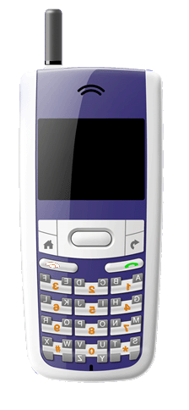


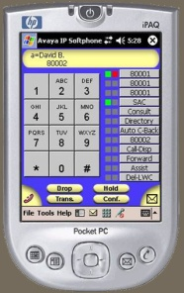



Handovers: Who makes the Decision ?
IEEE 802.21
Measurements, Triggers,
Neighbor Information
Measurements
Triggers
Neighbor Maps
Service Information
User Equipment
(User)
Network
(Operators)
IEEE 802.21 enables Co-operative
Handover Decision Making

Slide 10
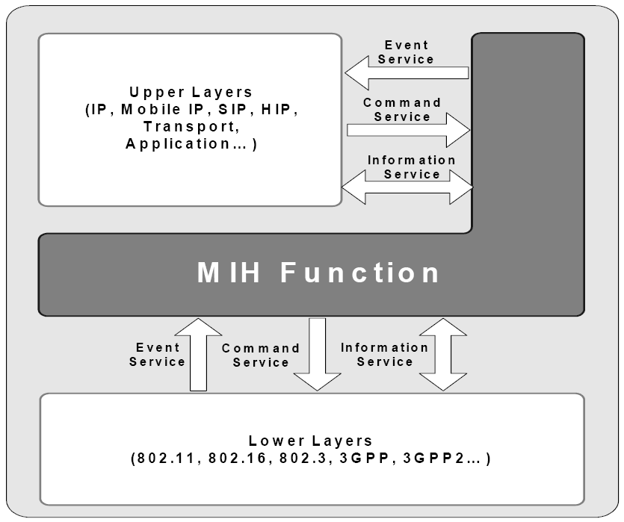
IEEE 802.21. Overview
IEEE 802.21 is a published standard
The purpose is to improve the user experience of user equipment by facilitating handover between heterogeneous access networks
Media Independent Handover Function (MIHF)
  802.21 provides mechanisms for network detection and selection, minimizing connectivity interruption while changing access link, and with an efficient battery usage
  Defined Services: Events, Commands, and Information
  The 802.21 layer belongs to the control plane
  Provides both L2 and L3 transports

Slide 11
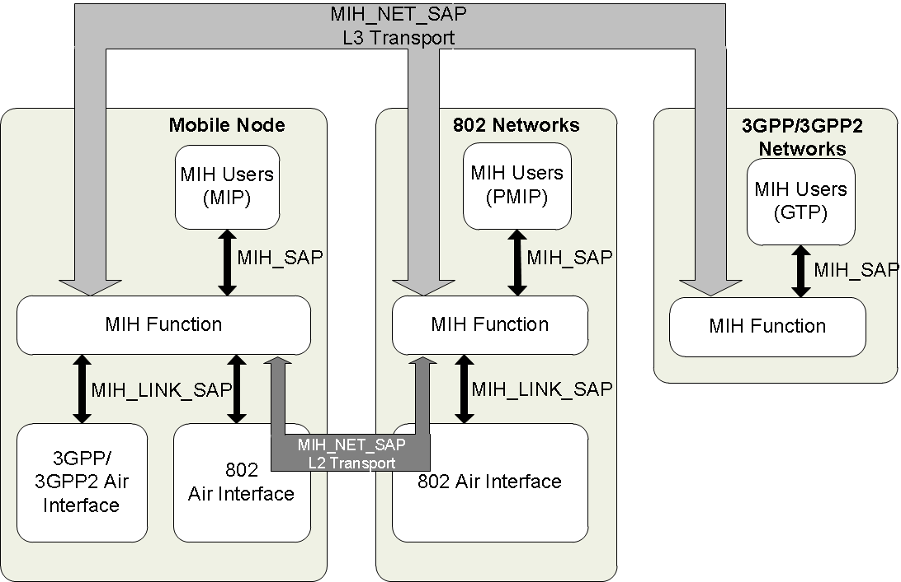
IEEE 802.21 Services(Logical Diagram)
MIES: Media Independent Event Service
  From Link layers to Upper layers
  Subscription mechanism
  L2/L3 communication
  Advisory nature, dynamic information
  Examples: Link Up, Link Down, Link Parameters change
MICS: Media Independent Command Service
  From MIH users to Lower layers
  Local or remote
  Its reception can generate an event
  Examples: Commit, Candidate_Query
MIIS: Media Independent Information Service
  Acquire network information
  Information can be accessed from any technology
  Network selection
  Examples: neighbor maps, coverage zones, etc.

Slide 12
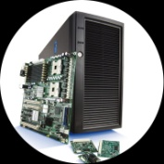
MIH Communication Model
Client Side
Candidate PoA
Network Side
MIH PoS
PoA:L2 Point of Attachment (AP/BS)
PoS: Point of Service
UE: User Equipment
MIH: Media Independent Handover
R2
R4
R5
MIH
MIH PoS
MIH
UE
R1
Serving PoA
R4
Non PoA
Network Entity
R3
R5
R4
MIH PoS
Non PoA
Network Entity
Communication Reference Point | Comments | Scope 802.21
R1, R2 | Between MIH on a UE and MIH PoS on serving/candidate PoA. | Yes
R3 | Between the MIH on a UE and an MIH PoS on a non-PoA network entity | Yes
R4 | Between MIH PoS and a non-PoS MIH Function instance in distinct Network entities | Yes
R5 | Between MIH PoS and another MIH PoS instance in distinct Network entities | Yes

Slide 13
MIH Protocol Call Flow
STA/UE (MIH Client)
MIH PoS
IS Server Discovery
MIH Request
MIH Response
STA- Station; UE – User Entity
PoS- Point of Service
IS – Information Server
MIH – Media Independent Handover

Slide 14
IEEE 802.21 Features
IEEE 802.21 framework provides a network Point of Service(PoS)
  A functional entity that provides services to the end devices
  PoS can generate command from network side, for example
  PoS acts as MIH Information Server for network discovery and selection(a.k.a. MIH Information Server)
MIH defines an ID called MIHF ID
  This identifies the device
Device MIHF ID needs a registration with the PoS before obtaining the Command Service
MIH protocol supports unicast and very limited use of multicast communications between two MIH peers, but there is no group management including commands for multicast communications

Slide 15
IEEE 802.21 Features Contd..
MIH protocol supports both L2 and L3 transports
    Ethertype is defined (IEEE Registry)
    UDP/TCP transport and ports are assigned by IANA (RFC 5677)
Discovery of MIH Server is defined in IETF
  DHCP Option (RFC 5678)
  DNS Option (RFC 5679)
MIH security is defined in IEEE 802.21a
  Specification is in RevCom’s March agenda

Slide 16
Outline
Use Cases
  Group Management in 802.15. 4 Neighborhood Area Networks (NAN)
  Mesh routing across multiple IEEE 802 access technologies
Overview of IEEE802.21
Activities in IEEE802.21 and how it can address the above use cases
Discussion

Slide 17
Addressing Group Management Use Case
IEEE 802.21 is discussing the possible amendment of the specification with the following features
  Group identifiers at the MIHF level, to form a specific group of nodes
  Mechanisms to distribute the group information to the devices
  Mechanisms to enable the users to ask for the creation of groups
  Distribution of the L2/L3 transport multicast mechanism to be used (e.g., the IP multicast address is going to be used)
  New primitives for the MIH Users to request the MIHF to join a specific group
  Group motivation (groups per technology, services, etc.)
  New attributes/IEs to support 802.15.4

Slide 18
Addressing Routing Use Case
If there are enough interests, we can discuss the following options:
Develop L2 independent routing protocol running over heterogeneous mesh networks
  Create a Study Group to discuss and develop PAR/5C
Develop L2 mesh routing protocol for IEEE 802.15.4 (or only for 4g)
  Jointly work with 802.15 and develop a PAR/5C
Develop a framework document to communicate between various L2 and L3 mesh protocols so that they can interwork
  Joint work with 802.15 and develop a PAR/5C

Slide 19
Discussion
Two relevant areas are presented
  We believe that both are relevant to 802.15 WG
    Group management
    L2 Routing
Group Management
  802.21 is well suited because of its experience with heterogeneous handover services which can easily address group management
  L2 Routing
    Do we work on development of L2 routing protocol within IEEE 802?
    802.21 protocol can help providing information required by L2 routing protocol
Industry may benefit with having this capability standardized within IEEE 802
We are looking for feedback from 802.15 WG

