Slide 1
Project: IEEE P802.15 Working Group for Wireless Personal Area Networks (WPANs)
Submission Title: [PAC Introduction]
Date Submitted: [18 January 2012]
Source: Myung Lee⁷
Company [Samsung Electronics ]¹, [ETRI]², [LG]³, [Huawei]⁴, [NICT]⁵, [CSEM]⁶ , [CUNY]⁷
Address [] Voice:[], FAX: [],
E-Mail:[shannon.park@samsung.com]¹, [jkkim@etri.re.kr]², [suhwook.kim@lge.com]³, [betty.zhao@huawei.com]⁴, [lee@nict.go.jp]⁵, [john.farserotu@csem.ch]⁶, [lee@ccny.cuny.edu]⁷
Re: [.]
Abstract: [Introduction to Peer Aware Communications (PAC)]
Purpose: [To present use cases and key requirements to clarify the scope of PAR & 5C]
Notice: This document has been prepared to assist the IEEE P802.15. It is offered as a basis for discussion and is not binding on the contributing individual(s) or organization(s). The material in this document is subject to change in form and content after further study. The contributor(s) reserve(s) the right to add, amend or withdraw material contained herein.
Release: The contributor acknowledges and accepts that this contribution becomes the property of IEEE and may be made publicly available by P802.15.

Slide 2
Introduction to
Peer Aware Communications (PAC):
A Study Group of IEEE 802.15 WG
Presenters:
Myung Lee (CUNY),
Huan-Bang Li (NICT),
Seung-Hoon Park (Samsung)

Slide 3
ToC
Introduction
Use-cases
  Social Networking
  Advertisement
  User-centric Service
  Consumer Electronics
  Extension to Infrastructure
  Emergency Service & Alarm
Key Technical Features
  Infrastructure-less peer-aware communication
  Fully distributed coordination
Why a new TG?

Slide 4
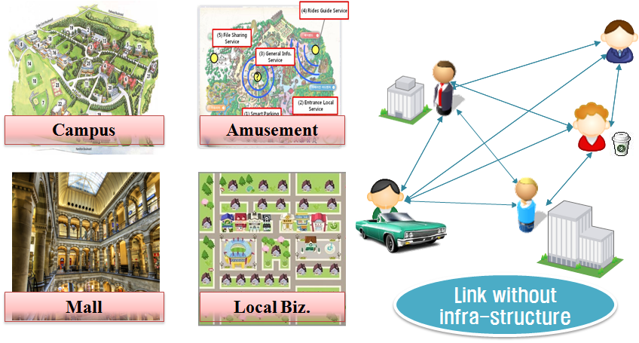
Introduction
Application driven
  to support burgeoning social networking, peer-to-peer applications, and emergency communications
Requirements
  Peer awareness
  Scalability
  Group communication
Need for a New TG

Slide 5
Use-cases

Slide 6













Use-case 1:
Social Networking
Geo-social networking
  Relevant to situation/context
  Local group chatting
Proximal search
  Suitable for dynamically changing proximal info
  Proximal profile matching
Personal broadcast
Food Truck
Friends
Neighbors
Company

Slide 7
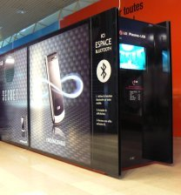



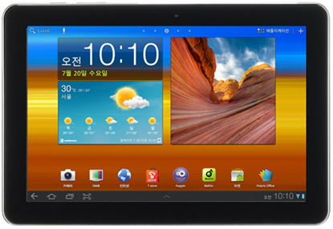
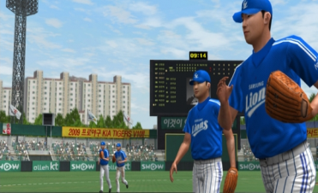


Use-case 2:
Advertisements
Broadcast type
  Kiosk
  Mall navigator
  Automatic narration/guide
Interactive type
  Precision marketing
  Advertisements with personalized information (coupon, brochure, mileage, etc)
  Mobile group buying
Kiosk
1
Broadcast Ad for McDonald’s Hamburger
Retailer
2
Receive Ad from near-by shop when hitting the score
John
Ads in Game

Slide 8





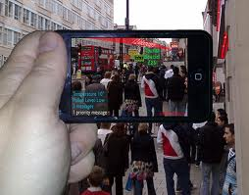



Use-case 3:
User-centric Service
PAC link
PAC link
Distributed Apps
  For user-centric applications that should be scalable and efficient
  Gaming, streaming, contents distribution
Augmented Reality
  based on real location + virtual scene, e.g. MyTown
User-centric Game Model
Personal DJ

Slide 9
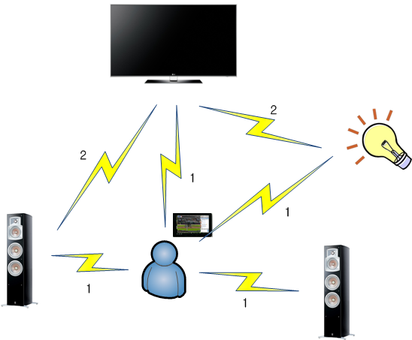
Use-case 4:
Consumer Electronics
Personalized auto-configuration
  To meet individual’s favorite profiles or context
Contents sharing
  Multi-screen services
Device sync-up

Slide 10
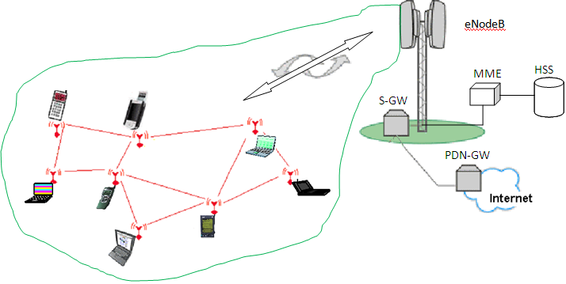
Use-case 5:
Extension to infrastructure
Multi-hop relay to infrastructure
  Coverage extension

Slide 11

Use-case 6:
Emergency Service & Alarm
Congestion avoidance
  Offloading from the overloaded traffic area
SOS tool
  connecting distant peoples at the disaster area
Accident alarm
  Fast notification to neighbor devices
  E.g. car accident alarm
Car Accident Alarm

Slide 12
Optimized Design to Support Use-cases
Peer awareness
Scalability
Low power consumption
Group communication
Security

Slide 13
Key Features
Infrastructure-less
peer-aware communication
Peer-to-peer network
with fully distributed coordination

Slide 14
Infrastructure-less
Peer-aware Communication (1/2)
No BS, no AP
  No cost for deployment or maintenance
  No network control overhead
  No infrastructure association
No LBS server
  Low cost to implement proximal search
  Avoid tracking and storing personal geo-location
  No single point of failure

Slide 15
Infrastructure-less
Peer-aware Communication (2/2)
Discovery with service/contents information
  without association
  relative positioning
Group communication
  link management for nodes in the same group

Slide 16


P2P Networks with
Fully Distributed Coordination
No coordinator node
  Direct link
  Low latency / low signaling overhead
  Simple & Scalable
Distributed protocol
  Synchronization
    enables low power consumption for discovery
  Resource management
    distributed multiple access
    distributed scheduling
    distributed interference management

Slide 17
Scope
  Discovery for peer information without association
    Discovery signaling rate -typically 100 kbps
    Number of peers >100
  Efficient data transmission by distributed coordination
    Data transmission rate -typically 10 Mbps
  Group communication
  Multi-hop support -typically 2 hops
  Relative positioning -typically 10 m
  Security
  Globally available unlicensed/licensed bands

Slide 18
Why a new TG?
Existing centralized architecture incurs substantial signaling overhead and communication latency when to support hundreds of devices in the proximity.
Parts of the features can be supported by existing standards, but no single standard can support all features

Slide 19
Contributors
Seung-Hoon Park, Daegyun Kim, Huai-Rong Shao (Samsung)
Suh Wook Kim, Jin Sam Kwak, Paul Jeon (LG)
Huan-Bang Li, Marco Hernandez , Ryu Miura (NICT)
Sunggeun Jin, Chanho Yoon, Jinkyeong Kim, Seong-Soon Joo (ETRI)
Betty Zhao (Huawei)
John R. Farserotu (CSEM)
Soo-Young Chang (CSUS)
Myung Lee (CUNY)

Slide 20
Thank You
Any Questions?

