Slide 1
Project: IEEE P802.15 Working Group for Wireless Personal Area Networks(WPANs)
Submission Title: White Space Channel Models for TG4m WPAN
Date Submitted: January 2012
Source: Sangsung Choi(ETRI) and Soo-Young Chang (CSUS)
Contact: Sangsung Choi(ETRI) and Soo-Young Chang (CSUS)
Voice: +82 42 860 6722, E-Mail: sschoi@etri.re.kr, sychang@ecs.csus.edu
Re: Channel models for TG4m proposals
Abstract: General facts regarding wireless channel models are introduced and a couple of models are suggested for TG4m white space channel models.
Purpose: Information to 802.15 WG
Notice: This document has been prepared to assist the IEEE P802.15. It is offered as a basis for discussion and is not binding on the contributing individual(s) or organization(s). The material in this document is subject to change in form and content after further study. The contributor(s) reserve(s) the right to add, amend or withdraw material contained herein.
Release: The contributor acknowledges and accepts that this contribution becomes the property of IEEE and may be made publicly available by P802.15.
Slide 1

Slide 2
WHITE SPACE CHANNEL MODELS FOR TG4m WPAN
Sangsung Choi (ETRI)
and
Soo-Young Chang (CSUS)
Slide 2

Slide 3
Table of Contents
Introduction
Key Requirements and Parameters for Applications
Path Loss and Shadowing
Multipath Channel Models: Power Delay Profile
Practical Multipath Models
Conclusions
References
Slide 3

Slide 4
Introduction
1. Purposes of Developing Channel Models
2. Issues for Channel Models
3. Other Channel Models Considered
4. Wireless Propagation Channels for Tg4m
Slide 4

Slide 5
PURPOSES OF DEVELOPING CHANNEL MODELS
Purposes
  To help the proposers for their system design
    To start with system design, we at least need to know some basic properties of the channel
      Path losses, max. and RMS delay spreads, coherence BW, coherence time, etc
  To evaluate the proposals
    To apply a channel model mainly for performance evaluation by simulations
Why these models are needed?
  These models support the algorithms design by providing a means for validation.
  The results obtained by computer simulations employing realistic models support the choice of the suitable transmission schemes as well as the selection of the appropriate RF technologies.
  They enable a forecast of the achievable coverage of the TV white space WPAN system:
    Channels at UHF/VHF are different from the channels at other frequency bands
    for various use cases using white space
    with given transmit power constraints (for the US case, 4W, 100mW, and 50mW).
Slide 5

Slide 6
ISSUES FOR CHANNEL MODELS
Path Loss
  Free space path loss
  Plane earth loss
  Diffraction
  LOS and NLOS
Shadowing
Multipath Fading
  Multipath delay spread
  Fading characteristics: K-factor
  Doppler spread
  Antenna directivity gain degradation
Additive Noise
Non-Ideal RF Devices
Interference into WPAN from other systems: co-channel and adjacent interference: C/I
  From incumbent transmitters: cognitive feature needed
  From other white space systems: coexistence issues to be cleared
  From rogue jammers: the proposers should address this issues.
Slide 6

Slide 7
COMPONENTS OF WIRELESS PROPAGATION CHANNEL MODELS
Path Loss and Shadowing
  Free space path loss
  Plane earth loss
  Diffraction
  Shadowing
Multipath Channel Models: Power Delay Profile
  Multipath delay spread
  Doppler spread
  K-factor
  Antenna directivity gain degradation
Additive Noise Model
Slide 7

Slide 8
ENGINEERING ISSUES
Typical system engineering questions:
  What is an appropriate packet duration, to avoid fading?
    Fast fading requires short packet durations, thus high bit rates ← mainly due to moving antennas
  How much ISI will occur?
    Carrier spacing should not be too-wide that it is more than the coherence BW of the channel, (especially, which could be a problem in NLOS in the range > 1KM).
  For frequency diversity, how far should one separate carrier from another?
  How far should one separate antenna from another for diversity?
  What is an appropriate interleaving depth?
  Do target data rates work well?
    Max. and RMS delay spreads, coherence BW, coherence time
The basic Rayleigh/Rician model gives the PDF of envelope.
  But: how fast does the signal fade?
  How wide in bandwidth are faded signals?
Slide 8

Slide 9
VARIOUS SCALES OF EFFECTS ON
CHANNEL MODELS (1)
‘Small-scale' effect:
  Multipath propagation leads to rapid fluctuations of the phase and amplitude of the signal if the vehicle moves over a distance in the order of a wave length or more.
‘Medium-scale' effect
  Shadowing : field strength variations occur if the antenna is displaced over distances larger than a few tens or hundreds of meters.
  Shadowing introduces additional fluctuations, so the received local-mean power varies around the area-mean. The term 'local-mean' is used to denote the signal level averaged over a few tens of wave lengths, typically 40 wavelengths. This ensures that the rapid fluctuations of the instantaneous received power due to multipath effects are largely removed.
‘Large-scale‘ effect
  Path losses cause the received power to vary gradually due to signal attenuation determined by the geometry of the path profile in its entirety. This is in contrast to the local propagation mechanisms, which are determined by building and terrain features in the immediate vicinity of the antennas.
  The large-scale effects determine a power level averaged over an area of tens or hundreds of meters and therefore called the 'area-mean' power.
http://people.seas.harvard.edu/~jones/es151/prop_models/propagation.html#credit
Slide 9

Slide 10
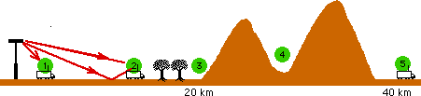
VARIOUS SCALES OF EFFECTS ON
CHANNEL MODELS (2)
Models of Large-scale effects: The most appropriate path loss model depends on the location of the receiving antenna.
  At location 1, free space loss is likely to give an accurate estimate of path loss.
  At location 2, a strong line-of-sight is present, but ground reflections can significantly influence path loss. The plane earth loss model appears appropriate.
  At location 3, plane earth loss needs to be corrected for significant diffraction losses, caused by trees cutting into the direct line of sight.
  At location 4, a simple diffraction model is likely to give an accurate estimate of path loss.
  At location 5, loss prediction fairly difficult and unreliable since multiple diffraction is involved.
Only Locations 1, 2, and 3 can be considered for TG4m which mainly needs to consider path loss, diffraction, shadowing, and multipath loss.
http://people.seas.harvard.edu/~jones/es151/prop_models/propagation.html#credit
Slide 10

Slide 11
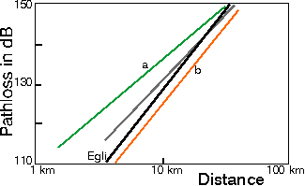
VARIOUS SCALES OF EFFECTS ON
CHANNEL MODELS (3)
Models of Large-scale effects: Path-loss law
  Figure shows Average path loss versus distance in UHF bands as measured in Northern Germany.
Green (a): forestry terrain;
Orange (b): open area;
Grey: average of (a) and (b);
Black: Egli's model
http://people.seas.harvard.edu/~jones/es151/prop_models/propagation.html#credit
Slide 11

Slide 12
ENVIRONMENT AND PROPAGATION TYPES
Urban or rural
  Urban environment
    Large cities
    Medium/small cities
  Suburban environment
  Rural environment
    assumed as flat
Line-of-sight (LOS) and non line-of-sight (NLOS)
  LOS
    No attenuation of the direct signal due to obstructing objects
    This requires the direct transmitter-receiver path including the space within 0.6 times the radius of the first order Fresnel zone to be free.
  NLOS
    For all other propagation scenarios
Slide 12

Slide 13
MODELS FOR DESIGN OF WIRELESS SYSTEMS
Three types of models for design of wireless systems
  Models for the signal distortion in the radio channel
  Models for the signal distortion in the antenna subsystems
  Models for the signal distortion in the non-ideal RF unit components
Slide 13

Slide 14
OTHER CHANNNEL MODELS CONSIDERED
802.11af
  11-10-0154-01-00af-channel-model-considerations-for-p802-11af
802.15.4g
  15-09-0263-01-004g-channel-characteristics-4g
  15-09-0279-01-004g-channel-characterization-for-sun
802.16.3c
  16-01-0029-04-003c (16.3c-01/29r4)
802.22
  22-05-0055-07-0000-wran-channel-modeling
ITU-R P.1546-1
COST 207
Slide 14

Slide 15
WIRELESS PROPAGATION CHANNELS FOR TG4m (1)
Generating synthetic, but realistic, series of relevant propagation parameters as a function of time or traversed distance.
Frequencies in the VHF/UHF white space bands
Propagation mechanisms
  reflections, diffractions, transmissions, shadowing, etc.
  caused by environmental features close to the user terminal or utility station and the other end of the link, the base station (or relay or access point)
Area coverage
  outdoor-to-outdoor, outdoor-to-indoor, and indoor-to-indoor links
  fixed local access systems (point-to-point and point-to-multipoint) and mobile systems (?)
Slide 15

Slide 16
WIRELESS PROPAGATION CHANNELS FOR TG4m (2)
Target wave propagation scenarios for TG4m
  outdoor narrow- to moderate-band (? up to 6 MHz) wireless transmission using fixed transmitter and receiver stations
A stochastic channel model is defined generating random impulse responses, which is suitable for employment in the TV white space WPAN system simulation chain.
The base and terminal stations are assumed separated by a few meters up to a few kilometres.
The followings are considered for wireless propagation channel models:
  Environment and Propagation Types
  Path Loss Calculation Including Shadowing
  Bandwidth related Channel Models: delay spread
  Practical Multipath Model (Based on Field Measurements): still needed
  Additive Noise Model
  Interference into TG4m WPAN
Slide 16

Slide 17
  Key Requirements and Parameters for Applications
  1. Typical Utility Needs
  2. Application Requirements Summary
Slide 17

Slide 18
TYPICAL UTILITY NEEDS
Extreme range of node density from sparse to dense (1/acre- 1000’s/acre)
  Both link range and network footprint need to be adaptable
  Presence of other wireless systems (lots of them)
  Automatically adapt to the dynamic environments: Work in rural and urban deployments
Network deployment needs to be flexible to meet a lot of different network topologies, network range, environments, etc.
Ubiquity and Reliability
  99% isn’t good enough
  100% of every utility’s customers and 100% of the utility infrastructure
Key objectives
  Extreme scalability (to tens of millions of nodes)
  High availability (uptime)
  Highly reliable data delivery (error detection)
  Ease of commissioning (highly autonomous)
    Ease of commissioning and fixed installation points means that directional antennae or modulation techniques that rely on position may have only limited use for W-SUN
15-09-0026-00-004g
Slide 18

Slide 19
KEY APPLICATION PROPERTIES
Typical data volume (10 x 4kB per day)
Latency tolerant (for many applications)
  Deterministic: ranges from 15s meter reads to 2s SCADA operations (15-09-0037)
  Some real-time response constraints (seconds)
Ubiquity
  Every customer connected
  Multiple per customer premise, multiple in-home connections
Cost constrained
  Need simple modulation (15-09-0037)
  Acquisition
  Ease of deployment
  Consistency across regions
  Long term cost of operation
Scalable
  Tens of millions of devices per utility
  Tens of billions nation/world wide
System longevity
  Measured in decades - multiple decades
Large packets/support for IP
  PHY frame sizes up to a minimum of 1500 octets
15-09-0026-00-004g
Slide 19

Slide 20
POSSIBLE COEXISTENCE SOLUTIONS
Passive (static) solutions for coexistence
  Random channel access
  Channel alignment
  Low duty cycle (temporal diversity)
  Frequency diversity
  ‘Noise-like’ signal modulation
Active (dynamic) solutions for coexistence
  Non-dedicated spectrum (license-exempted white space bands): not the solution because of not licensed bands unlike 4g: need cognitive type of coexistence
  CCA
  Dynamic channel selection
    Sense and avoid
  Adaptation
    Transmit power control
    Fragmentation
    Channel masking (black-listing/white-listing)
    etc.
  Piconet separation capability
    Coding, timing, …
  Energy detect, scanning, etc.
  And so on….
15-09-0031-00-004g
Slide 20

Slide 21
UBIQUITY AND DENSITY
Maximum allowable power setting may not be able to be used in sparse deployments.
  Power constraint imposed by FCC: to be operated with only minimally needed power
Power variation is advantageous when network density will support it.
  Transmit power control is necessary.
High-power devices have large interference ranges.
  Power variation
  Narrow bandwidth
Due to large number of nodes and hidden terminals, multiple collision domains may be required.
15-09-0037-00-004g
Slide 21

Slide 22
KEY UTILITY DEVICES CONTEXT
15-09-0026-00-004g
Slide 22

Slide 23
APPLICATION REQUIREMENTS SUMMARY (1)
Application | Description | Key Parameters | Reference
Smart utility networks (SUN) | TV White space application is a good candidate for SUN There is no special interference source except TV signal. Use the similar TV Channel frequencies all over the world | - Environment: Indoor/outdoor, Urban/suburban/rural - Operating range: up to several km - Up to several thousands of nodes in the network - Mobility (Device type): fixed - Security features: required - Reliability: high - Device category: as regulations applied to all applications | 15-09-0275-02 15-11-0171-00
Intelligent Transportation System | TV bands make signal travel longer distance and less vulnerable in rural areas, which can enable multiple applications between car and fixed node. Information delivery Traffic management Logistics tracking/Vehicle location | Environment: Outdoor Data rate: Generally <1Mbps, Up to 10Mbps PER: < 10% Operating range: One controller covers up to 1 square km Data flow: two-way, 100 end devices (mobile) to 1 controller (fixed) Transmission power: Obey regulations all over the world Power type: Mains powered or powered by car engine | 15-11-0194-00 15-11-0279-01
15-11-0684-04-004m
Slide 23

Slide 24
APPLICATION REQUIREMENTS SUMMARY (2)
Application | Description | Key Parameters | Reference
Surveillance, control and monitoring network | Larger coverage areas due to excellent propagation characteristics, which make it attractive for surveillance, control and monitoring networks | - Environment: Indoor/outdoor - Data rate: up to 2Mbps - PER <1% - Operating range: up to 1 Km - Mobility: support (e.g., up to 10Km/h) | 15-11-0215-02
Infrastructure moditoring network | Larger coverage areas due to excellent propagation characteristics, which make it attractive for infrastructure monitoring | - Environment: outdoor - Data rate: less than 100Kbps - PER < 1% - Operating range: up to several Km - Reliability: high - Mobility: fixed - Energy efficiency: high | 15-11-0215-02
Local network in machine-to-machine (M2M) | Larger coverage areas due to excellent propagation characteristics, which make it attractive for local networks in M2M | - Environment: Indoor/outdoor - Data rate: depends on M2M applications (40Kbps~2Mbps) - PER <1% - Operating range: depends on M2M applications (up to several Km) - Mobility: depends on M2M applications (up to 20~30Km/h) | 15-11-0215-02
15-11-0684-04-004m
Slide 24

Slide 25
  Path Loss and Shadowing
  1. Path Loss Calculation
  2. Shadowing
Slide 25

Slide 26
PATH LOSS CALCULATION
Two propagation models
  LOS propagation models
    Friis free space equation
  NLOS prediction models
    Models based on the extrapolation of Hata’s model
    ITU-R prediction method contained in ITU-R Recommendation P.1546-1
      This model is recommended for TG4m model.
Slide 26

Slide 27
PROPAGATION MODELS (1)
Line-of-sight (LOS) propagation models
  The loss in the direct signal propagation path under LOS condition including the loss in the antennas is given by the Friis free space equation
  [dB]
  where , c is the speed of light. Additionally, d, f, G_{B} and G_{T} specify the transmitter-receiver-distance in meters, the frequency in Hertz and the base and terminal station antenna gain values in dBi, respectively.
Slide 27

Slide 28
PROPAGATION MODELS (2)
Models of Large-scale effects: Path-loss law: Egli's model
  Figure shows Average path loss versus distance in UHF bands as measured in Northern Germany.
Green (a): forestry terrain;
Orange (b): open area;
Grey: average of (a) and (b);
Black: Egli's model
http://people.seas.harvard.edu/~jones/es151/prop_models/propagation.html#credit
Slide 28

Slide 29
PROPAGATION MODELS (3)
NLOS Okumura-Hata Model
  In NLOS scenarios an additional path loss results from scattering, diffraction and reflection effects. This is modelled by the term L_{excess}, i.e.,
  [dB]
  Besides of the frequency and the transmitter-receiver separation, the excess path loss depends on the base and terminal station antenna heights denoted by h_{B} and h_{T}, respectively, in meters.
Slide 29

Slide 30
PROPAGATION MODELS (4)
NLOS Okumura-Hata Model (cont’d)
  For frequencies within 150-1500 MHz and distances from one up to 20 kilometres,
    Hata’s model may be employed for the excess path loss prediction. The model is based on extensive measurements in Tokyo and makes a distinction between small/medium and large cities as well as between urban, suburban and open rural areas.
  For f₀ = 1 GHz,
    the excess path loss according to Hata’s model can be expressed by
  .
    The applicable coefficients L_{HATA} and μ_{HATA} for different h_{B} and h_{T} are summarised in tables on the following slides for small/medium cities, for large cities and for suburban and open areas.
Slide 30

Slide 31
PROPAGATION MODELS (5)
NLOS Okumura-Hata Model (cont’d)
 | h_{T} = 1 m | h_{T} = 4 m | h_{T} = 7 m | h_{T} = 10 m
h_{B} = 30 m | L_{HATA} = -9.22 μ_{HATA} = 15.22 | L_{HATA} = -17.02 μ_{HATA} = 15.22 | L_{HATA} = -24.82 μ_{HATA} = 15.22 | L_{HATA} = -32.62 μ_{HATA} = 15.22
h_{B} = 50 m | L_{HATA} = -7.93 μ_{HATA} = 13.77 | L_{HATA} = -15.73 μ_{HATA} = 13.77 | L_{HATA} = -23.53 μ_{HATA} = 13.77 | L_{HATA} = -31.33 μ_{HATA} = 13.77
h_{B} = 100 m | L_{HATA} = -6.17 μ_{HATA} = 11.80 | L_{HATA} = -13.97 μ_{HATA} = 11.80 | L_{HATA} = -21.77 μ_{HATA} = 11.80 | L_{HATA} = -29.57 μ_{HATA} = 11.80
h_{B} = 200 m | L_{HATA} = -4.42 μ_{HATA} = 9.83 | L_{HATA} = -12.22 μ_{HATA} = 9.83 | L_{HATA} = -20.02 μ_{HATA} = 9.83 | L_{HATA} = -27.82 μ_{HATA} = 9.83
Table A1: Hata's model excess path loss coefficients for small/medium cities at f₀ = 1 GHz.
 | h_{T} = 1 m | h_{T} = 4 m | h_{T} = 7 m | h_{T} = 10 m
h_{B} = 30 m | L_{HATA} = -9.22 μ_{HATA} = 15.22 | L_{HATA} = -17.02 μ_{HATA} = 15.22 | L_{HATA} = -24.82 μ_{HATA} = 15.22 | L_{HATA} = -32.62 μ_{HATA} = 15.22
h_{B} = 50 m | L_{HATA} = -7.93 μ_{HATA} = 13.77 | L_{HATA} = -15.73 μ_{HATA} = 13.77 | L_{HATA} = -23.53 μ_{HATA} = 13.77 | L_{HATA} = -31.33 μ_{HATA} = 13.77
h_{B} = 100 m | L_{HATA} = -6.17 μ_{HATA} = 11.80 | L_{HATA} = -13.97 μ_{HATA} = 11.80 | L_{HATA} = -21.77 μ_{HATA} = 11.80 | L_{HATA} = -29.57 μ_{HATA} = 11.80
h_{B} = 200 m | L_{HATA} = -4.42 μ_{HATA} = 9.83 | L_{HATA} = -12.22 μ_{HATA} = 9.83 | L_{HATA} = -20.02 μ_{HATA} = 9.83 | L_{HATA} = -27.82 μ_{HATA} = 9.83
Table A2: Hata's model excess path loss coefficients for large cities at f₀ = 1 GHz.
Slide 31

Slide 32
PROPAGATION MODELS (6)
NLOS Okumura-Hata Model (cont’d)
 | Suburban areas | Open areas
h_{B} = 30 m | L_{HATA} = -20.72 μ_{HATA} = 15.22 | L_{HATA} = -39.47 μ_{HATA} = 15.22
h_{B} = 50 m | L_{HATA} = -19.43 μ_{HATA} = 13.77 | L_{HATA} = -38.18 μ_{HATA} = 13.77
h_{B} = 100 m | L_{HATA} = -17.67 μ_{HATA} = 11.80 | L_{HATA} = -36.42 μ_{HATA} = 11.80
h_{B} = 200 m | L_{HATA} = -15.92 μ_{HATA} = 9.83 | L_{HATA} = -34.67 μ_{HATA} = 9.83
Table A3: Hata's model excess path loss coefficients for suburban and open areas at f₀ = 1 GHz.
Slide 32

Slide 33
PROPAGATION MODELS (7)
NLOS Okumura-Hata Model (cont’d)
  Frequency Dependency of the Excess Path Loss
    As the above calculations are based on a radio frequency of 1 GHz they are not directly applicable to the WRAN system. Clearly, the excess path loss is frequency dependent as at least the diffraction losses increase with f.
    Reliable investigations on the frequency dependency of the path loss based on measurements are rare since most channel sounders operate within a very limited band only.
    According to a model proposed based on experiments at 0.45, 0.9, and 3.7 GHz,** an excess path loss exponent of 0.6 was found appropriate for the modelling of the frequency dependency. With this extrapolation, the excess path loss, L_{excess}, can be predicted according to
    where μ_{excess} = 6.
** T.-S. Chu, L. J. Greenstein, “A Quantification of Link Budget Differences Between the Cellular and PCS Bands”, IEEE Trans. Veh. Tech., vol.48, no. 1, January 1998.
Slide 33

Slide 34
PROPAGATION MODELS (8)
NLOS Okumura-Hata Model (cont’d)
  Location Variability
    When the terminal or base stations move around in space, the received signal strength varies since the situation changes in terms of shadowing, number of reflected paths etc..
    It has turned out that the signal strength variations are quite well described by a lognormal distribution. Hence, L_{excess} provides the mean excess path loss in dB while σ_{L} is the standard deviation of the normal distributed signal strength in dB, known as the location variability. In fact, σ_{L} depends on the frequency and the environment. σ_{L} can be modelled according to
    with S_{E} = 5.2 for urban and S_{E} = 6.6 for suburban environments, respectively.
    Since the TG4m systems is planned to be fixed located, this equation will in fact not be exercised.
Slide 34

Slide 35
PROPAGATION MODELS (9)
NLOS ITU-R P.1546-1 Propagation Prediction Model
  The propagation prediction model contained in ITU-R Recommendation P.1546-1 has been developed over the years for the point-to-area prediction of field-strength for the broadcasting, land mobile, maritime mobile and certain fixed services (e.g., those employing point-to-multipoint systems) in the frequency range 30 MHz to 3 000 MHz and for the distances range 1 km to 1000 km.
  The model consists in a set of propagation curves that represent field-strength values for 1 kW effective radiated power (e.r.p.) at nominal frequencies of 100, 600 and 2 000 MHz, respectively, as a function of various parameters.
  The model includes the methods to interpolate and extrapolate field-strength values from these three nominal frequencies.
  The model also includes the method to obtain the effective height of the transmitting/base antenna above terrain height averaged between distances of 3 to 15 km in the direction of the receiving antenna. For paths shorter than 15 km, the method can take account of the height of the transmitting/base antenna above the height of a representative clutter around its location. The curves are produced for a receive antenna height corresponding to the representative height of the ground cover surrounding the receiving antenna location, i.e., 30m for dense urban area, 20 m for urban area and 10 m for suburban, rural and sea paths. A correction method is provided if receiving antennas at different heights.
RECOMMENDATION ITU-R P.1546-1 (2001-2003)
Slide 35

Slide 36
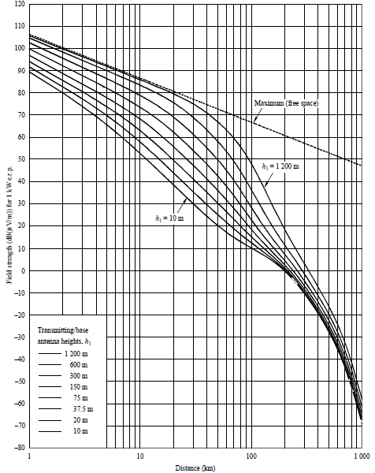
PROPAGATION MODELS (10)
NLOS ITU-R P.1546-1 Propagation Prediction Model (cont’d)
  The model includes curves for 1%, 10% and 50% time availability and a method is given to interpolate for time availability in the range from 1% to 99%. It also includes prediction over mixed land and sea propagation paths. The propagation curves represent the field strength value exceeded at 50% of locations within any area of typically 200 m by 200 m. A method is given for a correction for different percentages of location based on a standard deviation of 5.5 dB for wideband digital broadcasting.
An example curve of field strength vs distance for 100 MHz, land path, 50% time
RECOMMENDATION ITU-R P.1546-1 (2001-2003)
Slide 36
Slide 24

Slide 37
PROPAGATION MODELS (11)
NLOS ITU-R P.1546-1 Propagation Prediction Model (cont’d)
  Annex 1: Introduction
  Annex 2: Frequency range 30 MHz to 300 MHz
  Annex 3: Frequency range 300 MHz to 1000 MHz
  Annex 5: Additional information and methods for implementing the prediction method
  Annex 6: Procedure for the application of this Recommendation
  Annex 7: Comparison with the Okumura-Hata method
  Annex 8: Additional information and methods to calculate the field strength of any point contained within the envelope of the land family of curves
  Annex 9: Adjustment for different climatic regions
RECOMMENDATION ITU-R P.1546-1 (2001-2003)
Slide 37

Slide 38
PROPAGATION MODELS (12)
NLOS: Comparison between Okumura-Hata and ITU-R P.1546-1 models
  In Annex 7 of the ITU-R P.1546-1 Recommendation this ITU model gives results compatible with the Okumura-Hata model in the condition of mobile services in an urban environment for receive antenna height of 1.5 m, clutter height of 15 m and distances up to 10 km.
  A comparison was made with the two models at 600 MHz, 10 m receive antenna height, and for 50% location availability in open rural areas.
  The results indicate that the Okumura-Hata model predicts higher received field-strengths than the P.1546-1 model. Table in the following slide gives the results of this comparison.
22-05-0055-07-0000-wran-channel-modeling and RECOMMENDATION ITU-R P.1546-1 (2001-2003)
Slide 38

Slide 39
PROPAGATION MODELS (13)
NLOS: Comparison between Okumura-Hata and ITU-R P.1546-1 models (cont’d)
  Some further comparative notes on the two models:
    The Hata model covers the range of base antenna height of 30 m to 200 m whereas the P.1546-1 covers a range of 10 m to 1200 m;
    The Hata model covers the range of user terminal antenna heights from 1 m to 10 m whereas the P-1546-1 model assumes that the antenna is at the same height as the local clutter or ground cover (i.e., 30 m in dense urban, 20 m in urban and 10 m elsewhere) with a correction factor depending on the path length for different antenna height;
    The Hata model predict up to a range of 20 km whereas the P-1546-1 model goes up to 1 000 km;
    The frequency range of the Hata model is from 150 MHz to 2 000 MHz whereas the P-1546-1 allows interpolation and extrapolation from 30 MHz to 3 000 MHz based on three nominal frequencies (100, 600 and 2 000 MHz);
    The excess path loss increases by 6 dB per decade in the Hata model whereas it is distance independent in the P-1546-1 model.
    The standard deviation for the location variability is frequency dependent and found to be 8 dB at 600 MHz whereas it is equal to 5.5 dB for wideband digital broadcast signals and frequency independent in the P.1546-1 model;
    The Hata model does not allow for a variation of time availability;
    The Hata model does not include prediction over sea paths.
22-05-0055-07-0000-wran-channel-modeling and RECOMMENDATION ITU-R P.1546-1 (2001-2003)
Slide 39

Slide 40
PROPAGATION MODELS (14)
NLOS: comparison between Okumura-Hata and ITU-R P.1546-1 models (cont’d)
Table : Field-strength prediction difference between the Okumura-Hata model and ITU-R P.1546-1 model expressed in dB and in % (for 50% and 50%) (positive values indicate larger excess path loss predicted by P.1546-1)
Slide 40

Slide 41

SHADOWING (1)
Shadowing
  The effect that the received signal power fluctuates due to objects obstructing the propagation path between transmitter and receiver.
  These fluctuations are experienced on local-mean powers, that is, short-term averages to remove fluctuations due to multipath fading. Experiments reported by Egli in 1957 showed that, for paths longer than a few hundred meters, the received (local-mean) power fluctuates with a 'log-normal' distribution about the area-mean power. By 'log-normal' is meant that the local-mean power expressed in logarithmic values, such as dB or neper, has a normal (i.e., Gaussian) distribution.
Distinguishment between two means
  local means: average over about 40λ, to remove multipath fading, denoted by a single overline
  area means : average over tens or hundreds of meters, to remove multipath fading and shadowing, denoted by a double overbar.
The received power P_{Log} expressed in logarithmic units (neper), is defined as the natural logarithm of the local-mean power over the area-mean power, thus
http://wireless.per.nl/reference/chaptr03/shadow/shadow.htm
Slide 41

Slide 42


SHADOWING (2)
It has the normal probability density
where σ is the 'logarithmic standard deviation' in natural units. The standard deviation in dB is found from s = 4.34 σ. For instance, s = 6 dB shadowing is equivalent to σ = 1.36. If we convert 'nepers' to 'watts', the log-normal distribution of received (local-mean) power is found
Here the factor "1/local-mean power" occurs due to the conversion of the pdf of P_{Log} to local-mean power.
http://wireless.per.nl/reference/chaptr03/shadow/shadow.htm
Slide 42

Slide 43
SHADOWING (3)
Depth of Shadowing: σ
Large-area shadowing
  Egli studied the error in a propagation model predicting the path loss, using only distance, antenna heights and frequency.
  For average terrain, he reported a logarithmic standard deviation of about s = 8.3 dB and 12 dB for VHF and UHF frequencies, respectively. Such large fluctuations are caused not only by local shadow attenuation by obstacles in the vicinity of the antenna, but also by large-scale effects (hills, foliage, etc.) along the path profile, which cause attenuation. Hence, any estimate of the area-mean power which ignores these effects may be coarse.
  This log-normal fluctuation was called 'large-area shadowing' by Marsan, Hess and Gilbert. They measured semi-circular routes in Chicago , thus fixing distance to the base station, antenna heights and frequency, but measuring different path profiles. The standard deviation of the path loss ranged from 6.5 dB to 10.5 dB, with a median of 9.3 dB. This 'large-area' shadowing thus reflects shadow fluctuations if the vehicle moves over many kilometers.
http://wireless.per.nl/reference/chaptr03/shadow/shadow.htm
Slide 43

Slide 44
SHADOWING (4)
Depth of Shadowing: σ (cont’d)
Small-area shadowing
  In contrast to this, in most papers on mobile propagation, only 'small-area shadowing' is considered: log-normal fluctuations of the local-mean power are measured when the antenna moves over a distance of tens or hundreds of meters. Marsan et al. reported a median of 3.7 dB for small area shadowing. Preller and Koch measured local-mean powers at 10 m intervals and studied shadowing over 500 m intervals. The maximum standard deviation experienced was about 7 dB, but 50% of all experiments showed shadowing of less than 4 dB.
Mawaira of the Netherlands' PTT Research modelled large-area and small-area shadowing as two independent superimposed Markovian processes:
  3 dB with coherence distance over 100 m, plus
  4 dB with coherence distance 1200 m
Since shadowing is the fluctuation effects for mobile users, for our models it is not considered. These effects are reflected in path loss calculations.
http://wireless.per.nl/reference/chaptr03/shadow/shadow.htm
Slide 44

Slide 45
  Multipath Channel Models: Power Delay Profile
  1. Bandwidth Related Channel Models
  2. Free Space Theoretical Multipath Model
  3. Results Of Multipath Field Measurements
  4. Antenna directivity gain degradation
Slide 45

Slide 46
BANDWIDTH RELATED CHANNEL MODELS
Bandwidth related channel models
  Small-scale fading
    Additional variations of the signal attenuation led by multipath wave propagation
    With rapid changes when moving the antenna positions locally or there are moving objects between a transmitter and a receiver.
  Dispersion in the time domain and in a frequency selectivity of the channel
    Dispersion led by multipath for broadband transmission
    The dispersion of the transmitted signal induced by the channel is modelled by a convolution with the channel impulse response.
      For this impulse response, statistical models can be defined.
Slide 46

Slide 47
MULTIPATH AND FADING RATE
Differential path delay caused by reflections can be viewed in two different ways;
  From a data communications perspective this is seen as inter symbol interference (ISI) in the time domain. In the frequency domain it is observed as frequency selective fading or frequency nulls in the channel. The spacing of these nulls is approximately the reciprocal of the differential delay. The exact positioning of the null within the channel is dependent upon the relative phases of the multipath components, and the depth of the null is related to the relative amplitudes.
  From a propagation perspective this differential delay results in spatial nulls where the signal strength is reduced by destructive interference. The physical positioning of the nulls is controlled by the relative phase of the delayed path while the physical spacing of these nulls is dependent upon the wavelength of the carrier. Higher carrier frequencies lead to more closely spaced spatial nulls and an observer at a fixed point will experience more nulls passing through his position for a given rate of change of phase. Thus the fading rate is a function of both the velocity of the reflector and the wavelength of the carrier.
  The models in this document specify the reflector (car or bus) speed and use an attenuation factor to account for the size of the reflector. Actual fading rate must be derived from knowledge of the carrier frequency.
  15-09-0263-01-004g-channel-characteristics-4g
Slide 47

Slide 48
SLOW FADING
Many scenarios have an element of slow fading because of the stationarity of the end points.
Very slow fading complicates simulations because it seriously extends the length of the simulations required to get representative results. To eliminate this issue it is proposed to use a quasi-static channel where the I and Q components of each tap are chosen from independent normal distributions at the start of each burst, and average the performance over several hundred bursts. This gives the required Rayleigh distributed envelope, and is equivalent to an average of the performance over a population of several hundred receivers at the same nominal link distance. The resulting average PER is strongly related to the probability of link success over all locations at a given link distance.
Fast fading caused by passing vehicles assumes that there is a constant stream of cars passing by, as one might expect on a busy road or freeway. → this fast fading can be ignored for our purposes.
  15-09-0263-01-004g-channel-characteristics-4g
Slide 48

Slide 49
TIME DISPERSION VS FREQUENCY DISPERSION
A wireless channel exhibits severe fluctuations for small displacements of the antenna or small carrier frequency offsets.
 | Time Dispersion | Frequency Dispersion
Time domain interpre-tation | Channel variations Fast fading Correlation distance | Delay spread Inter symbol interference Channel equalization
Frequency domain interpre-tation | Doppler spectrum Intercarrier interference | Frequency selective fading Coherence bandwidth
Channel Amplitude in dB versus location (= time*velocity) and frequency
Properties of the Mobile Radio Propagation Channel, Jean-Paul M.G. Linnartz, Department Head CoSiNe Nat.Lab., Philips Research
Moving antennas
Delayed reflections
Slide 49

Slide 50
DISCRETE TIME MULTIPATH CHANNEL MODEL
The discrete-time impulse response model suitable for baseband Monte Carlo simulations is given by
,
where t_{Δ} is the sampling interval. The complex-valued coefficients h₀, h₁, … for the tapped-delay-line model are randomly generated. It is reasonable to assume uncorrelated scattering, i.e., E[h_{k} (h_{l})*] = 0 for k ≠ l. Also, a zero-mean complex Gaussian distribution is assumed for each coefficient with the variance given by
,
, k = 1,2,….
The complex Gaussian distribution of all tap coefficients leads to a Rayleigh fading characteristic in the absence of a direct path (i.e. c₀ = 0), whereas otherwise a Rician fading results. Taking the location variability into account, the parameters c₀ and c₁ are also random variables having a log-normal distribution.
Slide 50

Slide 51
POWER DELAY PROFILE (PDP) (1)
PDP provides statistical a-priori information about the impulse response.
  PDP provides the expected signal energy arriving at a specific delay from the transmission of a Dirac impulse.
  The earliest arriving contribution is assigned delay zero and normally originates from the signal part travelling in a direct transmitter-receiver path, resulting in a peak in the PDP.
  The energies in the indirect, reflected or scattered signal parts typically decay exponentially in the mean. This leads to the common spike-plus-exponential shape of the PDP, given by
  , τ ≥ 0,
  where δ(·) is the Dirac delta function.
    c₀ and c₁ determine the mean energies in the direct and indirect signal parts, respectively, and τ₁ specifies the exponential decay in the indirect components.
    The mean total signal energy returning from a transmitted unit energy pulse equals c₀+c₁.
Slide 51

Slide 52
POWER DELAY PROFILE (PDP) (2)
PDP provides statistical a-priori information about the impulse response.
  c₀ and c₁ values
    For LOS scenarios
,
    For NLOS scenarios and wide angle terminal station antennas
.
  The ratio c₀/c₁ is referred to as the K-factor K₀, providing information about the presence and strength of the direct propagation path.
  The root mean square (RMS) delay spread τ_{RMS} of the PDP defined in the previous equation
Slide 52

Slide 53
DELAY SPREAD AND K-FACTOR
K-factor
  power ratio between the direct path component and scattered multipath components
Both the delay spread and the K-factor
  heavily depend on the environment and the antenna types.
In LOS scenarios
  the K-factor is much larger than for NLOS scenarios even with omnidirectional antennas.
In NLOS scenarios,
  K₀ is determined by the presence and strength of a dominant signal path. If the area between the transmitter and the receiver is totally obstructed, K₀ is close to zero.
Clearly, the K-factor also increases when narrowing the terminal station antenna beamwidth
  because of increased fading of reflected signal parts arriving from “blind” angles.
Slide 53

Slide 54
      MULTIPATH VERSUS FREQUENCY
There is unquestionably a significant frequency dependence in terms of propagation losses.
  The attenuation resulting from diffraction around objects or penetration through them almost invariably increases with frequency.
The delay spread is independent of the operating frequency at frequencies above 30 MHz.
  As the wavelength increases, the energy scattered off a given object tends to decrease (more absorption and diffraction), which would decrease the amplitude of the multipath reflections.
  On the other hand, path loss decreases with increasing wavelength (i.e., the effective aperture of the isotropic antenna at that frequency).
  These two effects tend to balance each other, making delay spread roughly independent of frequency.
→ “Most of the important statistical parameters are relatively constant across the VHF and UHF bands”.
Slide 54

Slide 55
      EFFECT OF ECHOES WITH LARGE EXCESS DELAY
Long-delay echoes are produced by the RF signal reflecting from large and distant structures such as neighboring mountains.
  With light propagating at 300 m/μsec, an echo with a 25 μsec excess delay results from an RF signal having gone through a 7.5 km longer RF path than the direct path.
  In the frequency domain, this results in a comb-like ripple structure across the channel. Because of the extra spreading loss and partial absorption of energy by the reflecting surface, this long echo is usually received at lower power than the direct path.
This type of echoes are not considered for our models because of the shorter ranges being considered for the applications.
Slide 55

Slide 56
      EFFECT OF ECHOES WITH MEDIUM EXCESS DELAY (1)
Echoes with excess delays in the range between about 1 μsec and 10 μsec are the most prominent.
  They are produced by reflective surfaces in the neighborhood of the receiver or transmitter.
  They correspond to excess path lengths of 300 m to 3 km. These echoes are clearly the most powerful and the most numerous, due to the probability of finding sizeable reflecting surfaces in this range. Communication systems must compensate for these echoes.
For wideband signals, these echoes produce frequency selective fading with a coarser comb-like ripple structure within the transmission channel and create inter-symbol interference in typical transmissions, as illustrated in the figure of the following slide.
  This can be corrected by time equalization, or by discarding the ISI present in the symbol guard interval of a multi-carrier modulation.
For narrowband signal, these echoes may result in flat fading within the channel bandwidth.
Other means will then need to be used to recover the signal.
Slide 56

Slide 57
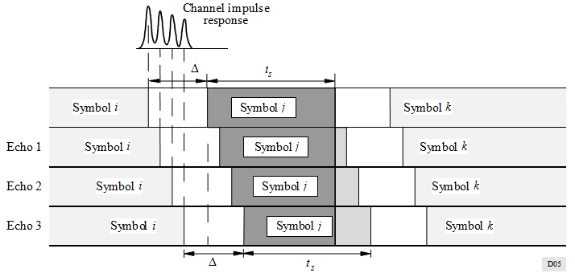
      EFFECT OF ECHOES WITH MEDIUM EXCESS DELAY (2)
Inter-symbol interference resulting from channel multipath
  Constructive contribution of echoes
Slide 57

Slide 58
      EFFECT OF ECHOES WITH SMALL EXCESS DELAY
Short echoes are produced by the RF signal being reflected by structures close to the receiver or the transmitter.
  Because of the small excess distance traveled, the reflected signal may approach the power of the direct signal if the nearby surface is very reflective for RF signals.
  As an example, a 0.3 μsec echo would be produced by a 90m extra length on the reflected path. This could be produced by a reflector located as close as 45 m from the receiver.
These short echoes tend to create flat fading at the receiver, depending on the channel bandwidth.
  If flat fading is experienced over the whole channel bandwidth, then one has to resort to antenna diversity to recover the signal.
Fortunately, the occurrence of such short echoes seems to be less than that for echoes with medium excess delay in the case where outside antennas with some directivity are used.
→ This type of echoes will be a dominant type for our models. So this type should be considered with more emphasis.
Slide 58

Slide 59
      EFFECT OF PRE-ECHOES
It is possible that the main signal is received at a lower power level than the reflected signals.
  In such a case, the receiver will have to work in presence of pre-echoes and still synchronize, and either equalize it or discard it.
  Because of the geometry involved in these signal reflection, attenuation and blockage, the extend of such pre-echoes is typically less than the post-echoes but they should not be neglected.
  A typical range for these pre-echoes is typically found to be around [5 μsec].
This type of echoes should be reviewed later after taking the practical measurement, but may not be important for our models.
Three types of echoes need to be considered if thinking of the reviews so far done
  Echoes with medium excess delay
  Echoes with small excess delay: most important
  Pre-echoes
Slide 59

Slide 60
      FREE SPACE THEORETICAL MULTIPATH MODEL (1)
In order to establish the worst channel multipath situation possible to bound the phenomenon, a theoretical model was developed where free-space propagation was assumed on any direct and indirect transmission paths.
For a given distance between a transmitter and a receiver, the effect of reflectors located at regular azimuth and distance intervals around the receiver and assumed to be oriented to reflect the signal from the transmitter toward the receiver were simulated for the generation of multipath signals at the receiver.
  The relationship between the level of each echo and its excess delay could then be established by this sampling mechanism.
Because of the fact that the line of sight signal and any close-in echoes may be faded at the receiver, this simple downward trend would not apply all the time and pre-echoes will tend to come up since the receiver will tend to synchronize on the strongest signal which may be at some specific excess delay (relative to the line-of-sight signal).
  The receiver synchronization within, and not only at the beginning of, the echo spread channel response needs to be considered in developing the multipath profiles to be used to test the various TG4m technologies to be proposed.
Slide 60

Slide 61
      FREE SPACE THEORETICAL MULTIPATH MODEL (2)
Figure: Multipath scatter plot for omni-directional receive antenna and 10 km separation between transmitter and receiver
Distance between RX antenna and reflector
Slide 61

Slide 62
      FREE SPACE THEORETICAL MULTIPATH MODEL (3)
Figure: Multipath scatter plot for directional receive antenna and 10 km separation between transmitter and receiver
Distance between RX antenna and reflector
Slide 62

Slide 63
      FREE SPACE THEORETICAL MULTIPATH MODEL (4)
Figure: Maximum multipath trends for various separation distances between the transmitter and the receiver
Slide 63

Slide 64
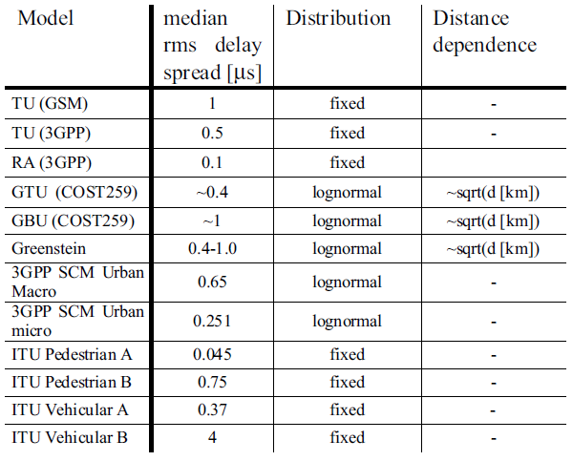
      FREE SPACE THEORETICAL MULTIPATH MODEL (4)
Delay spread characteristics of some commonly used channel models
Henrik Asplund, Kjell Larsson and Peter Okvist, How typical is the "Typical Urban" channel model? - Mobile-based Delay Spread and Orthogonality Measurements
Slide 64

Slide 65
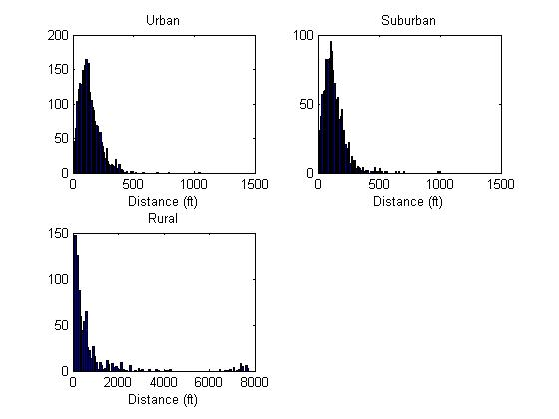
      RESULTS OF MULTIPATH FIELD MEASUREMENTS FROM 15.4g (1)
Link distance distribution
15-09-0279-01-004g-channel-characterization-for-sun
Slide 65

Slide 66
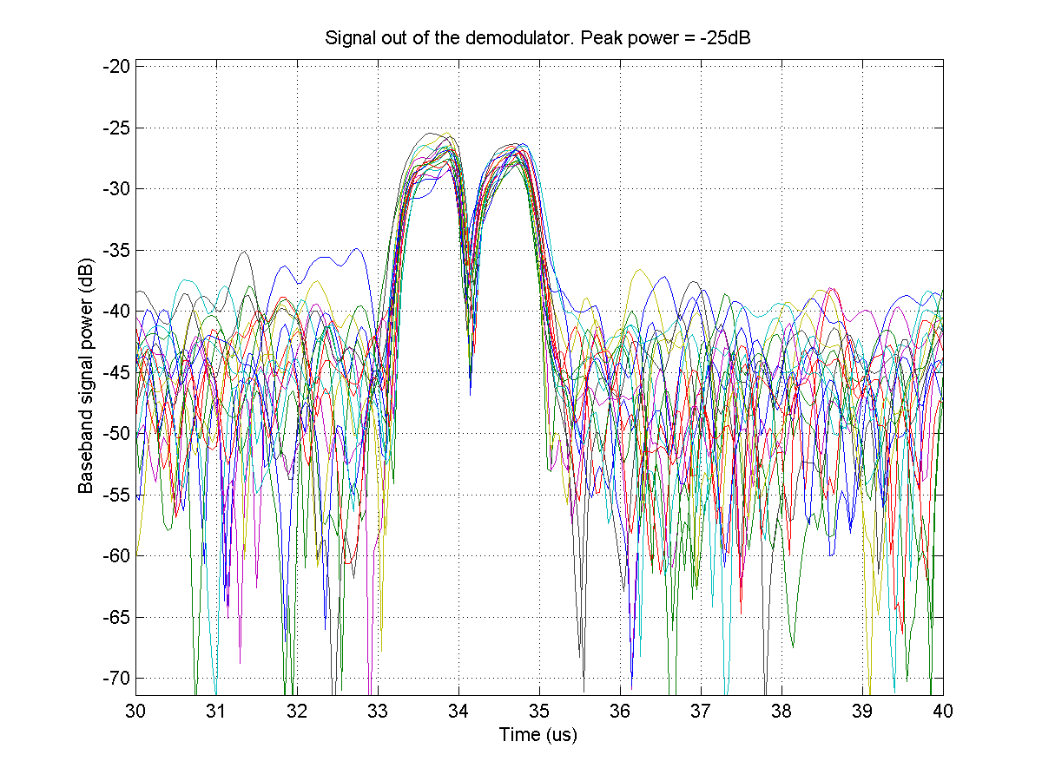
      RESULTS OF MULTIPATH FIELD MEASUREMENTS FROM 15.4g (2)
Many channels measured have some degree of dispersion between 1 and 2us for these relatively short distances.
  Rapid fading appears to be absent on all but a few measurements as expected.
It seems reasonable to model a channel characterizing this urban environment by a simple two path pseudo-static model.
  Each path gain is chosen from different Rayleigh distributions and held constant for the time that the channel is used.
This method allows average performance to be evaluated for a population of receivers in an area, or for a receiver used in a frequency hopping scenario. [*]
15-09-0279-01-004g-channel-characterization-for-sun
[*] Performance modeling for Smart Grid radios in Geographically Stationary and Frequency Hopping environments. Steve Shearer April 2009
Slide 66

Slide 67
      RESULTS OF MULTIPATH FIELD MEASUREMENTS FROM 15.4g (3)
Results from another reference *
  “The results of multipath power delay profile measurements of 900-MHz mobile radio channels in Washington, DC, Greenbelt, MD, Oakland, CA, and San Francisco, CA, are presented. The measurements have focused on acquiring worst case profiles for typical operating locations. The data reveal that
    at over 98% of the measured locations, rms delay spreads are less than 12 us.
    Urban areas typically have rms delay spreads on the order of 2-3 us and continuous multipath power out to excess delays of 5 us.
    In hilly residential areas and in open areas within a city, root mean square (rms) delay spreads are slightly larger, typically having values of 5-7 us.
    In very rare instances, reflections from city skylines and mountains can cause rms delay spreads in excess of 20 us. The worst case profiles show resolvable diffuse multipath components at excess delays of 100 us and amplitudes 18 dB below that of the first arriving signal.”
* 900 MHz multipath propagation measurements for US digital cellular radiotelephone (Rappaport, T.S.; Seidel, S.Y.; Singh, R.). Global Telecommunications Conference, 1989, and Exhibition. Communications Technology for the 1990s and Beyond. GLOBECOM’89., IEEE
15-09-0279-01-004g-channel-characterization-for-sun
Slide 67

Slide 68
      RESULTS OF MULTIPATH FIELD MEASUREMENTS FROM 15.4g (4)
Conclusions from 15-09-0279-01
  Signal delay spread in urban environment can reach 1us to 2us, even in line of sight and short distance conditions (100 to 150 meters).
  A 2-path Rayleigh model is applicable in many cases.
  Fast time fading due to moving objects appears to have a minimal impact.
  Measurements are compatible with results published in another reference.*
  Considering these test results and the results publish in this reference, it is clear that, while many links will have no multipath, another significant percentage of the links will have multipath with a delay spread between 1us and 5us.
* 900 MHz multipath propagation measurements for US digital cellular radiotelephone (Rappaport, T.S.; Seidel, S.Y.; Singh, R.). Global Telecommunications Conference, 1989, and Exhibition. Communications Technology for the 1990s and Beyond. GLOBECOM’89., IEEE
15-09-0279-01-004g-channel-characterization-for-sun
Slide 68

Slide 69
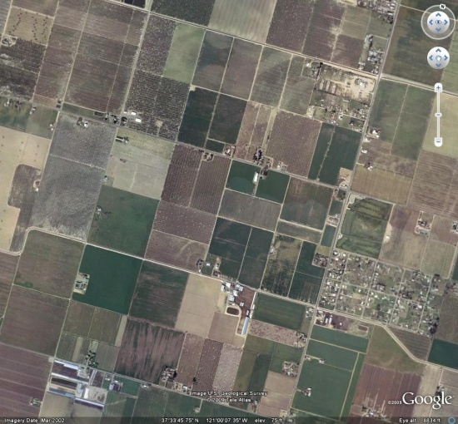
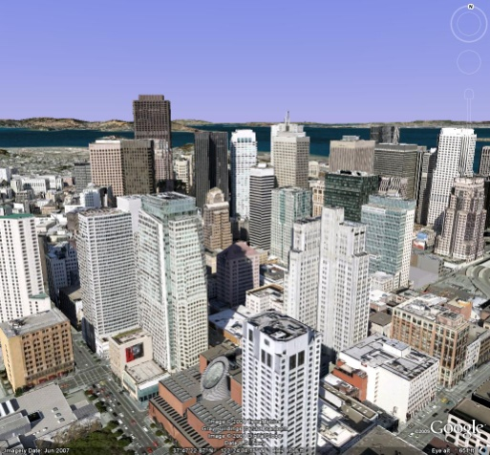
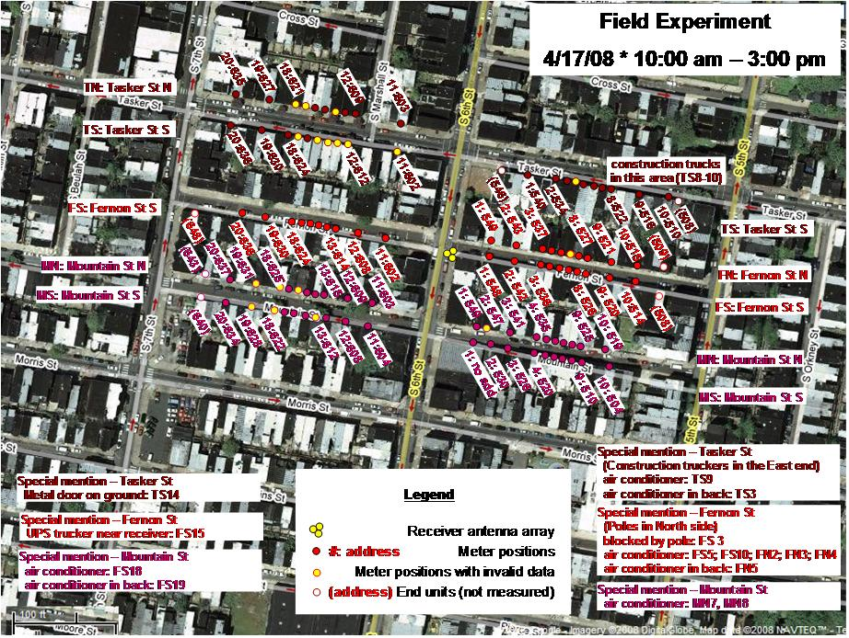
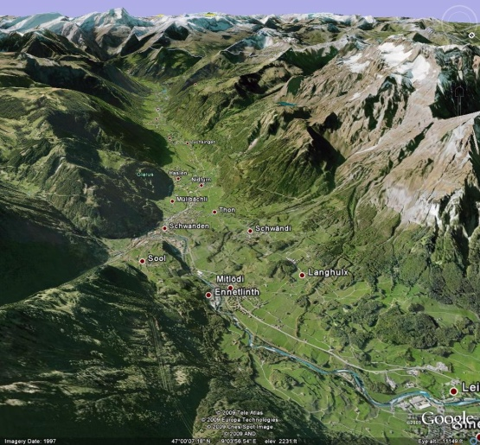
      RESULTS OF MULTIPATH FIELD MEASUREMENTS FROM 15.4g (5)
Does a 15.4g Channel have multipath?
Channel Models taken from ETSI ETSI EN 300 392-2 V3.2.1 (2007-09)
Propagation Model | Tap Number | Relative delay (us) | Average relative power (dB)
Rural Area (Rax) | 1 | 0 | 0
Typical Urban (Tux) | 1 | 0 | 0
 | 2 | 5 | -22.3
Bad Urban (Bux) | 1 | 0 | 0
 | 2 | 5 | -3
Hilly Terrain (HTx) | 1 | 0 | 0
 | 2 | 15 | -8.6
15-09-0279-01-004g-channel-characterization-for-sun
Slide 69

Slide 70
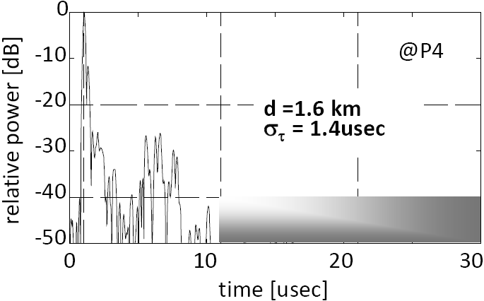
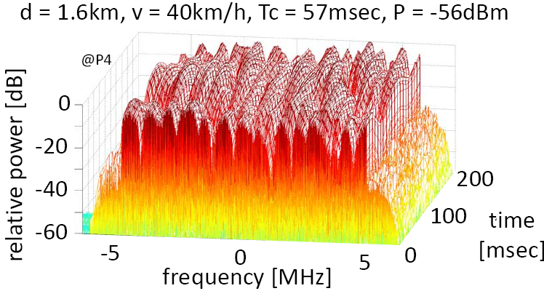
      RESULTS OF MULTIPATH FIELD MEASUREMENTS FROM 11af
Measurement results performed in a small city in Japan at 190 MHz (outdoor) from 11-10-0154-01
11-10-0154-01-00af-channel-model-considerations-for-p802-11af
Slide 70

Slide 71
ANTENNA DIRECTIVITY GAIN DEGRADATION
When the center of the antenna beam is oriented towards the impinging direct signal, the gain degradation concerns only the power in the indirect signal parts.
, τ ≥ 0.
where, μ_{D} represents the antenna directivity gain degradation factor in dB.
The model of this degradation was proposed for μ_{D} based on measurements in the 1.9 GHz band in suburban downlinks:
  The gain degradations have actually turned out to depend on the half-power-beamwidth β_{T} of the terminal station antenna and on the season I_{S} (I_{S} = +1 for winter, I_{S} = -1 for summer), while being relatively independent of d.
  For a 60 degree antenna beamwidth for instance, 2.5 dB and 1.9 dB reductions result for winter and summer, respectively, whereas for a 17 degree antenna the degradations are 6.4 dB and 5.1 dB, respectively.
  The model is formulated for β_{T} between 17˚ and 65˚, while extrapolations below 17˚ and beyond 65˚ are plausible. The above formula is adopted as the general model for lower frequency bands.
With an assumption that the terminal receivers uses omni-directional antennas, this issue does not need to be considered. Actually with directional antennas, delay spread decreases.
Slide 71

Slide 72
A Practical Multipath Model
1. Various Multipath Models
2. Multipath Profiles, 802.15.4m TGD Draft
Slide 72

Slide 73
      VARIOUS MULTIPATH PROFILES
      802.15.4g (1)
Channel Models taken from ETSI ETSI EN 300 392-2 V3.2.1 (2007-09)
Propagation Model | Tap Number | Relative delay (us) | Average relative power (dB)
Rural Area (Rax) | 1 | 0 | 0
Typical Urban (Tux) | 1 | 0 | 0
 | 2 | 5 | -22.3
Bad Urban (Bux) | 1 | 0 | 0
 | 2 | 5 | -3
Hilly Terrain (HTx) | 1 | 0 | 0
 | 2 | 15 | -8.6
15-09-0279-01-004g-channel-characterization-for-sun
Slide 73

Slide 74
      VARIOUS MULTIPATH PROFILES
      802.15.4g (2)
Dense City Deployment: typical of dense apartment complexes where dozens of end points might be located in a narrow utility alley or across the street in another alley
Dense City Deployment 100m
Path | Distance of reflector to LOS bore | Path length difference | Multipath delay | Multipath amplitude relative to 1’st path | Fading rate
1 | 0 | 0 | 0 | 0dB | 40mph
2 | 100m | 40m | .13us | 0dB | 40mph
Residential / Industrial: where the end points are either within, or around, the home or business park
Residential / Industrial 500m
Path | Distance of reflector to LOS bore | Path length difference | Multipath delay | Multipath amplitude relative to 1’st path | Fading rate
1 | 0 | 0 | 0 | 0dB | Quasi static
2 | 100m | 40m | .13us | 0dB | Quasi static
3 | 100m | 40m | .13us | -6dB | Equivalent to 75mph
  15-09-0263-01-004g-channel-characteristics-4g
Slide 74

Slide 75
      VARIOUS MULTIPATH PROFILES
      802.15.4g (3)
Medium Range: the link from the meter to a utility pole
Medium Range 2km
Path | Distance of reflector to LOS bore | Path length difference | Multipath delay | Multipath amplitude relative to LOS | Fading rate
1 | 0 | 0 | 0 | 0dB | Quasi static
2 | 400m | 150m | .52us | 0dB | Quasi static
3 | 400m | 150m | .52us | -6dB | Equivalent to 75mph
Long Range: a link from a utility pole to a number of houses in a rural setting
Medium Range LOS 20km
Path | Distance of reflector to LOS bore | Path length difference | Multipath delay | Multipath amplitude relative to LOS | Fading rate
1 | 0 | 0 | 0 | 0dB | Quasi static
2 | 4km | 1.5km | 5us | 0dB | Quasi static
  15-09-0263-01-004g-channel-characteristics-4g
Slide 75

Slide 76
      VARIOUS MULTIPATH PROFILES
      802.11af
Channel models for 802.11af
Indoor Models (IM)
 | Range | LOS/ NLOS | Paths | Max delay (-30 dB) | RMS delay T_rms | Coh. BW (0.5)= 1/(5*T_rms) | Coh. BW (0.9)= 1/(50*T_rms)
IM 1 | < 30 m | Yes | 6 to 12 | 300 ns | 50 ns | 4 MHz | 400 KHz
IM2 | 30 to 100m | Yes | 12 to 20 | 1 us | 100 ns | 2 MHz | 200 KHz
Outdoor Models (OM)
 | Range | LOS/ NLOS | Paths | Max delay (-30 dB) | RMS delay T_rms | Coh. BW (0.5)= 1/(5*T_rms) | Coh. BW (0.9) = 1/(50*T_rms)
OM 1 | < 500 m | - | 2 to 4 | 2 us | 0.4 us | 500 KHz | 50 KHz
OM 2 | 0.5 to 2 KM | - | 3 to 6 | 6 us | 1 us | 200 KHz | 20 KHz
OM 3 | 2 to 5 KM | - | 3 to 6 | 10 us | 3 us | 67 KHz | 6.7 KHz
11-10-0154-01-00af-channel-model-considerations-for-p802-11af
Slide 76

Slide 77
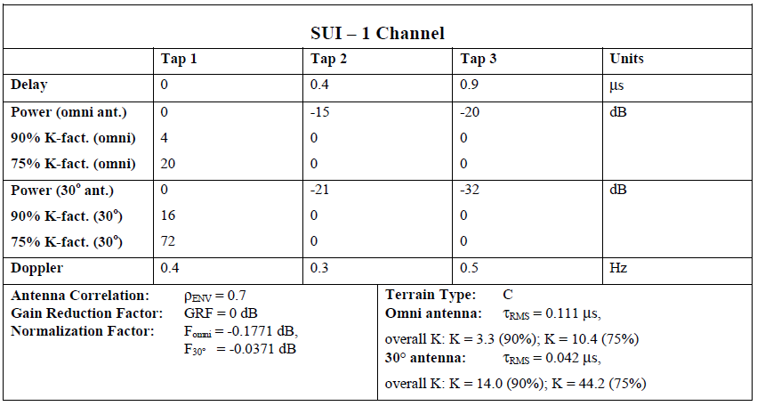
      VARIOUS MULTIPATH PROFILES
      802.16 (1)
Minimum path loss category: mostly flat terrain with light tree densities
IEEE 802.16.3c-01/29r4, Channel Models for Fixed Wireless Applications, 2001-07-17
Slide 77

Slide 78
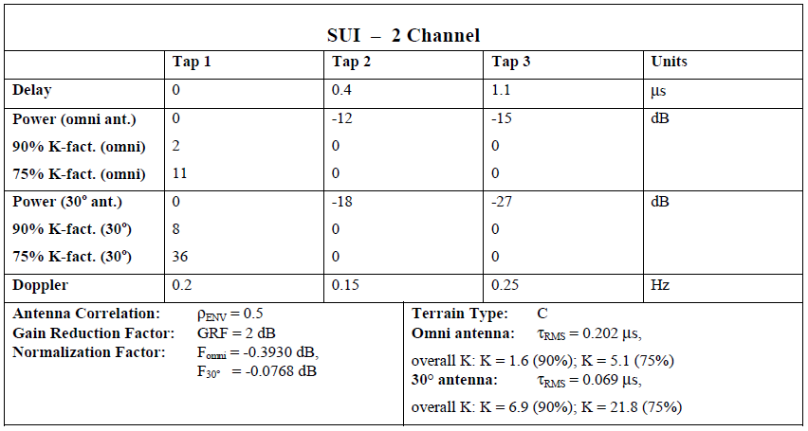
      VARIOUS MULTIPATH PROFILES
      802.16 (2)
Minimum path loss category: mostly flat terrain with light tree densities
IEEE 802.16.3c-01/29r4, Channel Models for Fixed Wireless Applications, 2001-07-17
Slide 78

Slide 79
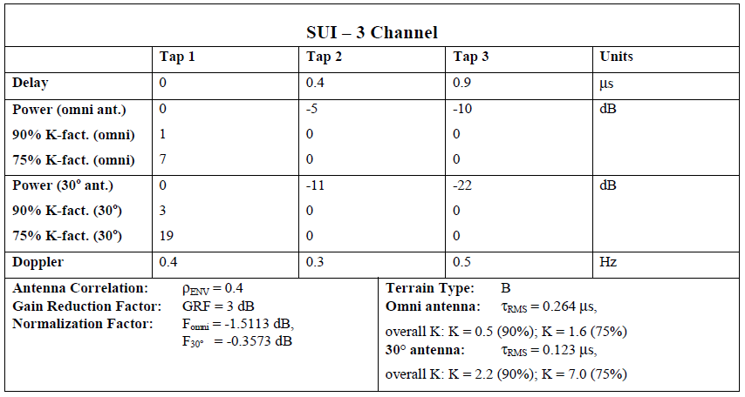
      VARIOUS MULTIPATH PROFILES
      802.16 (3)
Intermediate path loss category
IEEE 802.16.3c-01/29r4, Channel Models for Fixed Wireless Applications, 2001-07-17
Slide 79

Slide 80
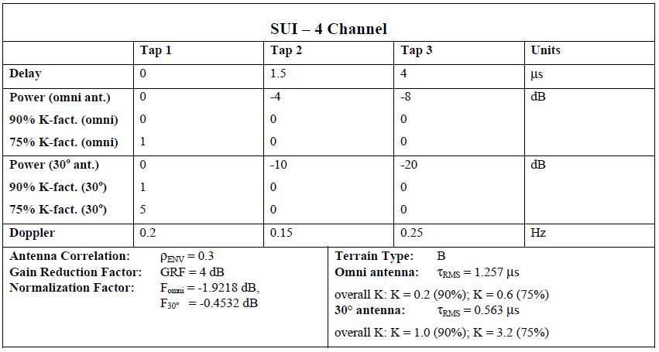
      VARIOUS MULTIPATH PROFILES
      802.16 (4)
Intermediate path loss category
IEEE 802.16.3c-01/29r4, Channel Models for Fixed Wireless Applications, 2001-07-17
Slide 80

Slide 81
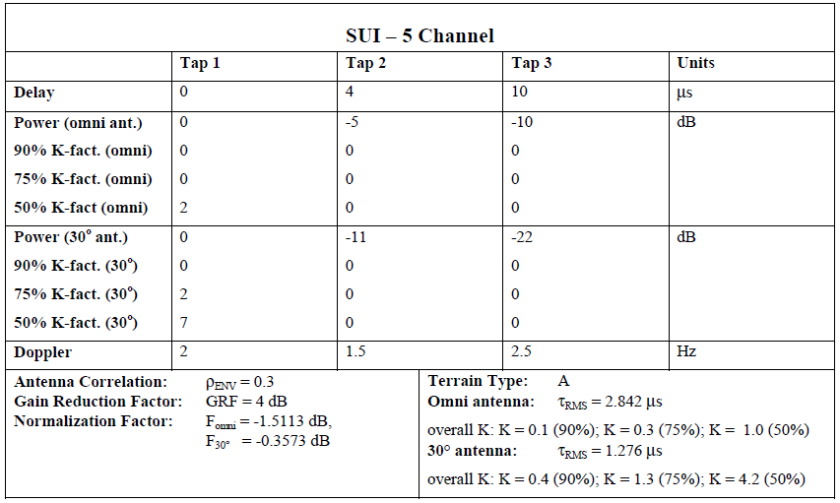
      VARIOUS MULTIPATH PROFILES
      802.16 (5)
Maximum path loss category: Hilly terrain with moderate-to-heavy tree densities
IEEE 802.16.3c-01/29r4, Channel Models for Fixed Wireless Applications, 2001-07-17
Slide 81

Slide 82
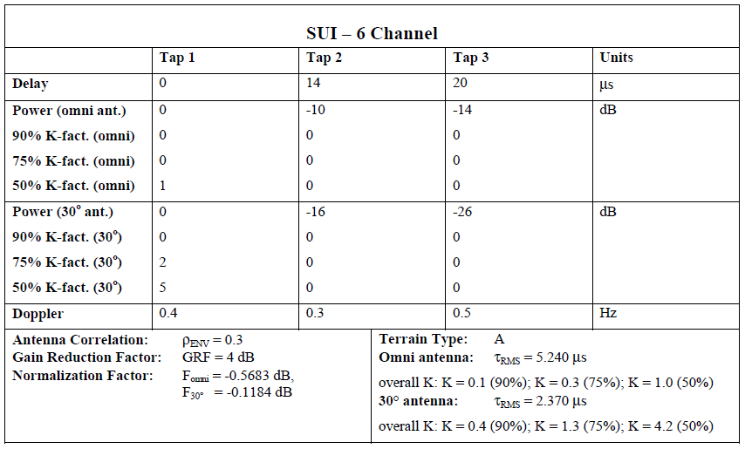
      VARIOUS MULTIPATH PROFILES
      802.16 (6)
Maximum path loss category: Hilly terrain with moderate-to-heavy tree densities
IEEE 802.16.3c-01/29r4, Channel Models for Fixed Wireless Applications, 2001-07-17
Slide 82

Slide 83
      VARIOUS MULTIPATH PROFILES
      802.22 (1)
The following four multipath profiles are provided for testing the proposed WRAN systems using a real-time multipath simulator.
  6 paths can be reproduced by a commonly available hardware channel simulators.
Reference channel multipath profiles for evaluation of 802.15 WRAN technologies
Profile A | Path 1 | Path 2 | Path 3 | Path 4 | Path 5 | Path 6
Excess delay | 0 | 3 μsec | 8 μsec | 11 μsec | 13 μsec | 21 μsec
Relative amplitude | 0 | -7 dB | -15 dB | -22 dB | -24 dB | -19 dB
Doppler frequency | 0 | 0.10 Hz | 2.5 Hz | 0.13 Hz | 0.17 Hz | 0.37 Hz
Profile B | Path 1 | Path 2 | Path 3 | Path 4 | Path 5 | Path 6
Excess delay | -3 μsec | 0 | 2 μsec | 4 μsec | 7 μsec | 11 μsec
Relative amplitude | -6 dB | 0 | -7 dB | -22 dB | -16 dB | -20 dB
Doppler frequency | 0.1 Hz | 0 | 0.13 Hz | 2.5 Hz | 0.17 Hz | 0.37 Hz
Profile C | Path 1 | Path 2 | Path 3 | Path 4 | Path 5 | Path 6
Excess delay | -2 μsec | 0 | 5 μsec | 16 μsec | 24 μsec | 33 μsec
Relative amplitude | -9 dB | 0 | -19 dB | -14 dB | -24 dB | -16 dB
Doppler frequency | 0.13 Hz | 0 | 0.17 Hz | 2.5 Hz | 0.23 Hz | 0.10 Hz
Profile D | Path 1 | Path 2 | Path 3 | Path 4 | Path 5 | Path 6
Excess delay | -2 μsec | 0 | 5 μsec | 16 μsec | 22 μsec | 0 to 60 μsec
Relative amplitude | -10 dB | 0 | -22 dB | -18 dB | -21 dB | -30 to +10 dB
Doppler frequency | 0.23 Hz | 0 | 0.1 Hz | 2.5 Hz | 0.17 Hz | 0.13 Hz
22-05-0055-07-0000-wran-channel-modeling
Slide 83

Slide 84
      VARIOUS MULTIPATH PROFILES
      802.22 (2)
22-05-0055-07-0000-wran-channel-modeling
Slide 84

Slide 85
      VARIOUS MULTIPATH PROFILES
      802.22 (3)
22-05-0055-07-0000-wran-channel-modeling
Slide 85

Slide 86
      VARIOUS MULTIPATH PROFILES
      802.22 (4)
22-05-0055-07-0000-wran-channel-modeling
Slide 86

Slide 87
      VARIOUS MULTIPATH PROFILES
      802.22 (5)
22-05-0055-07-0000-wran-channel-modeling
Slide 87

Slide 88
      VARIOUS MULTIPATH PROFILES
      COST 207 MODELS (1)
COST 207 Reference Models
The main reference is the work done in Europe as part of the development of the GSM mobile radio system in the UHF range.
Although this work was done for mobile communication, some useful information could be extracted for fixed point-to-point operation by considering the somewhat limited directivity of the user terminal antennas (typically 60º in low UHF).
Four mobile channel models, each representative of a different geographical environment, developed by the COST 207 committee on Digital Land Mobile Radio Communications.
Urban, non-hilly: | exp(-t/1us)
Rural, non-hilly: | exp(-9.2 t/1us)
Bad urban, hilly: | exp(-t/1us) 0.5 exp(5-t/1us) | for 0 < t < 5us for 5 < t < 10us
Hilly: | exp(-3.5 t/1us) 0.1 exp(15-t/1us) | for 0 < t < 2us for 15 < t < 20us
http://www.wirelesscommunication.nl/reference/chaptr03/fading/delayspr.htm
Slide 88

Slide 89
      VARIOUS MULTIPATH PROFILES
      COST 207 MODELS (2)
Figure: Multipath Power Delay Profile For Rural Areas
Figure: Multipath power delay profile for urban areas
Slide 89

Slide 90
      VARIOUS MULTIPATH PROFILES
      COST 207 MODELS (3)
Figure: Multipath Power Delay Profile For Typical Hilly Terrain
Figure: Multipath Power Delay Profile For Bad Case Hilly Terrain
Slide 90

Slide 91
      VARIOUS MULTIPATH PROFILES
      COST 207 MODELS (4)
Typical urban reception (TU6)
COST 207 describes typical channel characteristics for over transmit bandwidths of 10 to 20 MHz around 900MHz for GSM.
TU-6 models the terrestrial propagation in an urban area.
COST 207 profiles were adapted to mobile DVB-T reception in the E.U. Motivate project.
  Tap number Delay (us) Power (dB) Fading model
  1 0.0 -3 Rayleigh
  2 0.2 0 Rayleigh
  3 0.5 -2 Rayleigh
  4 1.6 -6 Rayleigh
  5 2.3 -8 Rayleigh
  6 5.0 -10 Rayleigh
Properties of the Mobile Radio Propagation Channel, Jean-Paul M.G. Linnartz, Department Head CoSiNe Nat.Lab., Philips Research
Slide 91

Slide 92
      VARIOUS MULTIPATH PROFILES
      COST 207 MODELS (5)
Model for a sample fixed channel
Tap number Delay ( (μs) Amplitude r Level (dB) Phase ( (rad)
1 0.050 0.36 -8.88 -2.875
2 0.479 1 0 0
3 0.621 0.787 -2.09 2.182
4 1.907 0.587 -4.63 -0.460
5 2.764 0.482 -6.34 -2.616
6 3.193 0.451 -6.92 2.863
- Properties of the Mobile Radio Propagation Channel, Jean-Paul M.G. Linnartz, Department Head CoSiNe Nat.Lab., Philips Research
- COST 207 Digital land mobile radio Communications, final report, September 1988.
- European Project AC 318 Motivate: Deliverable 06: Reference Receiver Conditions for Mobile Reception, January 2000
Slide 92

Slide 93
      MULTIPATH PROFILES,
      802.15.4m TGD DRAFT (1)
For indoor scenario (to be included)
 | Path 1 | Path 2 | Path 3 | Path 4 | Path 5 | Path 6
Indoor-B as defined in ITU-R M.1225
Path Delay (us) | 0 | 0.1 | 0.2 | 0.3 | 0.5 | 0.7
Avg PathGain | 0 | -3.6 | -7.2 | -10.8 | -18.0 | -25.2
15-11-0684-04-004m-tg4m-technical-guidance-document
Slide 93

Slide 94
      MULTIPATH PROFILES
      802.15.4m TGD DRAFT (2)
For outdoor scenario
 | Path 1 | Path 2 | Path 3 | Path 4 | Path 5 | Path 6
d=1.5 km Profile A
Path Delay (us) | 0 | 0.7 | 1.2 | 3.2 | 5.5 | 6.8
Avg Path Gain | 0 | -34.9 | -25.9 | -22.7 | -24.8 | -34.6
d=2.7 km Profile B
Path Delay | 0 | 0.9 | 1.7 | 3.1 | 3.8 | 7.5
Avg Path Gain | 0 | -18.2 | -20.6 | -25 | -26.5 | -19.6
d=6.1 km Profile C
Path Delay | 0 | 0.6 | 5.3 | 6.2 | 7.5 | 19.5
Avg Path Gain | 0 | -12.1 | -25.2 | -22.2 | -18.5 | -21.8
COST 207 Profile D
Path Delay | 0 | 0.2 | 0.5 | 1.6 | 2.3 | 5
Avg Path Gain | -3 | 0 | -2 | -6 | -8 | -10
15-11-0684-04-004m-tg4m-technical-guidance-document
Slide 94

Slide 95
Conclusions
Slide 95

Slide 96
CONCLUSION (1)
Path loss model
  As a result of the TG4m transmission channel considerations, for the path loss propagation model to be used for the TG4m channel model, the one described in ITU-R Rec, 1546-1 is better than Hata-Okumura model.
  This ITU-R model is included in the most recently revised Tg4m Technical Guidance Document (TGD), 15-11-0684-04.
Multipath model
  Various multipath models are reviewed including 802.11af, 15.4g, 16.3c and 802.22, and COST 207 models. However a set of models which best fit to TG4m systems can not be suggested. Multipath models based on real measurements needs to be established.
  TG4m system needs to be able to withstand the presence of multipath signals of up to 10 μsec excess delay and 2 μsec pre-echoes.
  The minimum bandwidth considered to minimize the effect of flat fading should be figured out.
Slide 96

Slide 97
CONCLUSION (2)
The parameters of the TG4m channel and their respective values and ranges of values
Parameter | Values/range
Transmitter-receiver separation (d) | A few metres up to several kilometres
Radio frequency (f) | VHF/UHF TV frequency bands
Control station antenna gain (G_{B}) | Needs to be specified
Customer premise equipment (or terminal equipment) antenna gain (G_{T}) | Needs to be specified
Customer premise equipment (or terminal equipment) antenna half power beamwidth (β_{T}) | Typically omni-directional
Propagation conditions | LOS, NLOS
Environment type | Urban, suburban, rural, large and small/medium cities;
Control station height h_{T} | 30–100 m
Terminal unit antenna height h_{B} | 10 m
Multipath profiles | Needs to be specified
Seasons of operation | All seasons
Slide 97

Slide 98
References
Slide 98

Slide 99
REFERENCES (1)
[1] “Fixed wireless routes for internet access”, IEEE Spectrum, September 1999.
[2] T. S. Rappaport, “Wireless communications”, Prentice-Hall, 1996.
[3] P. Karlsson, N. Löwendahl, J. Jordana, “Narrowband and wideband propagation measurements and models in the 27-29 GHz band”, COST 259 TD(98)17, COST 259 Workshop, Berne, Switzerland, February 1998.
[4] T.-S. Chu, L. J. Greenstein, “A Quantification of Link Budget Differences Between the Cellular and PCS Bands”, IEEE Trans. Veh. Tech., vol.48, no. 1, January 1998.
[5] A. Bohdanowicz et al., “Wideband Indoor and Outdoor Channel Measurements at 17 GHz”, VTC 1999.
[6] M. Mitsuhiko et al., “Measurement of Spatiotemporal Propagation Characteristics in Urban Microcellular Environment”, VTC 1999.
[7] V. Erceg et al., “A Model for the Multipath Delay Profile of Fixed Wireless Channels”, IEEE JSAC, vol. 17, no. 3, March 1999.
[8] D. Falconer, “Multipath Measurements and Modelling for Fixed Broadband Wireless Systems in a Residential Environment”, IEEE 802.16.1pc-00/01, IEEE 802.16 Broadband Wireless Access Working Group, 21/12/1999.
[9] P. Karlsson et al., “Outdoor Spatio-Temporal Propagation Measurements for Evaluation of Smart Antennas”, 3TRS091A.doc, ETSI EP BRAN #9, July 1998.
[10] AC085 – The Magic WAND, “Deliverable 2D8: Evaluation of the WAND System for Outdoor Point-to-Multipoint Configurations”, Aug. 1998.
Slide 99

Slide 100
REFERENCES (2)
[11] AC085 – The Magic WAND, “Deliverable 2D9: Results of outdoor measurements and experiments for the WAND system at 5 GHz”, Dec. 1998.
[12] N. Patwari, G. D. Durgin, T. S. Rappaport, R. J. Boyle, “Peer-to-peer low antenna outdoor radio wave propagation at 1.8 GHz” Proc. of the IEEE Vehicular Technology Conference (VTC '99 Spring), Houston, TX, vol. I, pp. 371-375, May 1999.
[13] M. Pettersen, P. H. Lehne, J. Noll, O. Rostbakken, E. Antonsen, R. Eckhoff, “Characterisation of the directional wideband radio channel in urban and suburban areas”, Proc. of the IEEE Vehicular Technology Conference (VTC '99 Fall), Amsterdam, The Netherlands, vol. I, pp. 1454-1459, September 1999.
[14] A. Plattner, N. Prediger, W. Herzig, “Indoor and outdoor propagation measurements at 5 and 60 GHz for radio LAN applications”, IEEE MTT-S International Microwave Symposium Digest, vol. 2, pp. 853-856, 1993.
[15] M. P. M. Hall, L. W. Barclay, M. T. Hewitt, “Propagation of Radiowaves”, The Institution of Electrical Engineers, London, UK, 1996.
[16] S. R. Saunders, “Antennas and Propagation for Wireless Communication Systems”, John Wiley & Sons, Chichester, UK, 1999.
[17] L. J. Greenstein, V. Erceg, Y. S. Yeh, M. V. Clark, “A New Path-Gain/Delay-Spread propagation model for Digital Cellular Channels”, IEEE Trans. Veh. Tech., vol. 48, no. 2, May 1997.
[18] L. J. Greenstein, V. Erceg, “Gain Reductions Due to Scatter on Wireless Paths with Directional Antennas”, IEEE Comm. Letters, vol. 3, no. 6, June 1999.
[19] ITT, “Reference Data for Radio Engineers”, Sixth Edition, 1975. Howard W. Sams and Co., Indianapolis.
Slide 100

Slide 101
REFERENCES (3)
[20] J. Rutman, “Characterization of phase and frequency instabilities in precision frequency sources: Fifteen years of progress”, IEEE Proc., vol. 66, no. 9, pp. 1048-1076, Sep. 1978.
[21] T. H. Lee, A Hajimiri, “Oscillator Phase Noise: A Tutorial”, IEEE J. Solid-State Circuits, vol. 35, no. 3, pp. 326-336, Mar. 2000.
[22] A. Demir, A. Mehrotra, and J. Roychowdhury, “Phase noise in oscillators: A unifying theory and numerical methods for characterization”, IEEE Trans. on Circuits and Systems-I, vol. 47, no. 5, pp. 655-674, May 2000.
[23] L. Tomba, “On the effect of wiener phase noise in OFDM systems”, IEEE Trans. Commun., vol. 46, pp. 580–583, May 1998.
[24] T. Pollet, M. van Bladel, and M. Moeneclaey, “BER sensitivity of OFDM systems to carrier frequency offset and Wiener phase noise”, IEEE Trans. Commun., vol. 43, pp. 191–193, Feb./March./April 1995.
[25] G. Foschini, “Characterizing filtered light waves corrupted by phase noise”, IEEE Trans. Inform. Theory, vol. 34, Nov. 1988.
[26] I. T. Monroy and G. Hooghiemstra, “On a recursive formula for the moments of phase noise”, IEEE Trans Commum., vol. 48, no. 6, June 2000.
[27] WRAN_2crln006a.doc, “Effects of Climate on WRAN system performance”, WRAN
Design note, Aug. 2000.
[28] R.L. Freeman, “Telecommunication Transmission Handbook”, New York: J. Wiley & Sons,
1991.
Slide 101

Slide 102
REFERENCES (4)
[29] H. Xu, T. Rappaport et al, “Measurements and Models for 38-GHz Point-to-Multipoint
Radiowave Propagation”, IEEE J. Selected Areas Commun., SAC-18, No. 3, March 2000, pp.
310-321.
[30] IEEE802.16.1.pc-00/12r1, “Multipath Measurements and Modeling for Fixed Broadband
Point-to-Multipoint Radiowave Propagation Links under different Weather Conditions”,
Contribution in IEEE 802.16.1, 25-02-2000.
[31] T. Pratt, C.H. Bostan, “Satellite Communications”, New York: J.Wiley, 1986.
[32] H. Masui et al, “Difference of Path Loss Characteristics due to Mobile Antenna Heights in
Microwave Urban Propagation”, IEICE Trans. Fundamentals, Vol. E82-A, No. 7, July 1999,
pp. 1144-1150.
[33] G. Durgin, T. Rappaport and H. Xu, “Measurements and Models for Radio Path Loss and
Penetration Loss In and Around Homes and Trees at 5.85 GHz”, IEEE Trans. on Commun.,
COM-46, No. 11, Nov. 1998, pp. 1484-1496.
[34] COST 207 Report, Digital land mobile radio communications, Commission of European Communities, Directorate General, Telecommunications, Information Industries and Innovation, Luxembourg, 1989
[35] Culver, R., Final Report of the Channel Characterization Task Group: The Derivation and Rationale for Multipath Simulation Parameters for the EIA-DAR Laboratory Testing, prepared for the EIA DAR Subcommittee, July 1995.– EBU Technical review – Septembre 2001
Slide 102

Slide 103
REFERENCES (5)
[36] Kahwa, T. and McLarnon, B., Channel characterization and modeling for digital radio, 2nd International Symposium on Digital Audio Broadcasting, Toronto, 1994.
[37] Lee, W.C.Y., Mobile Communications Engineering. New York: McGraw-Hill, 1982, p.43.
[38] Springer, K., Multipath propagation and fading statistics for digital audio broadcasting in the VHF and UHF bands, NAB Broadcast Engineering Conference Proceedings, 1993.
[39] McLarnon, B., Further results on the characterization of VHF broadcast channels, October 1995 (report tabled at an EIA DAR Subcommittee meeting).
[40] R. Voyer and R. Paiement, The Field Strength Variability of a 1.5 MHz Wide Signal at 1.5 GHz. Document submitted to the CCIR WP 10B (doc. 10B/85), Geneva (Switzerland), October 1993.
[41] ADAMAS IST Project- Channel Modeling (Public Deliverable)
[42] Evaluation of a DVB-T compliant digital terrestrial television system – IBC 97 publication
[43] The echo performance of DVB-T receivers – EBU Technical review – Septembre 2001
[44] 15-09-0279-01-004g-channel-characterization-for-sun
[45] 22-05-0055-07-0000-wran-channel-modeling
Slide 103

