Slide 1
Project: IEEE P802.15 Working Group for Wireless Personal Area Networks (WPANs)
Submission Title: [Investigation Report from CWPAN-MBAN Group ]
Date Submitted: [Jan. 10, 2012]
Source: [Liang Li, Nin Li, Zhu Lan] Company [Vinno, BPUT,CESI]
Address [Room 402 Building D, Shangdi Xinxi Lu No.2 Pioneering Park, Haidian District, Beijing, China 100085]
Voice:[8610-82782373], FAX: [8610-82893004], E-Mail:[liangli@vinnotech.com]
[If this is a response to a Call for Contributions, cite the name and date of the Call for Contributions to which this document responds, as well as the relevant item number in the Call for Contributions.]
[Note: Contributions that are not responsive to this section of the template, and contributions which do
not address the topic under which they are submitted, may be refused or consigned to the “General Contributions” area.]
Abstract: [Summary of CWPAN-MNA Standard Group]
Purpose: Discussion on SG-CMBAN
Notice: This document has been to assist the IEEE P802.15. It is offered as a basis for discussion and is not binding on the contributing individual(s) or organization(s). The material in this document is subject to change in form and content after further study. The contributor(s) reserve(s) the right to add, amend or withdraw material contained herein.
Release: The contributor acknowledges and accepts that this contribution becomes the property of IEEE and may be made publicly available by P802.15.

Slide 2
CWPAN-MBAN Actives
CWPAN SG6 (MBAN) opens the first meeting and collects a serial of possible Medical Networking applications on Medical Frequency Bands.
CAPAN SG6 discussed the PAR and prepared an application to formal Task Group
CWPAN does a serial of investigations:
  Stages of Chinese medical IOT standards
  Current mutual applications on approved medical frequency bands

Slide 3
Medical (WSN) Standard Development Stage
China Ministry of Health (Dept of Info Tech) is developing national IOT medical application plots
National Wireless Sensor Std committee sets up one Health IOT Std group. The group focus on
  Spec for health data merging and analysis.
  Spec of medical data sensor and collection
Current, No NATIONAL MBAN STANDARS and no std group for spec of wireless medical data communication networking

Slide 4
Some Applications on Frequency Band: 402-425MHz
In China, 400Mhz band is also approved for Walk-Talk Radios:
  Application on Radio Station. Pmax < 30w
  Application on mobile: Pmax <25W
  Application on handset; Pmax < 5W
In China, public Walk-Talk operates on 409.75-409.9875MHz. Total 20 channels, Pmax < 0.5W.

Slide 5
Medical Devices on MedRadio Frequency Band:
Some medical devices on MedRadio Frequency bands have been applied.
Frequency Bands:
  Medical Devices:
    Implanted Medical Devices
    Worn on Body Medical Devices.

Slide 6
Applications on Frequency Band: 605-630MHz
In China, 600Mhz band is major occupied by UHF TV :

Slide 7
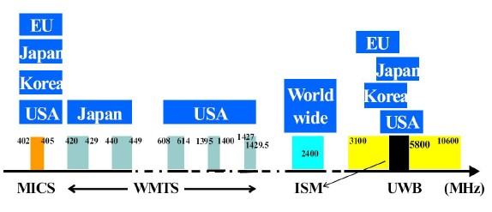
IEEE802.15.6 Supporting Possible Bands

