Slide 1
Project: IEEE P802.15 Working Group for Wireless Personal Area Networks (WPANs)
Submission Title: [PAC Introduction]
Date Submitted: [05 January 2012]
Source: Myung-Jong Lee⁷
Company [Samsung Electronics ]¹, [ETRI]², [LG]³, [Huawei]⁴, [NICT]⁵, [CSEM]⁶ , [CUNY]⁷
Address [] Voice:[], FAX: [],
E-Mail:[shannon.park@samsung.com]¹, [ ]², [ ]³, [ ]⁴, [ ]⁵, [ ]⁶, [mjlee999@gmail.com]⁷
Re: [.]
Abstract: [Introduction for Peer Aware Communication (PAC) to support local and dynamic traffic service nearby a user and expected market potential]
Purpose: [To show use cases and market potential and to clarify the scope of PAR & 5C]
Notice: This document has been prepared to assist the IEEE P802.15. It is offered as a basis for discussion and is not binding on the contributing individual(s) or organization(s). The material in this document is subject to change in form and content after further study. The contributor(s) reserve(s) the right to add, amend or withdraw material contained herein.
Release: The contributor acknowledges and accepts that this contribution becomes the property of IEEE and may be made publicly available by P802.15.

Slide 2
Introduction to Peer Aware Communications (PAC):
A Study Group of IEEE 802.15 WG

Slide 3
ToC
Introduction
Target Use-cases
Social Networking
Advertisement
Gaming
CE
Emergency
Key Requirements
Key Technical Features
Infrastructure-less peer-aware communication
Fully distributed coordination
Summary
Why a new TG?

Slide 4
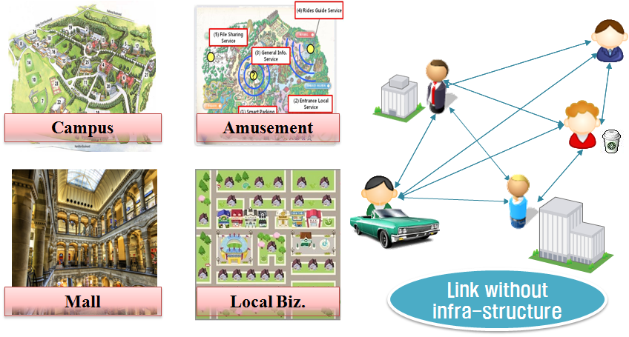
Introduction
Application driven
Primarily to support burgeoning social networking, peer-to-peer applications, and emergency communications for mobile devices
Requirements
Peer awareness in a close proximity
Low signaling overhead
Scalability
Group management
Need for a New TG

Slide 5
Target Use-cases

Slide 6
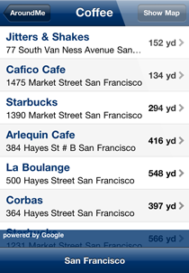
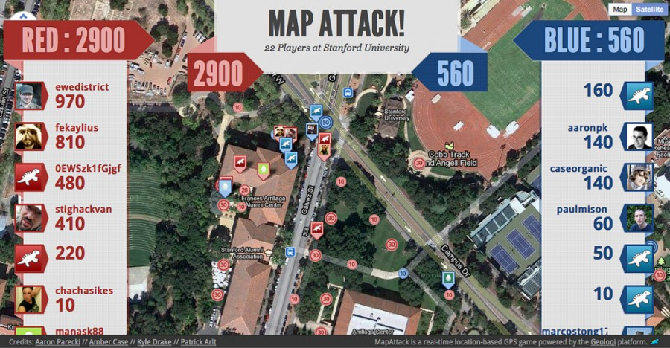
Location-based Service Trend
Geo-social networking
Who’s here
Location-based Game
‘check-in’ game:
over 25 various games from Wikipedia
Location-based Search
Around Me
Map Attack

Slide 7
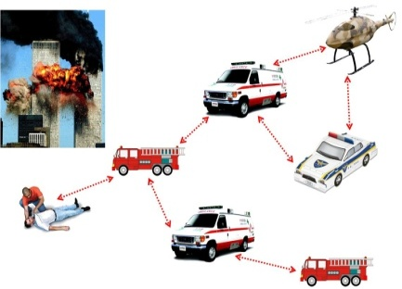
Target Use-cases
Urban/Crowded
SNS, Advertisements, Gaming,
Broadcasting/Multicasting
Service/Contents discovery
Rural/Isolated
SNS, Advertisements
Broadcasting/Multicasting
Public safety
Back-up network at emergency
Social Networking
Gaming
Public Safety
Notes:
The fully distributed network without infrastructure is not only useful for crowded places such as mall, stadium, campus, amusement park etc. but also isolated places not supported by infrastructure. It is also useful for emergency situations such as flooding, earthquake, fire, and etc.

Slide 8
Use-case 1: Social Networking
Geo-social networking
Relevant to situation/context
Local group chatting
Proximal filtering
Avoid too many info from SNS
Proximal search
Suitable for dynamically changing proximal info
Proximal answering engine
Proximal profile matching
Augmented society
Complementing real world
Personal broadcast
By relevant information
Food Truck
Friends
Neighbors
Company

Slide 9
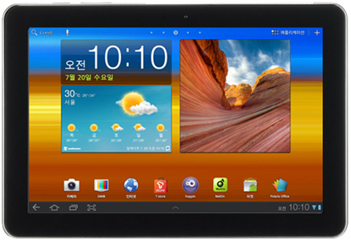
Use-case 2: Advertisements
1
Broadcast Ad for McDonald’s Hamburger
Advertising platform
By user interaction/context
Personalized promotions
Precision marketing
Related services
Advertisements with personalized information (coupon, brochure, mileage, etc)
Product information broadcastings
Experience of sample video or audio clips
Automatic narration/guide
Mobile group buying
Mall navigator
Retailer
2
Receive Ad from near-by shop when hitting the score
John
Ads in Game

Slide 10
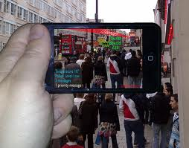
Use-case 3: User-centric Service Platform
PAC link
PAC link
Distributed SW platform
For user-centric applications that should be scalable and efficient
Gaming, streaming, contents distribution
Augmented Reality
Game based on real location + virtual scene, e.g. MyTown
User-centric Game Model
Personal DJ

Slide 11
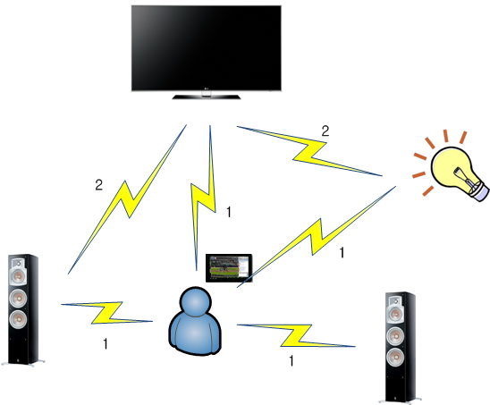
Use-case 4: CE (Consumer Electronics)
Personal environment setup
1. Notify user’s activity to each device and setup it
2. Each device adjust automatically its status and feedback to other devices
Device can automatically establish multi-hop wireless links forwarding data frames

Slide 12
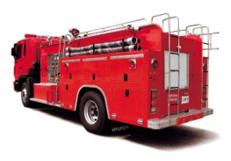
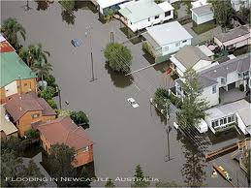
Use-case 5: Alarm & Emergency Service
Accident alarm
Fast notification in near-by area
E.g. car accident alarm
Emergency platform
Robust link to infrastructure or public officer, or among distant peoples
Coverage enhancement
E.g. finding a injury
Hazard sensing
Monitoring hazard syndrome and inform to people in the area
E.g. chemical effusion, air pollution, water contamination
Car Accident Alarm
Public Officer
Finding people
Connecting people

Slide 13
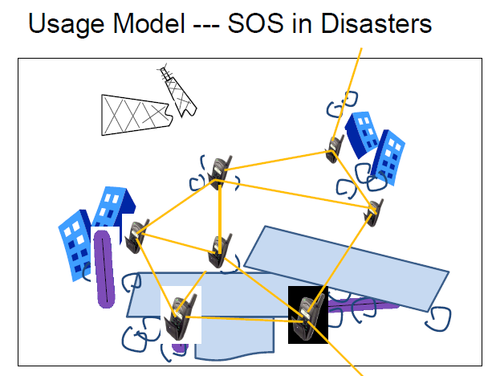
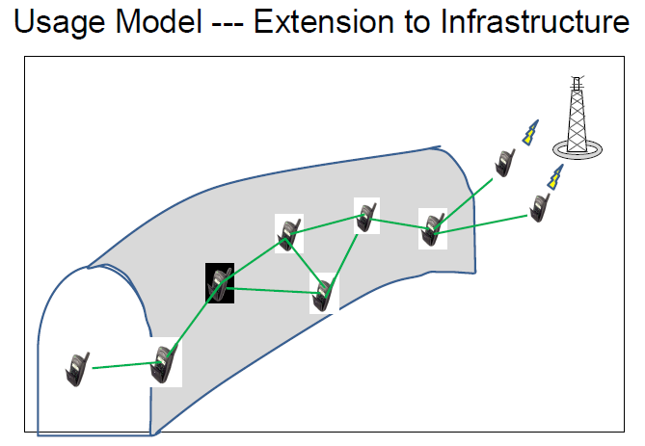

Slide 14
Key Features

Slide 15
Key Features
Optimized design of PHY and MAC to support Target use cases
Peer awareness in a close proximity
Low signaling overhead
Scalability
Low power consumption
Group management
Security
Infrastructure-less peer-aware communication
Peer-to-peer network with fully distributed coordination

Slide 16
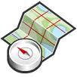
Peer Awareness
Relevant Message
Relevant Location
Relevant Time
Relevant People

Slide 17
Location-based Service
Positioning
attaining the current absolute geographic coordinates
legacy: GPS, Cellular, Base-station
Matching
geo-location matching: determine the location information from the coordinates value
matching my location / matching the location what I want to know
local info in server may not be updated timely
proximity matching
matching the location of someone/something in my proximity

Slide 18
Positioning
Legacy (GPS/A-GPS/Base station)
inaccurate indoor position
need support of operator’s network
local info in server may not be updated timely
high power consumption
→ Not good user experience
Alternative?
relative positioning may be sufficient → especially, for proximal discovery
independent from operator’s network → easy to implement

Slide 19
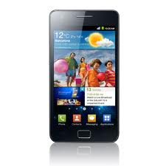
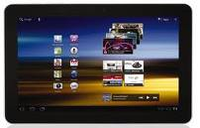
Matching
Server-based geo-location matching is going well
Current proximity matching for mobile devices
built on top of existing physical network infrastructures that focuses on matching among wireless devices in close proximity
Logically same to application
server
Wi-Fi AP
Cellular BS
different proprietary network infrastructures

Slide 20
Limitation of Existing Matching
High control overhead
due to periodic report from Apps and updates from server
sending position value or discovery request from nodes
retrieving matching result from server
frequent update is inevitable due to the device mobility
10s of protocol steps for link setup
Long latency
the communication path between devices is long even though two devices are geographically close in the same segment
Peer-awareness
by direct communication in close proximity

Slide 21
Comparison
 |  | GPS | A-GPS | BS | PAC
Positioning | Method | Absolute positioning |  |  | Relative positioning
 | Outdoor | High accuracy | High accuracy | Low accuracy | Moderate accuracy
 | Indoor /Urban | Low accuracy | Low accuracy | Low accuracy | Moderate accuracy
 | Latency | 10s of seconds | Several seconds | Several seconds | ?
Matching | Geo-location | Through remote server |  |  | P2P, conditionally
 | Proximity | Through remote server |  |  | P2P
Power consumption |  | High | Medium | Medium | Low

Slide 22
Infrastructure-less Peer-aware Communication
No BS, no AP
No cost for deployment or maintenance
No network control overhead
No LBS server
Low cost to implement proximal search
Avoid tracking and storing personal geo-location
No single point of hazard from cracking

Slide 23
Infrastructure-less Peer-aware Communication
Peer-awareness based communication
Discovery with service/contents information
without association
relative positioning
Group management
link management for nodes in the same group
multicasting, routing, data dissemination
Key challenge: How to realize/facilitate normally higher layer functions such as discovery and group communication?

Slide 24
Fully Distributed Coordination
No coordinator node
Direct link for user-centric operation
Low latency / low signaling overhead
Efficient resource usage
Simple & Scalable
Distributed protocol
Synchronization
enables low duty cycling for discovery
Resource management
distributed multiple access
distributed scheduling
distributed interference management

Slide 25
Distinctive Features
Discovery for peer information without association
Discovery signaling rate -typically 100 kbps
Number of peers >100
Efficient data transmission by distributed coordination
Data transmission rate -typically 10 Mbps
Group communications: n to m
Multi-hop support -typically 2 hops
Relative positioning -typically 10 m
Security
Globally available unlicensed/licensed bands

Slide 26
Potential Spectrum Bands
Globally available unlicensed/licensed bands
Unlicensed
No need for licensees, fast adoptions
Licensed
Easier to find Biz model (compared to unlicensed)
Potential spectrum bands
Unlicensed : TV White Space, WLAN(2.4GHz, 5GHz), local license-exempt band
Licensed: under utilized existing bands

Slide 27
Why a new TG?
Existing centralized architecture incurs substantial signaling overhead and communication latency when to support hundreds of devices in the proximity.
In view of IEEE 802 standard, current MAC and PHY are not optimized to support those applications.
Parts of the features can be supported by existing standards, but no single standard can support all features

Slide 28
Thank You
Any Questions?

