Slide 1
Project: IEEE P802.15 Working Group for Wireless Personal Area Networks (WPANs)
Submission Title: Impact of out-of-band emission limit in TVWS
Date Submitted: November 9, 2011
Source: Shigenobu Sasaki, Takuya Inoko, and Yutaro Fukaishi (Niigata University)
Address: 8050 Ikarashi 2-no-cho, Nishi-ku, Niigata, 950-2181, Japan
Voice: 81-25-262-6737, FAX: 81-25-262-6737, E-Mail: shinsasaki@ieee.org
Re: Call for Contribution (IEEE802.15.4m)
Abstract: This contribution discusses an impact of out-of-band emission limit in TV white space for consideration of the technical guidance document in the.
Purpose: Technical Contribution for discussion in IEEE802.15.4m
Notice: This document has been prepared to assist the IEEE P802.15. It is offered as a basis for discussion and is not binding on the contributing individual(s) or organization(s). The material in this document is subject to change in form and content after further study. The contributor(s) reserve(s) the right to add, amend or withdraw material contained herein.
Release: The contributor acknowledges and accepts that this contribution becomes the property of IEEE and may be made publicly available by P802.15.

Slide 2
Introduction
This contribution focuses the RF spectrum mask in TV white space (TVWS).
FCC specifies the in-band and out-of-band emission limit for TVWS in FCC Second R&O and FCC second MO&O.
Although out-of-band emission is strictly limited in TVWS, impact of this limitation has not been discussed in TG4m yet.
This contribution provides some spectrum examples for discussion about the impact of out-of-band emission limit in TVWS.
Notes:
FCC Second MO&O FCC-10-174A1 paragraph 84(Second RO&O), 85(petitions & replies), 86(decision)

Slide 3
Out-of-band emission limit in TVWS
FCC (unlicensed)
  See the right figure.
Canada (licensed)
  Out of band emission: more than 27dB reduction
UK Ofcom (unlicensed)
  Not specified yet
Fig. 1 RF spectrum mask in USA
(Source: IEEE Std 802.22TM-2011, Annex A)

Slide 4
Simulation: Frequency Spectrum
Two PHY features are considered.
  Filtered FSK
  OFDM
Common parameters
  Band of interest: 572-578 [MHz]
  (31ch in US)

Slide 5
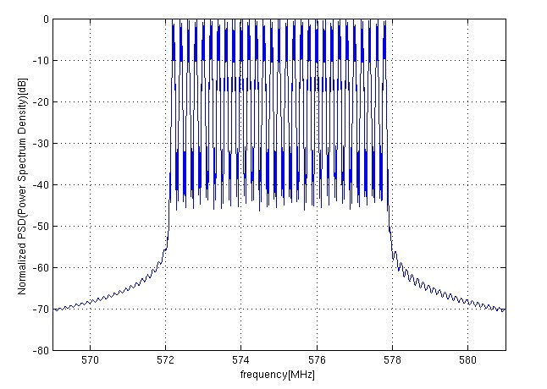
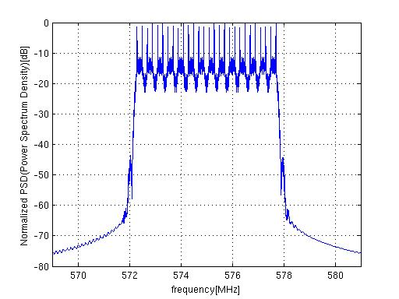
Example: Filtered FSK
In-band
In-band
-30dB
-55dB
50kbps – 2FSK
200kHz Channel spacing
BT = 1.0
29 channels
200kbps – 2FSK
400kHz channel spacing
BT = 1.0
14 channels
Notes:
BT=1.0 3dB cutoff (loose cutoff), BT=0.5 10dB cutoff

Slide 6
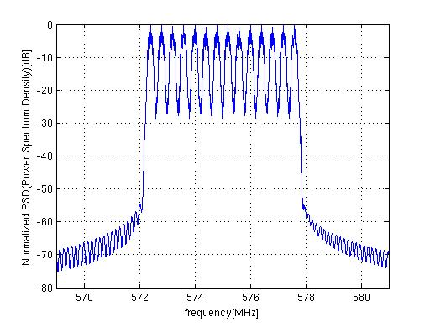
Example: Filtered FSK (cont’d)
November, 2011
In-band
-30dB
400kbps – 4FSK
400kHz channel spacing
BT = 0.5
14 channels
-55dB
Slide 6
Notes:
doc.: IEEE 802.15-<doc#>
<month year>
<author>, <company>
Page 6

Slide 7
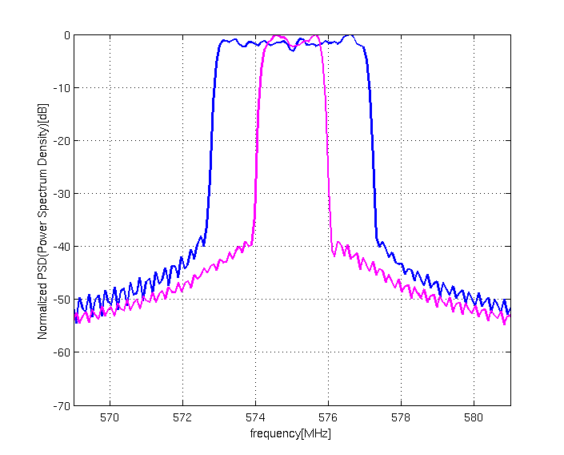
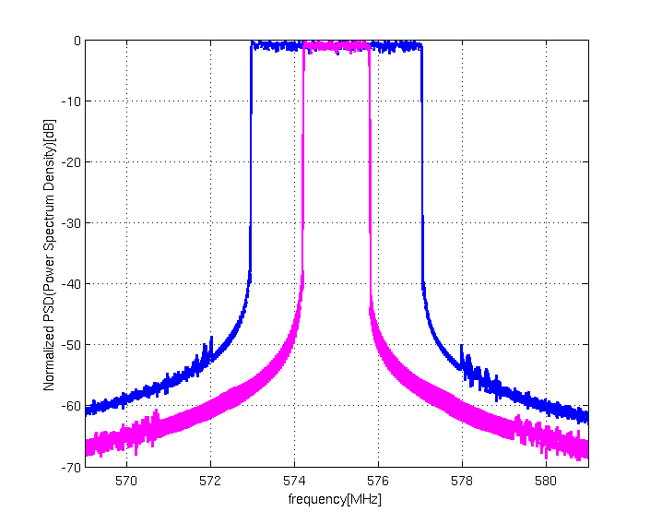
Example: OFDM (Basic sampling freq: 5MHz)
In-band
In-band
-30dB
-55dB
N_{FFT}=128, QPSK
N_{FFT}=2048, QPSK
# of active carriers | B_{[-30dB]} (MHz) | B_{[-55dB]} (MHz)
96 | 4.54 | 16.08
32 | 2.00 | 13.87
# of active carriers | B_{[-30dB]} (MHz) | B_{[-55dB]} (MHz)
1536 | 4.09 | 6.76
512 | 1.59 | 3.24

Slide 8
Discussions and Conclusions
It may be easy to comply with the stringent spectrum mask in the case of filtered FSK.
In the case of OFDM, system parameters should be carefully designed to comply with the stringent spectrum mask and very low out-of-band emission limit in TVWS.
Further consideration will be needed on other features of TVWS spectrum mask such as in-band PSD limit.

Slide 9
References
TG4m Technical Guidance Document, Doc. IEEE 802.15-11-0684-00-004m, Sept. 2011
FCC Second MO&O, FCC-10-174, Sep. 2010.
IEEE Std. 802.22TM-2011, July 2011

