Slide 1
Project: IEEE P802.15 Working Group for Wireless Personal Area Networks (WPANs)
Submission Title: PTC Spectrum Overview
Date Submitted: November 9, 2011
Source: John Notor, Notor Research
Address 1548 Arata Court, San Jose, CA 95125
Voice: 1-408-799-2738, E-Mail: gnu@notor.com
Abstract: Preliminary information about PTC spectrum issues in the U.S.A.
Purpose: To inform the members of 802.15 IG PTC of FCC actions pending relative to PTC spectrum.
Notice: This document has been prepared to assist the IEEE P802.15. It is offered as a basis for discussion and is not binding on the contributing individual(s) or organization(s). The material in this document is subject to change in form and content after further study. The contributor(s) reserve(s) the right to add, amend or withdraw material contained herein.
Release: The contributor acknowledges and accepts that this contribution becomes the property of IEEE and may be made publicly available by P802.15.

Slide 2
Status of PTC Spectrum in U.S.A
No spectrum has been allocated for Positive Train Control (PTC) in the U.S.A.
The FCC Wireless and Telecommunications Bureau has a proceeding open, WT Docket No. 11-79.
  Wireless Telecommunications Bureau Seeks Comment on Spectrum Needs for the Implementation of the Positive Train Control Provisions of the Rail Safety Improvement Act of 2008.
  The document specifically refers to the 220 MHz spectrum, and suggests that, based on an expert review by GAO, acquiring this spectrum may be a challenge.
IEEE 802.18 will be commenting on this proceeding and would like inputs from interested parties.

Slide 3
Conflicting Allocations at 220 MHz
Automated Maritime Telecommunications System (AMTS):
  Frequency range: 217-220 MHz.
Interactive Video and Data Service (IVDS, aka 218-219 MHz Service)
  Frequency range: 218-219 MHz.
The 220 MHz Radio Service:
  Frequency Range: 220-222 MHz.
The FCC would have to make changes to the allocation and operational rules to allow PTC operations in these bands. Alternatives include:
  Add co-primary allocations in the affected bands.
  Re-assign the bands to PTC and undertake some sort of band clearing activity to compensate current users/license holders.
  Some other approach.
  Normally a Notice of Proposed Rulemaking is issued to capture comments on any proposed changes.

Slide 4
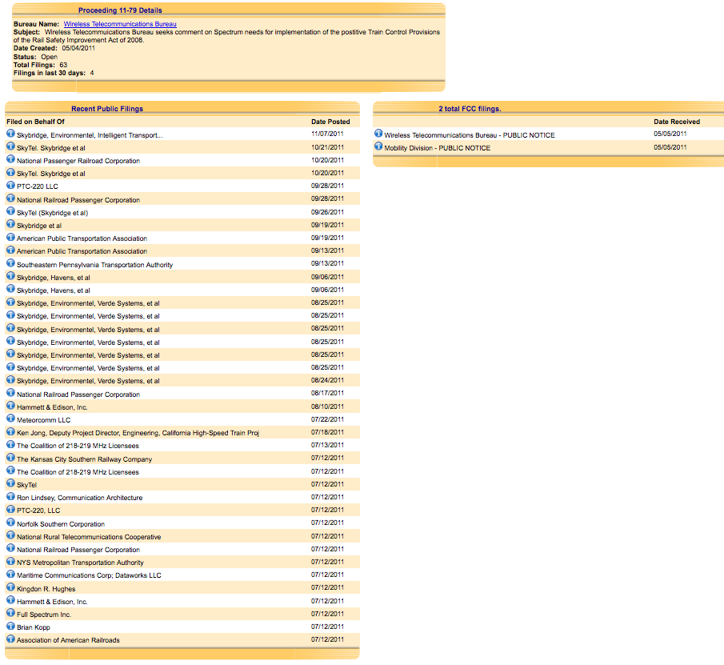
Comments Filed re: 11-79

Slide 5
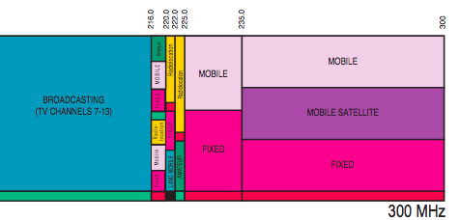
Spectrum Details

Slide 6
Next Steps
IEEE 802.18 files comments to proceeding.
FCC needs to complete it’s work on the proceeding.
Possible Outcomes:
  New spectrum allocated.
  No new spectrum allocated.

Slide 7
Questions?

