Slide 1
Project: IEEE P802.15 Working Group for Wireless Personal Area Networks (WPANs)
Submission Title: [Smart Antenna Opportunities for Spectrum Resource Usage Improvements]
Date Submitted: [8 November, 2011]
Source: [Bob Conley] Company [Eigen Wireless]
[Address: [23326 E 2nd. Ave., Liberty Lake, WA]
Voice:[509-723-4517], FAX: [509-9255-9899], E-Mail:[bconley@eigenwireless.com]
Dr Steven Schennum Company [Gonzaga University]
Address: [504 E Boone Ave., AD Box 26, Spokane, WA 99258]
Voice:[509-313-3545], FAX: [(509) 313-5871], E-Mail:[schennum@gonzaga.edu]
Re: [IG Spectrum Resources Usage call for contributions]
Abstract: [This document presents recent effort to characterize interference sources and propose and test high potential solutions that enhance spectrum usage in the 900 MHz and 2.4 GHz ISM bands.]
Purpose: [This document provides SI SRU alternative PHY level concepts for further investigation ]
Notice: This document has been prepared to assist the IEEE P802.15. It is offered as a basis for discussion and is not binding on the contributing individual(s) or organization(s). The material in this document is subject to change in form and content after further study. The contributor(s) reserve(s) the right to add, amend or withdraw material contained herein.
Release: The contributor acknowledges and accepts that this contribution becomes the property of IEEE and may be made publicly available by P802.15.

Slide 2
Smart Antenna Opportunities for Spectrum Resource Usage Improvements
Presented by Bob Conley
Eigen Wireless
Steven Schennum
Gonzaga University

Slide 3
Introduction
Concentration on ISM band interference studies
  Propagation characteristics of the desired (victim) signal and Interfering signals
  Focus on co-channel interferers
  Significant out-of-band interferers
Potential mitigating solutions
  Many papers and proposals have advocated MAC and PHY additions to support smart antennas.

Slide 4
ISM Environment
Desired Signal
  Propagation
  How much traffic?
  Building penetration loss?
  Polarization scattering loss?
  Delay Spread?
  Topography?

Slide 5
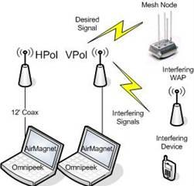
Measurements
Calibrated RSSI
Per SSID and MAC
Calculate apparent polarization

Slide 6
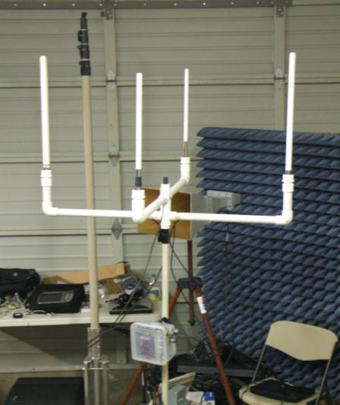
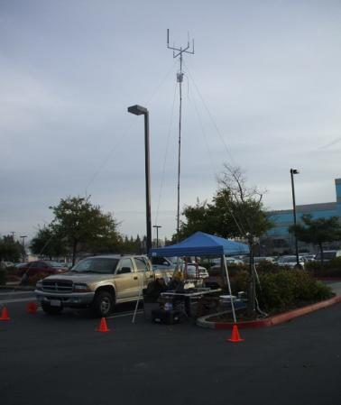
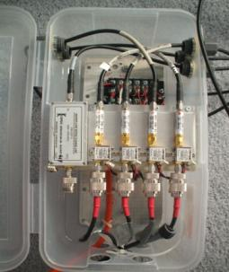
Measurements
Pushup Mast:
  Antenna set
  Horizontal Pol
  Vertical Pol
  Horizon and Downtilt
LNA
  Eliminate Cable loss

Slide 7
Topography
Spatial distribution of victim and interferer populations
  Adjacent or overlaid?
  Distinct elevations?

Slide 8
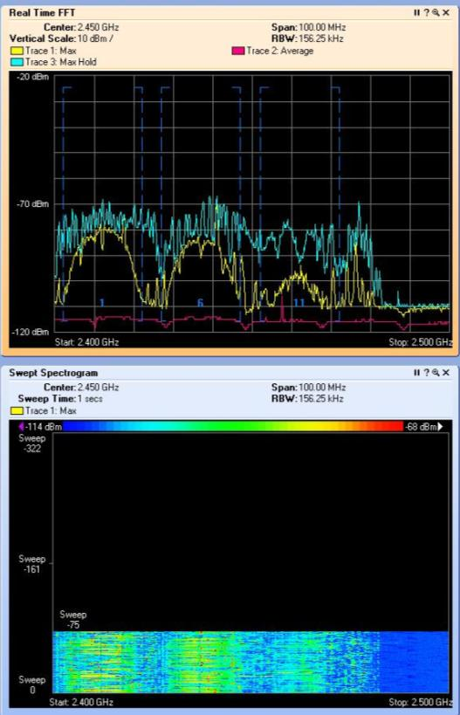
Interference Environment
Co-Channel
  Interference Sources?
    Outside or Self
  Traffic?
  Topography? 3D
  Polarization?

Slide 9
Interference Environment
Adjacent Channel
  Interference Sources?
    Outside or Self
  Traffic?
  Topography? 3D
  Polarization?
Out-of-Band
  800 MHz Cellular & Paging

Slide 10
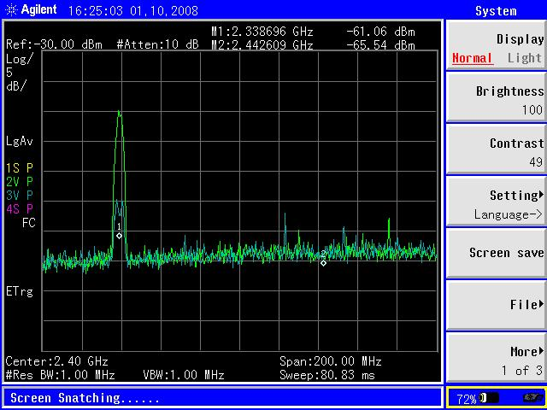
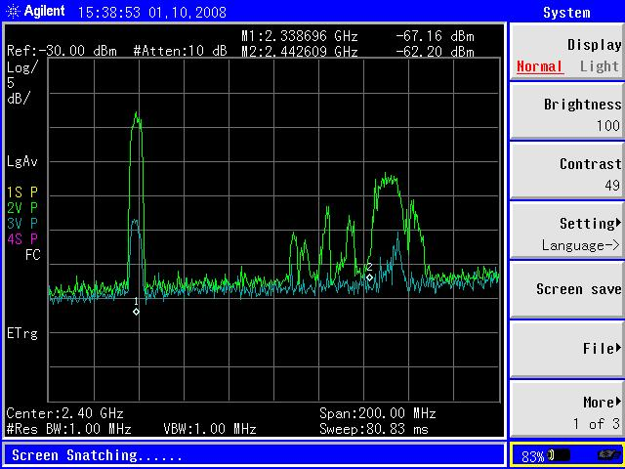
Out-of-Band in Zero-IF Receiver
Horizontal Rejection of Vertical Wi-Fi Traffic
2337 2349 MHz
Vertical to
Horizontal
-15 dB

Slide 11
“Smart” Antenna
2+ antenna Switched Diversity
2+ antenna Combining
Simple Switched Beam (Spatial Filter)
  Passive Beam Former
Active Beam former
Active Null Steering
MAC issues with non-omni arrays

Slide 12
Azimuthal and Elevation Beam Forming
Victim and interferer populations
  Adjacent or overlaid?
    If adjacent then Spatial Filtering (SF) is effective’
    If overlaid then SF effectiveness is reduced
  Distinct elevations?
    If distinct then vertical null steering is effective

Slide 13
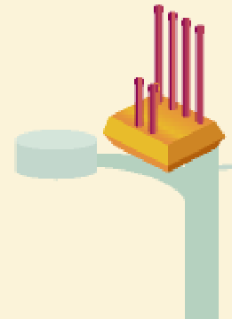
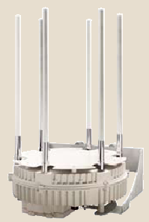
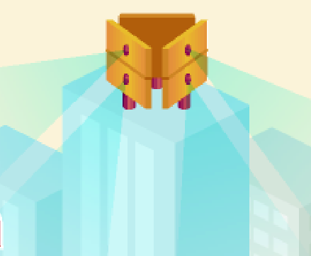
Array Configurations
ULAs
UCA
gO Networks, Wavion

Slide 14
Array Configurations
Azimuthal SF
  ULAs with back baffle
    Not Omni thus good for adjacent networks
  ULAs with no baffle
    Omni directional for overlaid interferers at the expense of duplicate lobe/null
  UCAs
    Omni with higher antenna count

Slide 15
SF Performance
Uniform illumination results in 12 dB Side Lobes
Improved side lobes via amplitude tapering or “windowing” Tradeoff is decrease in gain and pointing resolution
  Binomial distribution for “no” side lobes and -2.5db gain
  Dolph-Chebvshev for -20dB side lobes and -1.4dB in gain.

Slide 16
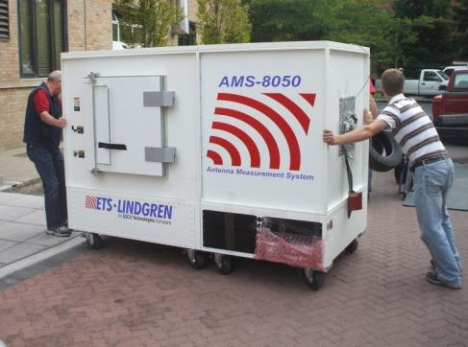
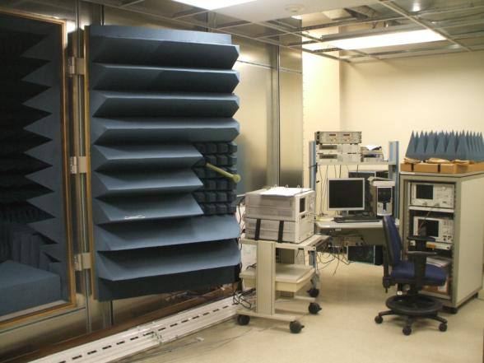
SARL Radiated Measurements
Two automated full anechoic antenna test chambers with multi axis positioners (MAP)
  Small aperture 3D patterns, 0.7 to 6 GHz DUT weight limit 10 lbs
  Large aperture 3D patterns, 0.3 to 6 GHz DUT 3D weight limit 75 lbs, 2D 1200 lbs
Automated outdoor range
  3D patterns 5lb DUT limit
  2D patterns, 0.7 to 6 GHz DUT weight limit 600 lbs

Slide 17
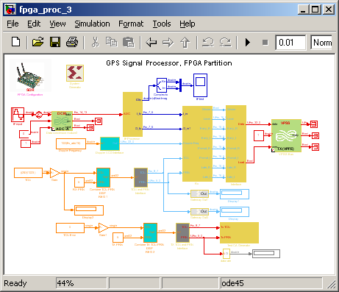
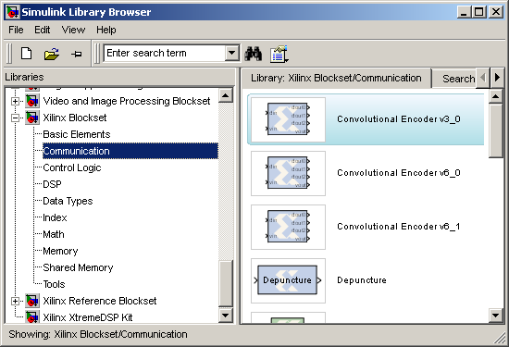
Proof-of-Concept on Software Defined Radio (SDR)

Slide 18
Thank You
www.gonzaga.edu/antenna

