Slide 1
Project: IEEE P802.15 Working Group for Wireless Personal Area Networks (WPANs)
Submission Title: [Positive Train Control Mandate and Technology]
Date Submitted: [08 Nov 2011]
Source: [Kevin Nichter] Company [Lilee Systems]
Address [2905 Stender Way, Suite 78, Santa Clara, CA, 95054 USA]
Voice:[+1 502-438-6950], E-Mail:[kevin.nichter@lileesystems.com]
Re: [PTC-IG November 2011 Session]
Abstract: [Overview of PTC technology and US mandate]
Purpose: [Informative presentation for the Positive Train Control Interest Group]
Notice: This document has been prepared to assist the IEEE P802.15. It is offered as a basis for discussion and is not binding on the contributing individual(s) or organization(s). The material in this document is subject to change in form and content after further study. The contributor(s) reserve(s) the right to add, amend or withdraw material contained herein.
Release: The contributor acknowledges and accepts that this contribution becomes the property of IEEE and may be made publicly available by P802.15.

Slide 2
Positive Train Control Mandate and Technology
Kevin Nichter
Lilee Systems

Slide 3
Agenda
Background on the emergence of PTC
PTC technology
Interoperability
PTC systems in use today
A standards-based approach using the ERTMS example
Emerging issues

Slide 4
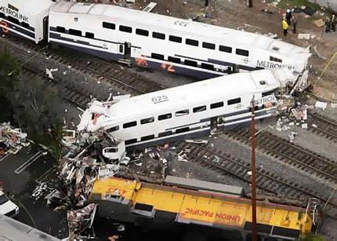
September 12, 2008
On September 12, 2008, a Metrolink passenger train collided with a Union Pacific freight train in Chatsworth, Los Angeles
Texting by Metrolink engineer
25 killed, 135 injured

Slide 5
Government Action
Rail Safety Improvement Act signed by President Bush on October 16, 2008 (“RSIA08”)
The bill mandates the implementation of Positive Train Control systems by December 31, 2015, on all
Tracks with passenger service
Tracks carrying hazardous materials which are poison or toxic by inhalation (PIH or TIH)
Tracks carrying 5 million gross tons of freight or more per year
Requires submission of plans to FRA
PTC Implementation Plan (PTCIP)
PTC Safety Plan (PTCSP)
PTC Development Plan (PTCDP)

Slide 6
Planning to Adopt Positive Train Control
PTC Implementation Plan (PTCIP) is the written plan that defines the specific details of how and when the railroad will implement the PTC system.
PTC Development Plan (PTCDP) provides a detailed discussion of specific elements of the proposed technology and product that will be used to implement PTC as required by RSIA08.
PTC Safety Plan (PTCSP) provides the railroad specific elements demonstrating that the system, as installed, meets the required safety performance objectives. Approval of the PTCSP comes in the form of a PTC System Certification.

Slide 7
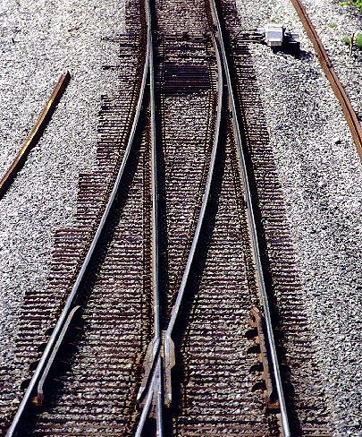
About Positive Train Control
Positive Train Control systems designed to prevent:
Train-to-train collisions
Overspeed derailments
Incursions into work zones
Movement through improperly configured switch
PTC systems are designed to override mistakes by human operators
Comprised of four subsystems
Locomotive segment
Wayside segment
Communications segment
Back office segment
Office
Communications Segment
Locomotive
Wayside

Slide 8
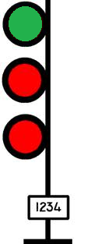
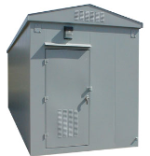
PTC Communications Segments
Network control centers communicate track warrants, database downloads, and other information to the locomotive
Can be performed through the interoperable 220 MHz network, or through other mediums as available
Network Control Center

Slide 9
PTC Segments
Wayside locations communicate signal status and switch point indications to train in signaled territory
Communicates switch position in dark territory
Communications links between wayside and office via base stations.
Network Control Center
Work orders, track
authorities, and databases

Slide 10
Interoperability Requirements
BNSF, CSX, NS, and UP form ITC (Interoperable Train Control) to support PTC
Working, steering, and executive committees
Radio system using 220 MHZ frequency with TDMA
Railroads are actively acquiring spectrum
Communications protocols and messaging formats
AMQP, EMP, ITCM, Class C & D,
Radio type usage
220 MHZ required for interoperability (across boundaries)
802.11 WiFi for use in yards
Satellite and cellular may be used where interoperability is not an issue (where it exists or is available today)

Slide 11
Interoperable and Confined Systems
Interoperability between Class Is
Locomotives must receive wayside status on home or foreign road
Back offices configured to communicate between roads
Interoperability between Class I s and transit systems
Geographical boundaries
Railroad A
Back Office
Railroad B
Back Office
Railroad A
Wayside
Railroad B
Wayside
Railroad A Locomotive
ITC (GPS-based) and ACSES (transponder-based)
Collaborative effort between Class I and Northeast Corridor stakeholders
Standalone, confined systems
Railroads without overlap with other systems
Interoperable 220 MHZ is therefore not a requirement

Slide 12
PTC in the United States
Project | Customer
ACSES (Advanced Civil Speed Enforcement System) | Amtrak (Northeast Corridor)
ASES (Advanced Speed Enforcement System) | New Jersey Transit
CAS (Collision Avoidance System) | Alaska Railroad
NAJPTC (North American Joint Positive Train Control) | IDOT (now TTCI)
ITCS (Incremental Train Control System( | Amtrak (Michigan)
ETMS (Electronic Train Management System) | BNSF
CBTM (Communications Based Train Management) | CSX
OTC (Optimized Train Control) | OTC
VTMS (Vital Train Management System) | UP
Train Sentinel | Ohio Central
Interoperable
Positive Train Control

Slide 13
Some “Train Control” Systems of Note
PTC (Positive Train Control)
Primarily focused on United States freight and transit systems
Affects Canadian railroads with tracks in U.S. (by mandate)
Useful as a “lower cost” option to traditional ERTMS applications
CBTC (Communications-Based Train Control)
Performance and functional specifications defined in IEEE 1474
Worldwide applications in transit markets
Frequency-agnostic (typically ISM band)
ATCS (Advanced Train Control System)
Not fully implemented
Successfully deployed as radio codeline standard in North America
ERTMS (European Rail Traffic Management System)
Comprised of ETCS and GSM-R

Slide 14
PTC Technology
Not all “PTC” systems can meet all four requirements
For example, incursions into work zones
Systems vary in complexity and level of proprietary communications technology
PTC System Requirements
Train-to-train collisions
Overspeed derailments
Incursions into work zones
Movement through improperly configured switch
GSM-R interoperability standard (Europe)
900 MHZ ATCS data radios, FEPs, and protocols for ACSES II
Proprietary, but transparent, data radio
PTC as designed can be used in an overlay environment (i.e. dark territory, non-signaled applications)
PTC as vital (i.e. ACSES) or non-vital (i.e. Train Sentinel)

Slide 15
Looking at ERTMS for a Moment…
ERTMS European Rail Traffic Management System
ETCS European Train Control System | GSM-R Global System for Mobile (Communications) - Railway
Voice & data
Can be a useful guide as to how a standards-based approach could work
Government and supplier support
European Union
UNIFE / UNISIG support ensures interoperability across vendors
Interoperable across geographical borders

Slide 16
Looking at ERTMS for a Moment…
ERTMS European Rail Traffic Management System
Level | Characteristics
1 | Wayside signals; overlay; central office issues movement authorities
2 | Wayside signals optional; track characteristics are pre-loaded; radio-based communications
3 | Moving block; train detection equipment at wayside unnecessary; vital train integrity capability
Positive Train Control elements exist here

Slide 17
The Emergence of the GSM-R Standard
UIC
Negotiations
CEPT
Recommendation
GSM
Decision
4 MHz
Industry body
48 country representation
Proven track record
Frequency
allocation
Railways
Functional requirements
UIC
EIRENE
European Integrated Radio Enhanced Network
Technical requirements
EC
MORANE
Mobile Oriented Radio Network
GSM-R bearer
Vendors

Slide 18
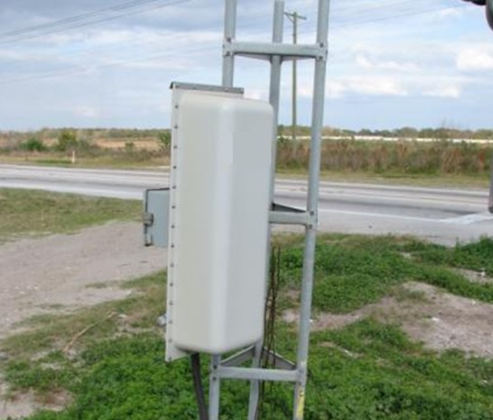
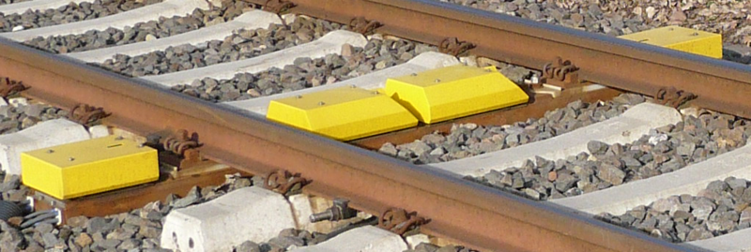
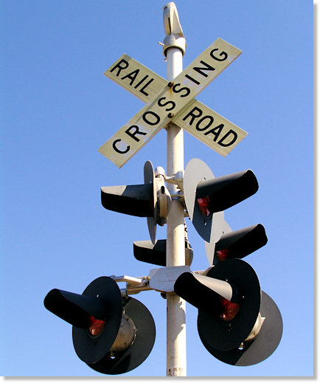
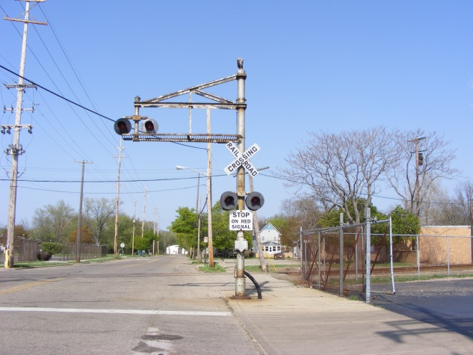
Other Systems in Use…
HBD (Hot Box Detector)
AEI (Automatic Equipment Identification)
Crossing alarm and asset management
DTMF-Based Crossing Activation

Slide 19
Immediate and Emerging Issues
Interoperability between ACSES and ITC
Are there other IEEE efforts that can address centralized management or other facets of PTC systems?
How will evolving needs and requirements be captured and implemented?
What else can be “absorbed” into the PTC communications system?
Advanced crossing starts
Codeline (controls / indications)
EOT / HOT, AEI, HBDs, and more
Motes?

