Slide 1
Project: IEEE P802.15 Working Group for Wireless Personal Area Networks (WPANs)
Submission Title: [CDM and Spreading Method for IEEE802.15.4k LECIM]
Date Submitted: [November, 2011]
Source: [Kyung Sup Kwak, Bin Shen, Yongnu Jin] and [Hyungsoo Lee, Jaedoo Huh]
Company: [Inha University] and [ETRI]
Address [428 Hi-Tech, Inha University, 253 Yonghyun-dong, Nam-gu, Incheon, 402-751, Republic of Korea]
Voice: [+82-32-860-7416], FAX: [+82-32-876-7349],
E-Mail: [kskwak@inha.ac.kr (other contributors are listed in “Contributors” slides)]
Re: [IEEE802.15.4k call for proposal]
Abstract: [A PHY Proposal for Low Energy Critical Infrastructure Monitoring Networks Applications TG4k]
Purpose: [To be considered in IEEE 802.15.4k]
Notice: This document has been prepared to assist the IEEE P802.15. It is offered as a basis for discussion and is not binding on the contributing individual(s) or organization(s). The material in this document is subject to change in form and content after further study. The contributor(s) reserve(s) the right to add, amend or withdraw material contained herein.
Release: The contributor acknowledges and accepts that this contribution becomes the property of IEEE and may be made publicly available by P802.15.

Slide 2
Introduction
The purpose of LECIM is to facilitate point to multi-thousands of points communications for critical infrastructure monitoring devices.
It addresses the application's user needs of minimal network infrastructure, and enables the collection of scheduled and event data from a large number of non-mains powered end points that are widely dispersed, or are in challenging propagation environments.-> Spreading Gain
Simultaneous operation for at lease 8 co-located orthogonal networks (CLON) are required in a region.=> Network Identification
Mechanisms that enable coexistence with other systems in the same band is needed => Need Good Cross-correlation Property

Slide 3
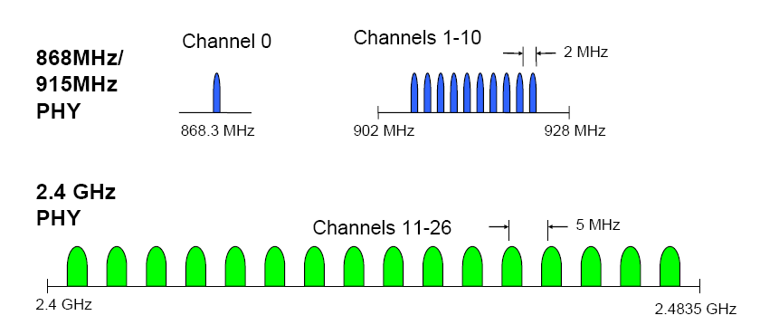
Operating Frequency Bands
compatible with 802.15.4 LR-WPAN
Totally, there are 3 applicable frequency bands and 27 channels with different bandwidth
16 channels in the 2.4GHz frequency band,
10 channels in the 915 MHz frequency band, and
1 channel in the 868 MHz frequency band for a certain application.
Simultaneous operation for at least 8 CLONs is feasible based on FDM mechanism.
TDM in a CLON can be further employed for providing more logical channels.

Slide 4
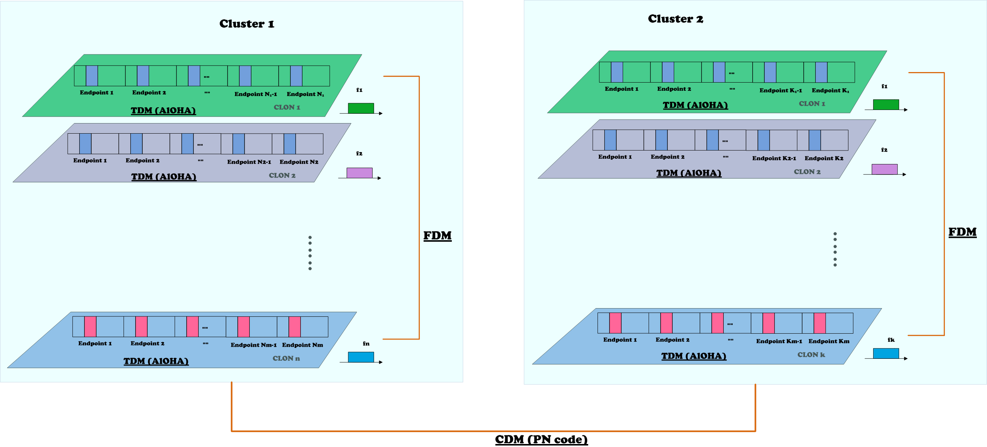
CLON & Cluster Topology
CLONs can use different frequency bands (channels) with different center frequencies;
Frequency Division Multiplexing (FDM) based orthogonality is thus utilized among CLONs.
Code Division Multiplexing (CDM) based on goood correlation property can be further adopted for multiple clusters of CLONs. (e.g., short PN codes for multi-cluster identification)

Slide 5
Contention-based Multiple Access
in Time-slotted CLON
A slotted ALOHA scheme can be used for contention as shown below.
Slots
Beacon
B
EAP
B
NAP
EAP: Exclusive(Emergence) Access Period NAP: Normal Access Period
Inha Univ/ETRI

Slide 6
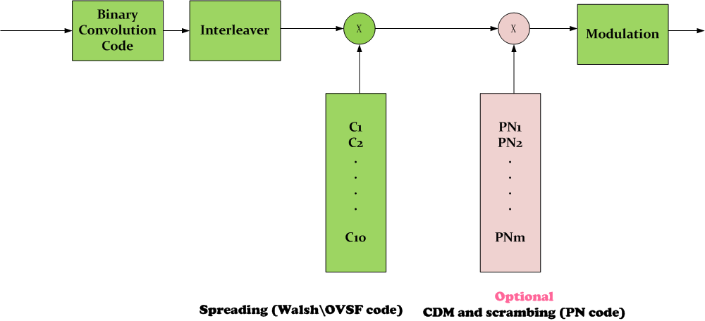
CDM & Spreading
-
Code Division Multiplexing (CDM) based orthogonality can be further adopted for multiple clusters of CLONs. (e.g., short PN codes for multi-cluster identification)
Walsh or OVSF code is used for obtaining the spreading gain.

Slide 7
Chip Rates and SF where SF codeword size are powers of 2
Data Rates (kbps) |  | Chip Rates | Roll-off coefficient | Spreading Factors (dB)
BPSK | QPSK |  |  | BPSK | QPSK (I/Q branch)
40 | 80 | 1.28Mcps | 0.5625 | 32 (15 dB) | 32 (15 dB)
30 | 60 | 1.92Mcps | 0.0417 | 64 (18 dB) | 64 (18 dB)
20 | 40 | 1.28Mcps | 0.5625 | 128 (21 dB) | 128 (21 dB)
10 | 20 | 1.28Mcps | 0.5625 | 128 (21 dB) | 128 (21 dB)
5 | 10 | 1.28Mcps | 0.5625 | 256 (24dB) | 256 (24dB)
4 | 8 | 1.024Mcps | 0.9531 | 256(24 dB) | 256(24 dB)
3 | 6 | 1.536Mcps | 0.3021 | 512(27 dB) | 512(27 dB)
2 | 4 | 1.024Mcps | 0.9531 | 512(27dB) | 512(27dB)
1 | 2 | 1.024Mcps | 0.9531 | 1024(30dB) | 1024(30dB)
0.8 | 1.6 | 1.6384Mcps | 0.2207 | 2048(33dB) | 2048(33dB)
0.6 | 1.2 | 1.2288Mcps | 0.6276 | 2048(33dB) | 2048(33dB)
0.4 | 0.8 | 1.6384Mcps | 0.2207 | 4096(36dB) | 4096(36dB)
0.1 | 0.2 | 1.6384Mcps | 0.2207 | 16384(42dB) | 16384(42dB)

Slide 8
Spreading codes : Gold code
Gold Sequence:
Gold sequences are constructed by two m-sequences of the same length with each other. Thus, for a Gold sequence of length m = 2^{l}-1, one uses two LFSR, each of length 2^{l}-1.
Properties:
Gold sequences provide larger sets of sequences with good periodic cross-correlation.
The cross-correlation functions for Gold sequences take on the preferred three values.
Gold sequences form an optimal set with respect to the Sidelnikov bound when m is odd.
If the LSFRs are chosen appropriately, Gold sequences have better cross-correlation properties than maximal length LSFR sequences.

Slide 9
Spreading codes : Gold code
Cross-Correlation Statistics of Gold Sequences
l Number of LFSR elements | m = 2^{l}-1 Sequence length | Number of m sequences | Max. cross correlation of m-sequence Normalized | t cross-correlation of Gold sequence | t/(2^{l}-1) cross correlation of Gold-sequence, Normalized
3 | 7 | 2 | 0.71 | 5 | 0.71
4 | 15 | 2 | 0.60 | 9 | 0.60
5 | 31 | 6 | 0.35 | 9 | 0.29
6 | 63 | 6 | 0.36 | 17 | 0.27
7 | 127 | 18 | 0.32 | 17 | 0.13
8 | 255 | 16 | 0.37 | 33 | 0.13
10 | 1023 | 60 | 0.37 | 65 | 0.06

Slide 10
Spreading codes : OVSF
OVSF code:
OVSF code is an example of a linear code over a binary alphabet that maps messages of length n to codewords of length 2^{n}.
Variable-length OVSF code is in fact the same as Walsh code, except that each sequence has different index number in the code set, which is result from their different generation algorithms.
Properties of Walsh and OVSF code :
Very easy to generate in practice, compare to the m-sequence by using LFSR
Has the orthogonal property. (Two codes are orthogonal if, and only if , any one is not the mother code or the descendent code of another.)
Requires strict time synchronization
Flexible Spreading factor (and data rate) control, with various power-2 SF
Used as spreading code and channel code. (e.g. Walsh in cdma2000 system and OVSF in W-CDMA system)

Slide 11
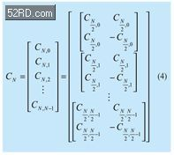
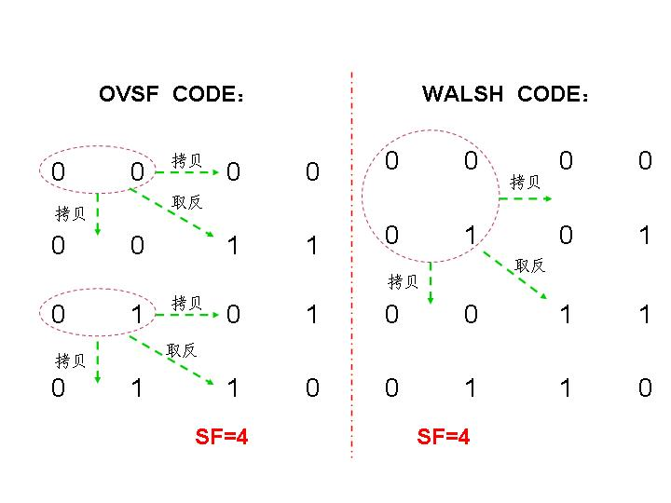
Spreading codes : OVSF
OVSF code: also generated from Hadamard matrix
but with permutation matrix concept
Compare with Walsh code:

Slide 12
Conclusions
In the LECIM system:
In a coodinator, Time-slotted multiple access is used to share a Resource (Channel).
In order to overcome the high path loss or interference, we can use Spreading Code . OVSF are more feasible (complexity, Data rate) than PN code.
For cluster ID, we can use PN code (Gold code or m-sequence) to identify cluster and to mitigate interference among clusters.
This PN code gives scrambling effect among CLONS and other systems on the same band.

