Slide 1
Project: IEEE P802.15 Working Group for Wireless Personal Area Networks (WPANs)
Submission Title: More MPDU Fragmentation Details
Date Submitted: 07 Nov 2011
Source: [Benjamin A. Rolfe, et al] Company [Blind Creek Associates}
Address []
Voice:[+1 408 395 7207], FAX: [NA], E-Mail:[ben @ blindcreek.com]
Re: [MPDU Fragmentation proposal in TG4k]
Abstract: [Updates the MPDU fragmentation proposal with additional details and merges concepts from all the fragmentation presentations presented so far in TG4k]
Purpose: [Support establish the baseline capability for MPDU fragmentaion]
Notice: This document has been prepared to assist the IEEE P802.15. It is offered as a basis for discussion and is not binding on the contributing individual(s) or organization(s). The material in this document is subject to change in form and content after further study. The contributor(s) reserve(s) the right to add, amend or withdraw material contained herein.
Release: The contributor acknowledges and accepts that this contribution becomes the property of IEEE and may be made publicly available by P802.15.

Slide 2

MAC Common Concepts and merge strategy
A Framework for LECIM MAC enhancements to guide baseline discussion

Slide 3
The MAC Table
Document | Over-simplified description
15-11-0589 | MPDU Fragmentation using
15-11-0596 | Low energy enhancements to 15.4 MAC
15-11-0597 | Slotted access (0599), synchronization (0598), Link Management (0600),
15-11-0598 | Synchronization using 15.4e DSME w/extensions
15-11-0599 | Slotted access using 15.4e DSME w/extensions
15-11-0600 | Link management using 15.4e DSME w/extensions
15-11-0605 | Hopping using MPDU fragmentation, use 15.4e TSCH
15-11-0607 | New MAC, beacon w/simplified SF, non-beacon, no CSMA (similar to subset of 15.4)
15-11-0629 | PHY proposal, use with 15.4e TSCH and/or DSME
15-11-0631 | Acknowledgment scheme for use with MPDU fragmentation
15-11-0641 | Non-beacon and TDMA-TDD with beacon
15-11-0606 | A Flexible MAC Proposals for TG4k Networks

Slide 4
Unique LECM Characteristics
Very wide network coverage area
Large number of end points
Extremely low data rates
Challenging outdoor environment leads to potentially very lossy channel
Critical nature of some situations (like emergency messages)

Slide 5
Concepts in common
Channel Access Methods
Slotted access is useful
  Slotted Random Access
  TDD/TDMA
Un-slotted access is also useful, LBT may help or hurt
  Random Access (RA) with and without LBT
Low Energy
Energy saving is very important
  Asymmetric architecture (hub has more power than spokes)
  Keep radio off
Fragmentation
Adapt MAC frame format to PHY characteristics
  Manage time on air
  Reduce error recovery overhead

Slide 6
Low Energy Concepts
Minimum active time
  RX “waiting” typically large part of active budget
  Retransmission costs energy => reduce retries saves energy
Reduce waiting time:
  Synchronous access
Asymmetric roles:
  Shift energy consumption to device with energy
Reduce retransmission costs
  Priority access to reduce collisions (RA)
  TDM access to reduce collisions (Slotted)
  Fragmentation
Reduce interference from cooperating devices
Help with everyone else

Slide 7
Low Energy Concepts
Synchronous access
  Can reduce ‘waiting’ and collisions from cooperating devices
  Costs energy to maintain via beaconing or other exchange
  Synchronous mechanisms in 15.4+15.4e (DSME, TSCH)
Asynchronous
  Only ‘on’ when necessary (event driven)
  May increase collision risk
  Several asynchronous mechanisms in 15.4+15.4e
  Some additions to existing mechanisms

Slide 8
LE Suggested merge strategy
Existing mechanisms can be used as basis
Extensions for LECIM to MAC-SAP
Use existing frame types, add new IEs and/or command frames
Add improved wake-up (0596) to 15.4e CSL and RIT

Slide 9
Slot Based, Synchronous Merge Strategy
(Beacon enabled)
Using Multi-superframe (DSME) [15-11-0599]
  Existing features, configured for LECIM needs
  Provides dedicated slots, EA access (priority)
  Static or very infrequently changing slot allocations (minimize overhead)
  Implicit slot allocation via standard defined function (not yet specified in 15.4+15.4e, can be higher layer function)
Add to 15.4+15.4e
  Slot types: Slot grade [11-0599], TDD Uplink/Downlink [11-0641]
  Extend MAC-SAP primitives
  New IEs and/or MAC commands using existing (4e) frame types

Slide 10
Non-slotted (Asynchronous) Merge Strategy
(Non-beacon enabled)
Existing channel access sufficiently flexible and configurable
Coordinator (concentrator) does ‘listening’ burden for uplink unicast
Use “Data as Ack” for downlink unicast (can use MP frame, data frame, or EACK)
Mostly higher layer use of existing features

Slide 11
Prioritized Channel Access
Some messages are critical (LECIM)
Traffic classifications:
  Normal: not latency sensitive, retransmission acceptable
  Emergency: need high probability of first time success
  Deterministic: may be latency sensitive, and/or periodic traffic

Slide 12
Fragmentation Merge
MPDU Fragmentation [15-11-0589]
Acknowledgement contributions
  Use incremental fragment Acknowledge and aggregated acknowledge [15-11-0631]
More details in 15-11-0758

Slide 13
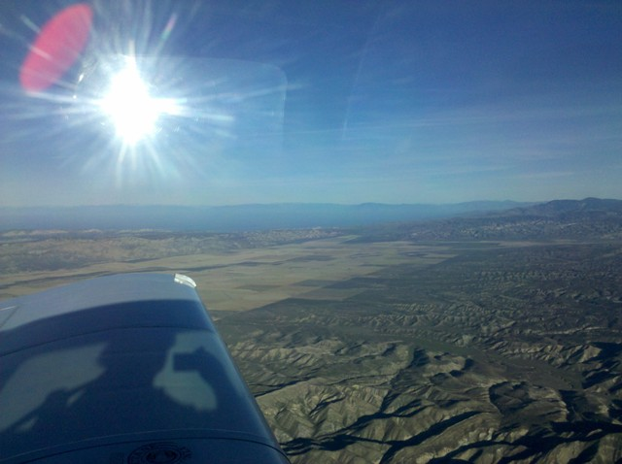
10,000 Foot View of Merge
Based on existing MAC (15.4+15.4e)
  [0599, 0596, 0597, 0631, 0641, 629,
  Existing MAC == 802.15.4-2011 + 802.15.4e
Existing MAC provides
  both synchronous and asynchronous
  Flexible channel access
  Frame types with extensibility
  Some low energy mechanisms
Enhancements
  Priority based slotted random access [11-0607]
  Extend LE flexibility

Slide 14

Conclusion
Let the fun begin!

Slide 15
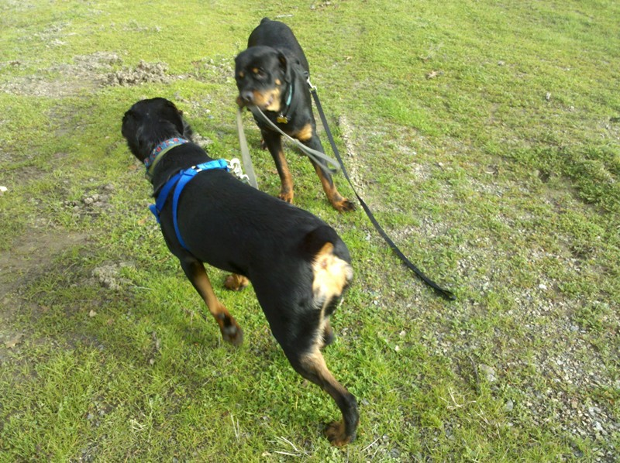
Thanks for listening

