Slide 1
Project: IEEE P802.15 Working Group for Wireless Personal Area Networks (WPANs)
Submission Title: [O-QPSK modulation discussion for TG4k]
Date Submitted: [September, 2011]
Source: [Xiang Wang]
Company: [Wuxi SensingNet Industrialization Research Institute]
Address [No.767, Jinzhong Rd, Shanghai]
Voice:[+86-021-52188899-635], FAX: [+86-021-52182002]
E- Mail:[wilsonwangxiang@gmail.com]
Re: [TG4k Call for Proposals]
Abstract: [Modulation Discussion for TG4k]
Purpose: [To be considered in IEEE 802.15.4k]
Notice: This document has been prepared to assist the IEEE P802.15. It is offered as a basis for discussion and is not binding on the contributing individual(s) or organization(s). The material in this document is subject to change in form and content after further study. The contributor(s) reserve(s) the right to add, amend or withdraw material contained herein.
Release: The contributor acknowledges and accepts that this contribution becomes the property of IEEE and may be made publicly available by P802.15.

Slide 2
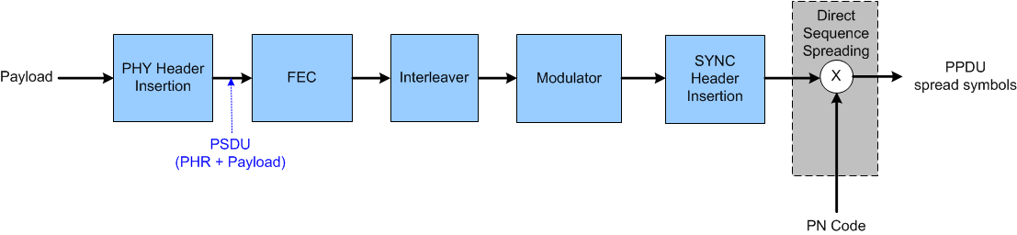

Reference Diagram (1)
Reference Diagram in Merged DSSS
(15-11-0795-01-004k)
Reference Diagram in IEEE802.15.4-2011 BPSK PHY

Slide 3

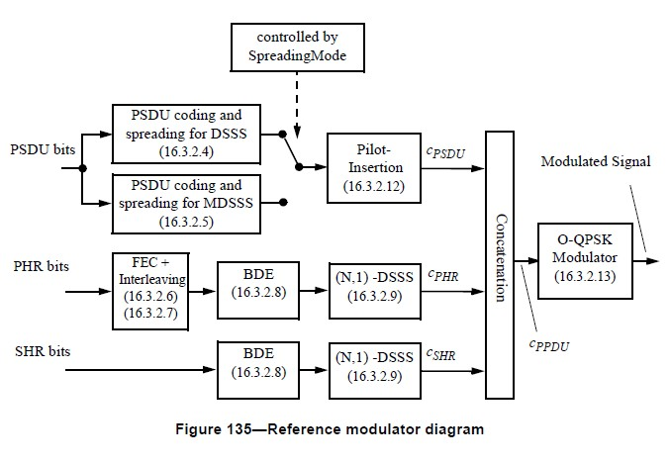
Reference Diagram (2)
Reference Diagram in IEEE802.15.4-2011 O-QPSK PHY
Reference Diagram in
TG4g MR-O-QPSK PHY

Slide 4
Spread concatenate O-QPSK (1)
Bit-to-Symbol
  symbol consist one bit or several bits to choose spread code
  (N,4) spread uses 4 bits as 1 symbol
  (N,1) spread uses 1 bit as 1 symbol
Symbol-to-Chip
  transfer symbol to chip
  choose 1 code sequence in 16 code sequences when using (N,4) spread
  choose +c sequence when symbol = 1, and –c sequence when symbol = 0, when using (N,1) spread
Bit-to-Symbol and Symbol-to-Chip is same between O-QPSK PHY and BPSK PHY

Slide 5
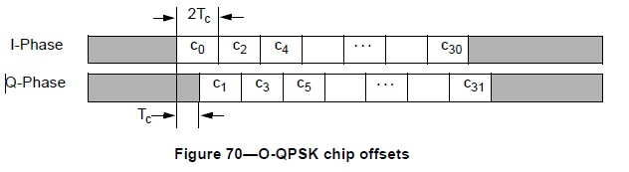
Spread concatenate O-QPSK (2)
O-QPSK modulator
  O-QPSK and Shape
  E.g (32,1) spreading
    Bit 1
    Symbol 1
    Chip Sequence [c0,c1,c2……c31], ci means 1 or -1
      separate chip sequence into I-phase and Q-phase
      delay Q-phase by Tc

Slide 6
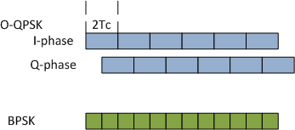
Data Rate
O-QPSK
  in each phase, one chip lasts 2Tc
  equal to each chip lasts Tc when combine I-phase and Q-phase
BPSK
  each chip lasts Tc
Conclusion
  Same chip rate and same PN sequence lead to same data rate

Slide 7
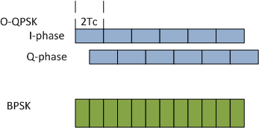
Process Gain
O-QPSK
  in each phase, power degrade 3dB
  same power when combine I-phase and Q-phase
BPSK
Conclusion
  Same PN sequence lead to same spread gain

Slide 8
Advantage of O-QPSK
Improve PA efficiency
  Nearly constant envelope
Compatible to IEEE802.15.4
  Same analog frontier design
  O-QPSK PHY in IEEE802.15.4-2011
  MR-O-QPSK PHY in TG4g Draft
Consider O-QPSK as a candidate for DSSS modulation scheme in TG4k

Slide 9
Thank you

