Slide 1
Smart Grid Information Update
November 2011
802.15 DCN: 15-11-0802-01
IEEE 802 LMSC Tutorial
Atlanta, GA, USA

Slide 2
Introduction to the event
90 minutes 7:30 – 9:00 pm
Motivation - Inform members of the rapidly expanding set of activities around the world
Currently the “Pet Rock” of the Standards World
Brief overview of topics – not enough time for in depth exposes
This will be interactive, ask questions, but there is a lot to cover

Slide 3
Speakers
Smart Grid Intro John Buffington - Itron
Europe Tom Siep, CSR & Larry Taylor – Rapporteur ETSI ERM/TG28, Discrete Time
Tim Godfrey - EPRI– Chair 802.16m
Bob Heile – Chair 802.15, Chair ZigBee, Co-Chair P2030 TF3
Phil Beecher – Elster, Itron, Landis & Gyr, Sensus- Chair 802.15.4g
Wi-Fi Activities – Dave Halasz – Aclara
IEEE Activity Overview - Bruce Kraemer – Chair 802.11, SGIP, PAP#2, Marvell Semiconductor
NIST PAP2 - Bruce Kraemer

Slide 4
What is Smart Grid?
John Buffington

Slide 5
Many SG Definitions Depend upon Perspective
An upgrade to the electrical power transmission, generation and distribution grid.
A myriad of business opportunities for new infrastructure (i.e. “smart” utility meters, Cap. Bank Controllers, HAN devices, etc.).
A business opportunity for networking the home to help improve managing energy consumption.
A vehicle to facilitate energy independence and curb greenhouse gas emissions.
Managing the impact of PHEV/EVs.

Slide 6
Example definition –
US Department of Energy
“an automated, widely distributed energy delivery network characterized by a two-way flow of electricity and information and will be capable of monitoring everything from power plants to customer preferences to individual appliances. It incorporates into the grid the benefits of distributed computing and communications to deliver real-time information and enable the near-instantaneous balance of supply and demand at the device level.”

Slide 7
SG: A group of intertwined Markets
Smart Grid
Transmission and Generation
Distribution Automation
Distributed Energy Gen. (DER)
Revenue Metering (AMI/AMR)
Plug-in / Hybrid/ Electric Cars
Demand Response (Premise HAN)

Slide 8
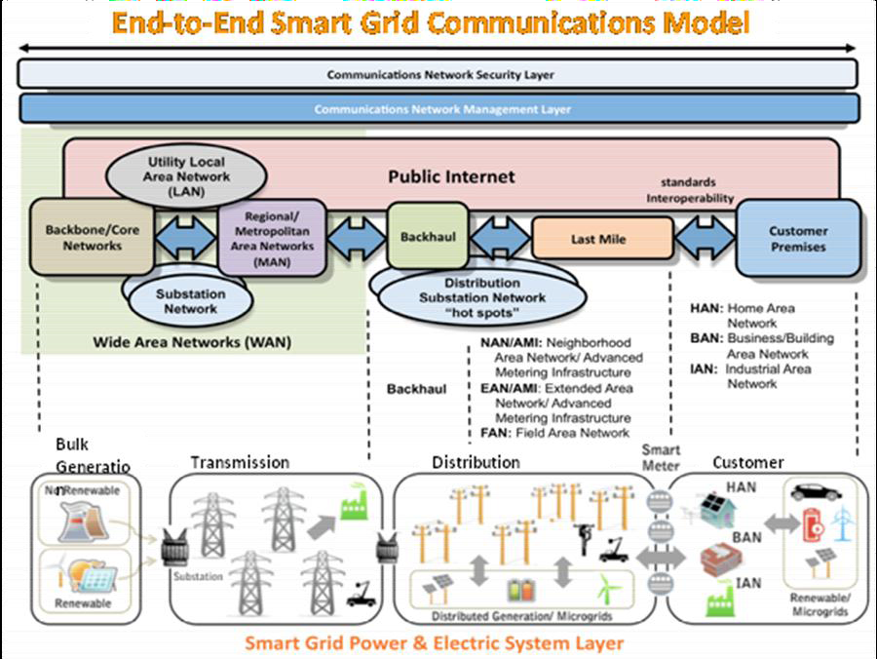
Example: IEEE P2030 SG Comm. Model

Slide 9

What benefits can 802 bring to the SG?
Continue to provide standards based communications that provide or enhance:
Communications interoperability.
Re-use of communications infrastructure.
Improved reliability and reduced latency.
Techniques that adapt to the environment thereby reducing both deployment and ongoing operational costs.

Slide 10
European Smart Grid Standards Update
Larry Taylor
Tom Siep
7 Nov 11
IEEE Atlanta, November '11 - Smart Grid Update
10

Slide 11
Update
EC Mandates
  M441 Smart Metering
  (http://www.cen.eu/cen/Sectors/Sectors/Measurement/Documents/M441.pdf)
  M490 Smart Grids
  (http://www.cen.eu/cen/Sectors/Sectors/Measurement/Documents/M441.pdf)
ETSI
  M2M
  ERM
  OSG (ISG)
Other
  SEDC
7 Nov 11
IEEE Atlanta, November '11 - Smart Grid Update
11

Slide 12
EU M441 Smart Metering Mandate
12
7 Nov 11
IEEE Atlanta, November '11 - Smart Grid Update
12
Objective: create European standards that will
  enable interoperability of utility meters (water, gas, electricity, heat),
  which can then improve the means by which customers' awareness of actual consumption can be raised,
  in order to allow timely adaptation to their demands.
Phase 1 Communications standards (connectivity) – mostly complete
  CENELEC Technical Report TR 50572
  Functional Communications Architecture
  Standards GAP analysis
  Use Case Task Group
  HAN out of scope
Phase 2 Additional Functionality (applications, target end of ’12)
Notes:
2 Phase Mandate
CEN/CENELEC/ETSI
Phase 1 Communications standards (connectivity)
Phase 2 Additional Functionality (application functionality)
Phase 1 (mostly) complete
Technical report in final approval process for publication as a CENELEC Technical Report TR 50572)
Functional Communications Architecture
Meter – Local/Neighbourhood Network
Meter – Head End System
Local/Neighbourhood Network – Head End System
Standards GAP analysis
Long list of potential standards
Basis for Phase 2 work program
Use Case Task Group
IEC Use Case model
Target completion of use case set Dec ’11
Foundation for Phase 2
HAN out of scope
Phase 2 (Target completion End ’12)
CEN/CENELEC/ETSI Work Program
DLMS/COSEM enhancements, PLC & WMBus (TC13, TC294)
Gas, Water, Heat meters (TC237, TC92, TC 176) & Gas Infrastructure (TC234)
ETSI security (TISPAN), M2M (TC M2M), connectivity (ERM, PLT)
12

Slide 13
EU M441 Smart Metering Mandate details
2 Phase Mandate
  CEN/CENELEC/ETSI
  Phase 1 Communications standards (connectivity)
  Phase 2 Additional Functionality (application functionality)
Phase 1 (mostly) complete
  Technical report in final approval process for publication as a CENELEC Technical Report TR 50572)
  Functional Communications Architecture
    Meter – Local/Neighbourhood Network
    Meter – Head End System
    Local/Neighbourhood Network – Head End System
  Standards GAP analysis
    Long list of potential standards
    Basis for Phase 2 work program
  Use Case Task Group
    IEC Use Case model
    Target completion of use case set Dec ’11
    Foundation for Phase 2
  HAN out of scope
Phase 2 (Target completion End ’12)
  CEN/CENELEC/ETSI Work Program
    DLMS/COSEM enhancements, PLC & WMBus (TC13, TC294)
    Gas, Water, Heat meters (TC237, TC92, TC 176) & Gas Infrastructure (TC234)
    ETSI security (TISPAN), M2M (TC M2M), connectivity (ERM, PLT)
13
7 Nov 11
IEEE Atlanta, November '11 - Smart Grid Update
13
Notes:
13

Slide 14
EU M490 Smart Grid Mandate
7 Nov 11
IEEE Atlanta, November '11 - Smart Grid Update
14
Objective: develop or update a set of consistent standards within a common European framework
  integrating a variety of digital computing and communication technologies and electrical architectures
  achieve interoperability
  enable or facilitate the implementation in Europe of the different high level Smart Grid services
  flexible enough to accommodate future developments.
Building, Industry, Appliances and Home automation
  Out of the scope
  however, their interfaces with the Smart Grid are not

Slide 15
EU M490 Smart Grid Mandate details
Background
  Derived from CEN/CENELEC/ETSI Smart Grids Joint WG
  JWG published its final report (V1.12) on Standards for Smart Grids on 4th May ’11
  European Commission Mandate 490
    Released by DG Energy March ‘11
    Based on JWG work
    Adopted by CEN/CENELEC/ETSI 1st June ’11
    Related Mandates
      M468 on Electric Vehicles
      M/441 on Smart Metering
Objectives
  Technical Reference Architecture for functional data flows
    Must be consistent with M441 connectivity architecture
  Set of consistent standards for information exchange (protocols and data models)
  Sustainable standards process (tools & processes)
7 Nov 11
IEEE Atlanta, November '11 - Smart Grid Update
15

Slide 16
M490 SGCG
SGCG Chair – Ralph Sporer (Siemens)
EC Reference Group – Manuel Sanchez-Jimenez (DG Energy)
M441/M468 Liaison – Willem Strabbing (ESMIG/KEMA)
Technical Committees
  Standards – Lauren Guise (Schneider)
  Process – Johannes Stein (VDE/DKE)
  Architecture – Emmanuel Darmois (Alcatel-Lucent)
  Security Alfred Malina/Laurent Schmidt (IBM/Schneider)
7 Nov 11
IEEE Atlanta, November '11 - Smart Grid Update
16

Slide 17
M490 Activity
7 Nov 11
IEEE Atlanta, November '11 - Smart Grid Update
17
M490 Progress
  Smart Grid Coordination Group (SGCG) formed May ‘11
  Standards GAP report released 28 July ’11
  Reference Architecture 1st draft Oct ‘11
NIST-M490 SGCG White Paper
  General agreement to coordinate standards efforts
  Released September ’11
  George Arnold (NIST National Coordinator) & Ralph Sporer (M490 Coordination Group Chair)

Slide 18
ETSI
7 Nov 11
IEEE Atlanta, November '11 - Smart Grid Update
18
TC M2M
  Specifications for Machine-to-Machine communications infrastructure
  World-wide membership & active participation
  Strong liaisons & collaborations with external SDOs
    Broadband Forum
    OMA
    GSMA
  Release 1 (near) complete
    Workshop 26/27 October
    270 participants
    5 End-End M2M demonstrations
    ‘Capillary Network’ interworking – ZigBee
  Network, Gateway & Device specifications
    Security
    Discovery
    Access Control
    Data transport
  REST style resource-based architecture
  Smart Metering / Smart Grid use cases

Slide 19
ETSI ERM
7 Nov 11
IEEE Atlanta, November '11 - Smart Grid Update
19
TG28 – Short Range Devices (SRD)
  PHY/MAC Work Items on Smart Metering
    Based on 15.4g
  PHY specification in Task Group approval
    Possible Technical Committee approval in November or December
    Published in early 2012
  MAC technical work started
    Target stable draft April ’12
    Publish Summer ’12
  Included in ETSI Work Program under M441

Slide 20
OSG
OSG is an ETSI Industry Specification Group (ISG)
  ISGs are open to ETSI members & non-members
    Specific membership agreement & operating procedures
    Resulting specifications publicly available free of charge
  OSG
    Created September ’11
    1st meeting 20 October ‘11
    Focus on Open Smart Grid Protocol (OSGP)
      Based on Echelon specifications for Data Concentrator – Smart meter communications
  OSG Membership
    Echelon, Actility, ESNA, Oracle
  ESNA
    Echelon sponsored market communications forum
7 Nov 11
IEEE Atlanta, November '11 - Smart Grid Update
20

Slide 21
SEDC
7 Nov 11
IEEE Atlanta, November '11 - Smart Grid Update
21
Smart Energy Demand Coalition
  Promotes Demand Side interests
  Very large membership of major market players
    Electricity utilities, equipment suppliers…
  Brussels lobbying
  Market communications
    Smart energy policies & programs that impact demand response interests
    Policy papers & lobbying fo demand side industry interests
SEDC
  Launched late 2010
  1st member meeting January ’11
  White papers
  Response to consultations
    e.g. Council of Europe Energy Regulators consultation on demand response market
  European Commission interface
    Commissioners
    DG TREN (Energy Directorate)

Slide 22
Smart Grid in Europe
Fairly complex landscape
  Many national authorities
    Range of national economic and technological development
    Range of market philosophies from open to closed
  European Union
    EC Directives
    EC Mandates
    Funded R&D programs
  Many standards publishing organisations
    IEC
    ITU
    CEN/CENELEC
    ETSI

Slide 23
European Context
Markets
  Fragmented electricity market vs US aging power grid
  Deregulation of electricity in some EC states
  Vision:
    Start with a smart metering infrastructure then extend to a smart grid network
Energy Efficiency Directive 2006/32/EC
  Promotes competition in energy supply as well as improvements in efficiency and carbon footprint reduction
Smart Grids Directive 2009/72/EC of 13 July 2009
  "Member States should encourage the modernisation of distribution networks, such as through the introduction of smart grids, which should be built in a way that encourages decentralised generation and energy efficiency."
Smart Energy Technology (SET) Plan sets out following objectives:
  35% of electricity from dispersed and renewable sources by 2020
  integrating further national networks into a pan-European network
  guaranteeing a high quality of electricity supply
  EU has funded a large number of research projects under FP7

Slide 24
European Smart Grid Programs
EU Smart Grids Task Force
  A Steering Committee and 3 Expert Groups
  EG 1. Functionalities of Smart Grids and Smart Meters
    State of the art - standards field trials,, products on the market
    Functionalities - services, SG components, functions, strategy for standards
  EG 2. Regulatory recommendations for data safety, data handling & data protection.
    Who owns the data? Who has access to the data? Need for one (standardized) data model.
    Cyber Security
  EG 3. Roles and responsibilities of actors involved in the deployment of Smart Grids.
    Role of standards

Slide 25
European Smart Grid Programs (2)
CEN/CENELEC/ETSI Smart Grids Joint WG
  A common initiative launched on March 8th
  Agreement to form a coordination group and a “Focus Group”
  Major stakeholders represented
IEC Global Standards for the Smart Grid
  Strategic Group 3 – working on Smart Grid since April ’09
  Cooperation with NIST
  Identified relevant IEC standards for Smart Grid

Slide 26
EU M/441 Smart Metering Mandate
European Commission Mandate
  Issued in March 2009 by DG TREN
  Sent to, and accepted by, the 3 ESO's : CEN, CENELEC and ETSI
  Managed by SM-CG populated by major stakeholders and user group
Main objective
  To build open interoperable standards for European smart meters, providing secure bi-directional communication and as well as enhanced functionality to promote consumer awareness of actual consumption
Time schedule :
  March 2009 + 9 months
    state of the art of existing standards, gap analysis, and first Work Program
    Currently preparing a Technical Report on architecture and standards
  March 2009 + 30 months
    Develop smart metering standards for additional functionality defined in the initial report
26

Slide 27
ITU
International rather than European, but based in Geneva
  T - Focus Group on Smart Grid (FG Smart)
    The Focus Group (FG) aims to identify potential impacts on standards development
    Investigate future ITU-T study items and standards development
    Familiarize ITU-T and standardization communities with emerging attributes of smart grid
    Encourage collaboration between ITU-T and smart grid communities
    G.hn
      Home networking standard – Fibre, Cable & PLC
  R - Spectrum requirements for smart grid
    ITU-R is developing a study question on suitable spectrum for Smart Grid
    Fixed & Mobile and possibly other interested work groups

Slide 28
ETSI
Machine-to-Machine
  Internet of Things
  Key strategic direction for ETSI
  Leverage vast mobile network experience
  Generic architecture for services
  Smart Metering / Smart Grid use cases
  TC M2M focus for ETSI responses to EC Mandates on Smart Metering and Smart Grid

Slide 29
ETSI (2)
Many other TCs working on relevant technology
  ERM (EMC & Radio Matters)
    TG28 (SRDs) – Smart Metering Wireless Access
    TG11 (2.4GHz wideband modulation), TGUWB and others
  TISPAN
    Security and End-to-End communications
  PLT
    ETSI Powerline communications standards
  More…..
Smart Grid Scoping Workshop – June ’10
  Led by ETSI Board “Champion”
  Investigate what is happening
  Brainstorm the issues and future direction

Slide 30
Wi-Fi® in the Smart Grid
Dave Halasz
November 2, 2011
Notes:
30

Slide 31
Smart Grid Information Update
November 2011
EPRI Status
IEEE 802 LMSC Tutorial
Atlanta, GA, USA

Slide 32
Electric Power Research Institute (EPRI)
http://www.epri.com/
The Electric Power Research Institute (EPRI) is an independent, non-profit company performing research, development and demonstration in the electricity sector for the benefit of the public.
Members represent more than 90% of the electricity generated and delivered in the U.S. International participation extends to 40 countries.

Slide 33
Agenda
Field Area Networks
CIM Interoperability
Demand Response – “DR Socket”
Demand Response – OpenADR

Slide 34
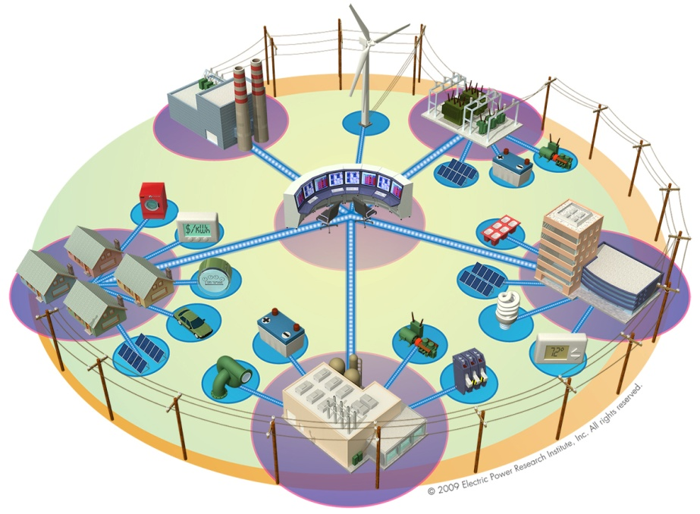



What is a Field Area Network? (FAN)
A unified network supporting multiple utility applications
High performance - able to support DA and ADA
Headroom to support growth and emerging needs: DER, PV, EVs
Integration/Convergence of existing services – AMI backhaul, LMR voice, etc

Slide 35



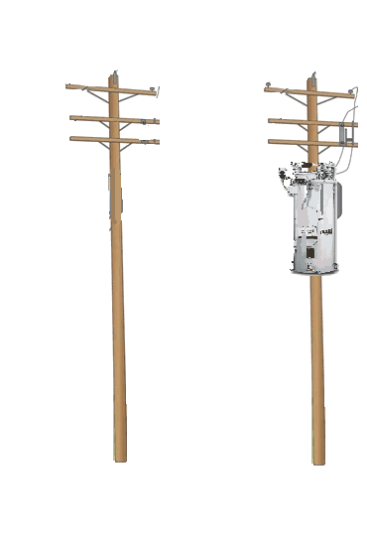
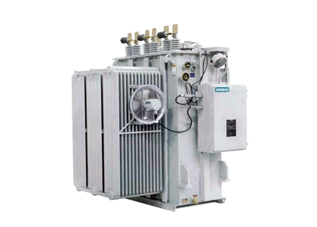


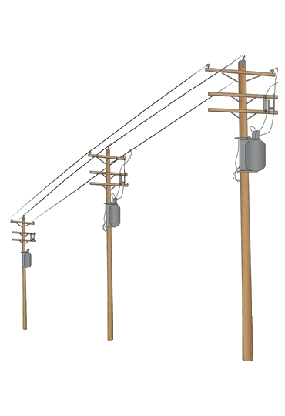
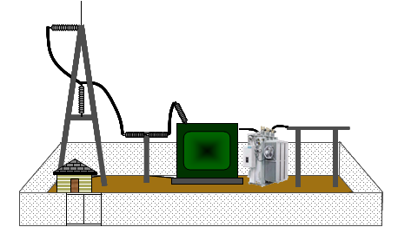



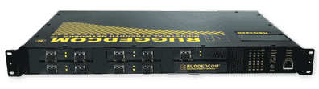



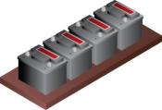


The problem: present day D-SCADA and AMI networks
Sectionalizers
Capacitor Banks
Distributed Regulators
Substation Regulators
?
AMI (mesh)
Smart Metering
ADA Star Comms
D-SCADA
Advanced Distribution Automation
Carrier Backhaul
MDMS
Notes:
[Builds over three mouse clicks]
[Initial display] This represents the kind of field infrastructure that can enable applications like Integrated Volt/VAr Control; automatic Fault Location, Isolation, and Restoration; Conservation Voltage Reduction; more precise asset monitoring and load monitoring; and so forth. Of course, substation automation is something utilities have been engaged in for many years.
[Mouse click] This depicts extending an Ethernet LAN-based system in a distribution substation out onto the feeder, to support protection, monitoring, etc. In an Integrated DMS, feeder-based applications should be seamless extensions of existing substation controls and logic. Today, this is done with single-purpose wireless links such as star communication systems based on narrowband VHF (MAS) radios. The problems are low bandwidth, high latency, and limited ability to expand and support more demanding applications.
[Mouse click] The first phase of Smart Grid deployments have focused on AMI. This is typically done with a proprietary RF mesh from the AMI vendor, with various carrier or leased line technologies used for backhaul. This results in an independent, parallel network, which raises costs and complexity.
[Mouse click] New, variable and even mobile Smart Grid sources and loads introduce a new challenge. Three important class of Distributed Energy Resources are represented here – PV arrays, energy storage (a bank of batteries), and Plug-in Electric Vehicles, in sufficiently large numbers, will affect the way distribution systems are planned, deployed, and managed in the not-so-distant future.
[Mouse click] The existing wireless networks do not have the capacity or performance characteristics to take on these new applications. The next slide shows how the FAN can complement, and eventually replace legacy networks, while providing a growth path to support new applications.
35

Slide 36
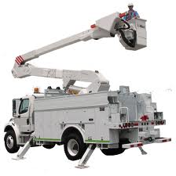

The solution: with Field Area Network
Sectionalizers
Capacitor Banks
Distributed Regulators
Substation Regulators
AMI (mesh)
Field Area Network
Smart Metering
D-SCADA
Advanced Distribution Automation
MDMS
Notes:
The Field Area network provides an integrated single network that can support existing DA and ADA applications, AMI backhaul, DER, PV, and field workforce support. The single network easily integrates into the utility core network. The support of multiple applications concurrently raises the benefit side of the cost/benefit analysis, and reduces lifecycle costs through reduced maintenance.
36

Slide 37

CIM Primer
CIM: Common Information Model
Written for two perspectives:
  IT: Needs a start.
  Operations: Needs understanding.
Reduce the costly learning curve for CIM adoption.
Copyrights and marks of other entities remain their property.

Slide 38
CIM-MultiSpeak* Harmonization Goals, Value, Deliverables
One important aspect of Smart Grid is interoperability
Today both CIM and MultiSpeak are used in the utility industry.
Objective of EPRI project is mapping the 61968-9 1st edition CIM standard to MultiSpeak
* MultiSpeak is a registered trademark of the
National Rural Electric Cooperative Association.
Notes:
Provide a cost saving tool for utilities, vendors and integrators.
Provide a callable API for in-line translation of messages between systems with MultiSpeak or CIM based service definitions.
Provide more choices for best of breed application selection for utilities.
38

Slide 39
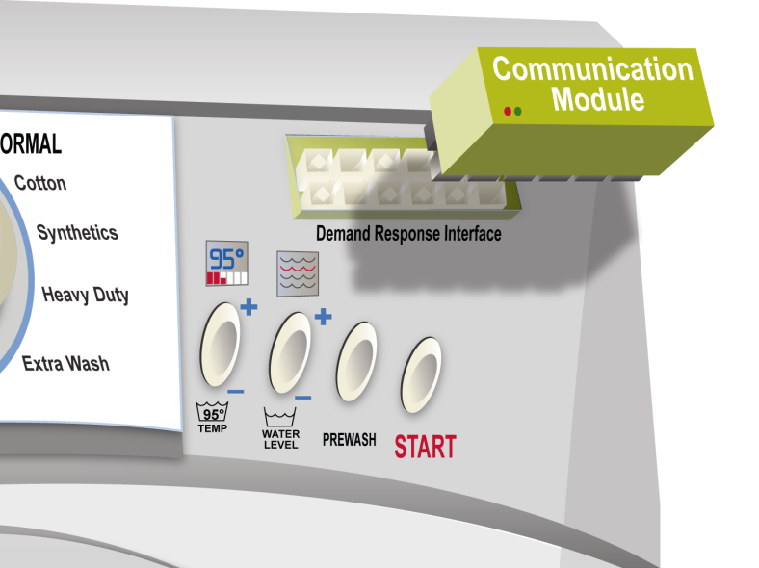
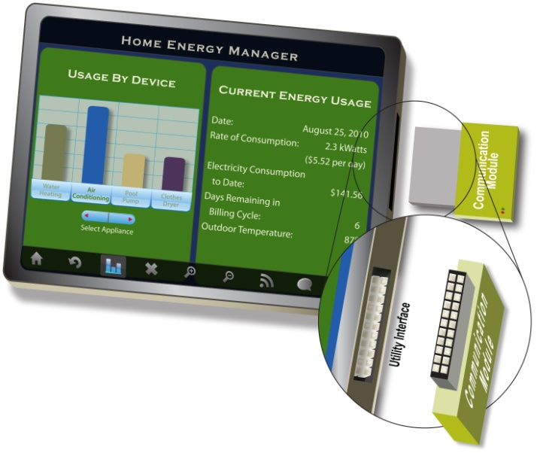
The Modular Communication Interface
Indispensible Characteristics
A uniform open standard An appliance works with any comm module
  A comm module works with any appliance
Homeowner Installable, removable and replaceable at any time
Intelligently informs the appliance, does not cut off its power
Low cost impact on appliances, cost is incurred only when actually utilized
Simple for the most limited of devices, yet extensible
Communication systems can evolve without obsoleting the end device

Slide 40



Progress Toward an Open Standard
January 2011
Home-to-Grid DEWG
September 2011
Specification at:
http://collaborate.nist.gov/twiki-sggrid/bin/view/SmartGrid/H2G

Slide 41
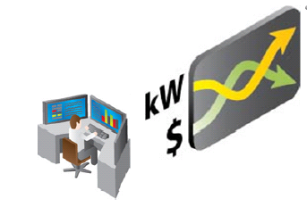




OpenADR Demonstration Project
OpenADR
Over FAN or NAN
HEMS
SEP 2
Over HAN
http://www.openadr.org/
Accelerate Standards Development of Protocols to Automatically Manage Loads for Demand Response (DR) and Ancillary Services.

Slide 42
Smart Grid Demonstration Initiative
The EPRI Smart Grid Demonstration Initiative is a five-year collaborative research effort focused on design, implementation, and assessment of field demonstrations to address prevalent challenges with integrating distributed energy resources in grid and market operations to create a “Virtual Power Plant.” This newsletter provides periodic updates on the project and relevant industry news and events.
http://smartgrid.epri.com/Demo.aspx

Slide 43
Thank You

Slide 44
November 2011
Smart Grid Update Tutorial
802 Plenary-Atlanta
Update on
Smart Energy Protocol 2.0 (SEP2)
November 7, 2011
Slide 44
Bob Heile, ZigBee Alliance
Notes:
doc.: IEEE 802.15-<doc#>
<month year>
<author>, <company>
Page 44

Slide 45
ZigBee Smart Energy
Brief Background
November 2011
Slide 45
Bob Heile, ZigBee Alliance

Slide 46






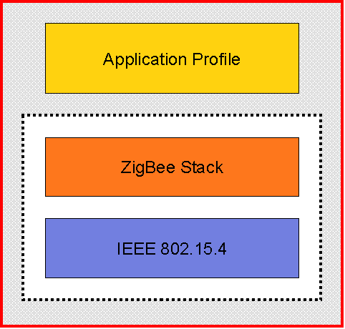
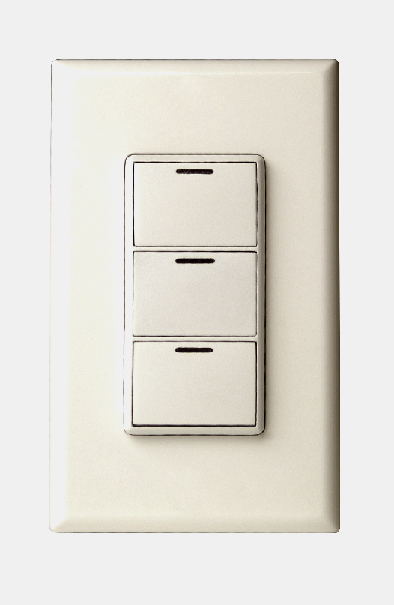
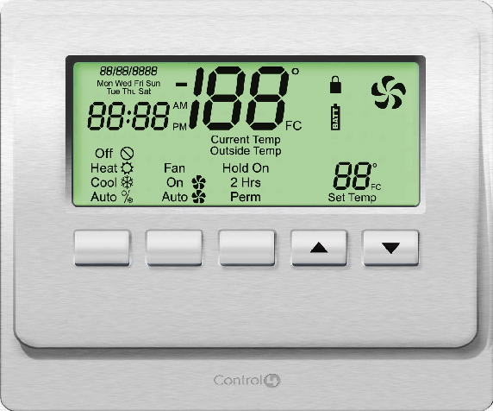
ZigBee Product Architecture
November 2011
{
ZigBee Application Profiles
ZigBee Certified Product
Products with same application profiles interoperate End-to-End
Slide 46
Bob Heile, ZigBee Alliance
46

Slide 47
Current ZigBee Application Profiles
November 2011
ZigBee Home Automation (ZHA)
ZigBee Smart Energy (ZSE)
ZigBee Building Automation (CBA)
ZigBee Telecom Services (ZTS)
ZigBee Health Care (ZHC)
ZigBee Remote Control (ZRC)
ZigBee Input Device (ZID)
ZigBee 3D Sync (Z3D)
ZigBee Retail Services (ZRS)
+Future profiles proposed by member companies…
Slide 47
Bob Heile, ZigBee Alliance

Slide 48
























Smart Energy & Home Automation
November 2011
Urgent demand for Smart Energy + compatibility with mainstream
Home Automation systems enables customer choice
Utility AMI
Network
Energy Services
Portal
(Electric Meter or Gateway)
Programmable
Communicating
Thermostat (PCT)
ZigBee
HAN
In-Home
Display
Load Control
Device
48
HVAC
System
Mobile
Phone
Slide 48
Bob Heile, ZigBee Alliance

Slide 49
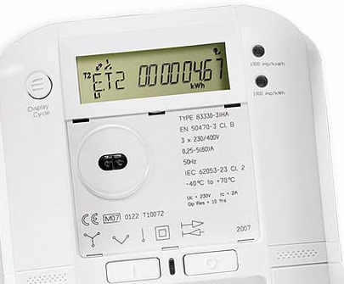
ZigBee Smart Energy Standard
November 2011
Supported Features Include:
  Basic metering [measurements, historical info, etc]
  Demand Response (DR) and Load Control
  Pricing [multiple units & currencies, price tiers, etc.]
  Text messages
  Device support for Programmable Communicating Thermostats (PCTs), Load Controllers, Energy Management Systems, In Home Displays (IHDs), etc.
  Security to allow consumer only, utility only, or shared networks
  Support for water and gas
Slide 49
Bob Heile, ZigBee Alliance

Slide 50
Recent ZigBee Smart Energy Enhancements
November 2011
Standardized Over-the-Air Bootloader
Enhanced Price Cluster Support
  Block tariffs, in which price changes are triggered by accumulated consumption, rather than time of day
  Price acknowledgements, application-level messages acknowledging receipt of a price update by a device
Tunneling Support
  Tunneling manufacturer-specific messages from back-office systems to in-home devices through an ESI
  Tunneling other standards-based protocols, such as ANSI C12.18 or DLMS COSEM
Meter Swap-Out Support
  Simplified Trust Center replacement & device re-provisioning
Prepayment
  Credit monitoring & connect/disconnect notification
Slide 50
Bob Heile, ZigBee Alliance

Slide 51
Origins of SEP2
November 2011
Slide 51
Bob Heile, ZigBee Alliance
IP version of the Smart Energy Application Profile standard released by the ZigBee Alliance in May 2008
Driven initially by NIST/DOE SGIP activities

Slide 52
SEP 2.0 Stack Overview and Responsibilities
November 2011
Slide 52
Bob Heile, ZigBee Alliance

Slide 53
6LoWPAN
November 2011
Header Compression and Fragmentation
  Needed due to 802.15.4’s 127 octet MTU
  Stateless
Neighbor Discovery
  Standard IPv6 ND not sufficient
IETF 6LoWPAN WG
Slide 53
Bob Heile, ZigBee Alliance

Slide 54
Routing Protocol for Low Power and Lossy Networks (RPL)
November 2011
“Route-Over” mesh routing protocol
  Messages run over IP
  Each link appears as an IP link
Directed Acyclic Graph
Source Routing
IETF ROLL WG (Routing over Lossy Links)
Slide 54
Bob Heile, ZigBee Alliance

Slide 55
Transport Layer Security (TLS)
November 2011
Security used at application layer
May also be used at link layer
Think ‘https’
Certificates
  A specific ECC cipher suite agreed as the mandatory cipher suite in Cincinnati
  A specific RSA cipher suite agreed as an optional cipher suite in Cincinnati
Slide 55
Bob Heile, ZigBee Alliance

Slide 56
PANA / EAP-TLS / EAP-PSK
November 2011
PANA (Protocol for carrying Authentication for Network Access ) is used for three-way negotiation onto a PAN
Used for link layer network admission (moving network key, etc.)
Runs over IP
EAP (Extensible Authentication Protocol) is simply a header to designate particular authentication protocol
  TLS (certificates)
  PSK (pre-shared keys)
Slide 56
Bob Heile, ZigBee Alliance

Slide 57
APP SUPPORT SPEC
November 2011
Slide 57
Bob Heile, ZigBee Alliance

Slide 58
App Support Spec
November 2011
Was a stand alone document managed by the ZigBee IP Working Group
Will be folded into the SEP2 App Spec for multiple MAC/PHY scenarios
Slide 58
Bob Heile, ZigBee Alliance

Slide 59
HTTP
November 2011
The web protocol we all know and love
Used to interact with ‘resources’ in a ‘RESTful’ (Representational State Transfer) manner
  4 verbs: GET, PUT, POST, DELETE
Driven by desire to have a long-lived protocol and a familiar protocol for consumer interactions
Slide 59
Bob Heile, ZigBee Alliance

Slide 60
mDNS(Multicast DNS)
November 2011
Familiar to many via Apple Bonjour
Enables DNS names without the need for a centralized DNS server
Used in conjunction with DNS-SD to provide device and service discovery
Slide 60
Bob Heile, ZigBee Alliance

Slide 61
SEP 2.0 APP SPEC
November 2011
Slide 61
Bob Heile, ZigBee Alliance

Slide 62
Efficient XML Interchange (EXI)
November 2011
Slide 62
Bob Heile, ZigBee Alliance
Tokenized XML
W3C standard
Message format of the HTTP resources

Slide 63
CIM (Common Information Model)
November 2011
The “what”--Metering, Pricing, etc.
IEC standard (61968/61970)
Semantic model used
UML -> Schema -> Resources
Slide 63
Bob Heile, ZigBee Alliance

Slide 64
DNS-SD (Service Discovery)
November 2011
Used in conjunction with mDNS
Service discovery --Types and Sub-Types
Essentially just DNS TXT records
  “Give me all smartenergy devices”
  “Give me all smartenergy metering devices”
Returns various information such as path
Slide 64
Bob Heile, ZigBee Alliance

Slide 65
STATUS
November 2011
Slide 65
Bob Heile, ZigBee Alliance

Slide 66
We are getting there…
November 2011
Have divided work into groups led by Section Champions
Have split out ZigBee SE1.x activity into its own Working Group
Most, if not all, contentious items thought to be resolved
First Interop event scheduled for Nov 28
Slide 66
Bob Heile, ZigBee Alliance

Slide 67
Update on SEP 2
Test & Certification Consortium
67

Slide 68
The MoU - Agreement
November 2011
Agreed in late July to establish a MAC/PHY independent testing and certification scheme for SEP 2.0 with industry stakeholders
An MoU was signed by three major Alliances –HomePlug, Wi-Fi, & ZigBee
Sole focus of the MoU and Consortium is about test & certification for SEP2
Slide 68
Bob Heile, ZigBee Alliance

Slide 69
Consortium Makeup
November 2011
Sponsors
  Industry Trade Associations supporting recognized MAC/PHYs
  Member of the Steering Committee
  Operate an established certification program with commercially available products
  Demonstrated commitment to SEP2 operation with MAC/PHY
  Demonstrated method for public access to MAC/PHY specs
Promoters
  Business interest in SEP2 certification
  Intend to test
  Industry trade association or government entity
General Members
  Can not participate in the technical committee or development of test materials
  Access limited to final test materials
Slide 69
Bob Heile, ZigBee Alliance

Slide 70
Technical Committee (TC) [1/2]
November 2011
TC is responsible for creating MAC/PHY-independent test materials that will be used to certify SEP2 products
Initially led by three Co-Chairs Pro Tem (to develop charter, scope, organization)
TC will propose its operating guidelines and work plan; it may create subgroups
Combination of conference calls, face-to-face meetings, and plugfests
Slide 70
Bob Heile, ZigBee Alliance
Notes:
70

Slide 71
Technical Committee (TC) [2/2]
November 2011
Any company that is a member in good standing of any of the Sponsors or Promoters may participate in the TC providing they execute a registration form and an IPR Agreement
Voting rights are by “participant member” company, not by individual
Voting rights are obtained & maintained by active participation in the TC (2/3 last meetings)
Slide 71
Bob Heile, ZigBee Alliance
Notes:
71

Slide 72
November 28th Test Event
November 2011
ZigBee Alliance sponsored event for SEP 2.0 Application Specification testing regardless of underlying MAC/PHY
NTS to host in Culver City, CA.
To ensure equal IPR protection, Non Members with SEP2 products are invited to participate if the they execute an Event Participation Agreement
Register on zigbee.org
Slide 72
Bob Heile, ZigBee Alliance

Slide 73
Questions?
November 2011
Slide 73
Bob Heile, ZigBee Alliance

Slide 74
802.15 TG4g
Phil Beecher
74

Slide 75
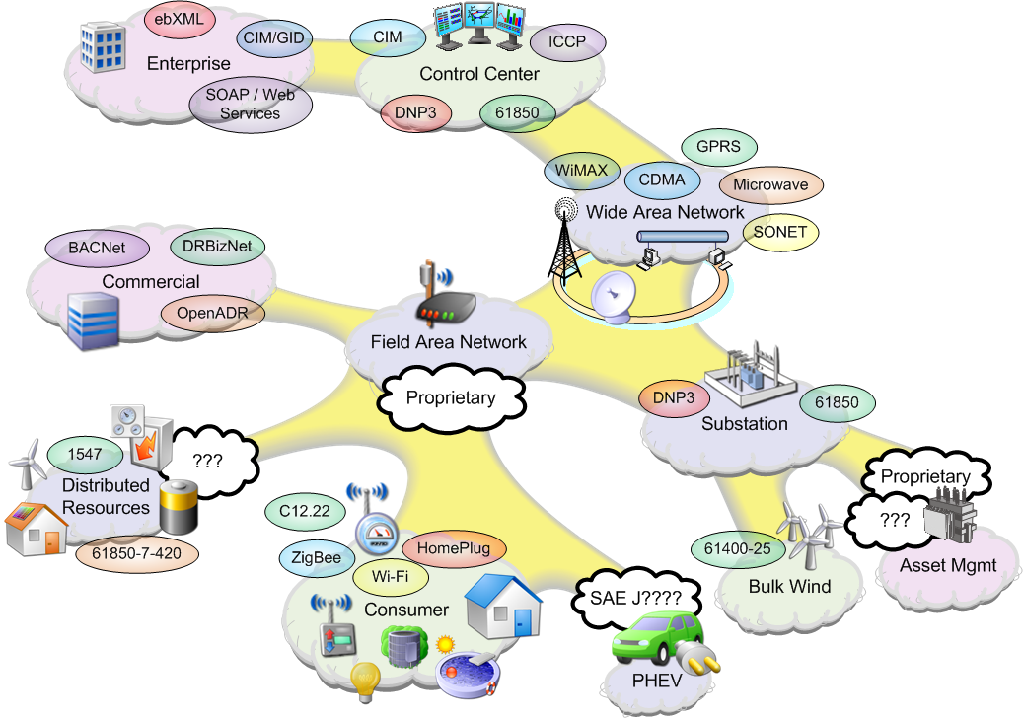
Smart Grid Domains – 802.15 TG4g
IEEE 802.15
TG4g Network

Slide 76
TG4g-SUN PAR Scope
This Standard defines an amendment to IEEE 802.15.4. It addresses principally outdoor Low Data Rate Wireless Smart Metering Utility Network requirements. It defines an alternate PHY and only those MAC modifications needed to support its implementation.
Specifically, the amendment supports all of the following:
Operation in any of the regionally available license exempt frequency bands, such as 700MHz to 1GHz, and the 2.4 GHz band.
Data rate of at least 40 kbits per second but not more than 1000 kbits per second
Achieve the optimal energy efficient link margin given the environmental conditions encountered in Smart Metering deployments.
Principally outdoor communications
PHY frame sizes up to a minimum of 1500 octets
Simultaneous operation for at least 3 co-located orthogonal networks
Connectivity to at least one thousand direct neighbors characteristic of dense urban deployment
Provides mechanisms that enable coexistence with other systems in the same band(s) including IEEE 802.11, 802.15 and 802.16 systems
Slide 76
Slide 76
Notes:
07/12/10
Page 76
Jul 12, 2010
Page 76

Slide 77
TG4g-SUN PAR Purpose
To provide a global standard that facilitates very large scale process control applications such as the utility smart-grid network. This amendment supports large, geographically diverse networks with minimal infrastructure. Smart Metering Utility Networks can potentially contain millions of fixed endpoints. The communication range, robustness, and coexistence characteristics required for this class of application have not been met with existing 802 standards (See explanatory notes in Section 8.1 Doc#15-08-705).
Slide 77
Slide 77
Notes:
07/12/10
Page 77
Jul 12, 2010
Page 77

Slide 78
IEEE 802.15 TG4g Highlights
Key features
  Three PHYS: FSK, OFDM and OQPSK
  FSK mode is mandatory
  Multiple Data rates supported
  Operation in multiple global frequency bands defined with flexibility to add new frequency bands
  Frequency hopping / channel agility where appropriate
  Large frame sizes providing direct support for IP frames without 6LoWPAN
  Optional forward error correction
  Support for coexistent networks
Notes:
78

Slide 79
TG4g-SUN History
September 2008
Study Group Formed
November 2008
PAR Approved
March 2010
1st Working Group Letter Ballot - failed
September 2010 – June 2011
Working Group Letter Ballots and Recirculation Ballots
July 2011– November 2011
Sponsor Ballot and Recirculation Ballot

Slide 80
TG4g-Sponsor Ballot Results
Slide 80
Slide 80
Notes:
07/12/10
Page 80
Jul 12, 2010
Page 80

Slide 81
Questions?

Slide 83
Smart Grid Information Update
November 2011
Wi-Fi Activities
IEEE 802 LMSC Tutorial
Atlanta, GA, USA

Slide 84
Wi-Fi technology has all the key building blocks for an effective, efficient smart grid
The Smart Grid needs solutions that are…
Widely-used
Compatible
Security- protected
IP-based
Produced in scale
More than 1B users and 2B products
11+ years of backward compatibility
WPA2 in every chip
IP networks and device to device
1B units in 2011
Wi-Fi technology delivers today!

Slide 85

Wi-Fi: The world’s home networking technology extends to smart energy use cases
Loved by consumers and specified by
broadband service providers
Whole-home coverage that
extends outdoors
Device-to-device and
traditional networking models;
all interoperate
Connect an entire household
of appliances, consumer
electronics, automobiles and
smart energy devices on a
single technology
Notes:
85

Slide 86
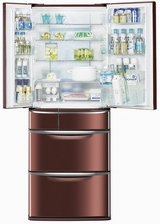
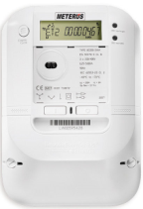
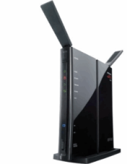
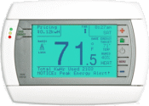
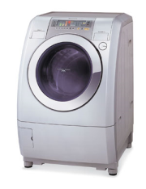
Wi-Fi brings more: Internet connectivity for remote management and two-way interaction
Utility AMI
Network
Internet
Notes:
86

Slide 87
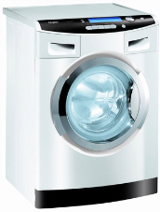
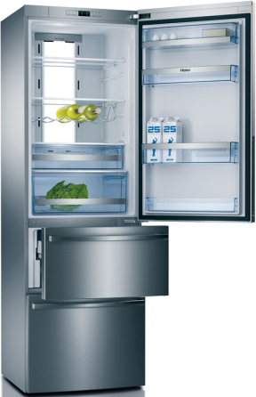
Wi-Fi: Connecting appliances
Efficient home appliances conserve energy and
when connected with Wi-Fi, contribute to a successful
smart grid
Consumer is able to manage their own energy
use, even remotely
Communicate with in-home and utility
energy management systems
AHAM (Association of Home Appliance Manufacturers) specified Wi-Fi as one of three top-rated smart appliance communications technologies
  Task force included 12 major appliance manufacturers
Notes:
87

Slide 88

Wi-Fi: Connecting consumer electronics
Consumer electronics (excluding handsets) now represent 25% of all Wi-Fi shipments worldwide
Wi-Fi becoming very desirable feature in televisions, set top boxes, gaming devices and high-end audio system
Advanced features to improve
performance in multimedia
applications will increase
Wi-Fi’s pervasiveness in
CE category
Compelling opportunity to connect
energy-consuming CE devices to
home energy management
systems; no new technology
needed

Slide 89
Wi-Fi and Consortium for SEP 2 Interoperability
Smart Energy Profile 2 (SEP 2) will be central for smart energy networks in home, commercial and enterprise settings
  SEP 2 applications manage the data transfer between two devices
Wi-Fi Alliance is founding SEP 2 Consortium with several technology organizations to ensure SEP 2 works on a variety of technologies
  Joint certification and test program to certify wireless and wired devices
  Addresses devices such as thermostats, appliances and gateways
  Application and device interoperability for the smart energy ecosystem ­– including utilities, product vendors and consumers
  Goal is to deliver an interoperability program as soon as possible
Wi-Fi Alliance presented the first large-scale multi-vendor demonstration of SEP 2 over Wi-Fi earlier this year
Notes:
89

Slide 90
Wi-Fi Alliance activities underway to address smart grid
Regulatory and government outreach
Technology and testing development
Liaisons and industry collaboration
Certification program for Smart Energy Profile 2 (SEP2) in development
Collaboration with other industry bodies (HomePlug, ZigBee, etc.)
Work with utilities focused on education and two-way exchange
Additional development work in power management protocols to address M2M usages
Expertise and input to government agencies and regulatory bodies
Notes:
90

Slide 92
Smart Grid Information Update
November 2011
IEEE Activities
IEEE 802 LMSC Tutorial
Atlanta, GA, USA

Slide 93
IEEE Smart Grid Website Structure
http://smartgrid.ieee.org/
IEEE & Smart Grid
Conferences
Publications
Standards
Societies
Resources

Slide 94
IEEE Banner Line
IEEE has the expertise to make smart grid a reality
IEEE is one of the very few organizations able to provide industry with a wide diversity of expertise, information, resources and the vision necessary to realize the smart grid’s full potential. Those resources include the IEEE Xplore digital library, which includes journal articles covering the most current research and conference proceedings, including "IEEE Innovative Smart Grid Technologies 2010" and the new "IEEE Smart Grid World Forum."
To date, nearly 2,500 papers focused on smart grid have been published in over 40 IEEE journals. IEEE has nearly 100 standards and standards in development relevant to smart grid, including the over 20 IEEE standards named in the NIST Framework and Roadmap for Smart Grid Interoperability Standards, Release 1.0. The NIST report describes a high-level reference model for the smart grid, identifies nearly 80 existing standards that can be used now to support its development, and identifies high priority gaps for which new or revised standards are needed.

Slide 95
Media Coverage (example from August)
FierceSmartGrid
Q&A with IEEE's Russell Lefevre
http://www.fiercesmartgrid.com/story/qa-ieees-russell-lefevre/2011-08-31
Smart Grid News
Surprising Deployment Developments by David Fox-Penner (IEEE newsletter)
http://www.smartgridnews.com/artman/publish/Business_Lessons_Learned/Jesse-s-summer-reading-list-including-the-best-book-yet-about-the-smart-grid-3928.html
Connected Planet
IEEE ’surprising’ smart grid findings won’t surprise rural readers
By Joan Engebretson
http://blog.connectedplanetonline.com/unfiltered/2011/08/16/ieee-surprising-smart-grid-findings-wont-surprise-rural-readers/
Utility Products
August Issue of IEEE Smart Grid Newsletter Features Smart Grid Early Adopters
http://www.utilityproducts.com/news/2011/08/1481254804/august-issue-of-ieee-smart-grid-newsletter-features-smart-grid-early-adopters.html

Slide 96
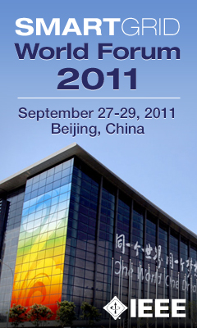
Past Conference Events

Slide 97
Future Conference Events
SMFG 2011 (Smart Measurements for Future Grids 2011)
http://smfg2011.ieee-ims.org/
The event will start on: Nov 14, 2011
And will end on: Nov 16, 2011
The power grids of the future come into reality by enabling intelligent communication across sensing, measurement, and control layers of the existing power systems.
ISGT Australia 2011 (IEEE Power & Energy Society Innovative Smart Grid Technologies Australia 2011)
http://isgtasia2011.com/
The event will start on: Nov 13, 2011
And will end on: Nov 16, 2011
The conference brings together University, Industry and Government people to discuss the latest innovation, up to date experiences and policy issues in Smart Grid development.

Slide 98
Future events
IEEE PES
Innovative Smart Grid Technologies Europe
October 14 - 17, 2012
Berlin, Germany
http://www.ieee-isgt-2012.eu/isgt2012/

Slide 99

IEEE SmartGridComm ’12
Tainan City, Taiwan November 5-8 2012
Third IEEE International Conference on Smart Grid Communications
http://www.ieee-smartgridcomm.org/

Slide 100
Publications
The latest Smart Grid research papers, working group reports and other valuable information is disseminated through the serial publication of IEEE Transactions on Smart Grid, and in the proceedings of conferences sponsored or co-sponsored by IEEE.
IEEE Transactions on Smart Grid
A joint publication of Computational Intelligence Society, Communications Society, Computer Society, Control Systems Society, Industry Applications Society, Industrial Electronics Society, Instrumentation and Measurement Society, Power Electronics Society, Power & Energy Society, Signal Processing Society.

Slide 101
Publications
The Transactions welcomes manuscripts on design, implementation and evaluation of energy systems that include smart grid technologies and applications. Surveys of existing work on smart grid may also be considered for publication when they propose a challenging perspective on the future of such technologies and systems.
The initial topical issues considered by the Transactions include:
Smart sensing, communication and control in energy systems
Wireless communications and advanced metering infrastructure
Smart grid for energy management in buildings and home automation
Phasor measurement unit applications for smart grid
Smart grid for plug-in vehicles and low-carbon transportation alternatives
Smart grid for cyber and physical security systems
Smart grid for distributed energy resources
Smart grid for energy savings and financial management
Smart grid in interdependent energy infrastructures
Smart grid for intelligent monitoring and outage management

Slide 102
Standards
IEEE has more than 100 standards and standards in development relevant to smart grid, including the over 20 IEEE standards named in the NIST Framework and Roadmap for Smart Grid Interoperability Standards, Release 1.0. The NIST report describes a high-level reference model for the Smart Grid, identifies nearly 80 existing standards that can be used now to support Smart Grid development and identifies high priority gaps for which new or revised standards are needed.

Slide 103
Standards
Standards currently in development include:
IEEE P2030 Draft Guide for Smart Grid Interoperability of Energy Technology and Information Technology Operation with the Electric Power System (EPS), and End-Use Applications and Loads
IEEE 802 LAN/MAN Standards Series
IEEE SCC21 1547 Standards for Interconnecting Distributed Resources with Electric Power Systems
IEEE Standard 1159 for Monitoring Electric Power Quality
IEEE Standard 762: Standard Definitions for Use in Reporting Electric Generating Unit Reliability, Availability, and Productivity
IEEE SCC 31 Automatic Meter Reading and Related Services

Slide 104
IEEE Smart Grid Newsletter
A monthly publication
The IEEE Smart Grid Newsletter features practical and timely technical information, and forward-looking commentary, on Smart Grid developments and deployments around the world. Designed to foster greater understanding and collaboration between diverse stakeholders, the newsletter brings together experts, thought-leaders, and decision-makers to exchange information and discuss issues affecting the evolution of the Smart Grid.
http://smartgrid.ieee.org/newsletter

Slide 105
Recent Newsletter examples
The Role of Demand Side Management
Future Grids Will Not Be Controllable Without Thinking Machines
Arrival of Smart Appliances Is a Milestone on the Path to the Smart Grid
Keeping Guard on Power Quality for Better Quality of Service

Slide 107
Smart Grid Information Update
November 2011
NIST PAP2
IEEE 802 LMSC Tutorial
Atlanta, GA, USA

Slide 108
Energy Motivation
108

Slide 109
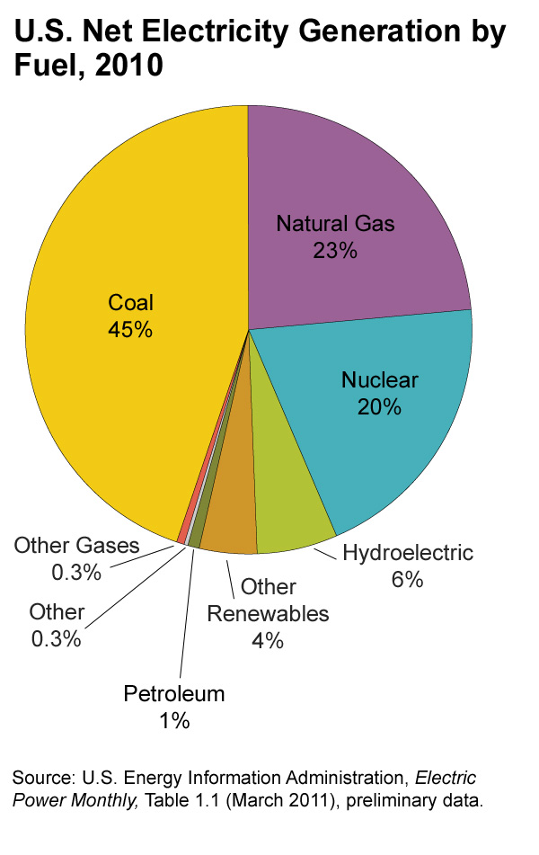
US Electric Generation
109

Slide 110
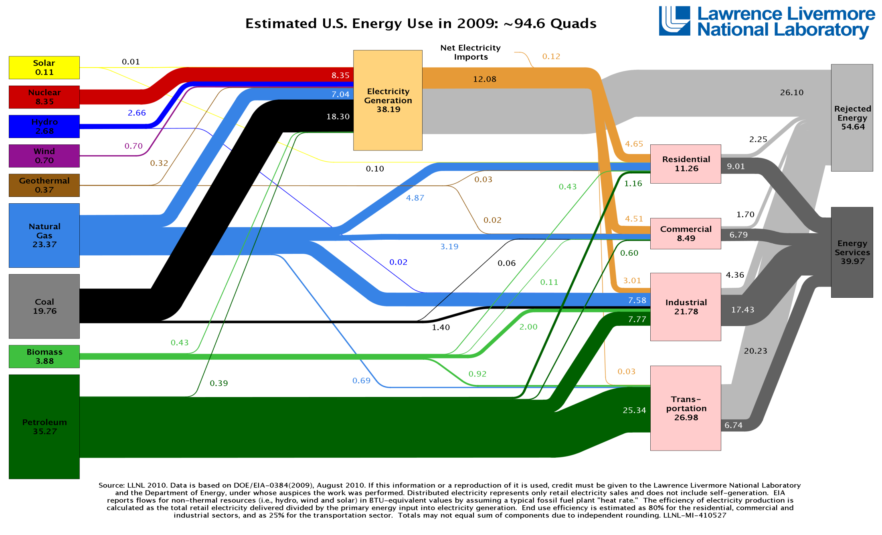
US Energy Use - 2009
70%
110

Slide 111
Government Motivation
111

Slide 112
Energy Independence & Security Act (2007)
EISA 2007 Directs National Institute of Standards & Technology (NIST) to:
  Coordinate the development of model standards for interoperability of smart grid devices and systems
    Create flexible, uniform, and technology neutral standards
EISA Directs FERC, when sufficient consensus, to:
  Adopt standards necessary to insure smart-grid functionality and interoperability in the interstate transmission of electric power, and regional and wholesale electricity markets
State Commissions:
  May consider standards when approving utility investments
Considerations for Regulators:
  Ensuring interoperability & security, without impeding innovation
  Consistent action will influence the vendor community
  Vendors often will follow standards that are not legally mandated
  SGIP standards reflect efforts to build broad stakeholder consensus
112

Slide 113
NIST SGIP Origins
Energy Independence and Security Act (EISA) of 2007
Title XIII, Section 1305.
Smart Grid Interoperability Framework
In cooperation with the DoE and other stakeholders, NIST has “primary responsibility to coordinate development of a framework that includes protocols and model standards for information management to achieve interoperability of smart grid devices and systems…”
113
Notes:
113

Slide 114
The American Recovery and Reinvestment Act
ARRA enacted 2009
$11 Billion for Smart Grid Technology
  40 million smart meters
  850 phasor measurement units
  Insulation
  ….
114

Slide 115
Standards
“Sound interoperability standards are needed to ensure that sizable public and private sector technology investments are not stranded. Such standards enable diverse systems and their components to work together and to securely exchange meaningful, actionable information.”
- NIST
115

Slide 116
Level of Urgency
The $3.4 billion in U.S. Smart Grid Investment Grants, combined with matching $4.7 billion in private funds ($8.1 billion total) will result in deployment, over the next 3-4 years of
  40 million smart meters (about 1/4 of the total meter base in the U.S.)
  850 phasor measurement units covering 100% of the grid
  200,000 smart transformers
  700 automated substations
  1 million in-home displays
  170,000 smart thermostats
  175,000 other load control devices.
There is only a very small window of opportunity to specify the standards that will be used in these deployments since they will be completed within 3-4 years.
116

Slide 117
NIST SGIP Projects
117

Slide 118
SGIP Catalog of Standards
The catalog is a compendium of standards and practices considered to be appropriate for the development and deployment of a robust and interoperable Smart Grid.
In general, compliance with a standard does not guarantee interoperability due to the above reasons or due to vagueness or under-specification in the base document. The SGIP as a part of its work program is defining a testing and certification program that may be applied to the standards listed in the catalog
http://collaborate.nist.gov/twiki-sggrid/bin/view/SmartGrid/SGIPCatalogOfStandards

Slide 119
Rationale for Priority Action Plans (PAPs)
National Institute of Standards and Technology (NIST) is proposing a set of priorities for developing standards necessary to build an interoperable Smart Grid. Among the criteria for inclusion on this initial list were immediacy of need, relevance to high-priority, availability of existing standards to respond to the need, state of the deployment of affected technologies, and estimated time frame to achieve an effective solution.
To facilitate timely and effective responses to these needs, NIST has drafted a preliminary Priority Action Plan (PAP) for each need. The PAPs are intended to scope out problem areas and to begin clarifying the steps required for achieving solutions.
PAPs are intended to facilitate progress, which includes more detailed definition of needs and identifying the appropriate actions and actors for accomplishing modifications or enhancements to standards as well as the harmonization required.
119
Notes:
119

Slide 120
Priority Action Plans
# | Priority Action Plan | # | Priority Action Plan
 |  | 1 | Role of IP in the Smart Grid
2 | Wireless Communications for the Smart Grid | 3 | Common Price Communication Model
4 | Common Schedule Communication Mechanism | 5 | Standard Meter Data Profiles
6 | Common Semantic Model for Meter Data Tables | 7 | Electric Storage Interconnection Guidelines
8 | CIM for Distribution Grid Management | 9 | Standard DR and DER Signals
10 | Standard Energy Usage Information | 11 | Common Object Models for Electric Transportation
12 | Mapping IEEE 1815 (DNP3) to IEC 61850 Objects | 13 | Harmonization of IEEE C37.118 with IEC 61850 and Precision Time Synchronization
14 | Transmission and Distribution Power Systems Model Mapping | 15 | Harmonize Power Line Carrier Standards for Appliance Communications in the Home
16 | Wind Plant Communications | 17 | Facility Smart Grid Information Standard
18 | SEP 1.x to SEP 2 Transition and Coexistence
120

Slide 121
IP Priority Action Plan
Develop Smart Grid application communication requirements and devise a taxonomy for applications with similar network requirements
  Draft matrix under development and available for review http://collaborate.nist.gov/twiki-sggrid/pub/SmartGrid/PAP02Wireless/app_matrix_pap.xls
Identify a Core Protocol Suite for IP-based Smart Grid
  IETF drafts and reports submitted for considerations
  http://collaborate.nist.gov/twiki-sggrid/bin/view/SmartGrid/PAP01InternetProfile
Develop Application-Specific Protocol Requirements
  Identify additional protocols or protocol enhancements beyond the core suite required by a specific class of applications
  Develop guidelines for IP-based Smart Grid networks
Perform Gap Analysis
  Identify new protocol or protocol enhancement standardization activities required to fully support the Smart Grid Vision
121
Notes:
Rewrite task 1 to state that these are application requirements that will need to be satisfied by Smart Grid
Task and 2 are near term, 3 is mid term, and 4 is mid to long term
Task 4 is about fulfilling long term vision and may be support for applications that don’t exist at all today
121

Slide 122
NIST SGIP Projects
122

Slide 123
Wireless Priority Action Plan
Develop Smart Grid application communication requirements and devise a taxonomy for applications with similar network requirements
  Draft under development and available for review http://collaborate.nist.gov/twiki-sggrid/pub/SmartGrid/PAP02Wireless/app_matrix_pap.xls
Develop terminology and definitions
Create an attribute list and performance metrics for wireless standards
  Draft developed and available for review
  http://collaborate.nist.gov/twiki-sggrid/pub/SmartGrid/PAP02Wireless/NIST_PAP2-_Wireless_Characteristics-IEEE802-v_02.xls
Create an inventory of wireless technologies and standards that are identified by each SDO
  Feedback is expected by December 6, 2009.
Conduct an evaluation of the wireless technologies based on the application requirements
Perform a gap analysis and developing guidelines for the use of wireless technologies.
123

Slide 124
PAP#2 Report Outline Jan 13, 2011
1. Introduction
2. Acronyms, Definitions
3 Smart grid Reference Architecture, Actors, Use Cases
3.4 Application requirements
3.4.1 Smart grid user applications’ quantitative requirements
3.4.2 Aggregation of requirements per actor to actor
4 Wireless Technology
5 Evaluation approach / Modeling approach
5.1 Channel Models
5.1.1 Indoor-indoor environments
5.1.2 Outdoor-outdoor environments
5.1.3 Outdoor-indoor environments
5.2 Physical Layer
5.3 MAC sublayer
5.4 Example Modeling Tool
5.5 Other Tools
6 Findings / Results
7 Conclusions
8 References
9 Bibliography

Slide 125
NIST PAP#2 Report – Section 4
4.1 Technology Descriptor Headings
To be able to describe wireless technology a set of characteristics were identified and organized into logical groups. The group titles are listed below.
  • 1. Link Availability
  • 2. Data/Media Type Supported
  • 3. Coverage Area
  • 4. Mobility
  • 5. Data Rates
  • 6. RF Utilization
  • 7. Data Frames & Packets
  • 8. Link Quality Optimization
  • 9. Radio Performance Measurement & Management
  • 10. Power Management
  • 11. Connection Topologies
  • 12. Connection Management
  • 13. QoS & Traffic Prioritization
  • 14. Location Characterization
  • 15. Security & Security Management
  • 16. Radio Environment
  • 17. Intra-technology Coexistence
  • 18. Inter-technology Coexistence
  • 19. Unique Device Identification
  • 20. Technology Specification Source
  • 21. Deployment Domain Characterization

Slide 126
PAP#2 Obervations
First report was not as complete or useful as expected in providing:
Utilities with definitive guidelines for selection among Wireless options
SDOs with Catalog of Standards recognitions
Project needed to be continued

Slide 127
PAP#2 Extended Goals
Utility side:
Complete the specification of source to sink smart grid data traffic
Actors
Payload sizes
Routing
Frequency
Security

Slide 128
UCAIUG: SG NET SRS
Smart Grid Networks System Requirements Specification
Release Candidate 3 revision
Monday, November 07, 2011

Slide 129
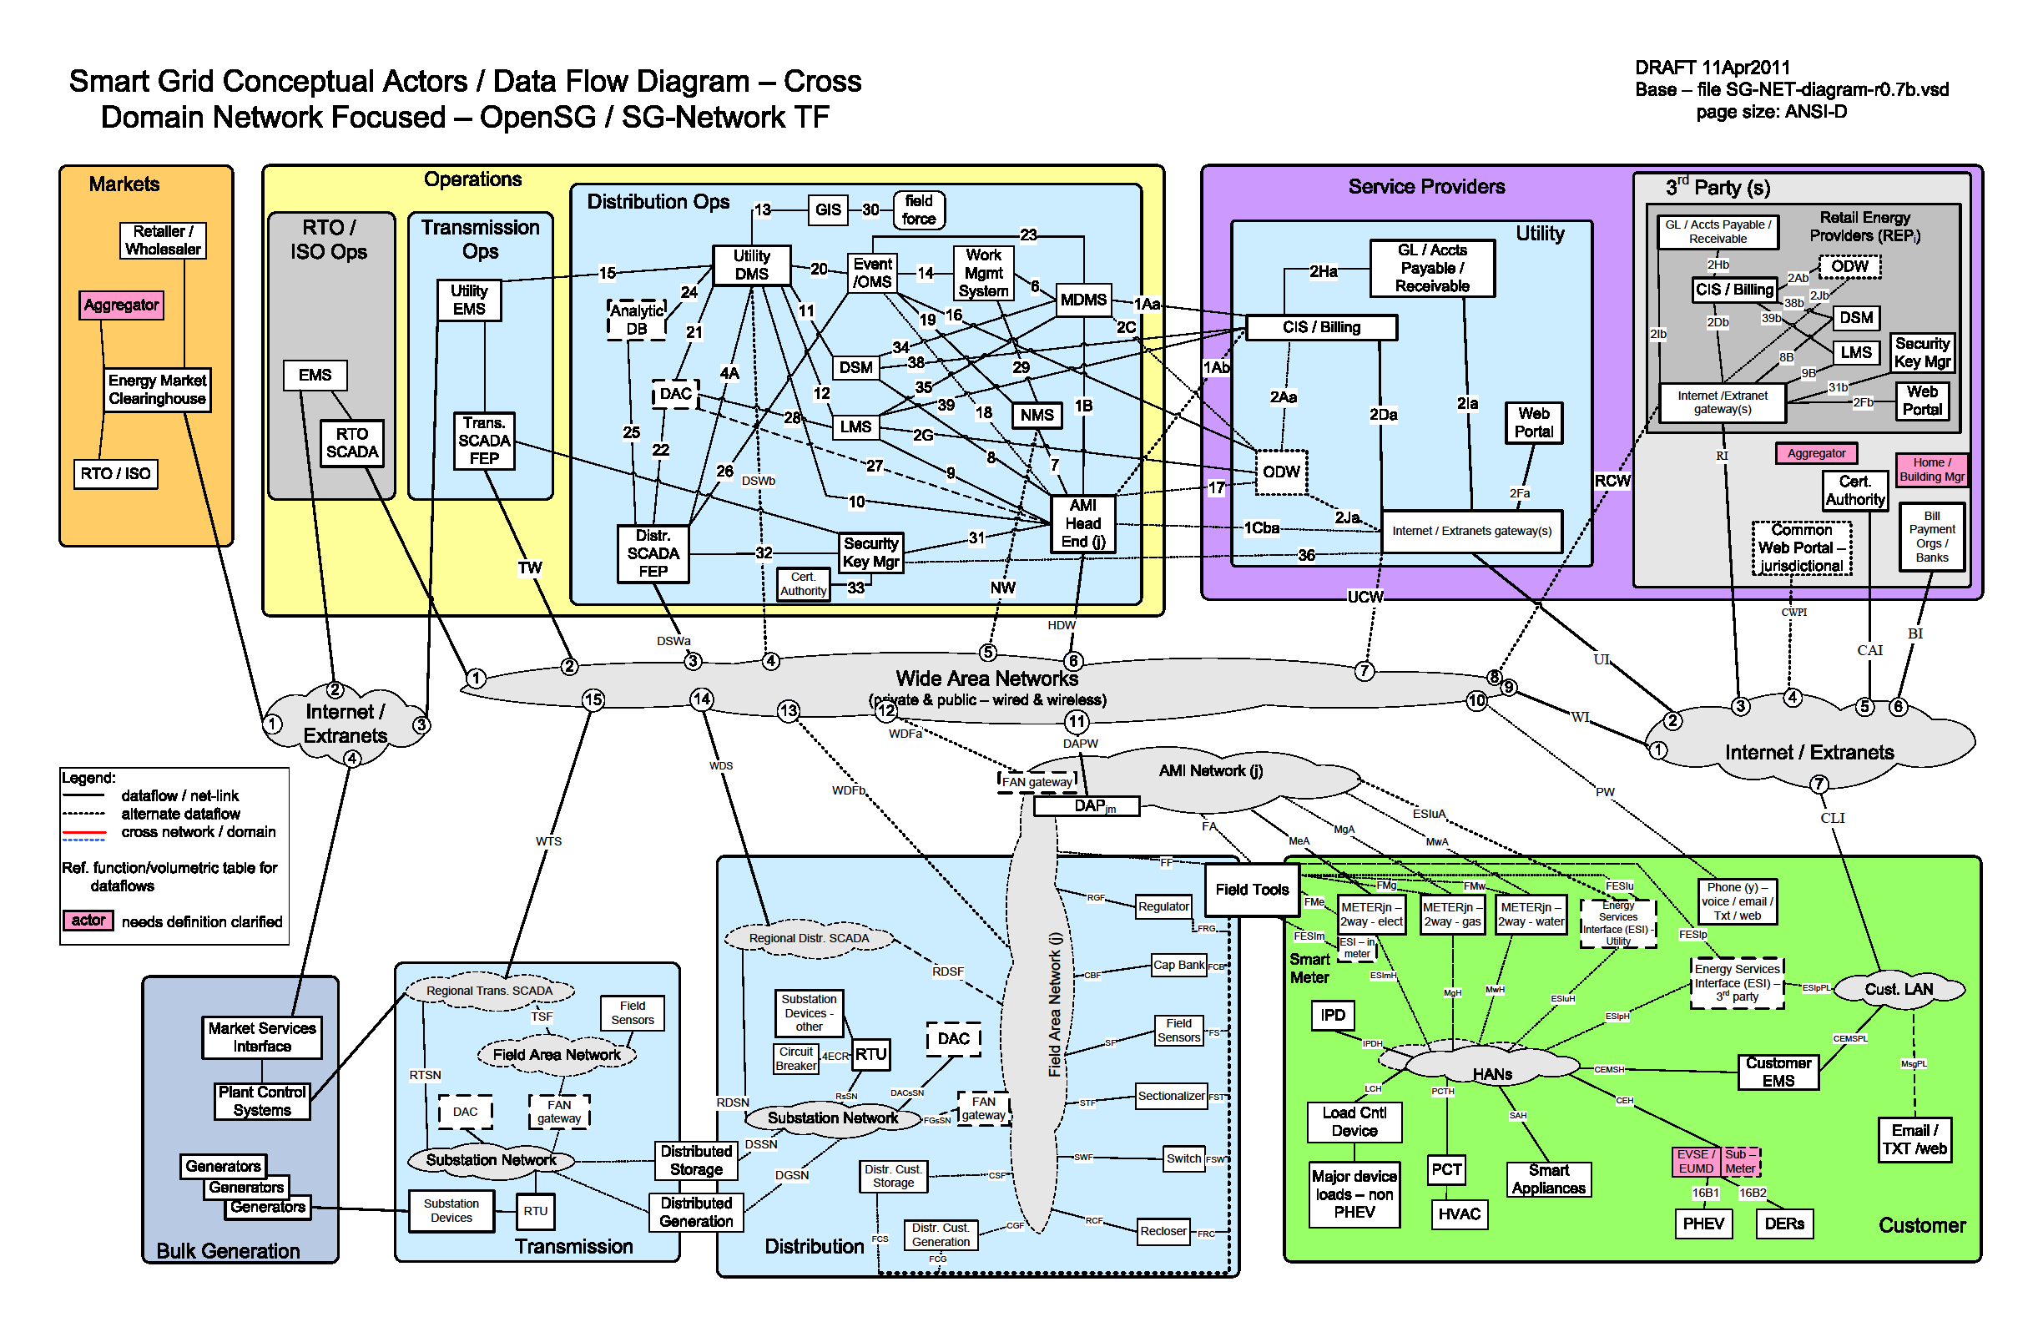
OpenSG Traffic Flows

Slide 130
PAP#2 Extended Goals
Technology side:
Work required cooperation
  Formed SDO subcommittee
Improve the clarity of wireless characterisitics
  Rewrite Section 4
Quantitatively define the range and data rate characteristics in typical deployment scenarios
  Rewrite Section 5
  Develop propagation tool

Slide 131
PAP#2 Extended Goals
Work will ongoing within….
OpenSG
802 Smart Grid ad hoc
PAP2 SDO
Wireless Guideline Report Version2 Completion target July 2012

Slide 132
PAP#2 Extended Goals
Further details Available in Smart Grid ad hoc this week
Two sessions
Tuesday pm2 - Hanover E
Thursday pm2 - Hanover C

Slide 133
NIST SGIP
Publications
&
References
133

Slide 134
Key SGIP Publications
Smart Grid Interoperability Panel Catalog of Standards
NIST-identified Standards for Consideration by Regulators, Release 1.0
GAO Report 11-117:Electricity Grid Modernization
NISTIR 7628 Guidelines for Smart Grid Cyber Security (3 vols.)
  http://csrc.nist.gov/publications/nistir/ir7628/nistir-7628_vol1.pdf
  http://csrc.nist.gov/publications/nistir/ir7628/nistir-7628_vol2.pdf
  http://csrc.nist.gov/publications/nistir/ir7628/nistir-7628_vol3.pdf
NIST Framework and Roadmap for Smart Grid Interoperability Standards, Release 1.0
http://collaborate.nist.gov/twiki-sggrid/pub/SmartGrid/IKBFramework/NISTFrameworkAndRoadmapForSmartGridInteroperability_Release1final.pdf
NIST Framework and Roadmap for Smart Grid Interoperability Standards, Release 2.0 (204 pages)
http://collaborate.nist.gov/twiki-sggrid/pub/SmartGrid/IKBFramework/Draft_NIST_Framework_Release_2-0_7-11-2011_clean.docx
Charter for the Smart Grid Advisory Committee
134

Slide 135
PAP#2 Version 1
May 2011
Guideline for Assessing Wireless Standards for Smart Grid Applications
Version 1.0 released Jan 13, 2011
http://collaborate.nist.gov/twiki-sggrid/pub/SmartGrid/PAP02Objective3/NIST_PAP2_Guidelines_for_Assessing_Wireless_Standards_for_Smart_Grid_Applications_1.0.pdf
Slide 135
Bruce Kraemer, Marvell

Slide 136
Sources
NIST Smart Grid web site
  http://www.nist.gov/smartgrid/
NIST Smart Grid Twiki
  http://collaborate.nist.gov/twiki-sggrid/bin/view/SmartGrid/WebHome
IP Priority Action Plan
  http://collaborate.nist.gov/twiki-sggrid/bin/view/SmartGrid/PAP01InternetProfile
Wireless Priority Action Plan
  http://collaborate.nist.gov/twiki-sggrid/bin/view/SmartGrid/PAP02Wireless
136

Slide 137
Links to Other US Activities
137
Department of Energy
Smartgrid.gov
National Association of Regulatory Commissioners (NARUC)
Federal Energy Regulatory Commission
Smart Grid Information Clearinghouse
North American Electric Reliability Corporation (NERC)

Slide 138
Thank You

