Slide 1
Project: IEEE P802.15 Working Group for Wireless Personal Area Networks (WPANs)
Submission Title: TV White Space Related Regulations and Activities for WPAN
Date Submitted: November 7, 2011
Source: Soo-Young Chang, California State University Sacramento, and Mi-Kyung Oh, and Sangsung Choi,
Electronics and Telecommunications Research Institute(ETRI)
Voice: +1 530 574 2741, E-maill: sychang@ecs.csus.edu
Re: [802.15 SG 4TV]
Abstract: TV white space related regulations and activities which may be related to future operations for WPAN are summarized.
Purpose: To provide information on the rules and activities to the 802.15 TG4m group
Notice: This document has been prepared to assist the IEEE P802.15. It is offered as a basis for discussion and is not binding on the contributing individual(s) or organization(s). The material in this document is subject to change in form and content after further study. The contributor(s) reserve(s) the right to add, amend or withdraw material contained herein.
Release: The contributor acknowledges and accepts that this contribution becomes the property of IEEE and may be made publicly available by P802.15.
Slide 1

Slide 2
Contents
Definition of white space
Definition of white space
Incumbent users
FCC Decision, Et Docket 04-186
Title 47 CFR Part 15 Subpart H
White Space Activities
US
Ofcom
UK
EU
Canada
Asia
Slide 2

Slide 3
DEFINITION OF WHITE SPACE (1)
White space
unused radio spectrum which has either never been used, or is becoming free as a result of technical changes.
In particular, the switchover to digital television frees up large areas between about 50 MHz and 700 MHz. This is because digital transmissions can be packed into adjacent channels, while analog ones cannot. This means that the band can be "compressed" into fewer channels, while still allowing for more transmissions.
In the United States,
Full power analog television broadcasts, which operated between the 54 MHz and 806 MHz (54-72,76-88,174-216,470-608,and 614-806) television frequencies (Channels 2-69), ceased operating on June 12, 2009 per a United States digital switchovers mandate. At that time, full power TV stations were required to switch to digital transmission and operate only between 54-698 MHz.
The abandoned television frequencies are primarily in the upper UHF "700-megahertz" band, covering TV channels 52 to 69 (698 to 806 MHz).
U.S. television and its white spaces will continue to exist in UHF frequencies, as well as VHF frequencies for which mobile users and white-space devices require larger antennas.
In the rest of the world,
The abandoned television channels are VHF, and the resulting large VHF white spaces are being reallocated for the worldwide (except the U.S.) digital radio standard DAB and DAB+, and DMB.
Slide 3

Slide 4
DEFINITION OF WHITE SPACE (2)
TVWS
TVWS network operates in VHF/UHF band.
The center frequency is fixed and specified for each TV channel.
The band is not necessarily continuous.
Bandwidth of each TV channel is 6MHz in US and 7MHz or 8MHz in other areas.
Comparison of TVWS band with 5GHz band
Path loss → smaller
Number of multiple paths → more
Delay spread → bigger
Coherent bandwidth → smaller
Doppler frequency → lower, Max 5.3Hz ~ 64.4Hz at 100km/h
Coherent time → larger
Advantages
Free of charge
Broad band available of 150 MHz while 3G has only 30 MHz, but interoperability with other systems in the same band should be solved.
Due to the physics of signal propagation, transmissions in the TV band can travel farther and can better penetrate into buildings than transmissions in the spectrum where existing unlicensed wireless broadband operations are permitted.
Slide 4

Slide 5
DEFINITION OF WHITE SPACE (3)
Capacity versus range
WCA White Space update, October 2011, Peter Ecclesine, petere@cisco.com
Slide 5

Slide 6
DEFINITION OF WHITE SPACE (4)
* Minimum SNR required to be able to decode packets
Breakpoint Distance BD >> SQRT(h_{t}h_{r})
Link budgets US TVWS v 2.4 GHz v 5.8 GHz
 |  | TVWS | TVWS-Fixed | WLAN-2.4 | WLAN-5
Tx Power (mW) |  | 40 | 4000 | 40 | 40
Tx Power (dBm) |  | 16.02 | 36.02 | 16.02 | 16.02
Tx Antenna Gain |  | 0 | 0 | 0 | 0
Rx Antenna Gain |  | -3 | 12 | 0 | 0
Frequency (MHz) |  | 518 | 192 | 2437 | 5500
Bandwidth (MHz) |  | 4 | 4 | 20 | 80
Wavelenth (meters) |  | 0.5791 | 1.5625 | 0.1231 | 0.0545
Path-loss Exponent |  | 4 | 4 | 4 | 4
Fade margin |  | 10 | 10 | 10 | 10
BD |  | 100 | 100 | 100 | 100
Noise Figure |  | 5 | 5 | 5 | 5
Noise Power |  | -107.97 | -107.97 | -100.99 | -94.96
1st meter loss |  | -26.72 | -18.10 | -40.17 | -47.24
BD Free Space Loss |  | -66.72 | -58.10 | -80.17 | -87.24
Minimum SNR* |  | 8 | 8 | 8 | 8
WCA White Space update, October 2011, Peter Ecclesine, petere@cisco.com
Slide 6

Slide 7
INCUMBENT USERS (1)
Incumbent users in TV channels
digital television stations, digital and analog Class A, low power, translator and booster stations;
translator receive operations; fixed broadcast auxiliary service links; private land mobile service/commercial radio service (PLMRS/CMRS) operations;
offshore radiotelephone service;
low power auxiliary services authorized pursuant to §§ 74.801-74.882, including wireless microphones and MVPD receive sites; and
unlicensed wireless microphones used by venues of large events and productions/shows as provided under section 15.713(h)(8).
Electronic News Gathering (<10,000 microphones in the field)
Commercial Mobile Radio Services in metro areas (TV 14-20)
Cellular/mobile in adjacent channels (lower 700 MHz)
Slide 7

Slide 8
INCUMBENT USERS (2)
Microphones and Part 74 licensed devices
Some wireless microphones and headsets that broadcast to a receiver which amplifies the audio. Wireless microphones allow the user to move about freely, unlike a conventional microphone, and are thus popular with musicians.
Some professional wireless microphones and 'low power auxiliary' stations (including those labeled as "UHF") must be licensed under Part 74, Subpart H of the FCC's rules. However, as of January 2010, many professional wireless microphones, and other Part 74 certified 'low power auxiliary' stations with a 50 mW output or less, can be operated in the "core TV band" (TV channels 2 through 51, except 37) frequencies without a license under a waiver of Part 15 rules. This waiver is expected to become permanent.
Units using the high UHF channels (700Mhz band) revoked from the TV bandplan in June 2009 became illegal to operate in June 2010.
Slide 8

Slide 9
FCC DECISION, ET DOCKET 04-186 (1)
Two dockets related to TV white space
FCC ET Docket 02-380: Additional Spectrum for Unlicensed Devices Below 900 MHz and in the 3 GHz Band
FCC 02-328 Notice of Inquiry (December 2002)
FCC ET Docket 04-186: Unlicensed Operation in the TV Broadcast Bands
FCC 04-113 Notice of Proposed Rule Making (May 2004)
FCC 06-156 First Report & Order and Further Notice of Proposed Rule Making (October 2006)
FCC 08-260 Second Report & Order and Memorandum Opinion and Order (November 2008): Received 17 Petitions for Reconsideration
FCC 10-174: Second Memorandum Opinion and Order (September 23, 2010)
Slide 9

Slide 10
FCC DECISION, ET DOCKET 04-186 (2)
FCC 04-113, Notice of Proposed Rule Making, May 13, 2004
Unlicensed Operation in the TV Broadcast Bands
In an initiative to increase the use of radio spectrum to provide greater service to the American public
To allow unlicensed radio transmitters to operate in the broadcast television spectrum at locations where that spectrum is not being used by television stations.
To allow the development of new and innovative types of unlicensed broadband devices and services for businesses and consumers by utilizing vacant spectrum that is particularly well suited for these purposes.
Further, new unlicensed broadband operations may provide synergy with traditional broadcast operations and offer broadcasters the opportunity to provide new services.
In order to ensure that no interference is caused to TV stations and their viewers, the Commission proposed to require unlicensed devices to incorporate “smart radio” features to identify unused TV channels.
Part 15 of the Commission’s rules permits the operation of unlicensed radio transmitters on a non-harmful interference basis to authorized services. Accordingly, any such uses would have to be on a strict non-harmful interference basis, and the Commission proposed specific technical requirements to ensure that TV reception is not impaired.
To classify the unlicensed broadband devices into two general functional categories.
Lower power “personal/portable” unlicensed devices, and
Higher power “fixed/access” unlicensed devices
Slide 10

Slide 11
FCC DECISION, ET DOCKET 04-186 (3)
FCC DA No. 08-2243, REPORT ON TESTS OF PROTOTYPE TV WHITE SPACE DEVICES, Oct. 15, 2008
The FCC's Office of Engineering and Technology released a report, which evaluated prototype TV-band white spaces devices submitted by Adaptrum, The Institute for Infocomm Research, Motorola and Philips.
The report concluded that these devices had met the burden of "proof of concept" in their ability to detect and avoid legacy transmissions, although none of the tested devices adequately detected wireless microphone signals in the presence of a digital TV transmitter on an adjacent channel.
From the results of these tests, later the FCC eliminated spectrum sensing as a mandatory function to protect incumbent users.
Although this sensing is strongly recommended and expected to be adopted in the future as a mandatory.
Sensing only devices with lower transmit power utilize this sensing to detect incumbent signals.
Slide 11

Slide 12
FCC DECISION, ET DOCKET 04-186 (4)
FCC 08-260, SECOND REPORT AND ORDER AND MEMORANDUM OPINION AND ORDER, Nov. 4, 2008
On November 4, 2008, the FCC voted 5-0 to approve the unlicensed use of white space and the actual Second Report and Order was released.
This R&O contains some serious obstacles for the development and use of TV Band Devices (TVBD). Devices
must both consult an FCC-mandated database to determine which channels are available for use at a given location, and
must also monitor the spectrum locally once every minute to confirm that no legacy wireless microphones, video assist devices or other emitters are present.
If a single transmission is detected, the device may not transmit anywhere within the entire 6 MHz channel in which the transmission was received.
Slide 12

Slide 13
FCC DECISION, ET DOCKET 04-186 (5)
FCC 08-260, SECOND REPORT AND ORDER AND MEMORANDUM OPINION AND ORDER, Nov. 4, 2008 (cont’d)
The rules are to provide for the following capabilities and safeguards:
Enable both fixed and personal/portable devices
Devices, except personal/portable devices in client mode, require geolocation capability and Internet access of a database of protected radio services and locations and channels that may be used by the TVBDs at each location. The TVBDs must first access the database before operating.
The database will be established and administered by a third party, or parties.
Fixed devices may operate on any channel between 2 and 51, except 3, 4 and 37…at up to 4 Watts EIRP.
Fixed and personal/portable devices must also sense TV broadcasting and wireless microphone signals. → this requirement was eliminated by the later rule, FCC 10-174.
Wireless microphones will be protected in a variety of ways:
channels from 2 – 20 will be restricted to fixed devices;
in 13 major markets where certain channels between 14 and 20 are for land mobile, 2 channels in 21 and 51 will be free of TVBDs; available for wireless microphones.
Devices must adhere to rules to further mitigate and remedy interference.
Sensing-only devices subject to a “much more rigorous set of tests”.
Slide 13

Slide 14
FCC DECISION, ET DOCKET 04-186 (6)
FCC 08-260, SECOND REPORT AND ORDER AND MEMORANDUM OPINION AND ORDER, Nov. 4, 2008 (cont’d)
TV channel availability check time
A TVBD is required to check for TV signals for a minimum time interval of 30 seconds. If a TV signal is detected on a channel indicated as available for use by the database system, the device will provide a notice of that detection to the operator of the device and a means for the operator to optionally remove the channel from the device’s list of available channels.
→ Now this rule is only effective for sensing only devices because sensing requirement was removed as a mandatory by the later rule, 10-174.
In-service monitoring
A TVBD must perform in-service monitoring of an operating channel a minimum of once every 60 seconds. There is no minimum channel availability check time for in-service monitoring.
→Now this is only required for sensing only devices by 10-174.
→ Need DFS (dynamic frequency selection) mechanism.
Sensing only devices
The Commission also will permit certification of devices that do not include the geolocation and data base access capabilities, and instead rely solely on spectrum sensing to avoid causing harmful interference, subject to a much more rigorous approval process.
Slide 14

Slide 15
FCC DECISION, ET DOCKET 04-186 (7)
FCC 10-174, Second Memorandum Opinion and Order, September 23, 2010
The FCC’s final rules for the use of white space for unlicensed wireless devices
The new rules removed mandatory sensing requirements which greatly facilitates the use of the spectrum with geolocation based channel allocation.
The final rules adopt a proposal from the White Spaces Coalition for very strict emission rules that prevent the direct use of other TVBD such as IEEE 802.11 (Wi-Fi) and 802.15 (WPAN) in a single channel effectively making the new spectrum unusable for IEE 802 technologies.
It also requires wireless microphone users who seek to register in the TV bands databases to certify that they will use all available channels from 7 through 51 prior to requesting registration.
Two vacant UHF channels are reserved for wireless microphones and other low power auxiliary service devices in all areas of the U. S..
It also maintains a reasonable separation distance between TV White Space device and wireless microphone usage permitted to be registered in the database. This order have also provided for a nominal separation distance between TVBDs and sites of venues and events where large numbers of unlicensed wireless microphones used by permitting such sites to be registered in the TV bands databases.
Slide 15

Slide 16
TITLE 47 CFR PART 15 SUBPART H
Code of Federal Regulations, Title 47, Part 15 (47 CFR 15)
FCC rules and regulations regarding low power unlicensed transmissions.
It is a part of Title 47 of the Code of Federal Regulations (CFR), and regulates everything from spurious emissions to unlicensed low-power broadcasting.
Nearly every electronics device sold inside the United States radiates unintentional emissions, and must be reviewed to comply with Part 15 before it can be advertised or sold in the US market.
Part 15 Subpart H (15.700)
Part 15 Subpart H sets forth the regulations for unlicensed Television Band Devices (TVBDs).
Slide 16

Slide 17
PERMISSIBLE CHANNELS OF OPERATION, 15.707
TV channels for Fixed devices and personal/portable devices
Fixed devices and personal/portable devices can be operated in the TV white spaces on an unlicensed basis:
Tighter limit around TV channel 37 (608-614 MHz): (radioastronomy)
If the first channel above and the first channel below TV channel 37 are available, i.e., not occupied by an authorized service,
operation of TVBDs is prohibited on these two channels;
If a channel is not available both above and below channel 37,
operation is prohibited on the first two channels nearest to channel 37.
These channels will be identified and protected in the TV bands database(s).
CH | Frequency(MHz) | Target device
2 | 54 - 60 | Only fixed to fixed
5-6 | 76 - 88 | Only fixed to fixed
7-13 | 174 - 216 | Only fixed to fixed
14-20 | 470 - 512 | Only fixed to fixed
21-36 | 512 - 608 | Fixed device , personal/portable device
38-51 | 614 - 698 | Fixed device , personal/portable device
Slide 17

Slide 18
TRANSMIT POWER LIMIT, 15.709(a) (1)
Transmit power
Fixed: maximum EIRP: 4 W
Max. power delivered to transmit antenna: 1W regardless of the number of TV channels on which the device operates
Directional antenna: 10-30 m above ground
Channels to be avoided: N, N±1 (N being occupied by incumbent)
Personal/portable: maximum EIRP: 100 mW
Channels to be avoided: N, N±1
When a Mode I or II device does not meet the adjacent channel separation requirements (i.e., it is operating in a channel adjacent to a licensed user channel within the protected area of that service), the allowable EIRP is limited to 40 mW.
Transmit power control: TVWS unique feature
to limit their operating power to the minimum necessary for successful communication.
Power spectral density conducted from the TVBD to the antenna when measured in any 100 kHz band during any time interval of continuous transmission:
Fixed devices: 12.2 dBm
Personal/portable devices operating adjacent to occupied TV channels: -1.8 dBm
Sensing-only devices: -0.8 dBm
All other personal/portable devices: 2.2 dBm
Slide 18

Slide 19
TRANSMIT POWER LIMIT, 15.709(a) (2)
Transmit power (cont’d)
Security measures for database access
TVBDs shall incorporate adequate security measures to prevent the TVBD from accessing databases not approved by the FCC and to ensure that unauthorized parties can not modify the TVBD or configure its control features to operate inconsistent with the rules and protection criteria set forth in this subpart.
(15.711(b)(3)(vi)) TV band devices shall incorporate adequate security measures to ensure that they are capable of communicating for purposes of obtaining lists of available channels only with databases operated by administrators authorized by the FCC, and to ensure that communications between TV band devices and databases and between TV band devices are secure to prevent corruption or unauthorized interception of data.
(15.711(b)(3)(vi)) This requirement includes implementing security for communications between Mode I personal portable devices and fixed or Mode II devices for purposes of providing lists of available channels.
Slide 19

Slide 20
ANTENNA REQUIREMENTS, 15.709(b)
Personal/portable devices
Transmit and receive antennas shall be permanently attached.
Fixed devices
The transmit antenna: < 30m above ground level
Fixed devices may not be located at sites where the height above average terrain (HAAT) at ground level is more than 76 meters.
Slide 20

Slide 21
EMISSION LIMITS, 15.709(c) (1)
Adjacent channel emission limit
In the television channels immediately adjacent to the channel in which a TVBD is operating, emissions from the TVBD shall be at least 72.8 dB below the highest average power in the TV channel in which the device is operating.
Emission measurements
In the channel of operation: performed using a resolution bandwidth of 6 megahertz with an average detector.
In the adjacent channels: performed using a minimum resolution bandwidth of 100 kHz with an average detector. A narrower resolution bandwidth may be employed near the band edge, when necessary, provided the measured energy is integrated to show the total power over 100 kHz.
Emission requirement for N+/-2, N+/-3, …
At frequencies beyond the television channels immediately adjacent to the channel in which the TVBD is operating, the radiated emissions from TVBDs shall meet the requirements of §15.209*.
* FCC 15.209: specifies Radiated emission limits.
Slide 21

Slide 22
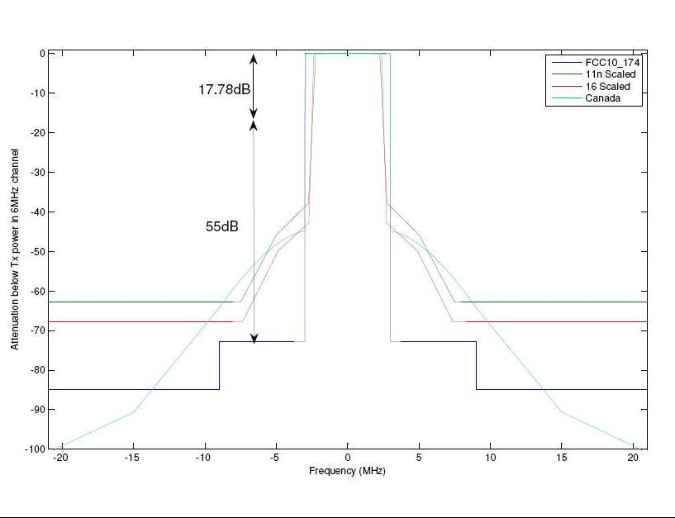
EMISSION LIMITS, 15.709(c) (2)
WCA White Space update, October 2011, Peter Ecclesine, petere@cisco.com
Slide 22

Slide 23
INTERFERENCE AVOIDANCE METHODS, 15.711 & 15.717 (1)
Two methods for interference avoidance
Geolocation and database access, 15.711
To identify available television channels
For protection of authorized and unlicensed services:
digital television stations, digital and analog Class A, low power, translator and booster stations;
translator receive operations; fixed broadcast auxiliary service links; private land mobile service/commercial radio service (PLMRS/CMRS) operations;
offshore radiotelephone service;
low power auxiliary services authorized pursuant to §§ 74.801-74.882, including wireless microphones and MVPD receive sites; and
unlicensed wireless microphones used by venues of large events and productions/shows as provided under section 15.713(h)(8).
In addition, protection shall be provided in border areas near Canada and Mexico in accordance with § 15.712(g).
Spectrum sensing for sensing only devices, 15.717
For TVBD devices that rely solely on spectrum sensing to identify available channels.
Slide 23

Slide 24
INTERFERENCE AVOIDANCE METHODS, 15.711 & 15.717 (2)
What is the TVBD database?
TVBD database
The TVBD database is a privately owned and operated service that
fixed and Mode II TVBDs must contact to obtain information on channel availability at the locations where they are operated and,
in the case of fixed devices, to register their operation at those locations.
Database administrator
The FCC has designated multiple database administrators from the private sector to create and operate the TVBD databases. Database administrators may charge fees for the provision of lists of available channels to TVBDs and for the registration of fixed TVBDs and temporary broadcast auxiliary links.
http://www.fcc.gov/document/part-15-tv-bands-devices
Slide 24

Slide 25
INTERFERENCE AVOIDANCE METHODS, 15.711 & 15.717 (3)
What does the TVBD database contain?
A TVBD database will be required to contain information including:
Records for stations in all of the authorized services that operate in the TV bands using fixed transmitters with designated service areas, including full service and low power TV stations.
The service paths of broadcast auxiliary point-to-point facilities.
The geographic regions served by private land mobile and commercial mobile radio service operations on channels 14-20.
Regions served by the Offshore Radiotelephone Service.
The locations of cable headends and low power TV receive sites that are outside the protected contours of the TV stations whose signals they receive.
The locations of registered sites where wireless microphones and other low power auxiliary devices are used on a regular or scheduled basis.
Registration information for fixed TVBDs.
http://www.fcc.gov/document/part-15-tv-bands-devices
Slide 25

Slide 26
GEOLOCATION AND DATABASE ACCESS, 15.711 (1)
Geolocation and database access requirements
Fixed TVBD devices
The geographic coordinates: an accuracy of +/- 50 meters by either an incorporated geo-location capability or a professional installer.
If the fixed TVBD is moved to another location or if its stored coordinates become altered, the operator shall re-establish the device’s by re-registering with the data base
Fixed devices must access a TV bands database over the Internet to determine the TV channels that are available
at their geographic coordinates,
taking into consideration the fixed device’s antenna height,
at least once a day to verify that the operating channels continue to remain available.
Operation on a channel must cease immediately if the database indicates that the channel is no longer available.
Slide 26

Slide 27
GEOLOCATION AND DATABASE ACCESS, 15.711 (2)
Geolocation and database access requirements (cont’d)
Fixed TVBD devices (cont’d)
Fixed TVBD must adjust their use of channels in accordance with channel availability schedule information provided by their database for the 48 hour period beginning at the time of the device last accessed the database for a list of available channels.
Fixed devices without a direct connection to the internet
A fixed TVBD needing initialization and registration may transmit to another fixed TVBD on either a channel that that other TVBD has transmitted on or on a channel which that other TVBD indicates is available for use to access the database to register its location and receive a list of channels that are available for its own use.
Slide 27

Slide 28
GEOLOCATION AND DATABASE ACCESS, 15.711 (3)
Geolocation and database access requirements (cont’d)
Mode II personal/portable devices
Accuracy of a geo-location capability to determine its geographic coordinates : +/- 50 meters.
Re-establishment of its position by using its geo-location capability
each time it is activated from a power-off condition and
at least once every 60 seconds while in operation, except while in sleep mode, i.e., in a mode in which the device is inactive but is not powered-down.
Access of the database
each time it is activated from a power-off condition and re-check its location
if it changes location during operation by more than 100 meters from the location at which it last accessed the database.
A Mode II personal/portable device that has been in a powered state shall re-check its location and access the database daily to verify that the operating channel(s) continue to be available.
Adjustment of their use of channels
in accordance with channel availability schedule information provided by their database for the 48 hour period beginning at the time of the device last accessed the database for a list of available channels.
Slide 28

Slide 29
GEOLOCATION AND DATABASE ACCESS, 15.711 (4)
Geolocation and database access requirements (cont’d)
Mode II personal/portable devices (cont’d)
Channel availability information for multiple locations
A Mode II personal/portable device may load channel availability information for multiple locations around, i.e., in the vicinity of, its current location and use that information in its operation.
A Mode II TVBD may use such available channel information to define a geographic area within which it can operate on the same available channels at all locations, for example a Mode II TVBD could calculate a bounded area in which a channel or channels are available at all locations within the area and operate on a mobile basis within that area.
A Mode II TVBD using such channel availability information for multiple locations must contact the database again if/when it moves beyond the boundary of the area where the channel availability data is valid.
Cease of operation
Operation must cease immediately if the database indicates that the channel is no longer available.
Slide 29

Slide 30
GEOLOCATION AND DATABASE ACCESS, 15.711 (5)
Geolocation and database access requirements (cont’d)
Identifying information
Fixed TVBDs shall transmit identifying information to register to and receive a list from a database. The identification signal must conform to a standard established by a recognized industry standards setting organization. The identification signal shall carry sufficient information to identify the device and its geographic coordinates: TVBD registration database.
Furthermore, fixed and personal/portable devices operating independently must provide identifying information to the TV bands database: TV bands database.
The TVBD must provide its FCC identifier, manufacturer's serial number and geographic coordinates to the database.
Failure to contact a database
If a fixed or Mode II personal/portable TVBD fails to successfully contact the TV bands database during any given day, it may continue to operate until 11:59 PM of the following day at which time it must cease operations until it re-establishes contact with the TV bands database and re-verifies its list of available channels.
Slide 30

Slide 31
GEOLOCATION AND DATABASE ACCESS, 15.711 (6)
Geolocation and database access requirements (cont’d)
Mode I personal/portable TVBD
A Mode I personal/portable TVBD may only transmit upon receiving a list of available channels from a fixed or Mode II TVBD that has contacted a database and verified that the FCC identifier (FCC ID) of the Mode I device is valid.
To initiate contact with a fixed or Mode II device, a Mode I device may transmit on an available channel used by the fixed or Mode II TVBD or on a channel the fixed or Mode II TVBD indicates is available for use by a Mode I device on a signal seeking such contacts.
At least once every 60 seconds, except when in sleep mode, a Mode I device must either
(1) receive a contact verification signal from the Mode II or fixed device that provided its current list of available channels or
(2) contact a Mode II or fixed device to re-verify/re-establish channel availability.
A Mode I device must cease operation immediately if it does not receive a contact verification signal or is not able to re-establish a list of available channels through contact with a fixed or Mode II device on this schedule.
Slide 31

Slide 32
GEOLOCATION AND DATABASE ACCESS, 15.711 (7)
Geolocation and database access requirements (cont’d)
Security for communications for channel availability information (15.711(f))
Communications between TV bands devices and TV bands databases and between fixed and Mode II devices
To be transmitted using secure methods that ensure against corruption or unauthorized modification of the data;
It is not necessary for TVBDs to apply security coding to channel availability and channel access information where they are not the originating or terminating device and that they simply pass through.
Communications between a Mode I device and a fixed or Mode II device
To employ secure methods that ensure against corruption or unauthorized modification of the data.
Contact verification signals transmitted for Mode I devices are to be encoded with encryption to secure the identity of the transmitting device.
Mode I devices using contact verification signals shall accept as valid for authorization only the signals of the device from which they obtained their list of available channels.
Slide 32

Slide 33
GEOLOCATION AND DATABASE ACCESS, 15.711 (8)
Geolocation and database access requirements (cont’d)
Security for communications for channel availability information (15.711(f)) (cont’d)
Contact verification signals
Definition and Requirements
An encoded signal broadcast by a fixed or Mode II device
For reception by Mode I devices to which the fixed or Mode II device has provided a list of available channels for operation
It shall be encoded to ensure that the signal originates from the device that provided the list of available channels
Purpose
To establish that the Mode I device is still within the reception range of the fixed or Mode II device
To validate the list of available channels used by the Mode I device
Device Operation
A Mode I device may respond only to a contact verification signal from the fixed or Mode II device that provided the list of available channels on which it operates.
A fixed or Mode II device shall provide the information needed by a Mode I device to decode the contact verification signal at the same time it provides the list of available channels.
Slide 33

Slide 34
GEOLOCATION AND DATABASE ACCESS, 15.711 (9)
Geolocation and database access requirements (cont’d)
Security for communications for channel availability information (15.711(f)) (cont’d)
Protection of a TV bands database from unauthorized data input or alteration of stored data.
To provide this protection, the administrator of the TV bands database administrator shall establish communications authentication procedures that allow the fixed or Mode II devices to be assured that the data they receive is from an authorized source.
Slide 34

Slide 35
INTERFERENCE PROTECTION REQUIREMENTS, 15.712 (1)
Basically these requirements are for database.
Protected contour
Required separation distance
* For Mode II devices, Less than 3 meters category applies.
Slide 35

Slide 36
INTERFERENCE PROTECTION REQUIREMENTS, 15.712 (2)
Protection of other types of incumbent users
Basically these requirements are for database.
(b) TV translator and Multi-channel Video Programming Distributor (MVPD) receive sites
(d) PLMRS/CMRS operations
(f) Low power auxiliary services, including wireless microphones
Fixed TVBDs are not permitted to operate within 1 km, and personal/portable TVBDs will not be permitted to operate within 400 meters.
TVBDs are not permitted to operate on the first channel on each side of TV channel 37 (608-614 MHz) that is not occupied by a licensed service.
(g) Border areas near Canada and Mexico
(h) Radio astronomy services
Slide 36

Slide 37
TV BANDS DATABASE, 15.713, 15.714 & 15.715
15.713 TV bands database
15.714 TV bands database administration fees
15.715 TV bands database administrator
→ Out of this scope of the TG4m standard
Slide 37

Slide 38
TVBDS THAT RELY ON SPECTRUM SENSING, 15.717
Power limit
Limited to a maximum EIRP of 50 mW
Sensing requirements
: although required, not necessarily sufficient for demonstrating reliable interference avoidance
Detection threshold: referenced to an omnidirectional receive antenna with a gain of 0 dBi
ATSC digital TV signals: -114 dBm, averaged over a 6 MHz bandwidth;
NTSC analog TV signals: -114 dBm, averaged over a 100 kHz bandwidth;
Low power auxiliary, including wireless microphone, signals: -107 dBm, averaged over a 200 kHz bandwidth.
Channel availability check time
A TVBD may start operating on a TV channel if no TV, wireless microphone or other low power auxiliary device signals above the detection threshold are detected within a minimum time interval of 30 seconds.
In-service monitoring
in-service monitoring of an operating channel at least once every 60 seconds
Channel move time
After a TV, wireless microphone or other low power auxiliary device signal is detected on a TVBD operating channel, all transmissions by the TVBD must cease within 2 seconds.
Slide 38

Slide 39
CERTIFICATION APPROVAL REQUIREMENTS FOR SENSING-ONLY TVBDS
The following equipment authorization requirements apply in addition to the requirements in Part 2 of the rules:
The application must include a full explanation of how the device will protect incumbent authorized services against interference.
A pre-production device, identical to the device expected to be marketed, must be submitted to the FCC for testing.
Applications for sensing-only TVBDs will be processed as follows:
Applications will be placed on Public Notice for a minimum of 30 days for comments and 15 days for reply comments. The Public Notice will include proposed test procedures and methodologies.
The Commission will conduct laboratory and field tests of the pre-production device which will be open to the public. This testing will be conducted to evaluate proof of performance of the device, including characterization of its sensing capability and its interference potential.
After the completion of testing, the Commission will issue by Public Notice, a test report including recommendations. The Public Notice will provide at least 30 days for comments and, if any objections are received, an additional 15 days for reply comments.
The decision on whether to certify a TVBD that relies on spectrum sensing will be made by the full Commission.
http://www.fcc.gov/document/part-15-tv-bands-devices
Slide 39

Slide 40
SUMMARY OF FCC GOVERNING REGULATIONS
Summary of FCC governing regulations.
 | Fixed device | Personal/portable device
 |  | Mode I (client) | Mode II (independent) | Sensing -only
Geolocation awareness | Required (accuracy +/-50m) | Not required | Required (accuracy +/-50m) | Not required
Geolocation re-establishment | Not required | Not required | Required (once/min) | Not required
Database access | Required (once/day) | Not required | Required (daily and upon location change) | Not required
Available channels | 2-51 (except 3,4,36-38) |  | 21-51 (except 36-38)
Power (EIRP) | 4 W | 100 mW * |  | 50 mW
Spectrum sensing | Not required |  |  | required
*
* When a Mode II device is operating in a channel adjacent to a licensed user and within the protected area of that service, the allowable transmit power should be limited to 40 mW.
** A single device could be capable of more than one type of operation.
*** Smart Utility Networks in TV White Space, Chin-Sean Sum, Hiroshi Harada, Fumihide Kojima, Zhou Lan, and Ryuhei Funada, NICT, IEEE Communications Magazine, July 2011
Slide 40

Slide 41
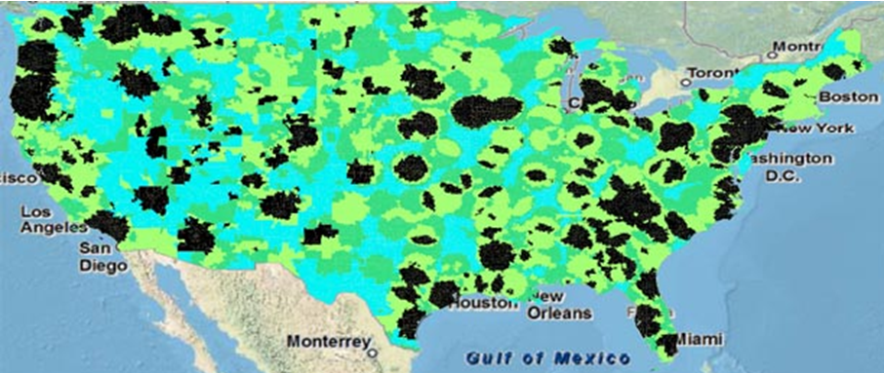
FCC RULES LIMIT WHITE SPACE AVAILABILITY IN POPULATED AREAS
White Spaces, Blacked Out: Empty airwaves called white spaces could enable long-range communications, but FCC rules strictly limit their use in populated areas. Such areas show up in black on this map of white-space availability in the part of the VHF band that corresponds to TV channels 7 to 13. A similar problem also occurs in the UHF spectrum.
Slide 41

Slide 42
WHITE SPACE ACTIVITIES
IEEE 802.22
WRAN
RASGCIM Study Group for Smart Utility and Critical Infrastructure Monitoring Networks
IEEE 802.11af -TVWS WiFi
IEEE 802.15 TG4m
IEEE 802.19.1 –Interoperability (or coexistence) among white space devices
ECMA TC-48 TG1
Devices from the White Spaces Coalition
Weightless M2M Standard
Slide 42

Slide 43
WHITE SPACE ACTIVITIES 802.22 RASGCIM SG (1)
802.22 RASGCIM Study Group
Scope: RASGCIM (Regional Area Smart Grid And Critical Infrastructure Monitoring)
This standard specifies alternate PHY and necessary MAC amendments to IEEE std. 802.22-2011 for operation in VHF/UHF TV broadcast bands between 54 MHz and 862 MHz to support enhanced broadband services and monitoring applications. The standard supports aggregate data rates greater than the maximum data rate supported by the IEEE std. 802.22-2011. This standard defines new classes of 802.22 devices to address these applications and supports more than 512 devices. This standard also specifies techniques to enhance communications among the devices and makes necessary amendments to the cognitive, security & parameters and connection management clauses.
For combined broadband services and monitoring applications aimed at wireless regional area networks using television white space bands
Extending regional area broadband services to applications such as real-time and/or near real-time monitoring, emergency broadband services, remote medical services etc
PAR and 5C submitted to EC in Sep. 2011
Slide 43

Slide 44
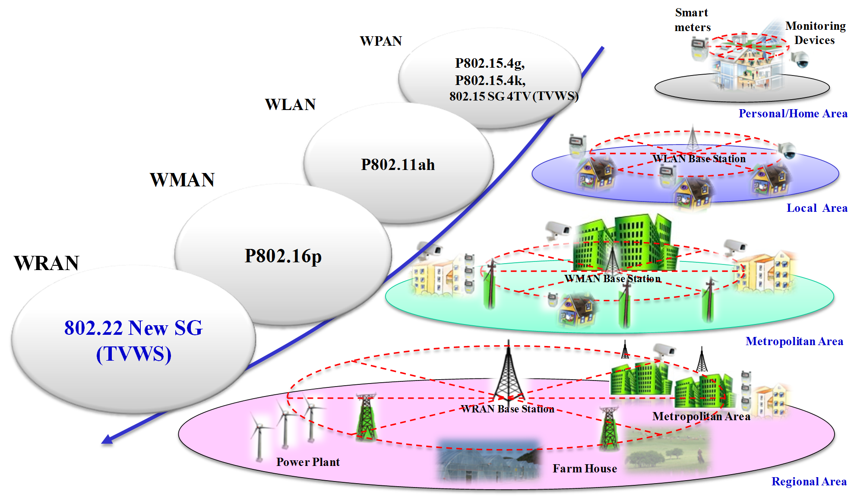
WHITE SPACE ACTIVITIES 802.22 RASGCIM SG (2)
802 Standard Activities for Smart Grid and Critical Infrastructure Monitoring
Slide 44

Slide 45
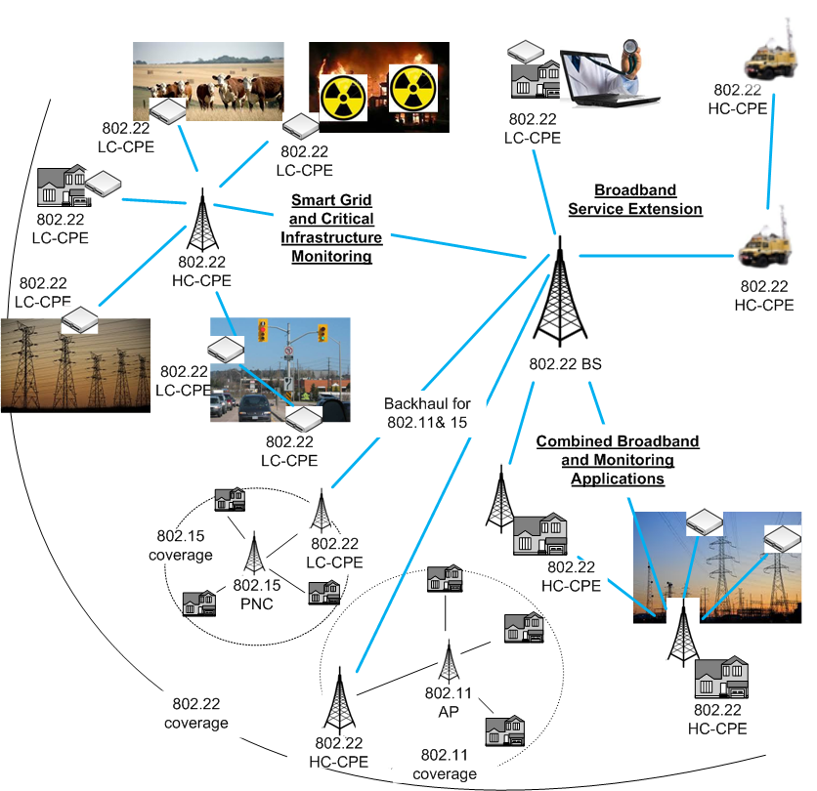
WHITE SPACE ACTIVITIES 802.22 RASGCIM SG (3)
Usage
Combined Smart Grid, Monitoring and Broadband Services by different types of CPEs
Properties
802.22 RA smart grid and critical infrastructure monitoring application will be complimentary to other short range applications at the users’ end We may have different types of CPEs in 802.22 new SG Currently CPEs can not communicate to each other. We need this capability Improved broadband service by using wider bandwidth through channel aggregation
Topology
Infrastructure mode & Ad mode
Slide 45

Slide 46
WHITE SPACE ACTIVITIES 802.22 RASGCIM SG (4)
Category | Usage Cases | Properties
A) Smart Grid & Monitoring | A1) Regional Area Smart Grid/Metering | Low capacity/complexity CPEs Very large number of monitoring CPEs Fixed and Potable CPEs Real time monitoring Low duty cycle High reliability and security Large coverage area Infrastructure connection
 | A2) Agriculture/Farm House Monitoring
 | A3) Critical Infrastructure/Hazard Monitoring
 | A4) Environment Monitoring
 | A5) Homeland Security/Monitoring
 | A6) Smart Traffic Management and Communication
B) Broadband Service Extension | B1) Temporary Broadband Infrastructure (e.g., emergency broadband infrastructure) | Fixed and Portable CPEs Higher capacity CPEs than Category A) High QoS, reliability and security Higher data rate than Category A) Easy network setup Infrastructure and Ad hoc connection
 | B2) Remote Medical Service
 | B3) Archipelago/Marine Broadband Service
C) Combined Service | C1) Combined Smart Grid, Monitoring and Broadband Service | Category A) and B)
Slide 46

Slide 47
WHITE SPACE ACTIVITIES 802.22 RASGCIM SG (5)
Categories | Usage Case | End Device Capability | Num of Devices | Communication | Mobility | Topology
A) Smart Grid & Monitoring | A1) Regional Area Smart Grid/Metering | Low | Very large | Low duty cycle | Fixed | Infrastructure (Fixed point-to-multipoints)
 | A2) Agriculture/Farm House Monitoring |  |  | High-reliability, Real-time, Low latency | Fixed/ Portable | Infrastructure (Point-to-fixed/portable multipoints)
 | A3) Critical Infrastructure/Hazard Monitoring
 | A4) Environment Monitoring
 | A5) Homeland Security/Monitoring
 | A6) Smart Traffic Management and Communication
B) Broadband Service Extension | B1) Emergency Temporary Broadband Infrastructure | High | Large | High reliability, Easy connection | Portable | Ad hoc (Portable-to-Portable)
 | B2) Remote Medical Service |  |  | Real-time, Low latency | Fixed | Infrastructure (Fixed point-to-multipoints)
 | B3) Archipelago/Marine Broadband Service |  |  | High QoS and reliability | Fixed/ Portable | Infrastructure (Point-to-fixed/portable multipoints)
C) Combined Service | C1) Combined Smart Grid, Monitoring and Broadband Service | High and Low | Very Large | Category A) and B) | Fixed/ Portable | Infrastructure and Ad-hoc
Slide 47

Slide 48
WHITE SPACE ACTIVITIES 802.22 RASGCIM SG (6)
Categories | Usage Case | Data Rate | Num of Devices | Bandwidth | Reliability QoS | Duty Cycle
A) Smart Grid & Monitoring | A1) Regional Area Smart Grid/Metering | Low (Single user) Mid (Aggregate) | Large | Small – Mid | High | Low
 | A2) Agriculture/Farm House Monitoring |  |  |  | Mid – High
 | A3) Critical Infrastructure/Hazard Monitoring
 | A4) Environment Monitoring
 | A5) Homeland Security/Monitoring
 | A6) Smart Traffic Management and Communication
B) Broadband Service Extension | B1) Emergency Temporary Broadband Infrastructure | High | Small –Mid | Large | Mid | Mid – High
 | B2) Remote Medical Service | Low - Mid |  |  | Very High | Low – Mid
 | B3) Archipelago/Marine Broadband Service | Mid – High |  |  | Mid | Mid – High
C) Combined Service | C1) Combined Smart Grid, Monitoring and Broadband Service | Low – Mid (Single) High (Aggregate) | Mid - Large | Large (Aggregate) | Mid | Mid - High
Slide 48

Slide 49
WHITE SPACE ACTIVITIES 802.22 RASGCIM SG (7)
Categories | Usage Case | Complexity | Power Consumption | Location Information | Mobility | Real Time
A) Smart Grid & Monitoring | A1) Regional Area Smart Grid/Metering | Low | Very Low | Desirable/ Mandatory in some cases | No | No
 | A2) Agriculture/Farm House Monitoring |  |  |  | Low | Yes
 | A3) Critical Infrastructure/Hazard Monitoring |  |  |  | Low | Yes
 | A4) Environment Monitoring |  |  |  | No | Yes
 | A5) Homeland Security/Monitoring |  |  |  | Low | Yes
 | A6) Smart Traffic Management and Communication |  |  |  | Mid | Yes
B) Broadband Service Extension | B1) Emergency Temporary Broadband Infrastructure | High | Mid – High | Not Necessary | Low – Mid | No
 | B2) Remote Medical Service | Low – Mid | Low – Mid | Desirable | Low | Yes
 | B3) Archipelago/Marine Broadband Service | Mid - High | Mid | Not Necessary | Low | No
C) Combined Service | C1) Combined Smart Grid, Monitoring and Broadband Service | Mid – High | Mid – High | Desirable | Low -Mid | Yes
Slide 49

Slide 50
WHITE SPACE ACTIVITIES WHITE SPACES COALITION
The White Spaces Coalition consists of eight large technology companies that planned to deliver high speed broadband internet access beginning in February 2009 to United States consumers via existing "white space" in unused television frequencies between 54-698 MHz (TV Channels 2-51). The coalition expected speeds of 80 Mbps and above, and 400 to 800 Mbps for white space short-range networking. The group includes Microsoft, Google, Dell, HP, Intel, Philips, Earthlink, and Samsung Electro-Mechanics.
The White Spaces Coalition was formed after the Senate set the date to cease analog broadcasts. It doesn't appear to have a website, but many of the companies involved in the White Spaces Coalition are also involved in the Wireless Innovation Alliance.
Google sponsored a campaign named Free the Airwaves with the purpose of switching over the white spaces that will be cleared up in 2009 by the DTV conversion process by the FCC and converted to an un-licensed spectrum that can be used by Wi-Fi devices. The National Association of Broadcasters (NAB) disapproves of the project because they claim that it would reduce the broadcast quality of their TV signals.
Slide50

Slide 51
WHITE SPACE ACTIVITIES UNITED KINGDOM (1)
Digital Dividend set for January 1, 2012
Ofcom consultations attempt to define how it will be done
Digital Dividend: Geolocation for Cognitive Access
Digital Dividend: 600 MHz band and geographic interleaved spectrum
Digital Dividend Review: geographic interleaved awards 470 -550 MHz and 630 – 790 MHz
http://ieee802.org/19/pub/Workshop/4_Kennedy-RIM.pdf and http://www.cept.org/ecc/groups/ecc/wg-se/se-43
Slide51

Slide 52
WHITE SPACE ACTIVITIES UNITED KINGDOM (2)
Ofcom’s progresses plans for white space (or interleaved) spectrum
: decision for next step after Nov. 2010 consultation
Ofcom’s Definition of white spaces:
unused areas of the airwaves or gaps that exist in bands that have been reserved for TV broadcasts typically between 470 and 790MHz
a range of frequencies that are not in use by the licensee all of the time at all locations. A white space device (WSD or devices) can make use of those frequencies provided interference is not caused to the licensed users of the spectrum.
Ofcom is also considering the future use of other White Spaces – such as those in the band currently used by FM radio services.
Applications considered
Enhanced Wi-Fi: boosting the range
Rural broadband: to link remote houses and villages to larger towns that are already connected to the internet
Machine-to-machine communications: for billions of devices to be able to connect wirelessly and via the internet for a range of applications
Smart metering system and intelligent transportation
Emergency services communications
http://media.ofcom.org.uk/2011/09/01/ofcom-progresses-with-new-wireless-technology/
Slide52

Slide 53
WHITE SPACE ACTIVITIES UNITED KINGDOM (3)
Ofcom’s progressed plans for white space (or interleaved) spectrum (cont’d)
: decision for next step after Nov. 2010 consultation
White space devices: license-exempt
Master device (or Location-aware wireless devices): to ensure that the devices do not interfere with existing licensed users of the spectrum, which include Digital Terrestrial Television and wireless microphone users.
To consult a list of databases hosted online.
To notify one of these databases of its location and update it on a regular basis: geolocation.
To obtain details of the radio-frequencies and power levels it is allowed to use from the database.
Slave device
http://media.ofcom.org.uk/2011/09/01/ofcom-progresses-with-new-wireless-technology/
Slide53

Slide 54
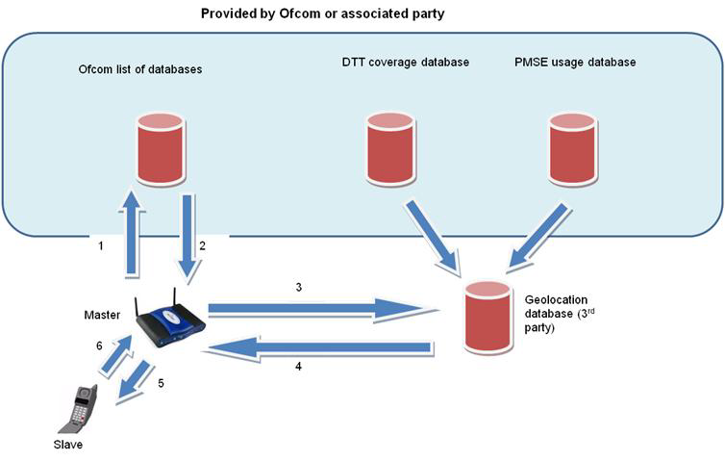
WHITE SPACE ACTIVITIES UNITED KINGDOM (4)
Ofcom’s progressed plans for white space (or interleaved) spectrum (cont’d)
: decision for next step after Nov. 2010 consultation
White space devices: license-exempt
DTT: digital terrestrial television
PMSE: programme making and special equipment (mostly wireless microphones in this band)
http://stakeholders.ofcom.org.uk/binaries/consultations/geolocation/summary/geolocation.pdf, Ofcom, Geolocation: Consultation, 9 November, 2010
Slide54

Slide 55
WHITE SPACE ACTIVITIES UNITED KINGDOM (5)
Ofcom’s TV white spaces
About 128 MHz of interleaved spectrum is available in nearly every household.
Lower UHF 470-550 MHz, Upper UHF 614-790 MHz
Analogue TV to be switched off October 24, 2012
OFCOM TV white space Technical Working Group working on the rules, and OFCOM expect to issue a Statutory Instrument in 2012 – pushing back 4G spectrum auction to 4Q12 pushes back TVWS rules.
Database calculates white spaces depending on accuracy of location, device radio characteristics. To protect mobile uses, database must be checked every hour.
WCA White Space update, October 2011, Peter Ecclesine, petere@cisco.com
Slide55

Slide 56
WHITE SPACE ACTIVITIES UNITED KINGDOM (6)
Cambridge, United Kingdom tests
On June 29, 2011, One of the largest commercial tests of white space Wi-Fi was conducted in Cambridge, England.
The trial was conducted by Microsoft using technology developed by Adaptrum and backed by a consortium of ISP's and tech companies including Nokia, BSkyB, the BBC, and BT, with the actual network hardware being provided by Neul.
In the demonstration, the Adaptrum whitespace system provided the broadband IP connectivity allowing a client-side Microsoft Xbox to stream live HD videos from the Internet. Also as part of the demo, a live Xbox/Kinect video chat was established between two Xbox/Kinect units connected through the same TV whitespace connection.
These applications were demonstrated under a highly challenging radio propagation environment with more than 120 dB link loss through buildings, foliage, walls, furniture, people etc. and with severe multipath effects.
Neul’s trial system:
broadband speeds of over 10Km supporting 16Mbps
a single base station can support over 1m end devices (for M2M applications).
http://en.wikipedia.org/wiki/White_spaces_(radio)
Slide56

Slide 57
WHITE SPACE ACTIVITIES EU (1)
EU efforts aimed at consistency across the EU
CEPT (ECC) Project Team SE43:
to look at the compatibility issues between the relevant services using 'white spaces' in the UHF TV bands.
specifying cognitive access; sensing and geolocation database
ECC Report 159:
sets technical and operational requirements for using TVWS by cognitive radios in EU in Jan. 2011 which are not so different from those of the FCC
The team:
made the preliminary conclusion that autonomous sensing is very challenging at the current stage of technological development - probably too difficult - to be used in order adequately to protect to the existing services;
provided guidance on the algorithms to be used in future geolocation database(s);
drew up a list of areas requiring further studies, including to address scenarios enabled by future technology developments, when these become better known.
http://ieee802.org/19/pub/Workshop/4_Kennedy-RIM.pdf and http://www.cept.org/ecc/groups/ecc/wg-se/se-43
Slide57

Slide 58
WHITE SPACE ACTIVITIES EU (2)
EU efforts aimed at consistency across the EU (cont’d)
ECC RA WS-CR (Electronic Communications Committee's Regulatory Affairs group on White Space Cognitive Radio):
Responsibility for developing recommendations on communication protocols linking geo-databases to WS devices in Europe
This will focus on different regulatory models for the management of Cognitive Radio databases, in particular:
certification or accreditation framework for database provider(s);
a suitable authorization regime (can be different depending on National administrations) under which the Cognitive Radio device should operate (i.e. general or individual authorization) to achieve 'Authorized Shared Access'.
ECC WG FM (Frequency Management group)
in February 2011 tasked a Correspondence Group to develop a regulatory framework for using cognitive technology for Programme Making and Special Events, based on Chapter 11 of ECC Report 159.
IETF PAWS (Protocol to Access White Space):
Asserting Who I am, What I am, Where I am, What I will permit, Receiving grants of what is permitted at my location
Finland
had TVWS trials in 2010, 2011.
http://ieee802.org/19/pub/Workshop/4_Kennedy-RIM.pdf and http://www.cept.org/ecc/groups/ecc/wg-se/se-43
Slide58

Slide 59
WHITE SPACE ACTIVITIES CANADA (1)
TV White Spaces
Transition to DTV: Aug. 31, 2011, applied to only certain mandatory markets
Licensed LPAs (low power apparatus) such as microphones in the band 698-806MHz.
RRBS (remote rural areas broadband services): licensed subscriber-based broadband Internet systems on TV channels 21 to 51 (512-698 MHz) except channel 37
the RRBS be located at sufficient distance from major population centers, TV broadcasting facilities and their service contours so as not to cause them interference; and
the RRBS not constrain the provision of current and future TV broadcasting services.
Dynamic spectrum access techniques for improved spectrum sharing
Protection approaches: to protect TV broadcasting stations, LPA and RRBS
Sensing
the use of a beacon or a hybrid database approach to protect receive-only stations
“hidden node” problem) should be solved.
Database
→ It focuses on database now and sensing will be considered in the future when technology becomes mature.
Industry Canada had Consultation SMSE-012-11 to align unlicensed use with FCC TVWS rules.
Slide59

Slide 60
WHITE SPACE ACTIVITIES CANADA (2)
TV White Spaces for Rural Access
RSS196: Point-to-Multipoint Broadband Equipment Operating in the Bands 512-608 MHz and 614-698 MHz for Rural Remote Broadband Systems (RRBS) (TV Channels 21 to 51)
Maximum bandwidth in a 6 MHz channel: 6 MHz
Maximum contiguous 6 MHz channels: 2 (12 MHz)
Minimum bandwidth in a 6 MHz channel: 500 kHz
Base station
Average tx output power: ≤125 watts
Average tx power spectral density: ≤14 dBW/100 kHz
Subscriber equipment
Average tx output power: ≤1 watt
Average tx power spectral density: ≤-7 dBW/100 kHz
SRSP 300-512: Technical Requirements for Remote Rural Broadband Systems (RRBS) Operating in the Bands 512-608 MHz and 614-698 MHz (TV Channels 21 to 51)
http://ieee802.org/19/pub/Workshop/4_Kennedy-RIM.pdf
Slide60

Slide 61
WHITE SPACE ACTIVITIES ASIA
Singapore
White Spaces Consultation and Test Plan by IDA:
TVBDs are able to operate in the unused spectrum of the TV VHF/UHF bands due to their ability to sense the radio environment and its dynamic spectrum sharing capabilities.
On 7 April 2010, IDA announced the 'White Space Technology Information Package and Test Plan‘.
Television Band Devices (TVBDs) Accessing VHF and UHF Bands in Singapore; Singapore had TVWS trials in 2010, 2011.
The upcoming trials, named Cognitive Radio Venues ("CRAVE"), will assist IDA in developing the regulatory framework for the use of TVDBs.
White space in frequency bands considered for terrestrial broadcast services
VHF between 174 to 230 MHz, UHF between 494 to 790 MHz
* IDA: Info-communications Development Authority
http://www.ida.gov.sg/Policies%20and%20Regulation/20100730141139.aspx
Slide61

Slide 62
WHITE SPACE ACTIVITIES ASIA
Singapore (cont’d)
Japan
Digital TV transition in 2012; expect to trial TVWS services in 2012
Active in P802.11af and P1900.4
China
Digital TV transition in 2015
Korea and South Africa
expect to trial TVWS services in 2012
http://ieee802.org/19/pub/Workshop/4_Kennedy-RIM.pdf and http://www.cept.org/ecc/groups/ecc/wg-se/se-43
Slide62

Slide 63
BUY-BACK OF TV SPECTRUM FOR OTHER BROADBAND PLAN IN US
The National Broadband Plan looks to enable an additional 500 MHz of spectrum for wireless broadband.
The President has issued a memorandum directing the FCC to “buy back” 120 MHz of spectrum from the TV broadcasters.
This could severely impact the available white spaces available for unlicensed use.
Slide63

Slide 64
REFERENCES (1)
47 CFR Part 15 (http://www.fcc.gov/oet/info/rules/part15/PART15_07-10-08.pdf )
FCC Part 15 Subpart H TVWS rules http://www.gpo.gov/fdsys/pkg/CFR-2010-title47-vol1/pdf/CFR-2010-title47-vol1-part15.pdf
FCC terminology https://mentor.ieee.org/802.11/dcn/11/11-11-0175-02-00af-fcc-tvws-terminology.ppt
US Metro white space April and September 2011 https://mentor.ieee.org/802.11/dcn/11/11-11-0499-03-00af-us-metro-mhzpops.xls
Calculations http://fjallfoss.fcc.gov/ecfs/document/view?id=7021713432
FCC 08-260 Second Report and Order and Memorandum and Order (http://hraunfoss.fcc.gov/edocs_public/attachmatch/DA-01-260A1.pdf)
FCC 10-174
Slide64

Slide 65
REFERENCES (2)
Cognitive radio in ECC http://www.wonderlandwpa.com/dev/ecc_newsletter_june/june-2011/index.html
ECC Report 159 http://www.erodocdb.dk/docs/doc98/official/Pdf/ECCRep159.pdf
FCC TVWS ECFS Proceeding 02-380, 04-186 http://fjallfoss.fcc.gov/ecfs/
FCC Part 15 Subpart H TVWS rules http://www.gpo.gov/fdsys/pkg/CFR-2010-title47-vol1/pdf/CFR-2010-title47-vol1-part15.pdf
FCC terminology https://mentor.ieee.org/802.11/dcn/11/11-11-0175-02-00af-fcc-tvws-terminology.ppt
IETF PAWS http://palgronsund.com/tag/ietf/
Showmywhitespace.com http://spectrumbridge.com/whitespaces.aspx
US Metro white space https://mentor.ieee.org/802.11/dcn/11/11-11-0499-03-00af-us-metro-mhzpops.xls
802.11ah sub 1 GHz channel models https://mentor.ieee.org/802.11/dcn/11/11-11-0968-01-00ah-channel-model-text.docx
Slide65

