Slide 1
Project: IEEE P802.15 Working Group for Wireless Personal Area Networks (WPANs)
Submission Title: [Performance simulation of DSA system]
Date Submitted: [4 November, 2011]
Source: [Shoichi Kitazawa] Company [ATR ]
Address [2-2-2 Hikaridai Seika, Kyoto 619-0288 Japan]
Voice:[+81-774-95-1511], FAX: [+81-774-95-1508], E-Mail:[kitazawa@atr.jp]
Re: []
Abstract: [This presentation shows effectiveness of our proposed DSA system when the DSA coexisted with Wireless LAN and Bluetooth.]
Purpose: [For discussion.]
Notice: This document has been prepared to assist the IEEE P802.15. It is offered as a basis for discussion and is not binding on the contributing individual(s) or organization(s). The material in this document is subject to change in form and content after further study. The contributor(s) reserve(s) the right to add, amend or withdraw material contained herein.
Release: The contributor acknowledges and accepts that this contribution becomes the property of IEEE and may be made publicly available by P802.15.

Slide 2
Performance simulation of DSA system
Authors:

Slide 3
Introduction
Efficient use of spectrum is critical issue in unlicensed band.
  Measurement results of current situation in the 2.4GHz ISM band and experimental results of high traffic load situation have been presented.
To achieve efficient spectrum use for future WPAN, we propose DSA system.
  Throughput simulation of the DSA system with multiple wireless systems by using PHY/MAC cross-layer simulator.
The effectiveness of the DSA system is shown in this presentation when the DSA system coexisted with multiple wireless system.

Slide 4
Features of DSA system
The system consisting of an access point (AP) and mobile stations (MS).
For efficient spectrum use and low overhead,
  Carrier sense to avoid interference to/from the other radio systems, but without random back-off (fixed-length quiet time)
  TDMA (polling) with DSA forming time frame and slots
  Using a Common Control Channel (CCH) with frequency hopping (FH) for link establishment
  Spectrum divided and single carrier modulation

Slide 5
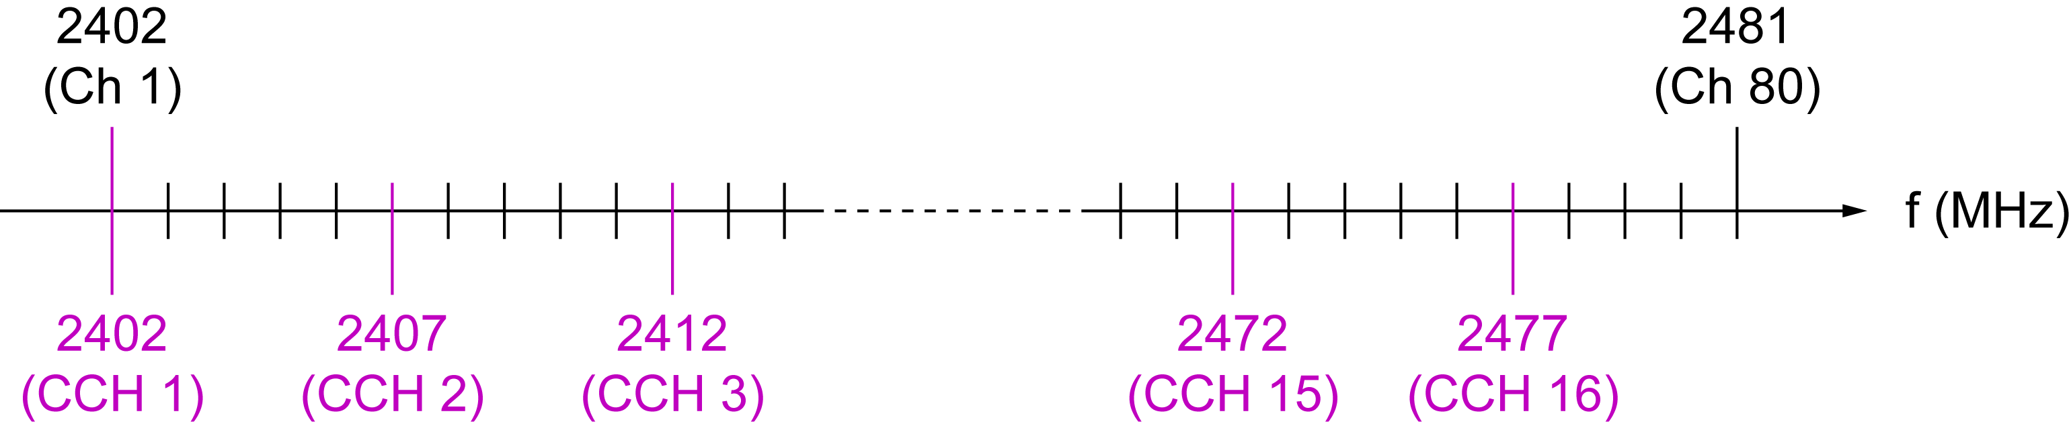
Frequency Channel Plan in 2.4 GHz Band
80 Frequency channel unit(FCU) in 80MHz.
Common control channel (CCH) hops on predetermined subset of frequency channels.
Data link channel (DCH) signal can be divided into multiple subspectra.
Example of DCH signal spectrum
1FCU
3FCU
4FCU

Slide 6
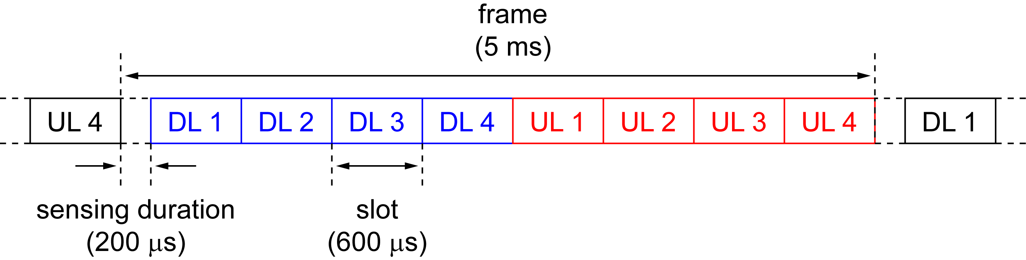
Frame Configuration
Frame and CCH hopping period of 5ms
Sensing and guard duration (quiet time) of 200 μs
4+4 slots TDMA-TDD

Slide 7
Simulation
The performance of the DSA when the system coexists with WLAN and/or BT were evaluated by network simulator based on QualNet.
Performance index
  MAC throughput
  Amount of unused resources

Slide 8
Simulation settings
30 m x 30 m area with AWGN propagation channel
WLAN (IEEE 802.11g ERP-OFDM DCF)
Bluetooth
DSA system
WLAN
Physical Data rate | 54 Mbps
TX Power | +16 dBm
Application | CBR (AP ➔ STA)
Offered load | 17, 20 Mbps
Bluetooth (BT)
Physical Data rate | 1, 2, 3 Mbps
TX Power | 0 dBm
Application | CBR (Full buffer)
AFH | ON
DSA
Physical Data rate | 2.8 Mbps/MHz
TX Power | +4 dBm
Application | CBR (AP ➔ MS)
Offered load | 20 Mbps

Slide 9
Simulation Scenarios
Condition |  | Condition
Case1 | WLAN 3BSS’s (ch 1, 6, 11) | Case4-1 | + DSA 1pair
Case2-1 | + WLAN 1BSS (ch 3) | Case4-2 | + DSA 2pairs
Case2-2 | + WLAN 2BSS’s (ch 3, 9) | Case4-3 | + DSA 3pairs
Case2-3 | + WLAN 3BSS’s (ch 3, 5, 9) | Case4-4 | + DSA 4pairs
Case2-4 | + WLAN 4BSS’s (ch 3, 5, 9, 13) | Case5 | + WLAN 1BSS + BT 2pairs
Case3-1 | + BT 1pair | Case6 | + WLAN 1BSS + DSA 2pairs
Case3-2 | + BT 2pairs | Case7 | + WLAN 1BSS + BT 1pair+DSA 2pairs
Case3-3 | + BT 3pairs
Case3-4 | + BT 4pairs

Slide 10
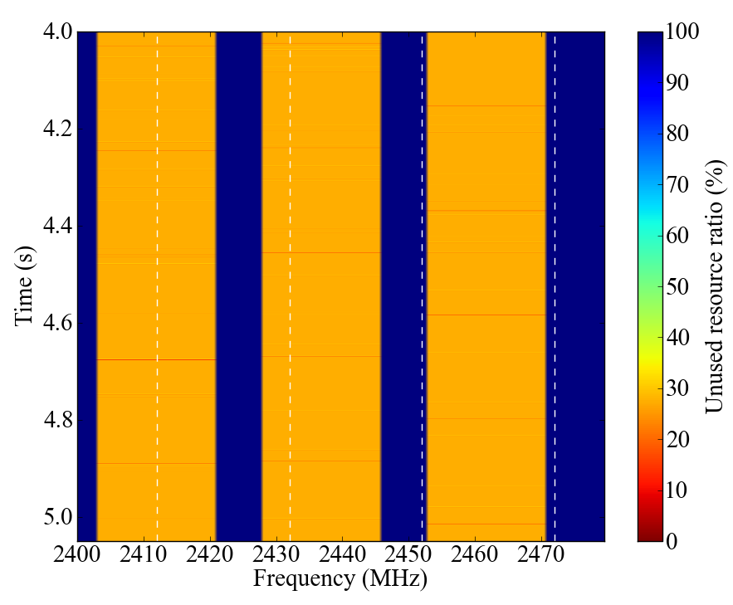
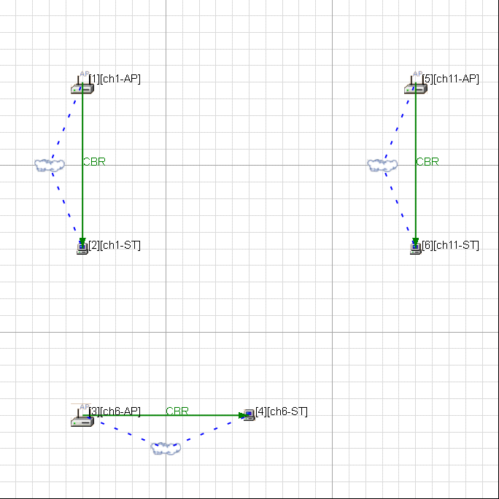
Case1: Baseline condition
WLAN 3 BSS’s operate at Ch 1, 6, 11 in 30 m × 30 m area
  Total throughput: 57.6Mbps
  Node throughput:19.2Mbps
Node location
Unused resources

Slide 11
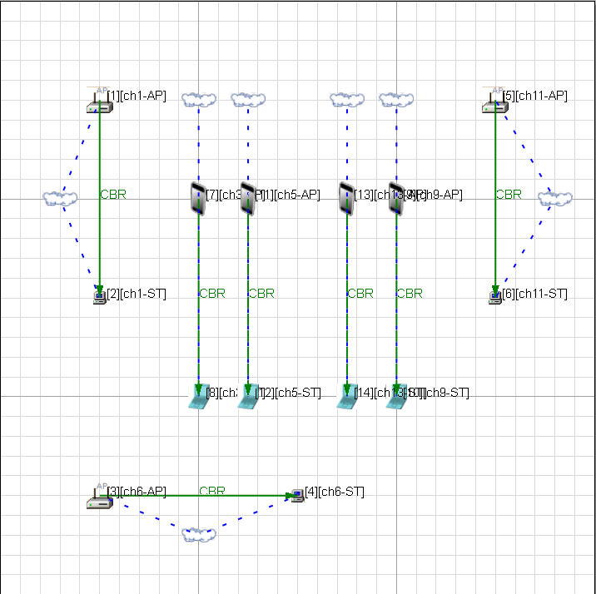
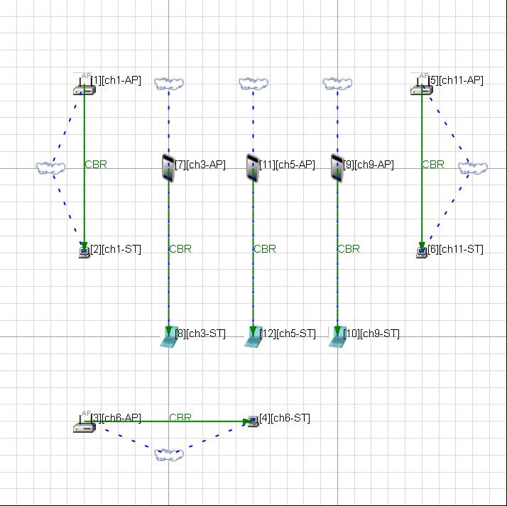
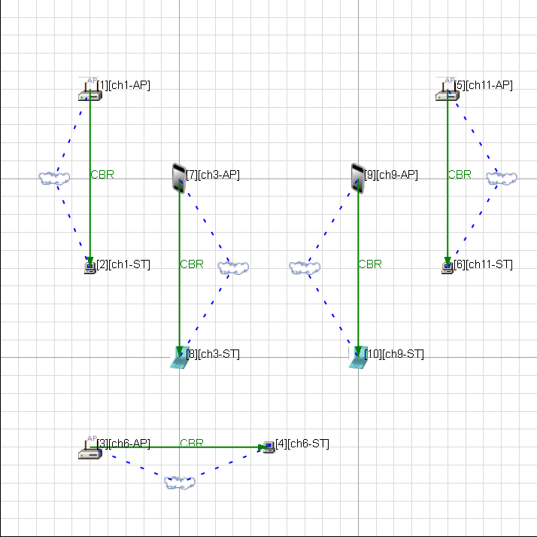
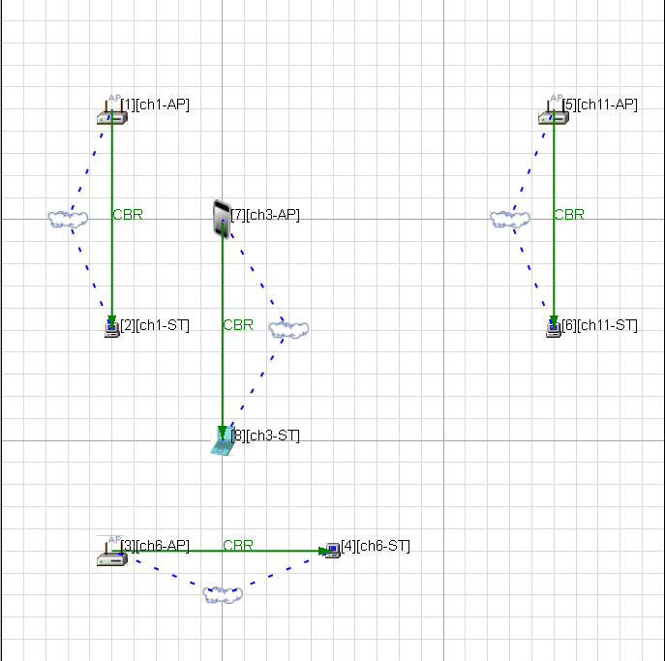
Case2: Setting & Location
Adding more WLAN BSS to Case1.
Case2-4
Case2-1
Case2-3
Case2-2
Node location

Slide 12

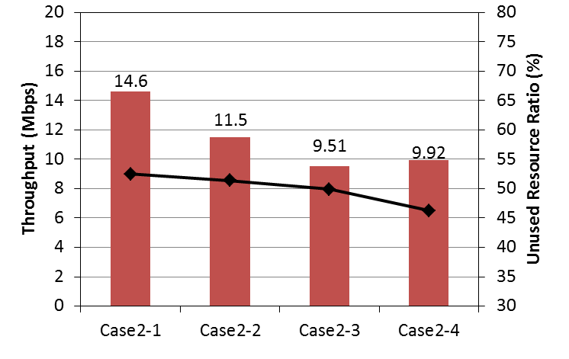
Case2: Simulation results
Average node throughput becomes deteriorate with the increase of number of BSS.
Average node throughput

Slide 13
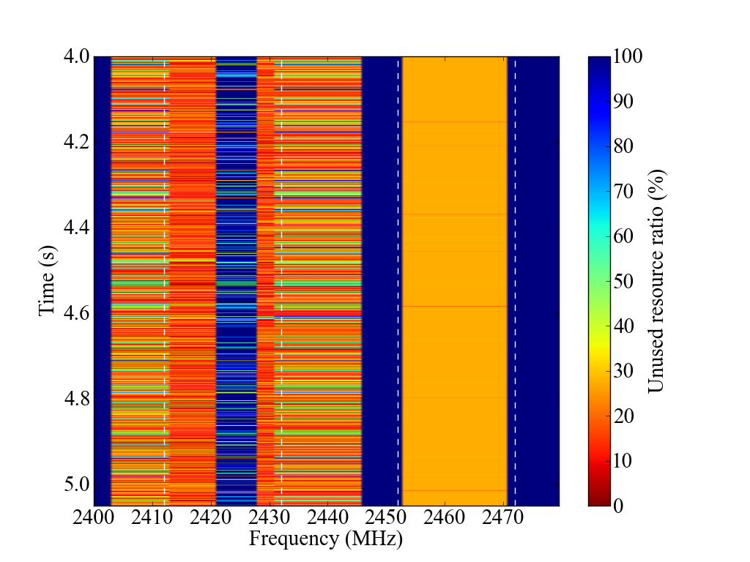
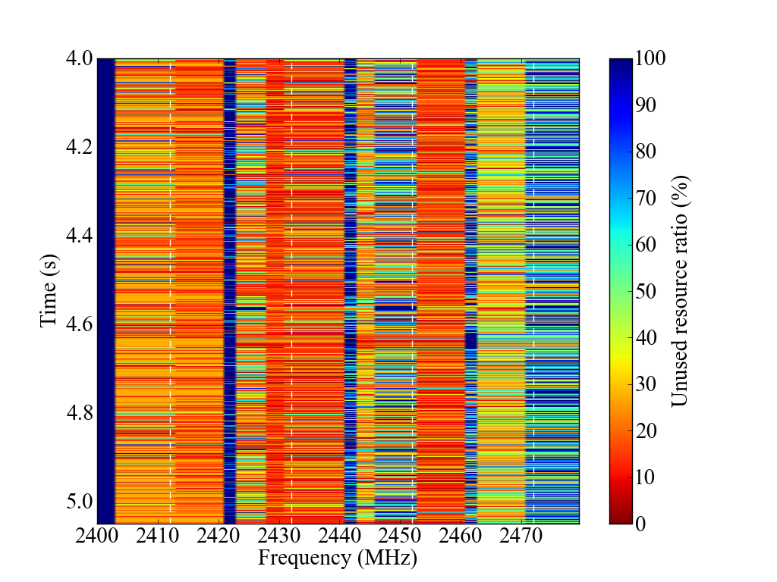
Unused resources
Case2-1
Case2-4

Slide 14
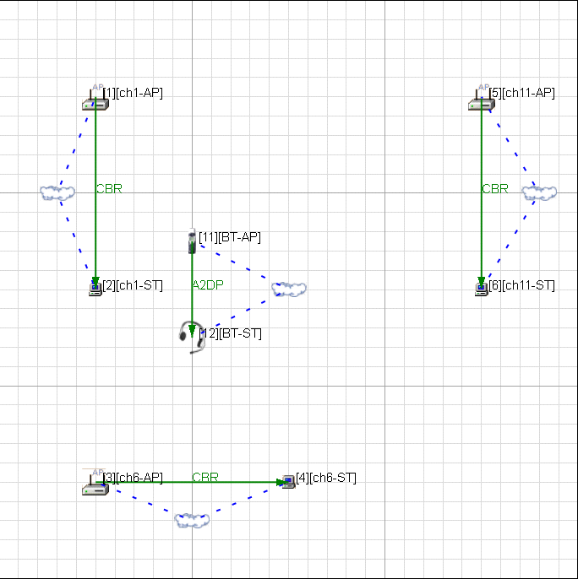
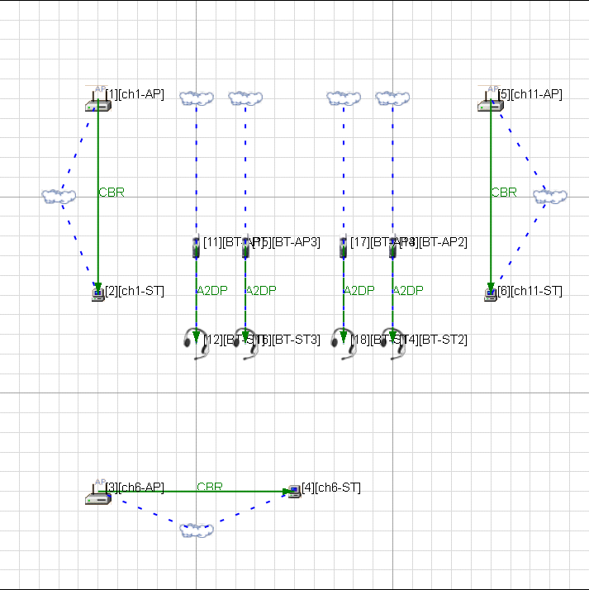
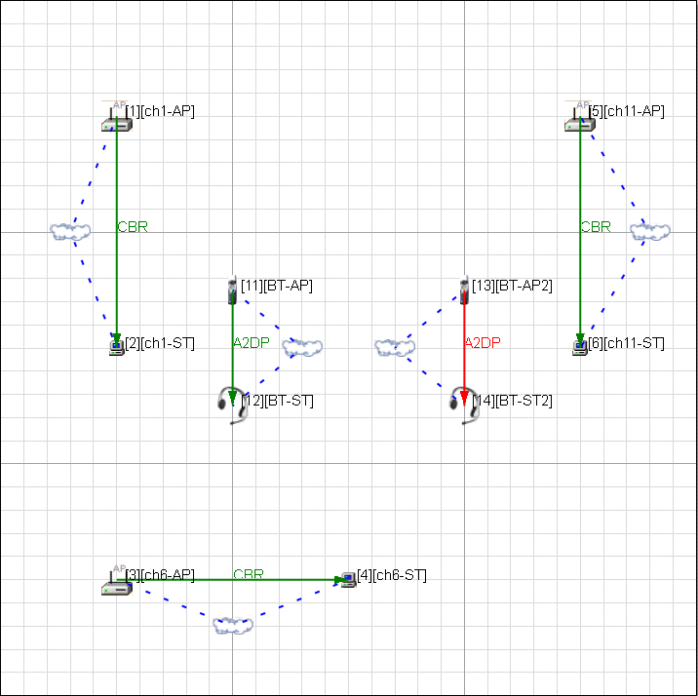
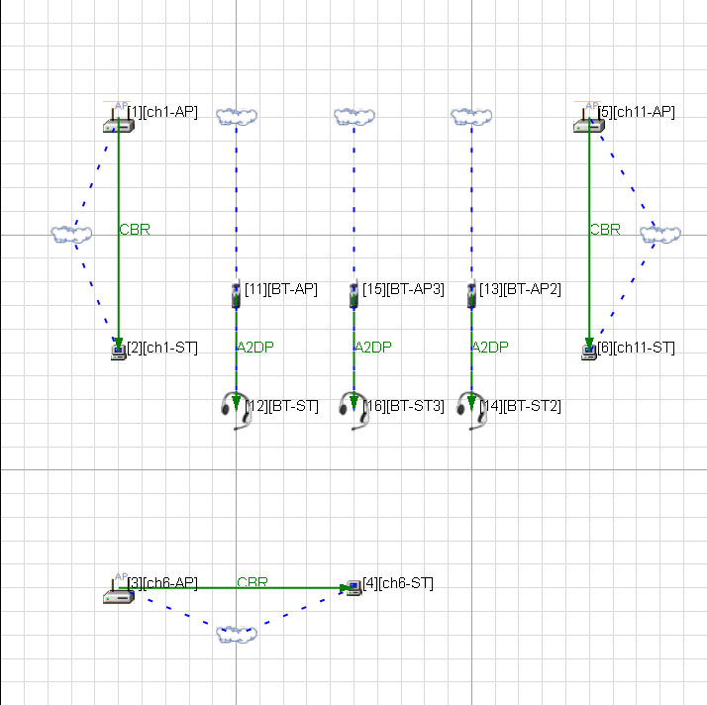
Case3: Setting & Location
Adding Bluetooth piconet to Case1.
Case3-1
Case3-2
Case3-4
Case3-3
Node location

Slide 15

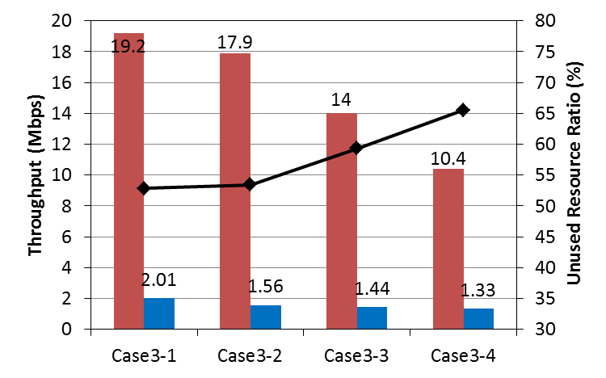
Case3: Simulation results
The throughput of the WLAN becomes deteriorates with increase of number of BT nodes.
Average node throughput

Slide 16
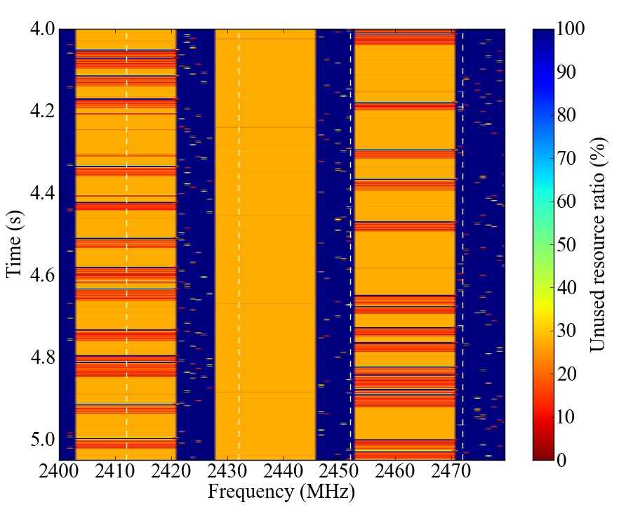
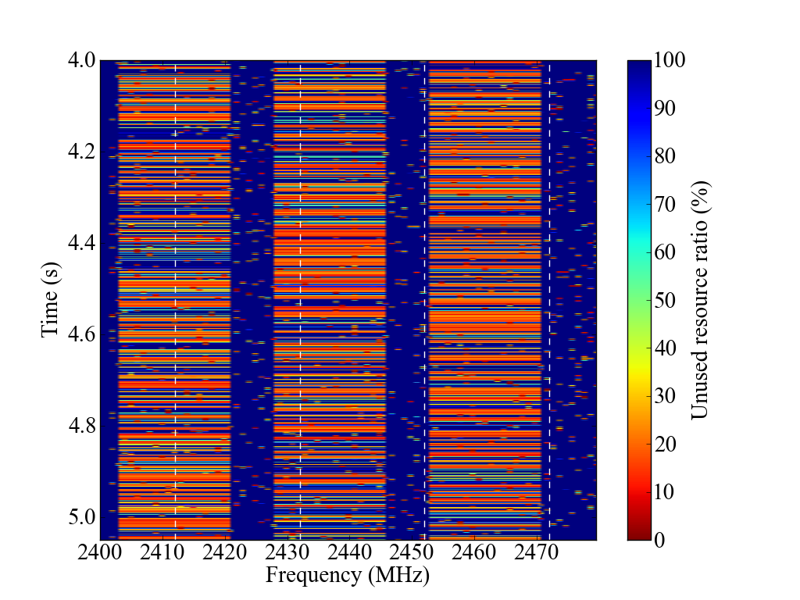
Unused resources
Case3-1
Case3-4

Slide 17
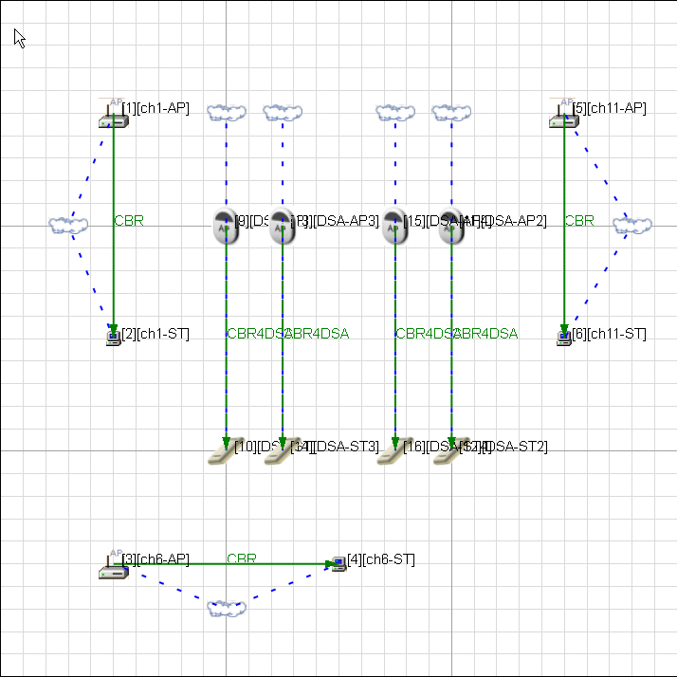
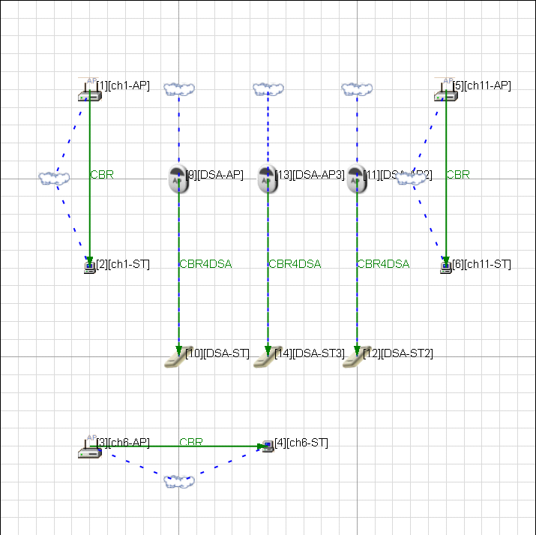
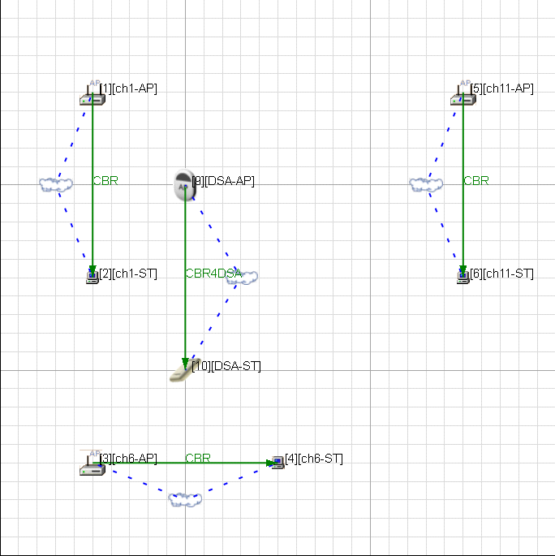
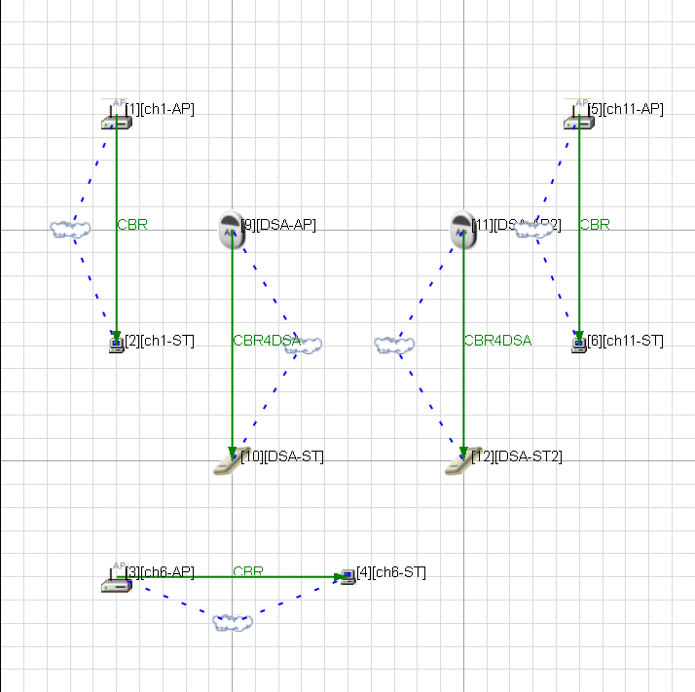
Case4: Setting & Location
Adding DSA group to Case1.
Case4-4
Case4-2
Case4-3
Case4-1
Node location

Slide 18

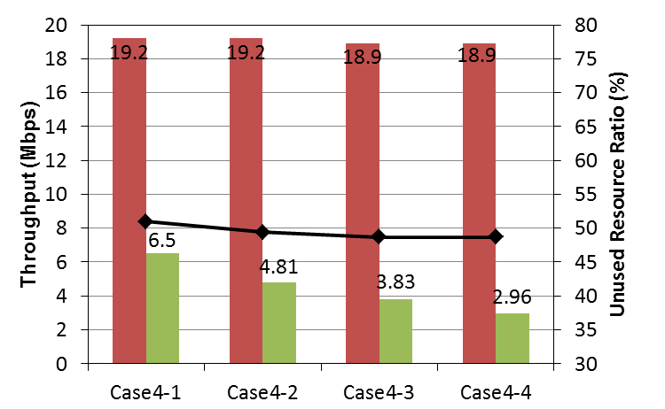
Case4: Simulation results
Even if the number of DSA nodes increase,
throughput of the WLAN about the same.
Average node throughput

Slide 19
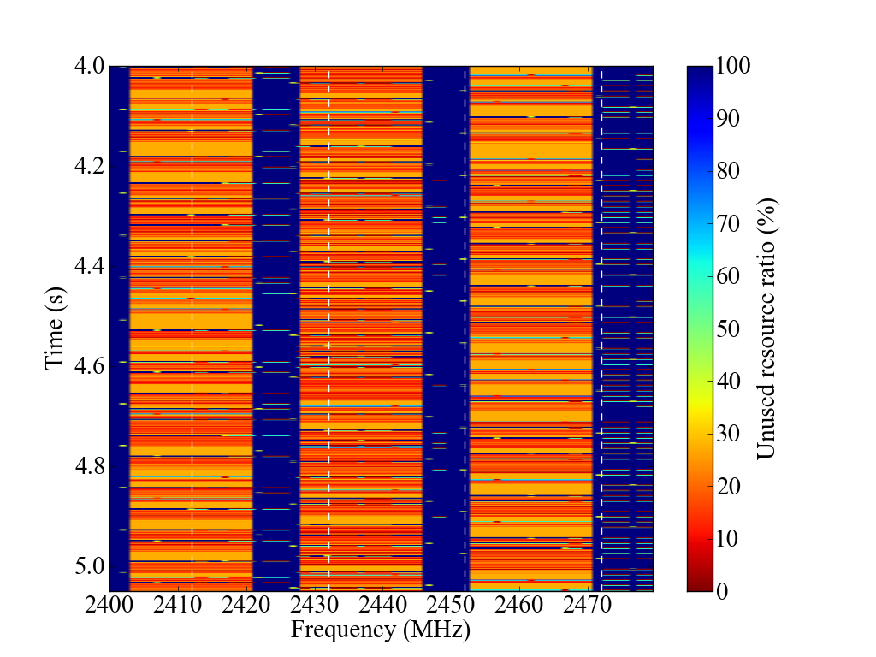
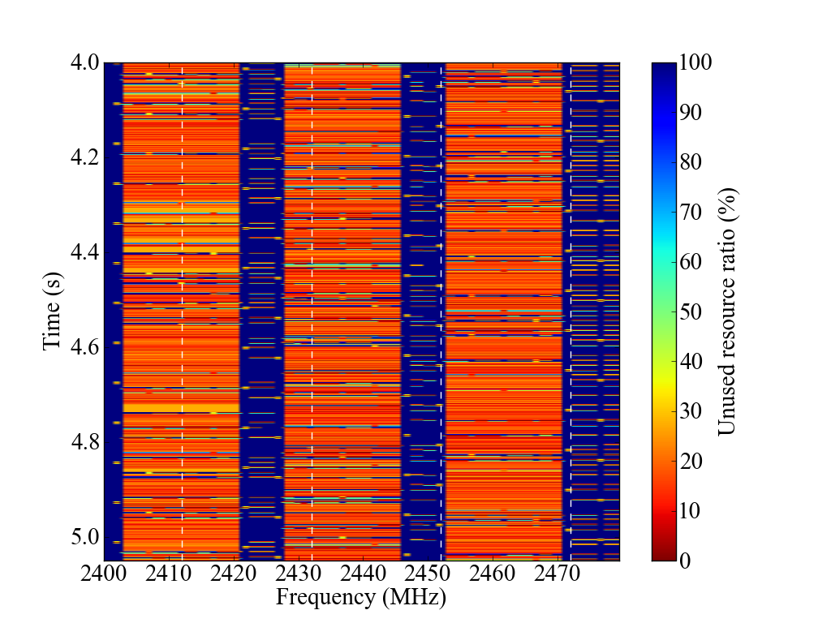
Unused resources
Case4-1
Case4-4

Slide 20
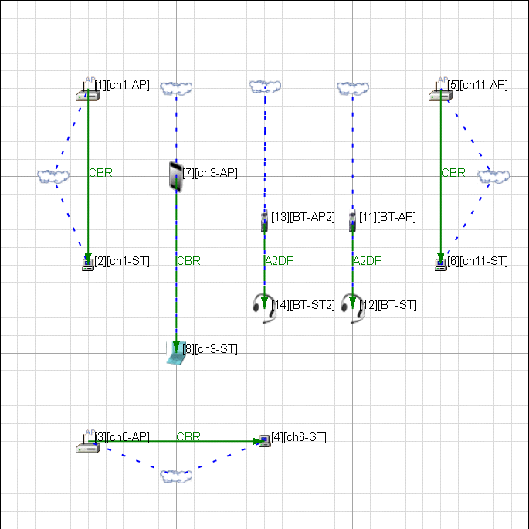
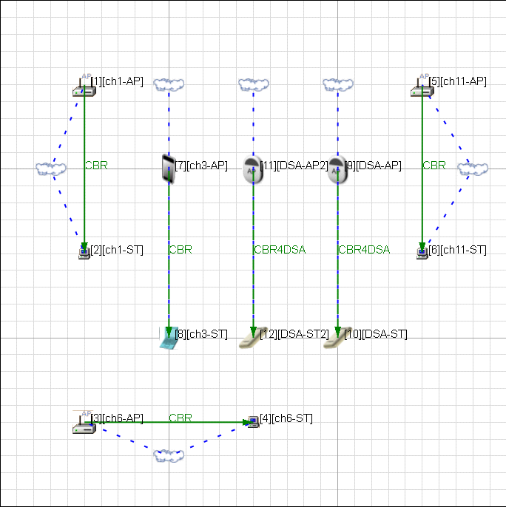
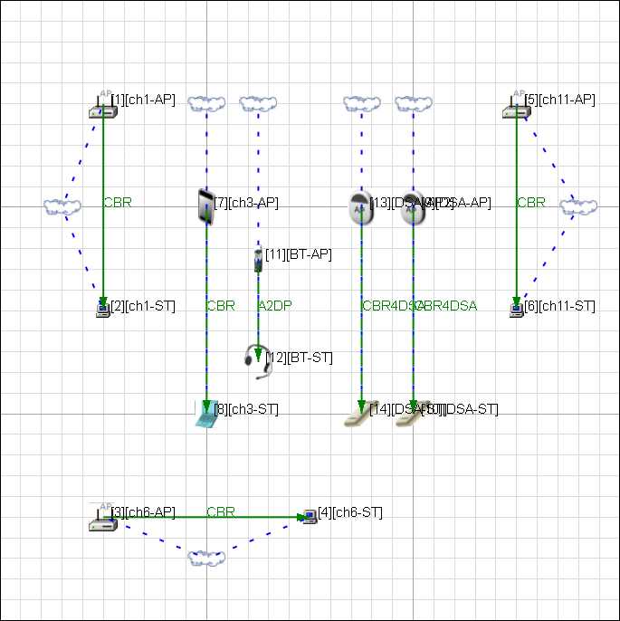
Case5 to 7 : Setting & Location
Coexistence with WLAN, BT, DSA
Case5
Case6
Case7
Node location

Slide 21

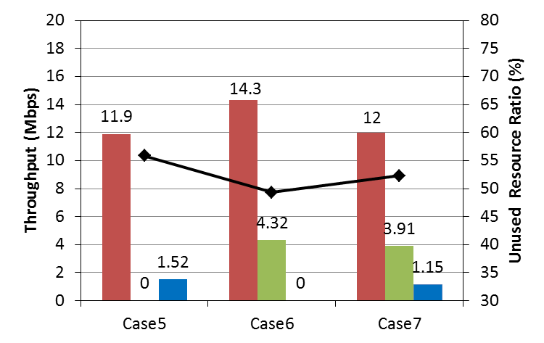
Case5 to 7: Simulation results
Average node throughput

Slide 22
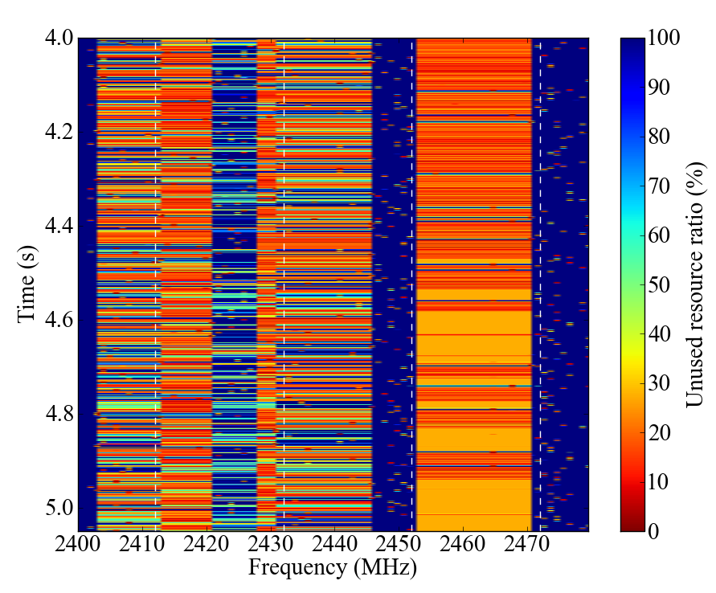
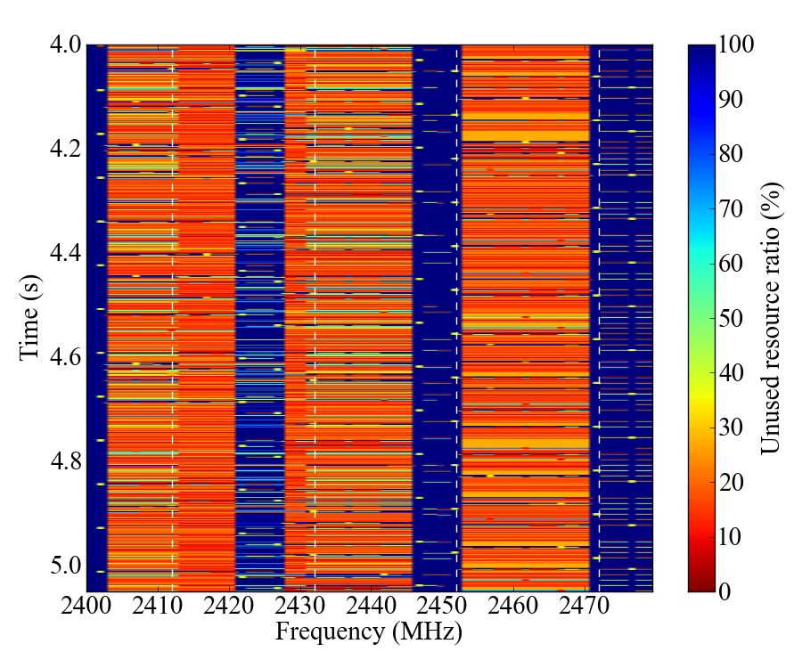
Unused resources
Case5
Case6

Slide 23
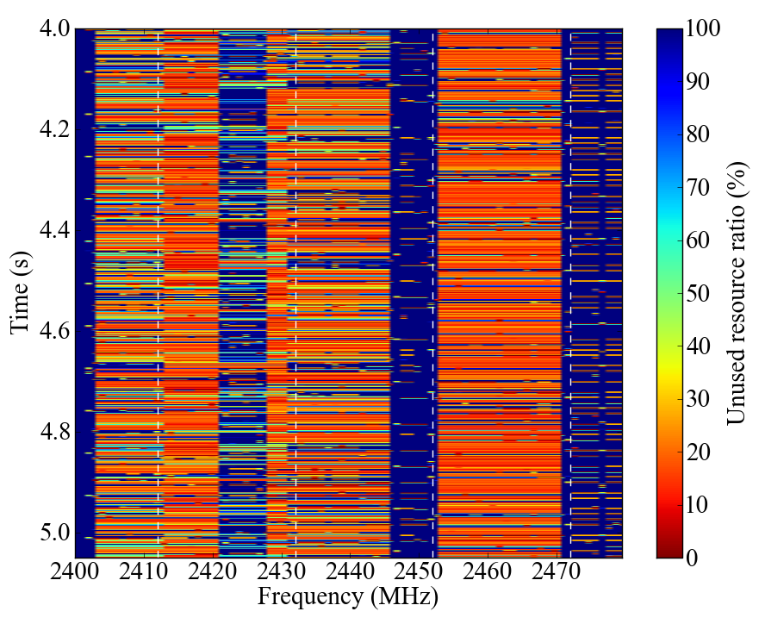
Unused resources
Case7

Slide 24
Conclusions
The network simulation results show that effectiveness of our proposed DSA system under congestion condition.
To achieve better use of spectrum resources and coexistence with other system, future WPAN consider following function.
  Frequency agility
  Variable bandwidth
Acknowledgment
This work is supported by the Ministry of Internal Affairs and Communications under a grant “Research and development on radio resource control technologies among multiple radio systems on same frequency band.”

Slide 25
Appendix: Simulation results

Slide 26
Summary of simulation

Slide 27
Case2-1:Case1+1BSS(ch3)
Node location
Unused resources

Slide 28
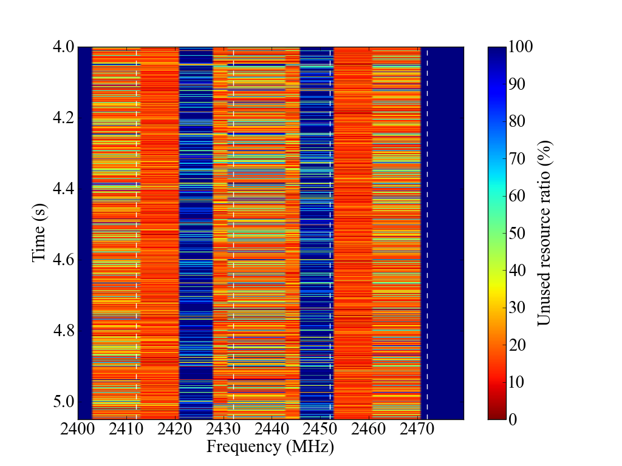
Case2-2:Case1 + 2BSS’s (ch3,9)
Node location
Unused resources

Slide 29
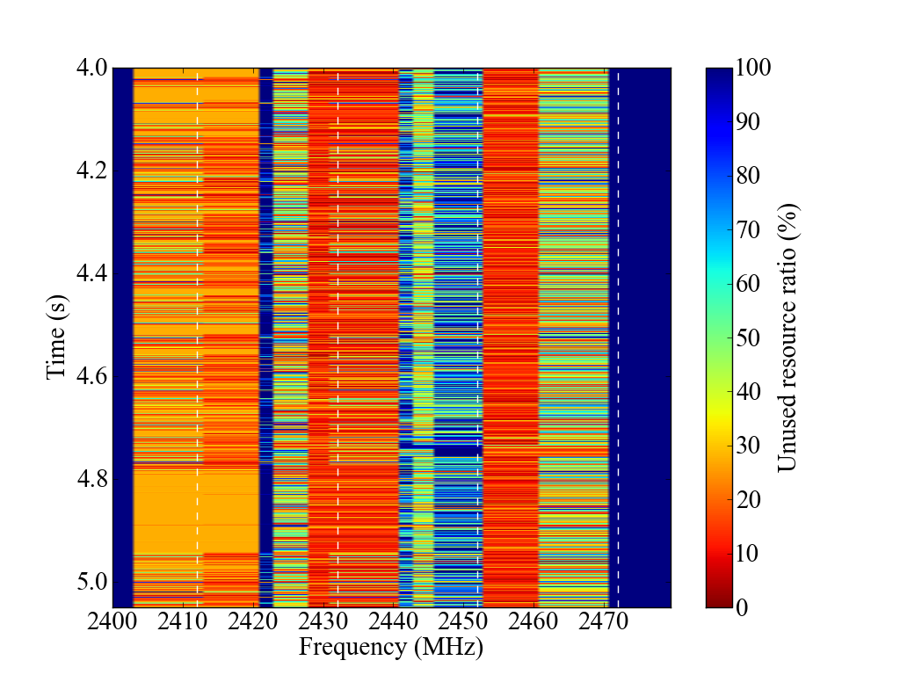
Case2-3:Case1 + 3BSS’s (ch3, 5, 9)
Node location
Unused resources

Slide 30
Case2-4:Case1 + 4BSS’s(ch3, 5, 9, 13)
Node location
Unused resources

Slide 31
Case3-1:Case1+BT 1pair
Node location
Unused resources

Slide 32
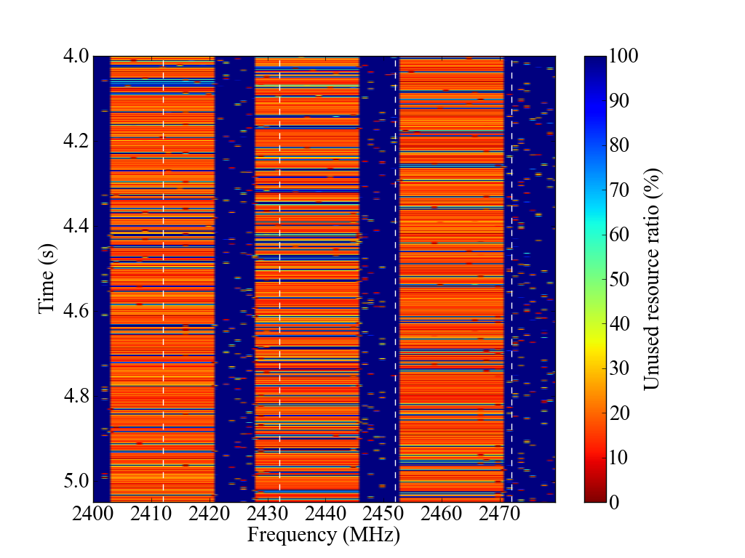
Case3-2:Case1 + BT 2pairs
Node location
Unused resources

Slide 33
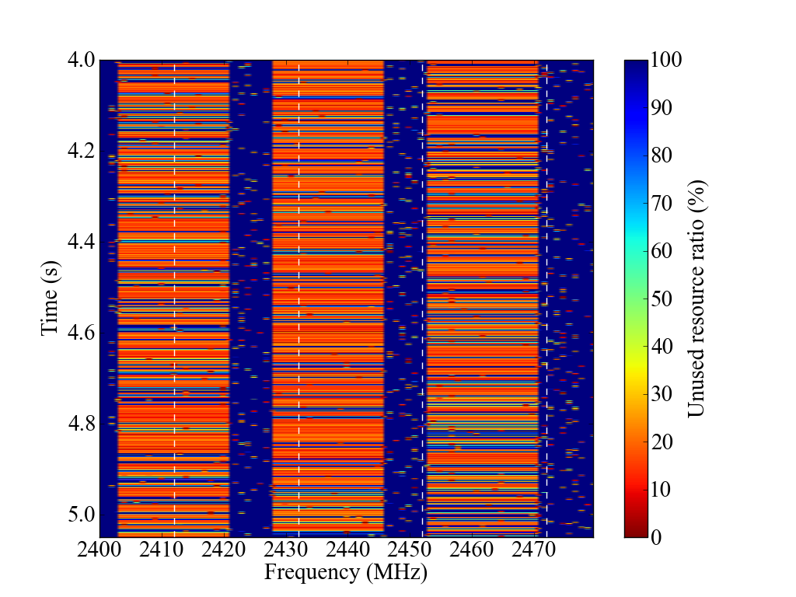
Case3-3:Case1 + BT 3pairs
Node location
Unused resources

Slide 34
Case3-4:Case1 + BT 4pairs
Node location
Unused resources

Slide 35
Case4-1:Case1 + DSA 1pairs
Node location
Unused resources

Slide 36
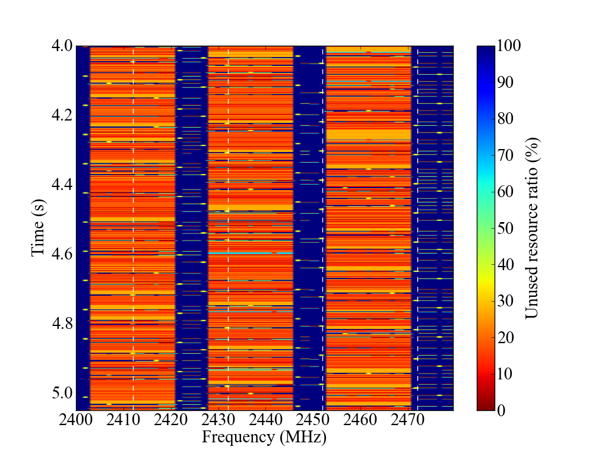
Case4-2:Case1 + DSA 2pairs
Node location
Unused resources

Slide 37
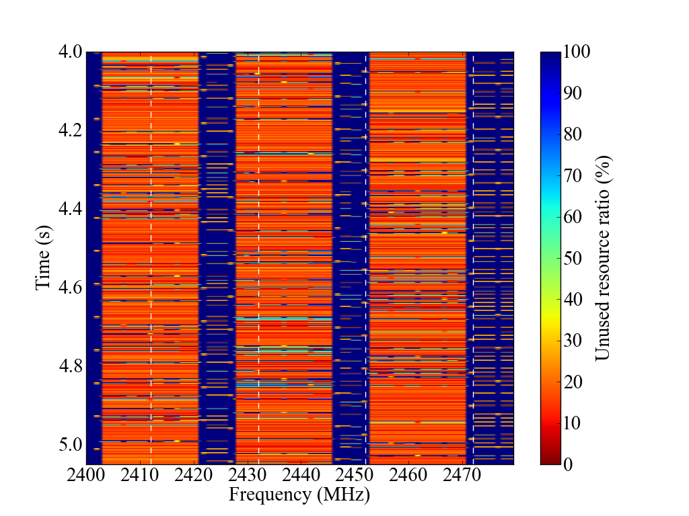
Case4-3:Case1 + DSA 3pairs
Node location
Unused resources

Slide 38
Case4-4:Case1 + DSA 4pairs
Node location
Unused resources

Slide 39
Case5:Case1 + WLAN 1BSS + BT 2pairs
Node location
Unused resources

Slide 40
Case6:Case1 + WLAN 1BSS + DSA 2pairs
Node location
Unused resources

Slide 41
Case7:Case1 + WLAN 1BSS + BT 1 pair
+ DSA 2pairs
Node location
Unused resources

