Slide 1
Project: IEEE P802.15 Working Group for Wireless Personal Area Networks (WPANs)
Submission Title: MAC common concepts and merge strategy
Date Submitted: 08 Nov 2011
Source: [Benjamin A. Rolfe, et al] Company [Blind Creek Associates}
Address []
Voice:[+1 408 395 7207], FAX: [NA], E-Mail:[ben @ blindcreek.com]
Re: [MAC discussion in TG4k]
Abstract: [Provides a summary of MAC considerations presented and suggests merge strategies]
Purpose: [Support MAC merging discussions]
Notice: This document has been prepared to assist the IEEE P802.15. It is offered as a basis for discussion and is not binding on the contributing individual(s) or organization(s). The material in this document is subject to change in form and content after further study. The contributor(s) reserve(s) the right to add, amend or withdraw material contained herein.
Release: The contributor acknowledges and accepts that this contribution becomes the property of IEEE and may be made publicly available by P802.15.

Slide 2
MPDU Fragmentation
Merging and Details

Slide 3
Goals by close of Atlanta
Consolidate contributions into a merged fragmentation baseline

Slide 4
Content
Sources
Progress since September
Acknowledgement scheme
CID Assignment
Fragment validation
Fragment contraction details

Slide 5
Sources
Taken material from prior MPDU fragmentation, Acknowledgement for fragmentation, and bits from other MAC presentations.
Document # | Title,
15-11-0631-01-004k | Acknowledgement Scheme for 4k Fragmentation
15-11-0589-00-004k | MPDU Fragmentation update
15-11-0478-02-004k | MPDU Fragmentation for TG4k
Also borrowed from many of the other MAC presentations:
Document # | Title, descriptions
15-11-0478-02-004k | MPDU Fragmentation for TG4k: lists prior documents on MDPU fragmentation
15-11-0806-00-004k | MAC Merge Concepts: Summary of presentations on MAC for 4k so far

Slide 6
Progress since Okinawa
Okinawa presentations
More details as PHY details come in
Presentations on Ack schemes
Several more presentations on need
Conference calls and email threads
Acknowledgement schemes
Methods for identifying fragments
Specific information in each fragment

Slide 7
Re-cap
General agreement fragmentation needed at very low data rates
Good analysis presented to show cost/benefits, when useful
Mostly agreement
Existing MPDU format has advantages
Need some flexibility
Process:
Build off existing MAC
Identify open issues and fill in the holes
Present results in a proposed merged baseline (here)

Slide 8
Acknowledgement
Two level acknowledgement
Fragment level: incremental
Each fragment carries a “ack now” flag
Acknowledgement == progress report, indicates fragments received so far
Can acknowledge every fragment or aggregate any number
Aggregated Acknowledgement
Using existing ACK/EACK frames
At end of reassembly or when other action needed
Includes fragment status, channel feedback
EACK can support channel diversity
New IEs for status and feedback content

Slide 9
Information required for each fragment
Fragment Descriptor
Type of fragment
LQI (feedback)
CID present
Chan open
Last fragment
Sequence ID
Context ID
16-bit short address
Fragment # in sequence

Slide 10
Fragment Structure
16, 24 or 32 octets
FHR |  |  | Payload | FFR
Octets: 2 | 0/1 | 0/2 | [7-10, 15-18 or 23-26] | 4
Fragment Descriptor | Ext. Descriptor | CID | Fragment Data | Frag CRC
Bits: 3 | 3 | 1 | 1 | 1 | 1 | 1 | 5
Sub-type | LQI | Chan open | Last Frag | SDU # | CID Present | ACK Reqst | Fragment #

Slide 11
FHR Fragment Descriptor
Fragment type:
Fragment (part of fragment sequence)
Not a fragment
Fragment Incremental acknowledgement
LQI: Link Quality indication. Measurement method is PHY dependent
CID present: indicates CID follows descriptor
Fragment acknowledge request: when set, the receiving device sends ack with status of fragments so far
Channel open indicates to receiving device that additional data will follow, so stay awake.
Last Fragment indicates that this is the final fragment in the current fragment sequence.
Sequence number identifies which sequence the fragment belongs to. This provides a means to have multiple sequences “in progress” at the same time.

Slide 12
FHR (cont)
Context ID
16-bit short address
May be omitted completely
For coordinator -> end node, specifies destination (source is implied)
For end node -> coordinator, specifies sources (destination is implied)
Fragment number
Indicates which fragment in the sequence

Slide 13
Fragment Formats
Type Not Fragment, no CID (example: coordinator -> end device )
Fragment Descriptor | Fragment Data | Frag CRC
Type Not fragment w/CID (example: end device -> coordinator)
Fragment Descriptor | CID | Fragment Data | Frag CRC
Type Fragment w/CID (example: coordinator -> end device ):
Fragment Descriptor | CID | Fragment Data | Frag CRC
Type Fragment, no CID (example: end device -> coordinator)
Fragment Descriptor | Fragment Data | Frag CRC

Slide 14
Format of Incremental Acknowledgment (I-ACK)
I-ACK (example: coordinator -> end device )
Fragment Descriptor | Fragment Status |  | Fragment CRC
 | Bit 0 | Bit n
1 | 2 | 3 | … | n-1 | n
I-ACK (example: end device -> coordinator)
Fragment Descriptor | CID | Fragment Status |  | Fragment CRC
 |  | Bit 0 | Bit n
1 | 2 | 3 | … | n-1 | n

Slide 15
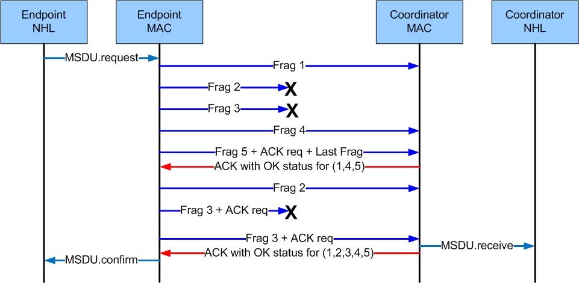
Example Exchange: End device to coordinator Transfer

Slide 16
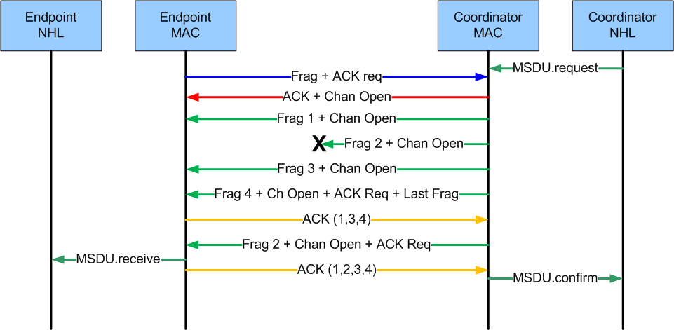
Example Exchange: Coordinator -> end device Transfer

Slide 17
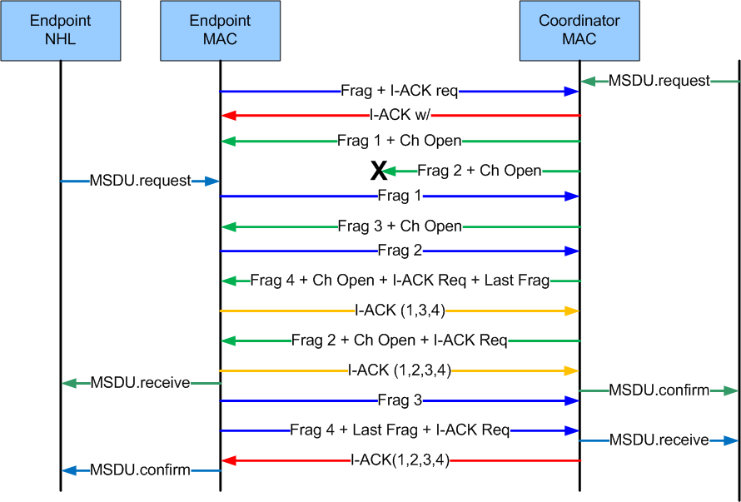
Example Transfer: Simultaneous

Slide 18
Context Assignment Examples
Example Higher (network) layer approach using existing MAC mechanisms:
Using 802.15.4-2011 Association request/response to assign
Using Multi-purpose frame (15.4e) to implement context information exchange

Slide 19
Example 1: 802.15.4 Association
Association Request 25 or 20 octets
Association Response 26 or 21 octets
Use short address to combine {source, destination, PAN ID} uniquely for bi-directional link
Currently SA assignment method higher layer and/or implementation specific [leave it that way]..reduces to “higher layer assigns it” with existing MAC means for exchanging
Octets:2 | 8 | 8 or 2 | 2 | 1 | 1 | 1 | 2
FCF | Source Address | Dest. Address | Dest. PAN | DSN | CFID | Capability Info | FCS
Octets:2 | 8 | 8 or 2 | 2 | 1 | 1 | 2 | 1 | 2
FCF | Source Address | Dest. Address | Dest PAN | DSN | CFID | Short Address | Status | FCS

Slide 20
802.15.4 Association
Notes:
Can be applied to beacon or non-beacon PANs per 15.4-2011
15.4-2011 implies dependence on beacon exchange…but specifies parameters provided by higher layer
Thus can support other method to ‘discover’ coordinator (i.e. without beacon exchange)
Overloading the meaning of “short address” (been done before)

Slide 21
Example 2: Context association using MP
Association request using Multi-purpose frame (15.4e)
Octets:2 | 8 | 8* |  | 2
FCF | Source Address | Destination Address | LECIM Assoc IE | FCS
LECIM Context Association IE
Request: 16 octets Response: 22 Octets
Octets:2
IE Descriptor
Octets:2 | 2
IE Descriptor | Context ID
Broadcast request (Source address only)
Directed response (both)
Can follow with other ‘discovery’ messages

Slide 22
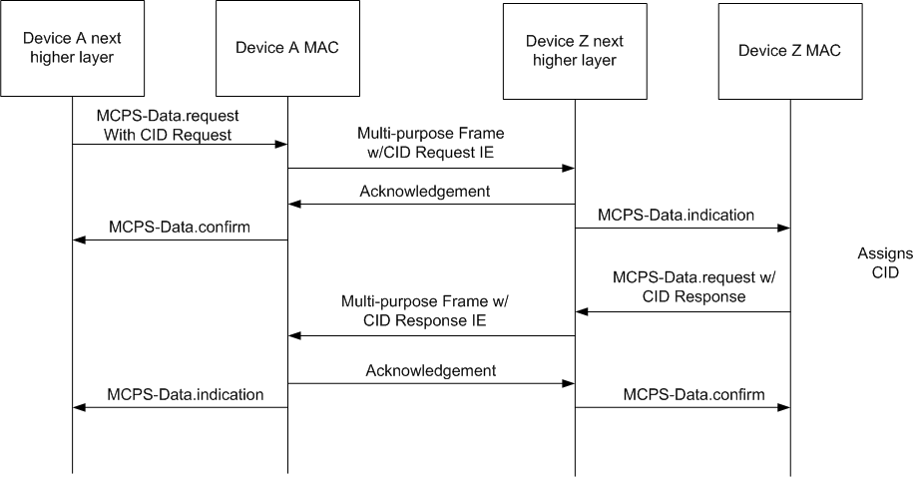
Example CID Assignment Exchange

