Slide 1
Project: IEEE P802.15 Working Group for Wireless Personal Area Networks (WPANs)
Submission Title: Use Cases for Peer Aware Communications (Sub 3 GHz)
Date Submitted: October 2011
Source: Suhwook Kim (LG Electronics)
Address: LG R&D Complex 533, Hogye-1dong, Dongan-gu, Anyang-shi, Kyungki-do, Korea
Voice: +82-31-450-1936, FAX: +82-31-450-4049, E-Mail: suhwook.kim@lge.com
Re: PAC Call for Presentations document number 15-11-0712
Abstract: Use Cases of Peer Aware Communication (PAC).
Purpose:
Notice: This document has been prepared to assist the IEEE P802.15. It is offered as a basis for discussion and is not binding on the contributing individual(s) or organization(s). The material in this document is subject to change in form and content after further study. The contributor(s) reserve(s) the right to add, amend or withdraw material contained herein.
Release: The contributor acknowledges and accepts that this contribution becomes the property of IEEE and may be made publicly available by P802.15.
Slide 1

Slide 2
Peer Aware Communication (PAC)
Key features: Infrastructureless, Fully Distributed, Peer-to-peer Communications
Autonomous Association: (without human intervention )
Discovery signaling rate -typically 100kbps
The number of devices in the discovery >100
Data Transmission rate -typically 10 Mbps
Group communications: n to m
Localization -typically 10m
Unlicensed/lightly licensed bands
Slide 2

Slide 3
Peer Aware Communication (PAC)
Peer Aware, what?
Peer’s Interest
What a peer is interested
Use case category 1 - Social Activity
Peer’s Purpose
What a peer want to have
Use case category 2 - Commerce & Advertisement
Peer’s Capability
What a peer is capable of
Use case category 3 - Personal environment setup
Slide 3

Slide 4
Peer Aware Communication (PAC)
Category 1: Social Activity
Group chatting
Social gaming
Social media, Personal broadcasting (Music, video, etc.)
Category 2: Commerce & Advertisement
Online brochure/coupon
Mall navigator
Category 3: Personal environment setup
Home theater configuration
Smart vehicle
Slide 4

Slide 5
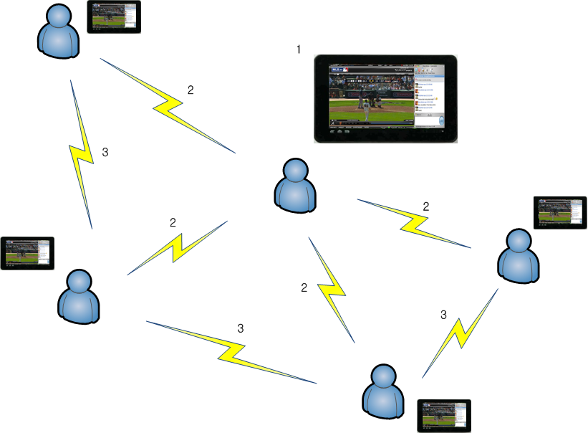
Peer Aware Communication (PAC)
Use case: Category 1 - Social Activity
1. Generate multimedia content with online chatting window
2. Broadcast and join
3. Enjoy the content
with chatter
Slide 5

Slide 6
Peer Aware Communication (PAC)
Technical requirement
 | Data rate | Coverage | Delay sensitivity | Mobility | Security requirement
Group chatting | ~ 1 Mbps | ~ 1 km | Low | Pedestrian | Low (public) High(private)
Social gaming | ~ 5 Mbps | ~ 1 km | High | Nomadic | High
Social media, Personal broadcasting | ~ 10 Mbps | ~ 100 meter | High | Nomadic | Low (public) High(private)
Slide 6

Slide 7
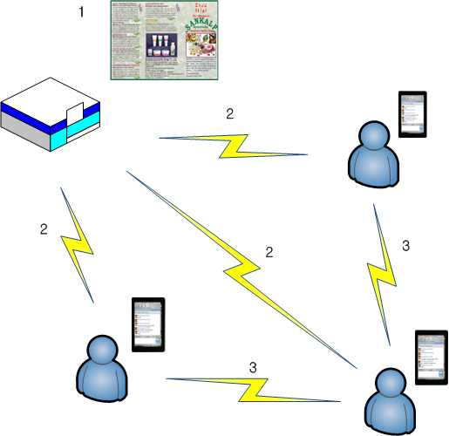
Peer Aware Communication (PAC)
Use case: Category 2 - Commerce & Advertisement
1. Make online brochure with special sale information
2. Distribute brochure
3. Share the information and
grade its quality
Slide 7

Slide 8
Peer Aware Communication (PAC)
Technical requirement
 | Data rate | Coverage | Delay sensitivity | Mobility | Security requirement
Online brochure/coupon | ~ 1 Mbps | ~ 1 km | Low | Pedestrian | High
Mall navigator | ~ 1 Mbps | ~ 1 km | Low | Pedestrian | Low
Slide 8

Slide 9
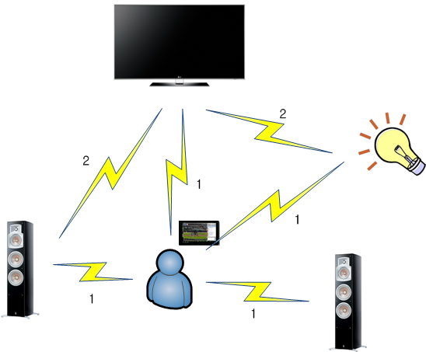
Peer Aware Communication (PAC)
Use case: Category 3 - Personal environment setup
1. Notify user’s activity to each device and setup it
2. Each device adjust automatically
its status and feedback to other
devices
Slide 9

Slide 10
Peer Aware Communication (PAC)
Technical requirement
 | Data rate | Coverage | Delay sensitivity | Mobility | Security requirement
Home theater configuration | ~ 5 Mbps | ~ 10 meter | Medium | Low | Low
Smart vehicle | ~ 1 Mbps | ~ 1 km | High | High | High
Slide 10

