Slide 1
Project: IEEE P802.15 Working Group for Wireless Personal Area Networks (WPANs)
Submission Title: Usage Cases for Peer Aware Communications
Date Submitted:
Source: Sunggeun Jin and Jinkyeong Kim
Address: sgjin@etri.re.kr
Re:
Abstract:
Purpose:
Notice: This document has been prepared to assist the IEEE P802.15. It is offered as a basis for discussion and is not binding on the contributing individual(s) or organization(s). The material in this document is subject to change in form and content after further study. The contributor(s) reserve(s) the right to add, amend or withdraw material contained herein.
Release: The contributor acknowledges and accepts that this contribution becomes the property of IEEE and may be made publicly available by P802.15.
Slide 1

Slide 2
PAC Functions
Main distinct identities
Coverage extension by using multi-hop
High precision location services
High speed ( > 300 Mbps ) throughput with low power consumption
Paging (wake-up) services
Dynamic routing protocols for walking users
Group Communications
Implementation
One standard/PHY/MAC/chip solution to support above features
Not combination of existing technologies into a combo chip
Physical layer to enable multiple data rates
MAC layer operation in fully distributed manner

Slide 3
Dynamic Scalability of Broad Range of Link Rates
Different QoS requirements in personal space
Heterogeneous services requiring different types of resources to support its own QoS
Fast transfers of data file and multimedia
High data rate and energy efficiency
Dynamic link rate adaptation for different features of services
Link rates change and flexible frame structure
Sufficiently high link rate: 20Mbps ~ at least 300 Mbps
Adaptive resource allocation for different services
New frame structure to accommodate services with different QoS

Slide 4
Fast Association and Group Communications
Instantaneous connection establishment
Seamless mobility without service interruption
Fast neighbor devices discovery
Dynamic and automatic connection/disconnection
Fast synchronization for PAC devices in distributed manner
Group communications
Dynamic grouping of devices without service interruption
Based on fast association and synchronization

Slide 5
Examples of Services
Slide 2

Slide 6
Gaming in Close Proximity

Slide 7
Museum Guide
Notes:
http://trendland.net/2011/01/03/phillips-de-pury-virtual-gallery-tour/#

Slide 8
Local Advertisements

Slide 9
Local Product Information

Slide 10
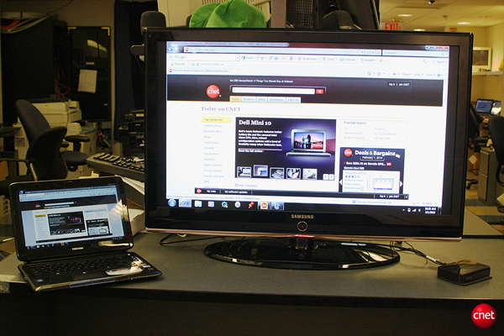
Wireless Display

Slide 11
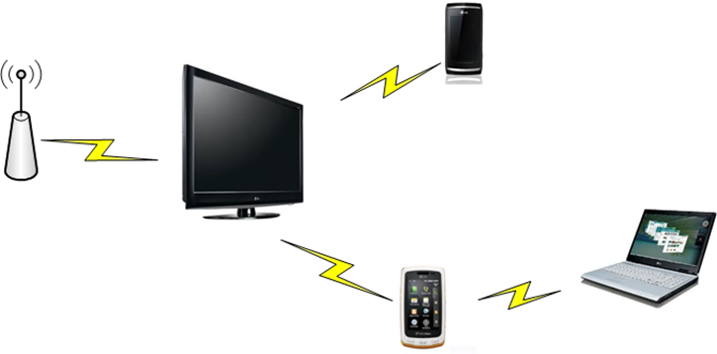
Multi-hop Support
Device can automatically establish multi-hop wireless links forwarding data frames.
Devices discover neighboring devices in a fast manner according to user-defined profiles.

Slide 12
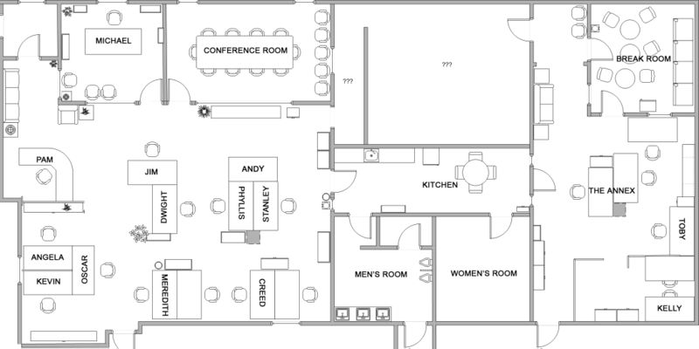
Location Services
High precision user tracking will bring enormous benefits for the services including advertisement, fast device discovery, short-range broadcastings and etc.

