Slide 1
Project: IEEE P802.15 Working Group for Wireless Personal Area Networks (WPANs)
Submission Title: [Proposed Comment Resolutions for CID 79, 162, 177, 178, 179 and 184]
Date Submitted: [04 Oct 2011]
Source: [Seung-Hoon Park, Taehan Bae, Dr.Euntae Won], Company [Samsung Electronics¹]
[Jung-hwan Hwang, Sung-weon Kang], Company [ETRI²]
Address [416, Maetan-3Dong, Yeongtong-Gu, Suwon-Si, Gyeonggi-Do, 443-742, Korea]
Voice:[+82-10-9349-9845], FAX: [+82-31-279-2441], E-Mail:[shannon.park@samsung.com]
{416, Maetan-3dong, Yeongtong-gu, Suwon-si, Gyeonggi-do, 443-742, South Korea}{+82-31-279-4960}{ etwon@samsung.com }
{138 Gajeong-ro, Yuseong-gu, Deajeon, 305-700, South Korea} {+82-42-860-5625}{ jhhwang@etri.re.kr }
Re: [Response to IEEE 802.15.6 Sponsor Ballot 1 Comments]
Abstract: [This document proposes several resolutions for Clause 11 of Sponsor Ballot 1]
Purpose: [For discussion by IEEE 802.15 TG6]
Notice: This document has been prepared to assist the IEEE P802.15. It is offered as a basis for discussion and is not binding on the contributing individual(s) or organization(s). The material in this document is subject to change in form and content after further study. The contributor(s) reserve(s) the right to add, amend or withdraw material contained herein.
Release: The contributor acknowledges and accepts that this contribution becomes the property of IEEE and may be made publicly available by P802.15.

Slide 2
CID-79
  Comment:
The HBC PHY is outside the scope of the 802.15 TG6 PAR. The Human Body Communication Physical Layer is not a wireless technology. As described by Annex C, the HBC PHY uses the human body as a conductive media for data communication. As such, the HBC PHY is outside the scope of the 802.15 TG6 PAR which defines "a standard for short range, wireless communication in the vicinity of, or inside, a human body". The sponsor ballot invitation states that "One of the responsibilities as a balloter is to ensure that the scope off the draft is within the scope of the work authorized by the PAR
  Commenter’s Resolution:
Remove the Human Body Communication PHY from the draft to preserve the scope of the 802.15 TG6 PAR. Delete clause 11 and annex C.
  Comment Status: Defer to 10/4 teleconference
  Proposed Resolution: Reject

Slide 3
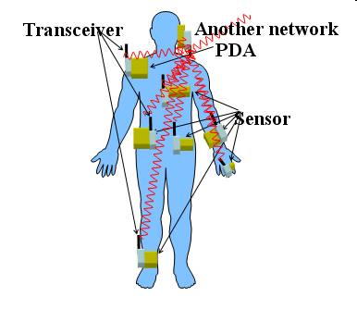
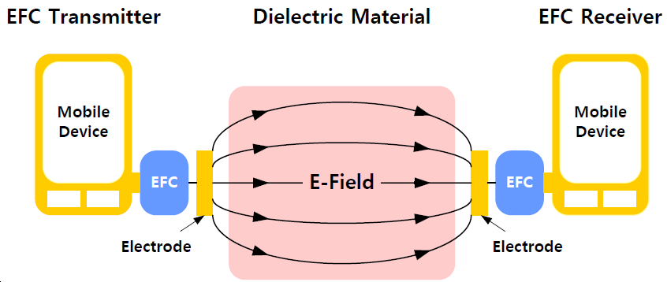
CID-79
  HBC is not basically different from wireless communication in the fact that both use field-coupling between transmitter and receiver.
(Human body)
Far-field coupling
(Propagation)
Near-field coupling
Wireless communication
HBC [5]

Slide 4
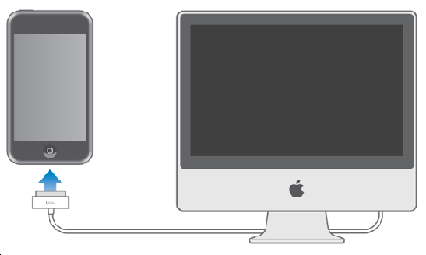
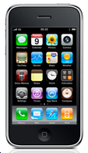

CID-79
  Comparing with wire-line communication, a common-ground between transmitter and receiver is not formed in HBC.
Tx
Rx
Tx
Rx
Signal line
Ground line
No common-ground due to no ground line
Common-ground by ground line
HBC
Wire-line communication

Slide 5
CID-79
  Fields are coupled through human body in the case of implant communications in the same way as HBC
  Near-field condition can be formed when communication range is shorter than wave-length even in wireless communication
Propagation through body
Human body

Slide 6
CID-162
  Comment:
Does Human Body Communications (HBC) as elaborated in clause 11 satisfy the IEEE SA's definition of "wireless communication" as included in the PAR, paragraph 5.2 (first sentence). Figure 159 includes a block for an "electrode" whereas wireless communication systems include an antenna.
  Commenter’s Resolution:
If HBC does not satisfy the IEEE SA's definition of "wireless communication" then remove clause 11 and any text referencing this clause from the draft standard. An alternative would be to modify the PAR.
  Comment Status: Defer to 10/4 teleconference
  Proposed Resolution: Reject
  Wireless communication systems does not limit to use only the antenna. For example, 802.15.7 Visible Light Communication has no antenna, but LED and photo detector. And TG6 Technical Requirement Document defines electrodes as well as antennas. Refer CID-79.

Slide 7
CID-177
  Comment:
The draft standard does not specify pulse shaping filters (either transmit or receive) for the HBC mode of operation. Submission IEEE 802.15-10-0318-00-0006 illustrates the improved out-of-band rejection offered by a transmit filter, but this filter is not specified in the draft standard. Further, the draft standard's low-frequency spectral mask does not appear to reflect the implementation of a transmit filter such as the one described in IEEE 802.15-10-0318-00-0006.
  Commenter’s Resolution:
Specify HBC transmit and receive filters in the standard. For example, sub-clause 9.5.2.1 specifies a square-root raised cosine (SRRC) pulse shape for the NB PHY (this pulse shape also influences frequency-domain content). If such filters are not required to ensure interoperability, then please provide related technical justification
  Comment Status: Defer to 10/4 teleconference
  Proposed Resolution: Reject
  Tx filter is implementation dependent, so any type filter can be implemented to satisfy requirements of transmit spectral mask.

Slide 8
CID-178
  Comment:
The low-frequency spectral mask may not be sufficient to prevent suspension of therapy in the large population of patients with implanted medical devices. Additionally, the spectral mask may not be sufficient to prevent interference with signals from MICS implants emitted at relatively low levels of EIRP (generally less than 200 nW). The qualitative phrase "to protect the safety for the human body" in sub-clause 11.8.2 is not sufficient to ensure patient safety. IEEE legal staff (Legal review for P802.15.6_D01, Michelle Turner, 2 Nov. 2010; posted to STDS-802-15-BAN reflector on 11 Nov. 2010) advised "... If this is a matter of concern, its should be discussed further with members of the implantable medical device industry to determine an appropriate spectral mask." Concerns of the active implantable medical device industry are summarized in document IEEE 802.15-11-0533-01-0006.
  Commenter’s Resolution:
While low frequency masks (below the HBC frequency of operation) are defined in D04, the discussion with AdvaMed to establish maximum output power levels and an appropriate spectral mask is not yet complete (three conference calls held to date). The minutes from the last conference call are documented in IEEE P802.15-11-0441-00-0006. The proposed resolution is to remove clause 11 and any text referencing this clause from the draft standard, with the HBC mode potentially being further considered in a new Study Group or Task Group. This action would provide AdvaMed members and HBC proponents additional time to analyze potential degradation of medical device operation (due to EMI produced by HBC), without delaying approval of IEEE 802.15.6 and its other modes. As an alternative, HBC proponents could agree to meet with representatives of the active implantable medical device industry as suggested on slide 16 of IEEE 802.15-11-0533-01-0006.

Slide 9
CID-178
  Comment Status: Defer to 10/4 teleconference
  Proposed Resolution: Reject
  The Tx spectral mask will be edited to have more out-of-band rejection to prevent potential interference with signals from medical devices. Refer CID 82 for spectral mask update.

Slide 10
CID-179
  Comment:
The phrase "The radiation power to the human body .." is ambiguous. This phrase (including measurement methodology) must be fully explained and understood so members of the medical device industry can make the appropriate conversions as required to evaluate compliance to ANSI/AAMI PC69 Annex M (Correlation between levels of test voltages used in the standard and radiated field strengths). The qualitative phrase "to protect the safety for the human body" in sub-clause 11.8.2 is not sufficient to ensure patient safety. IEEE legal staff (Legal review for P802.15.6_D01, Michelle Turner, 2 Nov. 2010; posted to STDS-802-15-BAN reflector on 11 Nov. 2010) advised "... Further, if the proper transmit power is a matter of concern, it should be discussed further with members of the implantable medical device industry to determine an appropriate transmit power level." Concerns of the active implantable medical device industry are summarized in document IEEE 802.15-11-0533-01-0006.
  Commenter’s Resolution:
The related discussion with AdvaMed to establish maximum output power levels and an appropriate spectral mask is not yet complete (three conference calls held to date). The minutes from the last conference call are documented in IEEE P802.15-11-0441-00-0006. The proposed resolution is to remove clause 11 and any text referencing this clause from the draft standard, with the HBC mode potentially being further considered in a new Study Group or Task Group. This action would provide AdvaMed members and HBC proponents additional time to analyze potential degradation of medical device operation (due to EMI produced by HBC), without delaying approval of IEEE 802.15.6 and its other modes. As an alternative, HBC proponents could agree to meet with representatives of the active implantable medical device industry as suggested on slide 16 of IEEE 802.15-11-0533-01-0006.

Slide 11
CID-179
  Comment Status: Defer to 10/4 teleconference
  Proposed Resolution: Reject
  - The Tx spectral mask will be edited to have more out-of-band rejection to prevent potential interference with signals from medical devices.
  Also, the meaning of the radiation power will be clarified as editing a relevant sentence of section 11.8.2. (refer CID 180)
  “ The radiation power from the human body shall be less than -36 dBm as total power in the operating
  band”
  will be replaced with
  “ The radiation power at 3 meters from the electrode in the air shall be less than -36 dBm as total power in
  the operation band.

Slide 12
CID-184
  Comment:
  “Current radio specification for HBC PHY only specify receiver sensitivity requirements; which is not adequate to guarantee a receiver quality as mentioned in Section 1.2 of the draft related to the reliability, co-existence and QoS of devices used in or around a body”
  Commenter’s Resolution:
  “Enhance radio specifications by including Rx specifications for adjacent/alternate channel rejection, blocking , intermodulation and/or co-channel specifications”
  Recommend to Revise:
  Delete one of two HBC(EFC) bands, 21 MHz or 32 MHz
  Proposed Resolution
    The 32MHz band will be deleted from Clause 11
    Remove all description, table, or figure related to the 32MHz band

