Slide 1
Project: IEEE P802.15 Working Group for Wireless Personal Area Networks (WPANs)
Submission Title: [Revised Comment Resolutions for CID 82]
Date Submitted: [21 Sep 2011]
Source: [Seung-Hoon Park, Taehan Bae, Dr.Euntae Won], Company [Samsung Electronics¹]
[Jung-hwan Hwang, Sung-weon Kang], Company [ETRI²]
Address [416, Maetan-3Dong, Yeongtong-Gu, Suwon-Si, Gyeonggi-Do, 443-742, Korea]
Voice:[+82-10-9349-9845], FAX: [+82-31-279-2441], E-Mail:[shannon.park@samsung.com]
{416, Maetan-3dong, Yeongtong-gu, Suwon-si, Gyeonggi-do, 443-742, South Korea}{+82-31-279-4960}{ etwon@samsung.com }
{138 Gajeong-ro, Yuseong-gu, Deajeon, 305-700, South Korea} {+82-42-860-5625}{ jhhwang@etri.re.kr }
Re: [Response to IEEE 802.15.6 Sponsor Ballot 1 Comments]
Abstract: [This document proposes several resolutions for Clause 11 of Sponsor Ballot 1]
Purpose: [For discussion by IEEE 802.15 TG6]
Notice: This document has been prepared to assist the IEEE P802.15. It is offered as a basis for discussion and is not binding on the contributing individual(s) or organization(s). The material in this document is subject to change in form and content after further study. The contributor(s) reserve(s) the right to add, amend or withdraw material contained herein.
Release: The contributor acknowledges and accepts that this contribution becomes the property of IEEE and may be made publicly available by P802.15.

Slide 2
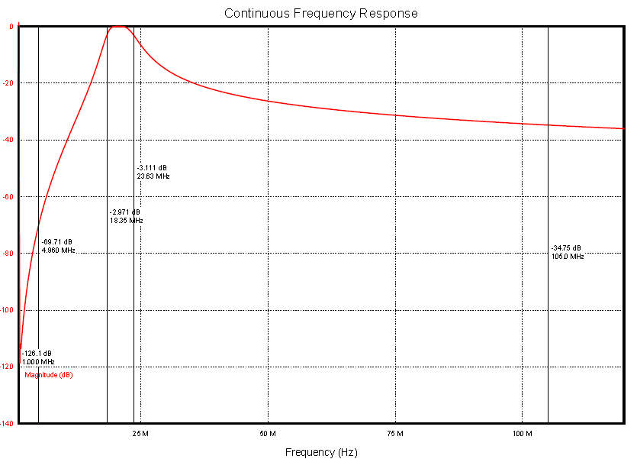
CID-82
Proposed Resolution
-3 dBr
@ 18.375 MHz
-3 dBr
@ 23.625 MHz
Proposed Transmit Mask
-34 dBr
@ 105 MHz
-25 dBr
@ 50 MHz
-80 dBr
@ 2 MHz
-120 dBr
@ 1 MHz

