Slide 1
Project: IEEE P802.15 Working Group for Wireless Personal Area Networks (WPANs)
Submission Title: [Proposed Comment Resolutions for CID 35, 82, 177, 180, and 184]
Date Submitted: [21 Sep 2011]
Source: [Seung-Hoon Park, Taehan Bae, Dr.Euntae Won], Company [Samsung Electronics¹]
[Jung-hwan Hwang, Sung-weon Kang], Company [ETRI²]
Address [416, Maetan-3Dong, Yeongtong-Gu, Suwon-Si, Gyeonggi-Do, 443-742, Korea]
Voice:[+82-10-9349-9845], FAX: [+82-31-279-2441], E-Mail:[shannon.park@samsung.com]
{416, Maetan-3dong, Yeongtong-gu, Suwon-si, Gyeonggi-do, 443-742, South Korea}{+82-31-279-4960}{ etwon@samsung.com }
{138 Gajeong-ro, Yuseong-gu, Deajeon, 305-700, South Korea} {+82-42-860-5625}{ jhhwang@etri.re.kr }
Re: [Response to IEEE 802.15.6 Sponsor Ballot 1 Comments]
Abstract: [This document proposes several resolutions for Clause 11 of Sponsor Ballot 1]
Purpose: [For discussion by IEEE 802.15 TG6]
Notice: This document has been prepared to assist the IEEE P802.15. It is offered as a basis for discussion and is not binding on the contributing individual(s) or organization(s). The material in this document is subject to change in form and content after further study. The contributor(s) reserve(s) the right to add, amend or withdraw material contained herein.
Release: The contributor acknowledges and accepts that this contribution becomes the property of IEEE and may be made publicly available by P802.15.

Slide 2
CID-35
  Comment:
Always Active field is not relevant to Rate Indicator function of HBC.
  Commenter’s Resolution:
Please describe alternative method to inform RI mode.
  Comment Status: Revised.
  Recommend to Revise:
The former version used MAC field unreasonably. So RI mode operation based on PHY is recommended.

Slide 3
CID-35
  Proposed Resolution
- replace "especially for high data rates"
to "especially only for burst mode".
- replace "To use RI, the sender should indicate to the receiver by setting Always Active field to one in MAC capability format."
to "The MAC shall set the burst mode bit as defined in Table 84,
to support higher throughput by allowing the transmission of consecutive frames without ACK and higher data rate for PHY header. "

Slide 4
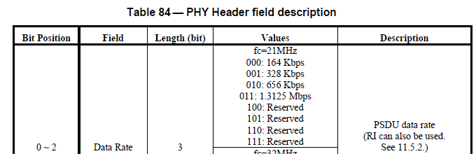

CID-35
…

Slide 5
CID-35
  Proposed Resolution
replace “A hub may initiate RI mode for only one RI enabled device and transmits a stream of frames. After finishing the traffic session to a device, a hub should indicate to the device by setting Always Active field to zero."
to “The MAC shall indicate that the next packet is part of burst with RI mode to the receiver by setting Burst Mode field to one. The MAC shall indicate that the next packet is not part of burst with DRF mode to the receiver by setting Burst Mode field to zero. In the burst mode, the inter-frame spacing pMIFS is defined in 11.11.3."

Slide 6
CID-82
  Comment:
The transmit mask for HBC lacks sufficient filtering of out of band emissions. Only -9.5 dBr is shown for DC (0Hz) levels. Additional filtering is needed to reduce the probability of conducted or radiated EMI/EMC issues with other body worn devices.
  Commenter’s Resolution:
Change Figure 171 and Figure 172 to show a *maximum* value of -120 dBr at 1 MHz (absolute) frequency. Such attenuation is readily achievable using a 5th order Butterworth passive filter or numerous other filter options.
  Comment Status: Tent. Accepted.
  Recommend to Revise:
Figure 171 and 172 will be updated to show -100 dBr at 1MHz.

Slide 7
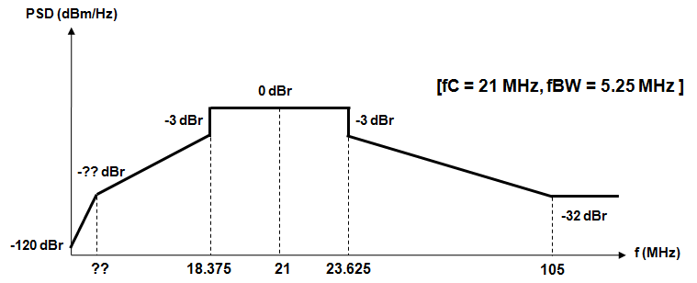
CID-82
  Proposed Resolution
-7.8 dBr
1
5

Slide 8
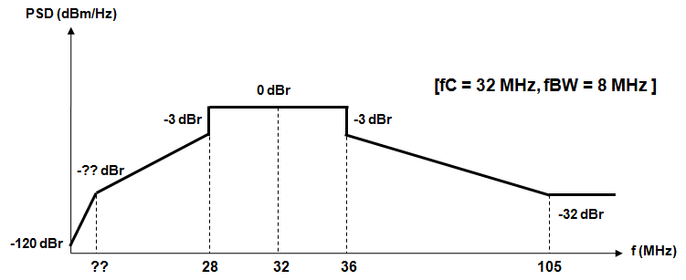
CID-82
  Proposed Resolution
-12.7 dBr
1
5

Slide 9
CID-177
  Comment:
  The draft standard does not specify pulse shaping filters (either transmit or receive) for the HBC mode of operation. Submission IEEE 802.15-10-0318-00-0006 illustrates the improved out-of-band rejection offered by a transmit filter, but this filter is not specified in the draft standard. Further, the draft standard's low-frequency spectral mask does not appear to reflect the implementation of a transmit filter such as the one described in IEEE 802.15-10-0318-00-0006.
  Commenter’s Resolution:
  Specify HBC transmit and receive filters in the standard. For example, sub-clause 9.5.2.1 specifies a square-root raised cosine (SRRC) pulse shape for the NB PHY (this pulse shape also influences frequency-domain content). If such filters are not required to ensure interoperability, then please provide related technical justification.
  Proposed Resolution: Reject
  Tx filter is implementation dependent, so any type filter can be implemented to satisfy requirements of transmit mask.

Slide 10
CID-180
  Comment:
The term "radiation power" is expressed as dBm without any sort of typical suffix (for radiated power) such as ERP, EIRP or TRP.
  Commenter’s Resolution:
Please add additional language to clarify the meaning of "radiation power" and how it is to be measured in HBC applications. How is load impedance factored into radiation power measurements? What is the influence of electrode size and distance from the skin? Do HBC radiation power measurements incorporate a body phantom as required for the MedRadio service? What is the field intensity in the area of implantation (that can potentially interfere with medical devices such as pacemakers, implantable cardioverter defibrillators, and insertable cardiac monitors)? From slide 16 in IEEE 802.15-10-0318-00-0006 it appears that radiation power is measured without a load (i.e., the nearby skin) at a distance of 3 meters? Is radiation power measured with a tone (CW carrier) or a modulated carrier?
  Comment Status: Revised.
  Recommend to Revise:
  The term “radiation power” means EIRP that is radiated from an electrode.
  The radiation power was measured in the air at a distance 3 meters away from an electrode, and then transformed into power of a modulated signal.

Slide 11
CID-180
  Proposed Resolution
To clarify meaning of the radiation power,
replace “The radiation power from the human body shall be less than -36 dbm as~~"
to "The radiation power from the human body shall be less than -36 dbm EIRP as~~"

Slide 12
CID-184
  Comment:
  “Current radio specification for HBC PHY only specify receiver sensitivity requirements; which is not adequate to guarantee a receiver quality as mentioned in Section 1.2 of the draft related to the reliability, co-existence and QoS of devices used in or around a body”
  Commenter’s Resolution:
  “Enhance radio specifications by including Rx specifications for adjacent/alternate channel rejection, blocking , intermdulation and/or co-channel specifications”
  Recommend to Revise:
  Delete one of two HBC(EFC) bands, 21 MHz or 32 MHz
  Proposed Resolution
    The band to be deleted will be decided before 4th October
    Remove all description, table, or figure related to the decided band

