Slide 1
Project: IEEE P802.15 Working Group for Wireless Personal Area Networks (WPANs)
Submission Title: [Case Study of Interference Cancellation Method using Unipolar-ZCD code in LED-ID System]
Date Submitted: [21 September, 2010]
Source: [Jaesang Cha, Yeong Min Jang, Jinyoung Kim, and Kyesan Lee]
Seoul National University of Technology, Kookmin University, Kwangwoon University, Kyunghee University]
Address [Seoul National University of Science and Technology , Seoul, Korea]
Voice:[82-2-970-6431], FAX: [82-2-974-6123], E-Mail:[chajs@seoultech.ac.kr]
Re: []
Abstract:[Case Study of Interference Cancellation Method using Unipolar-ZCD code in LED-ID System]
Purpose: [Contribution to IEEE 802.15 WNG]
Notice: This document has been prepared to assist the IEEE P802.15 WNG. It is offered as a basis for discussion and is not binding on the contributing individual(s) or organization(s). The material in this document is subject to change in form and content after further study. The contributor(s) reserve(s) the right to add, amend or withdraw material contained herein.
Release: The contributor acknowledges and accepts that this contribution becomes the property of IEEE and may be made publicly available by P802.15.
Slide 1
Notes:
doc.: IEEE 802.15-09-0117-00-0007
<month year>

Slide 2
Contents
Interference problems of LED-ID Channel
ZCD Concept
Structure for ZCD Code based LED-ID
BER Performance of Proposed Structure
Conclusion

Slide 3
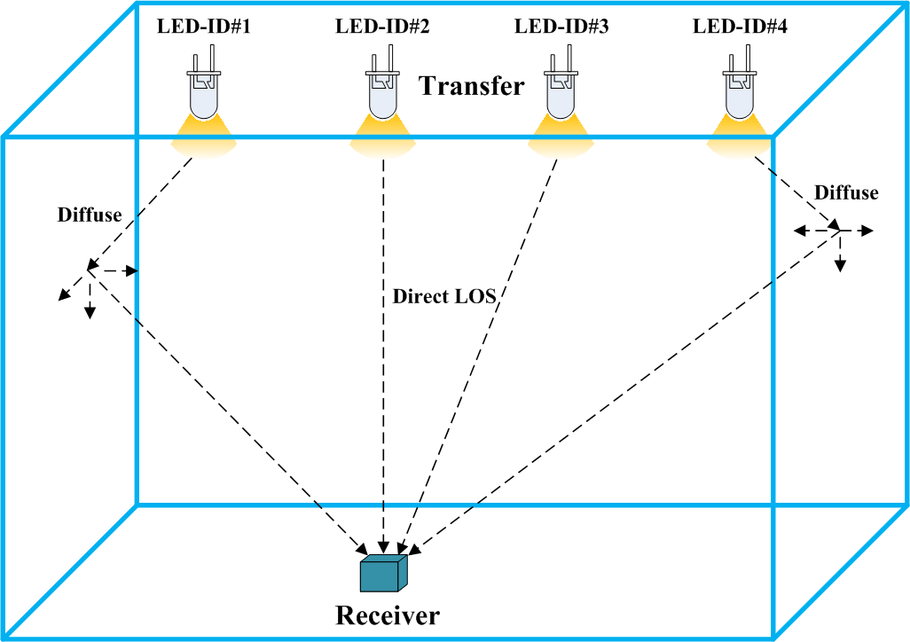
Interference Problems of LED-ID channel
Contents
LOS(Line of Sight) - No blocking
Appearing Diffusing components by reflection
Appearing interference by Each LED-ID code of correlation function
LED-ID channel with a lot of interference components could be modeled by summation of various light sources and reflective lights

Slide 4
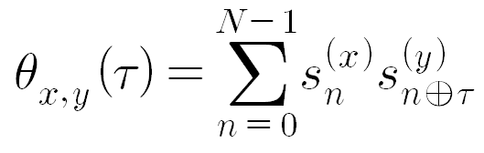
ZCD(zero correlation duration) concept
N : a period of spreading code
ACF(Auto Correlation Function) : x = y
CCF(Cross Correlation Function) : x ≠ y
ZCD: Continuous orthogonal property with zero ACF sidelobe and
zero CCF duration

Slide 5
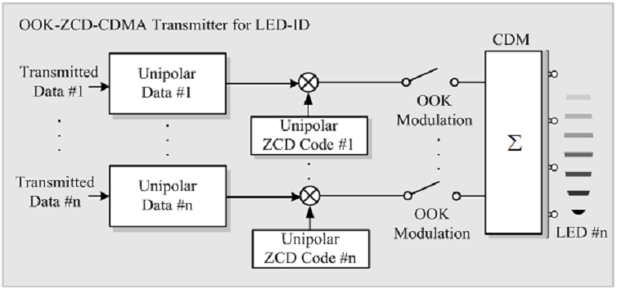
Tx structure of ZCD-CDM based LED-ID
Unipolar data are spreaded by ZCD code
Each spreading signal is used in ZCD-CDM for multiplexing
Each LED Tag has unique code for ZCD-CDM without
multi-tag interferences

Slide 6
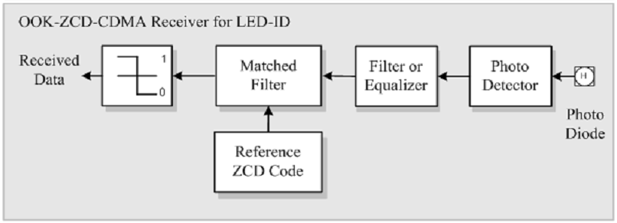
Rx Structure for ZCD-CDM based LED-ID
Rx signals are detected and demodulated by PD and Equalizer
Information data is obtained by despreading and data recovery with reference ZCD code and matched filter

Slide 7
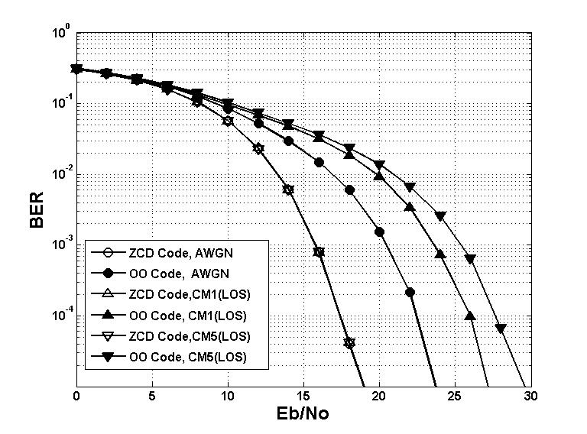
Performance of Proposed Structure
Classification | Contents
Spreading code | Unipolar ZCD Code
Modulation | ZCD-CDM
Code (Chip Length) | 32 chip
Detection type | Matched Filter
Channel | AWGN, CM1, CM5
< BER performance according to increasing
Eb/No under LOS Channel Model >
< Simulation Parameters >
ZCD-CDM by using Unipolar ZCD code has better performance compared with OO(orthogonal optical) code based system (8~10dB of BER 10⁻³ )
Proposed scheme has a strong resistance against multipath interferences or multi tag interferences

Slide 8
Conclusion
ZCD-CDM based LED-ID system is proposed
Proposed scheme has a strong resistance against various interferences such as multi-path interferences and multi tag interferences

