Slide 1
Project: IEEE P802.15 Working Group for Wireless Personal Area Networks (WPANs)
Submission Title: [Case Study for Positioning Data Watermarking Scheme using Visible Light]
Date Submitted: [21 Sep., 2010]
Source: [Jaesang Cha, Yeong Min Jang, Kyesan Lee,Yonghwan Sohn and Sangguk Han ]
Seoul National University of Science and Technology, Kookmin University, Kyunghee University and Yonsei University]
Address [Seoul National University of Science and Technology, Seoul, Korea]
Voice:[82-2-970-6431], FAX: [82-2-974-6123], E-Mail:[chajs@seoultech.ac.kr]
Re: []
Abstract: [In this presentation, we introduced positioning data watermarking scheme using visible light in indoor environment.]
Purpose: [Contribution to IEEE 802.15 WNG]
Notice: This document has been prepared to assist the IEEE P802.15 WNG. It is offered as a basis for discussion and is not binding on the contributing individual(s) or organization(s). The material in this document is subject to change in form and content after further study. The contributor(s) reserve(s) the right to add, amend or withdraw material contained herein.
Release: The contributor acknowledges and accepts that this contribution becomes the property of IEEE and may be made publicly available by P802.15.
Slide 1
Notes:
doc.: IEEE 802.15-09-0117-00-0007
<month year>

Slide 2
Contents
Watermarking structure for positioning data using visible light
Simulation Examples(BER, DER)
Conclusion

Slide 3
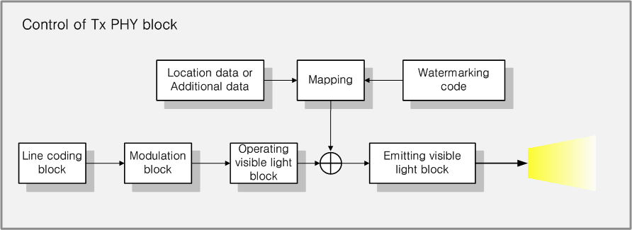
Watermarking of Location Data (Tx Block)
Location data is watermarked and added to visible light carrier.
Visible light carrier are transmitted with additional location data

Slide 4
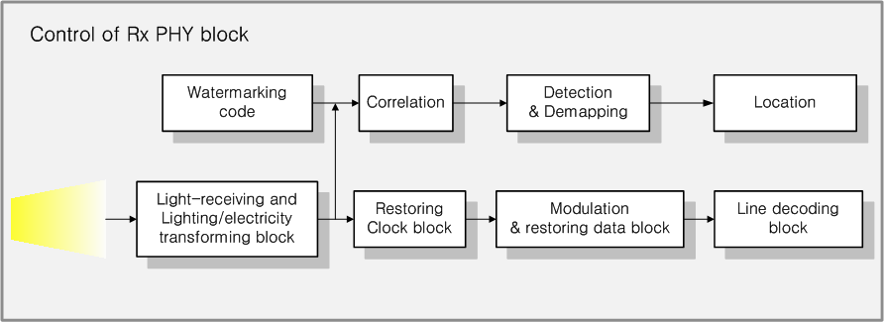
Detection for Watermarked Positioning data (Rx block)
Location data is detected and recovered by demapping and correlation from received signal

Slide 5
Examples of Watermarking & Detection
Location data are spreaded and watermarked to visible light carrier(Tx)
Watermarked location data is detected by correlation(Rx)

Slide 6
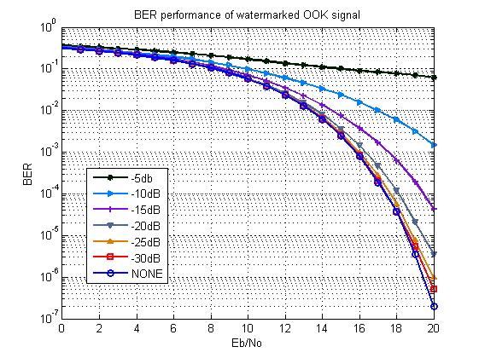
BER Simulation Example
Classification | Contents
Modulation | OOK
DATA Length | 1024
Code (Chip Length) | Unipolar code (1024)
Channel | AWGN
Watermarking cod Amplitude | -30 ~ -5 dB
< BER performance by watermarking level >
< Parameters of simulation >
BER is obtained by various watermarking level
Watermarking level under -10dB, BER of 10⁻³ is maintained

Slide 7
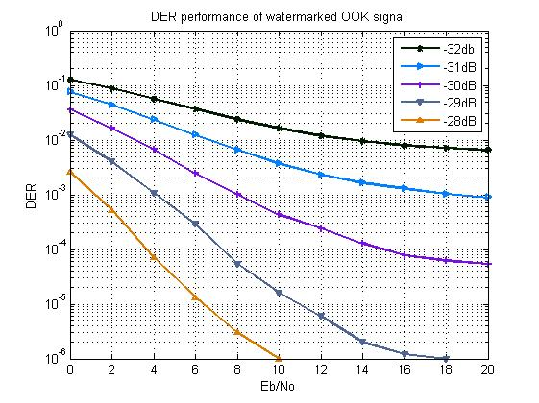
DER Simulation Example
Classification | Contents
Modulation | OOK
DATA Length | 1024
Code (Chip Length) | Unipolar code (32768)
Channel | AWGN
Watermarking cod Amp | -32 ~ -28 dB
< DER performance by watermarking level >
< Parameters of simulation >
If watermarking level is increased, DER of additional data is decrease
Watermarking level under -31dB, DER value is under 10⁻³

Slide 8
Conclusion
We proposed an indoor positioning data watermarking scheme for LED light(Visible Light)
Simulation result showed that the proposed watermarking system will be useful for visible light based positioning system

