Slide 1
Project: IEEE P802.15 Working Group for Wireless Personal Area Networks (WPANs)
Submission Title: [Case Study for High Speed Data Transmission of LED-ID System]
Date Submitted: [21 Sep, 2011]
Source: [Kyesan Lee, Kyujin Lee, Dongho Cha, Yi Ying, Jaesang Cha, Yeong Min Jang, Jinyoung Kim,]
Kyung Hee University, Seoul National University of Science and Technology, Kookmin University, Kwangwoon University]
Address [Case Study for High Speed Data Transmission of LED-ID System, Gyeonggi-Do, Korea]
Voice:[82-2-201-3278], FAX: [82-2-204-8115], E-Mail:[ kyesan@khu.ac.kr]
Re: []
Abstract: [Case Study for High Speed Data Transmission of LED-ID System]
Purpose: [Contribution to IEEE 802.15 WNG]
Notice: This document has been prepared to assist the IEEE P802.15. It is offered as a basis for discussion and is not binding on the contributing individual(s) or organization(s). The material in this document is subject to change in form and content after further study. The contributor(s) reserve(s) the right to add, amend or withdraw material contained herein.
Release: The contributor acknowledges and accepts that this contribution becomes the property of IEEE and may be made publicly available by P802.15.
Slide 1
Notes:
doc.: IEEE 802.15-09-0117-00-0007
<month year>

Slide 2
Contents
Data Transmission Issues of LED-ID.
Problems of Data Transmission in LED-ID System.
Conclusion.

Slide 3
LED Internal Temperature & Data Transmission Issue
The performance degradation due to increased operating time.
- Increased LED internal temperature
- Degraded photoelectric transformation
- Degraded signal power
Increasing
operating time
Increased
LED internal
temperature
Degraded
signal power
Need adaptive modulation and coding to compensate the signal power degradation

Slide 4
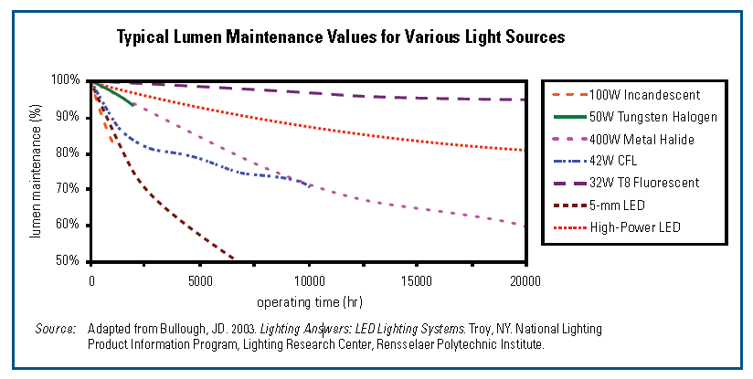
LED Internal Temperature & Data Transmission Issue
The performance degradation due to increased operating time.
- Increased LED internal temperature
- Degraded photoelectric transformation
- Degraded signal power

Slide 5
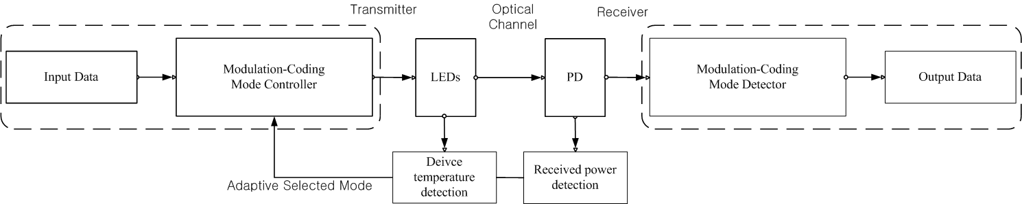
Data Transmission in LED-ID System
The performance enhancement scheme for LED-ID.
- Adaptive Modulation and Coding technique
- To compensate the degradation of Photoelectric Transformation
Block diagram of the proposed system

Slide 6
Parameters of simulation
Modulation Scheme | IM-DD
Pulse Modulation | BPSK, QPSK 16-QAM, 64-QAM
Multiplexing Method | WDM
Received Power | -22 [dBm]
Average O/E conversion efficiency | 0.53 [A/W]
Original Bit Rate | 400 [Mbit/s]
Noise Model | AWGN is dominant
FEC | Convolutional Code with code-rate, R
Code-rate, R | 1/2,1/3,2/3,3/4
Background light | 0 [dBm]
Target BER | 10⁻⁴

Slide 7
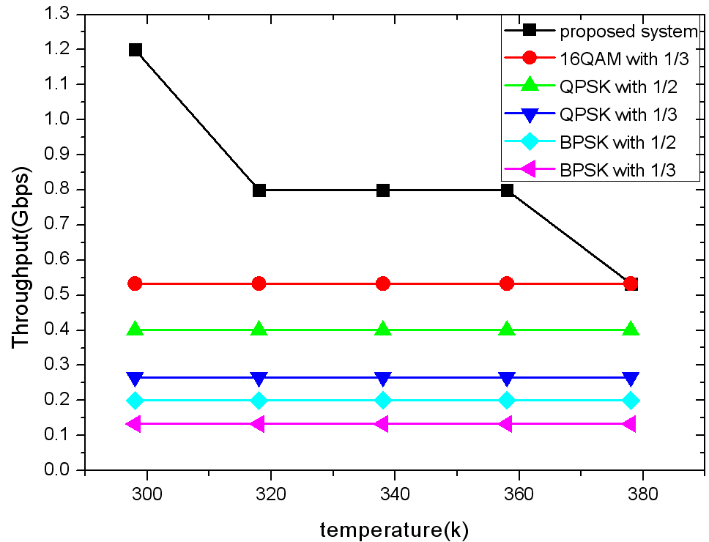
Performance of AMC

Slide 8
Conclusion
We proposed an Adaptive Modulation and Coding Techniques to compensate the degradation according to LED operating time.
Computer simulation showed that the proposed system achieved enhanced data rate in the LED-ID system.

