Slide 1
Project: IEEE P802.15 Working Group for Wireless Personal Area Networks (WPANs)
Submission Title: [Definition and Characteristics of LED-ID]
Date Submitted: [21 Sept., 2011]
Source: [Yeong Min Jang, Kyesan Lee, Jinyoung Kim and Jaesang Cha]
[Kookmin University, Kyunghee University, Kwangwoon University and Seoul National University of Science and Technology]
Address [Kookmin University, Seoul, Korea]
Voice:[82-2-910-5068], FAX: [82-2-910-5068], E-Mail:[yjang@kookmin.ac.kr]
Re: []
Abstract: [Definition and Characteristics of LED-ID]
Purpose: [Contribution to IEEE 802.15 WNG]
Notice: This document has been prepared to assist the IEEE P802.15. It is offered as a basis for discussion and is not binding on the contributing individual(s) or organization(s). The material in this document is subject to change in form and content after further study. The contributor(s) reserve(s) the right to add, amend or withdraw material contained herein.
Release: The contributor acknowledges and accepts that this contribution becomes the property of IEEE and may be made publicly available by P802.15.
Slide 1
Notes:
doc.: IEEE 802.15-09-0117-00-0007
<month year>

Slide 2
Contents
Characteristics of LED-ID
Advantages of LED-ID
Issues of LED-ID
Conclusion

Slide 3
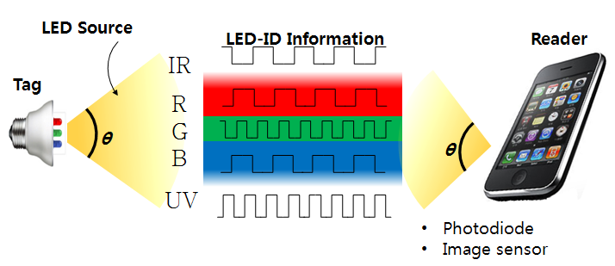
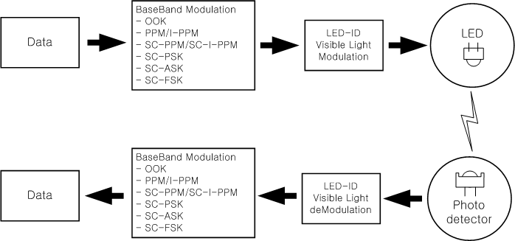
Characteristics of LED-ID
LED-ID system
- Allocate the ID to each illumination source(LED-ID Tag).
- Transmit the information from LED-ID Tag to Reader
by using the LED light.
- Support the various multimedia applications with high QoS.

Slide 4
LED-ID vs. 802.15.7
Data(application) types
- VLC(802.15.7): mainly deal with real time interactive data
- LED-ID : mainly deal with stored tag data such as advertisement,
merchandized data, digital signage data etc.
Data rate & Positioning
- VLC (802.15.7) : ~ 1 Mbps and no Location awareness algorithm
- LED-ID : ~ 100 Mbps and location awareness algorithm

Slide 5
LED-ID vs. VLC(802.15.7)
PHY/MAC
- VLC(802.15.7) : based on draft 802.15.7
- LED-ID : Enhanced PHY/MAC algorithm characterized by
high rate modulation methods with positioning method
Different access schemes and link switching etc.
Different infrastructure networks
Etc.

Slide 6
Advantages of LED-ID
Advantages
- Low power consumption
- Variable colors( combinations of RGB)
- Eco-friendly
- Eye safety
- Non RF resource
- High spectral efficiency
- High compatibility of lighting equipment

Slide 7
Issues of LED-ID
Issues of LED-ID system
- Multiple access techniques and Interference avoidance user capacity, multi tag interference, interference management,
FOV, collision avoidance, etc.
- High data transmission.
coverage, data rate, tag contents etc.
- Network infrastructure
PLC network, optical network, wired & wireless interworking etc.
- Security & QoS
network security, reliability, cost, SLA etc.
- Positioning
high resolution (cm level) indoor positioning technique etc.

Slide 8
Conclusion
Introduced the concepts and characterizations of LED-ID
Please send your comments about our contributions for LED-ID

