Slide 1
Project: IEEE P802.15 Working Group for Wireless Personal Area Networks (WPANs)
Submission Title: [IEEE 802.4k System Proposal - ISWAN (Integrated Services Wide Area
Networks)]
Date Submitted: [20 Sep, 2011]
Source: [Shu Kato¹, Hirokazu Sawada¹, Lawrence Materum¹, Nobuhiko Shibagaki²] Company [1 Tohoku University, 2 Hitachi Ltd.]
Address [2-1-1, Katahira, Aoba-ku, Sendai, Miyagi, Japan]
Voice:[+81-22-217-5506], FAX: [+81-22-217-5476], E-Mail:[shukato@riec.tohoku.ac.jp]
Re: [802.15.4K final proposal call]
Abstract: [IEEE 802.4k System Proposal - ISWAN (Integrated Services Wide Area Networks)]
Purpose: [Presented to the IEEE802.15.4k LECIM task group for consideration]
Notice: This document has been prepared to assist the IEEE P802.15. It is offered as a basis for discussion and is not binding on the contributing individual(s) or organization(s). The material in this document is subject to change in form and content after further study. The contributor(s) reserve(s) the right to add, amend or withdraw material contained herein.
Release: The contributor acknowledges and accepts that this contribution becomes the property of IEEE and may be made publicly available by P802.15.

Slide 2
IEEE 802.4k System Proposal
- ISWAN (Integrated Services Wide Area Networks)
Shu Kato¹, Hirokazu Sawada¹, Lawrence Materum¹, Nobuhiko Shibagaki²
(1 Tohoku University, 2 Hitachi Ltd)

Slide 3
ISWAN Proposal
Summary
Applications
Frequency band
Network topology
MAC
PHY
Major system parameters
PHY/MAC Consideration
Conclusion

Slide 4
Summary
In order to realize more economical low energy sensor systems, Integrated Services Wide Area Networks (ISWAN) has been proposed. ISWAN intends to provide multiple services ranging from low cost wide area sensor/monitoring, to anti-disaster & disaster-relief systems by one physical network.
The proposed system adopts DSSS with strong FEC to mitigate high path loss / wider coverage, high and unknown interferences in the unlicensed bands and to realize high reliable sensor data transmission with TDMA –TDD as access methodology (with an option of non-beacon transmission).
To enhance reliability further, a Double layer topology with multiple frequency bands has been proposed.
To realize lower power consumption, a dynamic network configuration, “Non-beacon and TDMA-TDD with beacon” system has been proposed as an alternative MAC.

Slide 5
Applications
Higher layer integrated Services Wide Area Network (ISWAN) as a part of LECIM: Sharing one physical system by many different applications supporter by wider coverage and high reliability
Key characteristics required:
i. Low energy consumption: battery operation
nodes for 10 ⁺ years
ii. Long transmission range: targeting for 20 km, 120 dB path loss
iii. Co-existence in unlicensed bands: up to 8 orthogonal networks
iv. Integrated services by one physical system
v. High reliability to serve all required nodes
vi. Meeting required latency for each service
Leading to a high reliable, high efficient and cost effective wide area network: ISWAN

Slide 6
Successful Deployment of LECIM depends on
Cost and Reliability – including Disaster Relief Networks
The cost will be reduced by sharing the one physical system by multiple applications /services
The reliability will be enhanced by higher link margin and network topology
Non-emergency Application examples: Cost needs to be lower for more use, better deployment
Infrastructure: Power transmission/distributions, Gas distribution, Oil pipeline, bridge, dam, road, …
Building monitoring,
Agriculture：water temperature, humidity, PH, water depth….
Fishery：Sea water temperature, toxic,
Environment：Rainfall, Temperature, Wild animal monitoring,
Health: Aged people, Children tracking/monitoring
Others
Emergency applications
Anti-disaster: such as Detecting Tsunami in advance
Disaster relief

Slide 7
A New 900 MHz Spectrum Allocation in Japan
: 13.8 MHz
26 MHz
902
US (max erp <=1 W)
928 MHz
6.5 MHz
Korea
917
923.5
13.8 MHz
Japan
915.9
928 MHz
929.7
(Max BW = 1MHz)
Country | Tx power regulations
USA | Max e.r.p. <= 1 W
Korea | 3 mW or 10 mW (920.6~923.5MHz and six 200 KHz channels below 920.6 MHz)
Japan | 1mW , 20 mW or 250 mW (915.9~929.7MHz) Max BW = 1 MHz

Slide 8
Path Loss Characteristics at 420 MHz
(Okumura-Hata Model: assumed): 25 dB Lower than 900 MHz@10 k m

Slide 9
Path Loss Characteristics at 900 MHz
(Okumura-Hata Model: assumed)

Slide 10
Path Loss Characteristics at 2.4 GHz
(Okumura-Hata Model: assumed)

Slide 11
Spectrum Candidates and TX Power and Antenna Gain Regulations for ISWAN in Japan
 | TX power | Antenna gain | Channel bandwidth | Antenna Tx power(dBm) | Relative path loss (dB) | Use case
429.8125 - 429.925MHz | 10mW | ~ 2.14 dBi | 8.5kHz | 12 dBm | 0 | Telemeter, Tele-control, Data transmission
920.5 - 923.5MHz | 250mW | 3dBi | 200kHz×n (n=1 – 5) | 30 dBm | - 6.6 | Sensor Networks, Smart Meters (Middle Power)
920.5 – 928.1MHz | 20mW | 3dBi | 200kHz×n (n=1 – 5) | 16 dBm |  | Sensor Networks, Smart Meters Low Power(Basic)
920.5 - 923.5MHz | 20mW | 3dBi | 200kHz×n (n=1 – 5) |  |  | Tele-metering, Tele-control (Low Power (Extended))
915.9 - 928.1MHz | 1mW | 3dBi | 200kHz×n (n=1 – 5) |  |  | Active RFID (Ultra Low Power (Basic))
928.1 - 929.7MHz | 1mW | 3dBi | 200kHz×n (n=1 – 5) |  |  | Remote control (Ultra Low Power (Extended))
2400MHz ~2483.5MHz | 10mW/MHz | ~ 12.14 dBi | 26MHz 38MHz(OFDM) | 36.2 dBm (/26 MHz) | - 15 | (WLAN)

Slide 12
Frequency and Dual-band Operation for Higher Reliability
Unlicensed band for better global / local promotion
- 2.4 GHz,
- 920 MHz,
- 420MHz (in Japan)
2. Dual-band nodes / AP for better connectivity
2.4 GHz / 423 MHz, 920 MHz / 423 MHz
3. Bandwidth
i. 2.4 GHz / 900 MHz: 1 MHz with 1 MHz guard band
ii. 423 MHz (in Japan): 8.5 kHz/Ch
(May lead to a new MAC development necessity)

Slide 13
Topology: Double layer Network
Two layer topology composed of STAR like networks (Top layer) and Bottom layer
Star like network with one AP and many nodes (devices) for higher capacity and low system & operation cost
Bottom layer network with higher reliable connections to Top layer nodes with low capacity as an extension for specific applications / environments

Slide 14
Proposed MAC Modes: Dual mode MAC
- CSMA mode for small number of terminals
LECIM MAC
Beacon enabled Mode
Non-beacon enabled Mode
Superframe
CSMA
(for low power MAC)
TDMA with Slotted ALOHA
CCA - even though not very effective – comes with little additional cost and it is used in non-beacon enabled mode for generality.

Slide 15
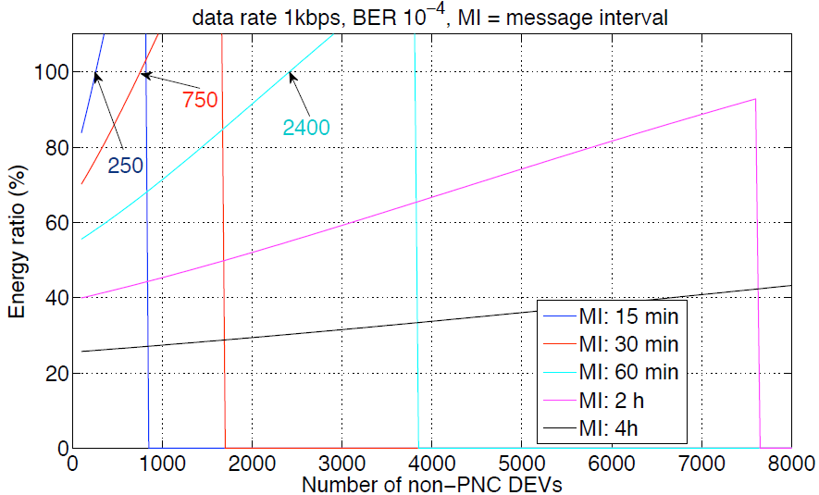
Energy Ratio Example: non-beacon enabled over slotted TDM
Non-beacon mode is quite energy efficient with low duty ratio devices

Slide 16
Low Power and High Reliability
Low power MAC: two dynamic mode change – Non-beacon and TDMA-TDD
Double layer network topology for higher reliability
Fragmentation : mandatory for reliable transmission in interference environment /unlicensed bands - how to implement fragmentation will be depending on TG4K discussion (Ref.: Rolf)

Slide 17
PHY
Modulation: Constant / quasi-constant envelope modulation –GMSK / XPSK, OQPSK, Pie/2 DBPSK
FEC: Convolutional encoding – Viterbi decoding (R=1/2, K=7)]
Double SD Maximum Likelihood Decoding for 5.5 dB coding gain
TDMA/TDD (optionally non-beacon systems)
DSSS for uplink and down link to mitigate high path loss and interference: spreading factor ranging from 1 – 10,000
Bit rate: Adaptive bit rates ranging from 100 bps to 40 kbps by changing spreading factor and modem rates
Software defined modem for both Top layer and Bottom layer communications
Hi PAE PA by “constant envelope” modulations: low power consumption
Beam forming antenna for higher link margin and higher reliability – beam direction adjustment at installation based on TG3C Specification / technology

Slide 18
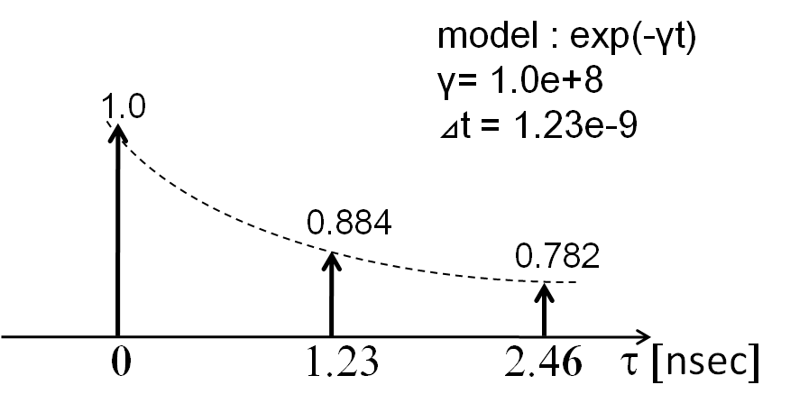
Convolutional Encoding and Viterbi Decoding Performance
Higher Coding Gain in Interference than AWGN Environments
Assumed channel model:
Two path exponential decay
More than 7 dB Coding gain at Pe=1 x 10-4

Slide 19
Major system parameters
Channel bandwidth:
i. 1 MHz for 920 MHz and 2.4 GHz
ii. 8.5 kHz for 420 MHz
2. Bit rates:
  Category 1 – up to 40 kbps/ 1 MHz
  Category 2 – up to 9.6 kbps/ 8.5kHz for Bottom layer
3. Spreading factor: 1 – 10,000 for category 1
Antenna gain: up to regulations limit
2.4 GHz: 10-12 dBi with beam forming capability
900 MHz, 420 MHz: 2-3 dBI
5. Tx output power: up to regulations limit (Limits in Japan shown below)
2.4 GHz:10 dBm
900 MHz: 10/24 dBm
420 MHz: 10 dBm
6. MCS
“Constant envelope modulation” for power efficiency: GMSK, XPSK, (OQPSK, pie/2 DBPSK)
FEC: Convolutional encoding and Viterbi decoding (R=1/2, K=7)

Slide 20
Super frame format for TDMA-TDD
Super frame
Beacon
Down link slot
Contention Slot (Up link), if space in SF
TDMA slot (Up link), assigned based on DEVID & Beacon sequence No.
Slot length dynamically adjusted
(Length based on ACKed data transaction with lowest bit rate)

Slide 21
ISWAN Link Budget Example
Channel model | Hata (large urban) | Hata (large urban) | Erceg (Flat)
Channel Model Parameters
Frequency (MHz) | 420 | 920 | 2400
Collector Antenna Height (m) | 10 | 10 | 10
Endpoint Antenna Height (m) | 2 | 2 | 2
Distance (km) | 6.5 | 8 | 10
Channel Band Width(KHz) | 8.5 | 1000 | 1000
Downlink Path Loss Calculation
Collector Tx Power (dBm) | 10 | 24 | 10
Collector Tx Antenna Gain (dBi) | 2 | 3 | 12
Path Loss (dB) | -154.5 | -166.9 | -174.4
Shadowing Margin (dB) | 0 | 0 | 0
Penetration Loss (dB) | -10 | 0 | 0
Endpoint Rx Antenna Gain (dBi) | 2 | 2 | 2
Endpoint Interference (dB) | 1 | 1 | 1
Rx Power at Endpoint (dBm) | -149.5 | -136.9 | -149.4
Spread gain (dB) | 33 | 33 | 33
FEC gain (dB) | 5.5 | 5.5 | 5.5
Reciever sencitivity (dBm) | -111.0 | -98.4 | -110.9
Uplink Path Loss Calculation
Endpoint Tx Power (dBm) | 10 | 10 | 10
Endpoint Tx Antenna Gain (dBi) | 2 | 3 | 12
Penetration Loss (dB) | -10 | 0 | 0
Path Loss (dB) | -154.5 | -166.9 | -174.4
Shadowing Margin (dB) | 0 | 0 | 0
Collector Rx Antenna Gain (dBi) | 2 | 2 | 2
Collector Interference (dB) | 2 | 2 | 2
Rx Power at Collector (dBm) | -148.5 | -149.9 | -148.4
Spread gain (dB) | 33 | 33 | 33
FEC gain (dB) | 5.5 | 5.5 | 5.5
Reciever sencitivity (dBm) | -110.0 | -111.4 | -109.9

Slide 22
PHY/MAC Consideration
To mitigate high path loss of 120 dB and high interference in unlicensed bands, DSSS is the most efficient way as proposed by On-Ramp as well and we promote this approach basically with following major items to be clarified
Major items need to be clarified
i. Synchronization of direct sequence spread code in very low C/N environments, 40 dB lower than conventional SC transmission,
(We propose to use Golay sequence with a length of 512)
ii. Preamble design (of the packet) fro robust communications,
(We propose to use Gold code or M-sequence with a length of 32 – 48)
iii. Modulation schemes: constant envelope, quasi constant envelope, (We propose to use constant envelope or quasi- constant envelope modulation schemes)
iv. TDMA –TDD frame structure for multiple services
v. PSDU FCS: 16 bit FCS will be good enough
vi. Device wake up process and system management
vii. Network coordination/synchronization
Viii. Necessity of interleaver?

Slide 23
Conclusion
ISWAN for High Reliable and Low Power Monitoring Systems
In order to realize more economical low energy sensor systems, Integrated Services Wide Area Networks (ISWAN) has been proposed. ISWAN intends to provide multiple services ranging from low cost wide area sensor/monitoring, to anti-disaster & disaster-relief systems by one physical network.
The proposed system adopts DSSS with strong FEC to mitigate high path loss / wider coverage, high and unknown interferences in the unlicensed bands and to realize high reliable sensor data transmission with TDMA –TDD as access methodology (with an option of non-beacon transmission).
To enhance reliability further, a Double layer topology with multiple frequency bands has been proposed.
To realize lower power consumption, a dynamic network configuration, “Non-beacon and TDMA-TDD with beacon” system has been proposed as an alternative MAC.

