Slide 1
Project: IEEE P802.15 Working Group for Wireless Personal Area Networks (WPANs)
Submission Title: A Reed-Solomon Erasure Correction Based Hybrid ARQ Scheme
Date Submitted: September 21, 2011
Source: [Sourav Dey, David Howard, Ted Myers] Company [On-Ramp Wireless, Inc.]
Address [10920 Via Frontera, Suite 200, San Diego, CA 92127, USA]
Voice:[+1(858)592-6008], FAX: [+1(858)592-6009], E-Mail:[sourav.dey@onrampwireless.com, david.a.howard@ieee.org, ted.myers@onrampwireless.com]
Re: [LECIM Call For Proposals, DCN: 0147-02]
Abstract: [Response to LECIM Call For Proposals, DCN: 0147-02]
Purpose: Present a potentially more efficient ARQ scheme for the LECIM fragmentation layer based on the erasure correction capabilities of Reed-Solomon Codes.
Notice: This document has been prepared to assist the IEEE P802.15. It is offered as a basis for discussion and is not binding on the contributing individual(s) or organization(s). The material in this document is subject to change in form and content after further study. The contributor(s) reserve(s) the right to add, amend or withdraw material contained herein.
Release: The contributor acknowledges and accepts that this contribution becomes the property of IEEE and may be made publicly available by P802.15.

Slide 2
A Reed-Solomon Erasure Correction Based Hybrid ARQ Scheme
9/22/2011

Slide 3
ARQ Scheme in the Fragmentation Layer
802.15.4 “Upper” MAC
MAC
Fragmentation “Lower” MAC
ARQ
LECIM PHY
PHY

Slide 4
Outline
Immediate ACK ARQ Scheme
  Call Flow, Limitations
Bit-Mapped ACK ARQ Scheme
  Call Flow, Limitations
Reed-Solomon Hybrid ARQ Scheme
  Call Flow, Benefits
Further Work
  Packet Size, ACK Packing, More Questions

Slide 5
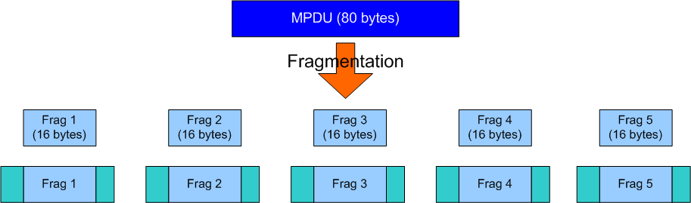
Immediate ACK ARQ
MPDU Size = 80 bytes
Fragment Payload Size = 16 bytes
Number of Fragments = 80/16 = 5
    If not evenly divisible, can zero pad so a multiple of 16 bytes

Slide 6
Immediate ACK ARQ
Receiver gives feedback immediately
  “ACK required” can be configured using a header bit in fragment
Transmitter waits for feedback until timeout
  If not received by certain time, retransmit fragment
Inefficiency
  Number of ACKs = Number of Fragments
  Minimum size of ACK packet is fragment
  Immense waste of downlink channel capacity

Slide 7
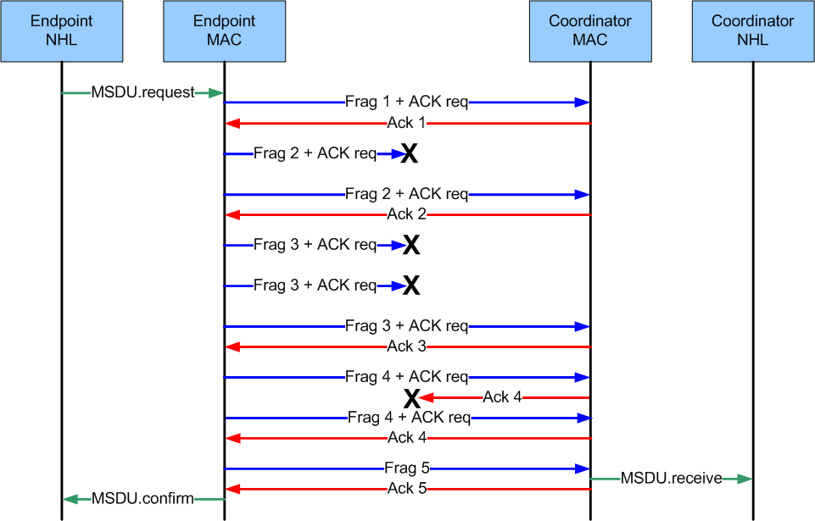
Immediate ACK Call Flow

Slide 8
Bit-Mapped ACK ARQ
MPDU Size = 80 bytes
Fragment Payload Size = 16 bytes
Number of Fragments = 80/16 = 5
    If not evenly divisible, can zero pad so a multiple of 16 bytes

Slide 9
Bit-Mapped ACK ARQ
Receiver gives feedback of all fragments when asked
  “ACK request” can be configured using a header bit in fragment
Special ACK packet which contains bit-mapped ACK of all the fragments in the transfer
  Number of fragments in transfer can be communicated between TX and RX in a session initialization or in frag. header
Bit-Mapped ACKs more efficient on downlink channel
Still inefficient though
  Many ACKs to support uplink data transfer
  Lots of downlink bandwidth consumed just ACKing
  Number of DL ACKs scales with fragment error rate (FER)
  The coordinator will be talking to many endpoints, this could become a bottleneck to aggregate coordinator throughput

Slide 10
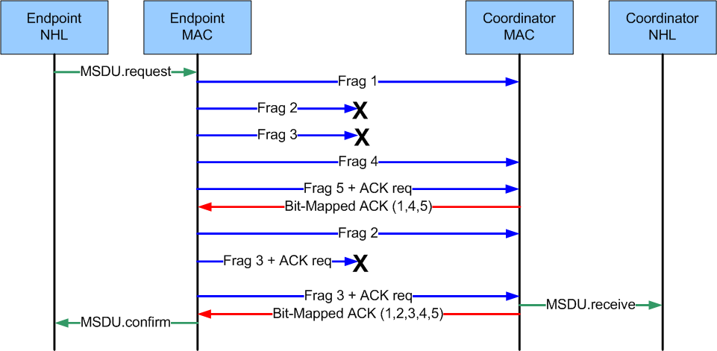
Bit-Mapped ACK Call Flow

Slide 11
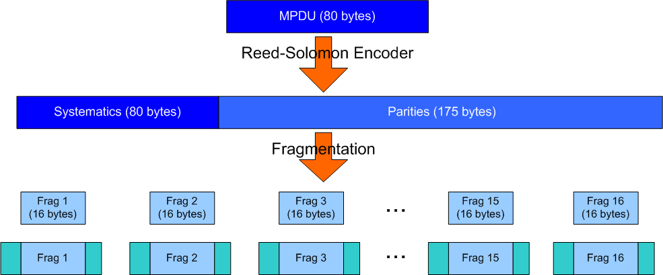
Reed-Solomon Hybrid ARQ
(n=255, k=80, p=175) Reed Solomon Code
  Each byte is a symbol of the code
  Fragment this into 16 byte packets
  Simple scheme for example, more elaborate fragmentation coming soon….
Reed Solomon Erasure Correction
  Receiving any k=80 symbols out of the n=255 leads to successful decoding

Slide 12
Reed-Solomon Hybrid ARQ
Inspired by Type II Hybrid ARQ used in WCDMA, etc.
TX transmits fragments open-loop until ACK
  Listens for an ACK after sending systematic symbols
Once RX gets any k=80 symbols correctly it sends an ACK
  Treats frame errors as erasures in the RS codeword
Minimum use of downlink channel
  Only one ACK per MSDU no matter what FER!
Can be made more efficient with enhancements!

Slide 13
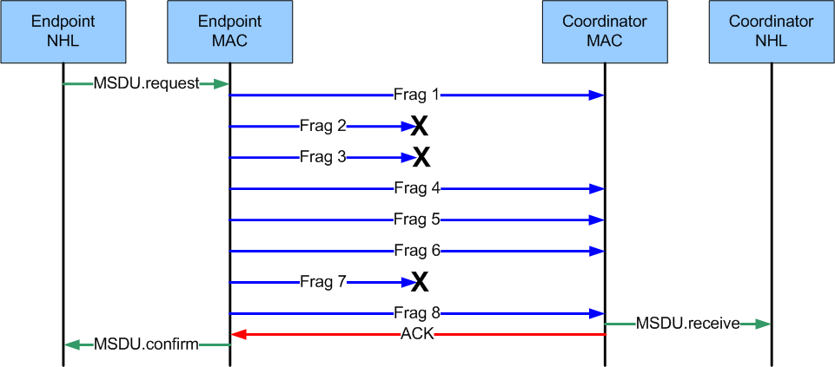
Reed-Solomon Hybrid ARQ Call Flow

Slide 14
Further Work: Packet Size
How do you adapt this code to different packets sizes?
For packet sizes shorter than K, we can puncture the code.
  Do you use the same mother for all packet sizes and puncture the code?
  Do we adapt the mother code depending on size of packet?
How about for packet sizes larger than K?
  Can setup multiple simultaneous codeword streams using row/column fragmentation.
  Split the packet into enough codewords so that the payload down the column fits into a single fragment.

Slide 15
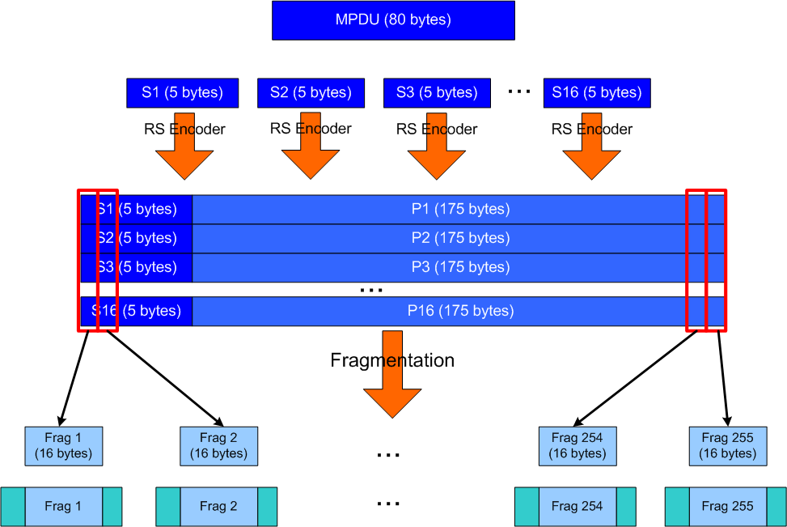
Row/Column Fragmentation

Slide 16
Further Work: ACK Packing
The ACK is a single bit, do we need to waste a whole fragment on it?
Could put the ACK in a “multicast” fragment
  ACK is a list of CIDs that it is stopping TX for
Get even more efficiency!
  Can pack 8 stops in one 16 byte fragment and get 8x more capacity on downlink

Slide 17
Further Work: More Questions
Which RS Codes would be the best to use for this scheme?
  Is there a tradeoff – more parity is better?
  Use less parity and repeat the codeword if necessary?
How much overhead does this scheme add?
  Any more header necessary?
  Need to signal k and which fragment number (so you know where to put in the decoder)
More questions?

Slide 18
Conclusion
Reed-Solomon Hybrid ARQ has much better ACK efficiency over simpler schemes
Can remove potential downlink “bottleneck” at coordinator
Open questions that need further study

