Slide 1
Project: IEEE P802.15 Working Group for Wireless Personal Area Networks (WPANs)
Submission Title: LECIM High Gain DSSS PHY
Date Submitted: September 19, 2011
Source: [Sourav Dey, David Howard, Ted Myers] Company [On-Ramp Wireless, Inc.]
Address [10920 Via Frontera, Suite 200, San Diego, CA 92127, USA]
Voice:[+1(858)592-6008], FAX: [+1(858)592-6009], E-Mail:[ sourav.dey@onrampwireless.com, david.a.howard@ieee.org, ted.myers@onrampwireless.com]
Re: [LECIM Call For Proposals, DCN: 0147-02]
Abstract: [Response to LECIM Call For Proposals, DCN: 0147-02]
Purpose: [High Gain DSSS PHY Proposal]
Notice: This document has been prepared to assist the IEEE P802.15. It is offered as a basis for discussion and is not binding on the contributing individual(s) or organization(s). The material in this document is subject to change in form and content after further study. The contributor(s) reserve(s) the right to add, amend or withdraw material contained herein.
Release: The contributor acknowledges and accepts that this contribution becomes the property of IEEE and may be made publicly available by P802.15.

Slide 2
LECIM High Gain DSSS PHY Proposal
9/19/2011

Slide 3
PHY Overview
Channels
  1 MHz Occupied Bandwidth (1 Mcps)
  2 MHz Channel Spacing
Bands
  2.4 GHz ISM Band
  900 MHZ ISM Band
  Other Regional Bands
Transmit Power
  Scale to Regional Regulations

Slide 4
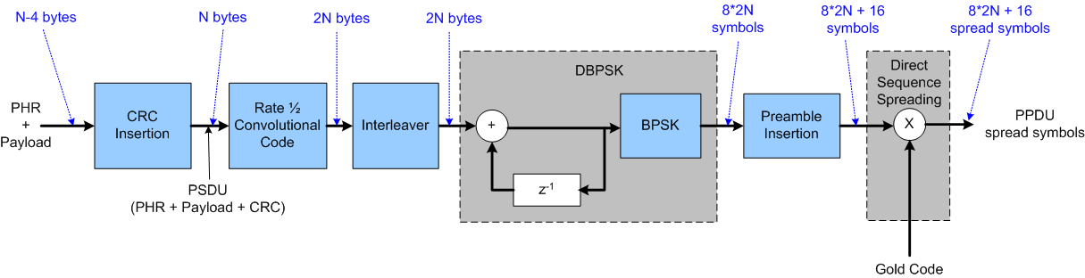
Reference Modulator
Cyclic Redundancy Check
Convolutional Code
Interleaver
Differential BPSK
Preamble
Variable Spreading Factor DSSS

Slide 5
Cyclic Redundancy Check
CRC-32
  Generator Polynomial: x^32 + x^26 + x^23 + x^22 + x^16 + x^12 + x^11 + x^10 + x^8 + x^7 + x^5 + x^4 + x^2 + x^1 +1
  Industry standard CRC, same as in 802.11, 802.15.4, Ethernet, etc.
  Strong error detection so very few false packets sent to MAC layer

Slide 6
Convolutional Code
Rate ½ Convolutional Code
  Octal Generators: (133,171), Constraint Length = 7, Free Distance = 10
  Industry standard code same as in 802.11 and 802.15.4
  Optional tail-biting implementation possible
    Tail-biting initialization preserves code rate
    Could be important for small LECIM packets sizes
  Boosts receiver sensitivity relative to un-coded D-BPSK
  Simple Viterbi/MAP algorithm based decoder
Notes:
Row/column, bit-reversed? 16 byte fragment – 20 bytes after (320 bits, bit –reverse punctured) 16 bytes could be ms apart.

Slide 7
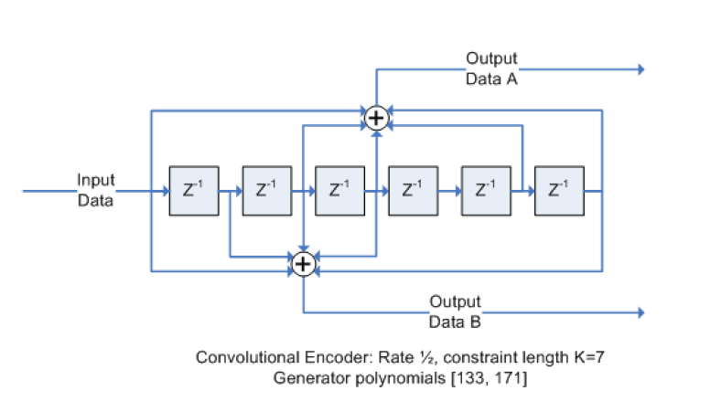
Rate ½ (133,171) Convolutional Code
Zero-Termination
  Terminate input with all zeros
  Send 1 extra byte to terminate the codeword → reduces rate
Tail-Biting
  Initialize shift registers with 7 bits from end of input packet
  Don’t need to send extra byte to terminate the codeword

Slide 8
Interleaver
Interleaving
  Design of interleaver will depend upon supported PPDU size N
  Propose a simple Pruned Bit-Reversal Block Interleaver
    No pruning necessary for codeword sizes that are powers of two
    Can prune for codeword sizes that are not powers of two
  Makes reception robust to bursty interference and channel events

Slide 9
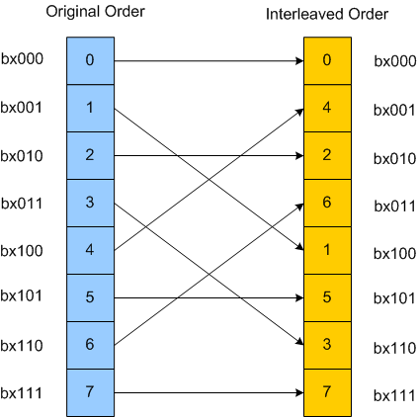
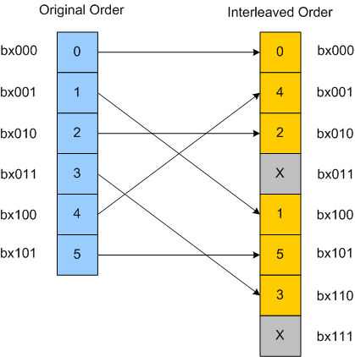
Pruned Bit-Reversal Interleaver
Power of 2 Codeword
Non Power of 2 Codeword

Slide 10
Differential BPSK
Binary Phase Shift Keying (BPSK)
  Higher order modulation, like QAM and QPSK, undoes processing gain by requiring much higher SNR
Differential modulation
  Allows the option of building a simple non-coherent receiver with a 3dB loss of receiver sensitivity relative to coherent BPSK
Notes:
Get the Es/No vs. Eb/No story down.

Slide 11
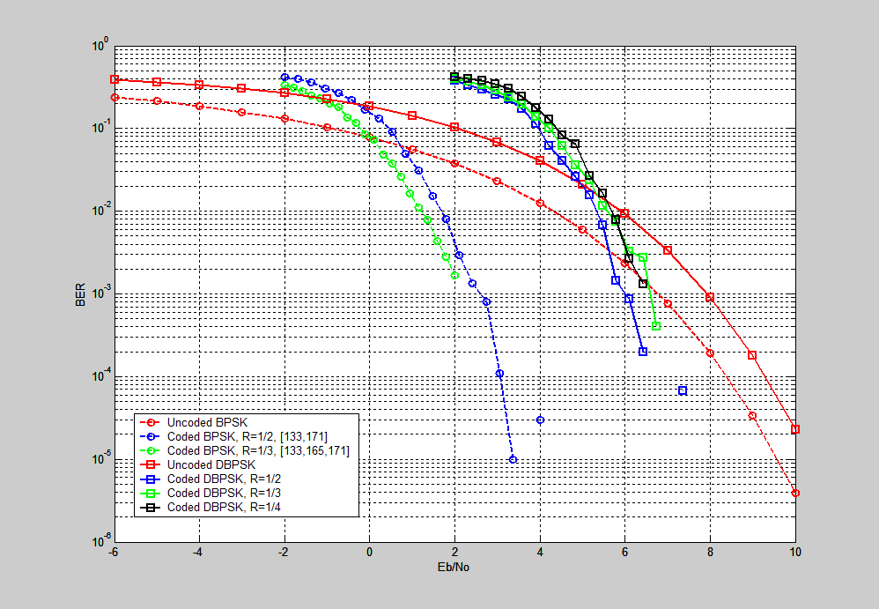
BER Curves for Coded BPSK and DBPSK

Slide 12
Preamble
Preamble is fixed proportion of PHY packet
  Composed of 16 symbols per PPDU
  Need to design a symbol sequence with good auto-correlation properties
Uses of the Preamble
  Timing recovery
  Frequency recovery
  Channel estimation

Slide 13
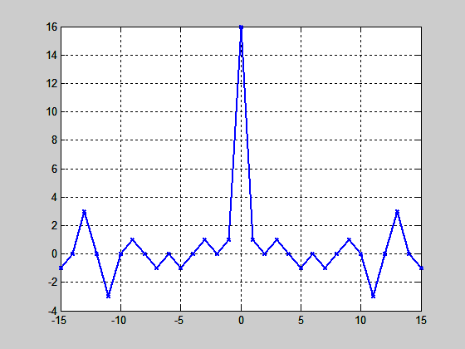
Preamble Design
Brute force search over all 16 symbol BPSK sequences for one with minimum RMS side-lobes (in its autocorrelation function)
x = [-1 -1 1 1 1 1 1 1 -1 1 -1 1 1 -1 -1 1]
Auto-correlation

Slide 14
Direct Sequence Spreading
Constant Chip Rate of 1 Mcps
Gold Codes for PN sequences
  Large family of parameterizable spreading codes
  Good periodic cross-correlation and off-peak auto-correlation properties
  Used for cell separation in WCDMA
Can use different Gold Codes to separate
  Different Networks → Network Coexistence
  Different Collectors → Multiple Collectors on Network
  Different Endpoints → Multiple Endpoints on Collector
Notes:
Each code is another logical channel

Slide 15
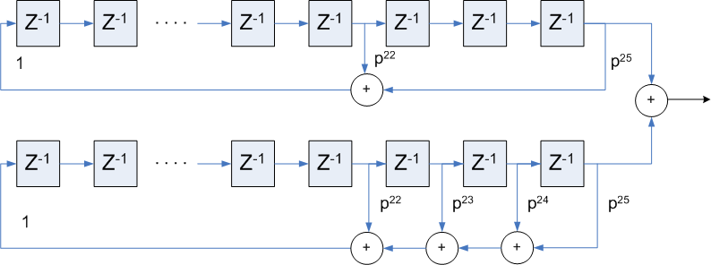
Gold Codes
Derived as the binary addition (XOR) of two “preferred” m-sequences
m = Length of LSFR
n = 2^{m}-1 = Length of Gold Sequence
n+2 = Total Gold Sequences = {a,b,a*b, a*Tb, a*T²b, …}
Can parameterize by the initial state of the lower LFSR = T^{k}b

Slide 16
Gold Codes
Generators:
  p1(x) = x²⁵ + x²² + 1
  p2(x) = x²⁵ + x²⁴ + x²³ + x²² + 1
m = 25, n = 33,554,431, n+2 = 33,554,433

Slide 17
More DSSS Benefits
Multipath Mitigation
  RAKE receiver with MRC is known to do a good job for DSSS
  Advanced receivers can use more sophisticated techniques
Coherence Time Mitigation
  As long as symbols on the order of coherence time can get time diversity across a PHY packet
Interference Mitigation
  DSSS provides robust co-channel and adjacent channel rejection to all sorts of interference, wideband, narrowband, pulsed

Slide 18
Variable Spreading Factors
Chips per Coding Symbol | Processing Gain (dB) | Required Carrier-to-Noise (dB) | Receiver Sensitivity @ kTb (dBm) | Data Rate
 |  |  |  | bits/sec | (KB/day)
16 | 12 | -9 | -118 | 31000 bps | 340000
32 | 15 | -12 | -121 | 16000 bps | 170000
64 | 18 | -15 | -124 | 8000 bps | 84000
128 | 21 | -18 | -127 | 4000 bps | 42000
256 | 24 | -21 | -130 | 2000 bps | 21000
512 | 27 | -24 | -133 | 1000 bps | 11000
1024 | 30 | -27 | -136 | 500 bps | 5300
2048 | 33 | -30 | -139 | 250 bps | 2600
4096 | 36 | -33 | -142 | 120 bps | 1300
8192 | 39 | -36 | -145 | 60 bps | 660
16384 | 42 | -39 | -148 | 30 bps | 330
32768 | 45 | -42 | -151 | 15 bps | 160
Reference receiver characteristics: Post De-spread SNR = 3 dB, 5 dB Noise Figure
Notes:
Huge link budgets possibel – by giving up data rate.

Slide 19
Variable Spreading Factor Benefits
Link Asymmetry
  LECIM links can have asymmetric interference and transmit power between collector and endpoint
  Can use spreading factor selection to balance the link budget between uplink and downlink
Varied loss between endpoints
  Spreading factor selection can adapt so endpoints use minimum necessary spreading factor
Changing Link Conditions
  Spreading factors (and transmit power) can adapt dynamically as channel and interference conditions change
Battery Life
  Adaptive spreading factor selection minimizes the Tx time

Slide 20
Fragmentation
PHY, as presented, is agnostic to the size of the PSDU
  But assumes a fixed size PSDU → zero size PHR
Any low data rate PHY, like this one, would be helped by shorter PSDU than current 802.15.4 PSDU
  Better for coexistence
  Better for interference robustness
  Better for channel variation tracking
  Better for battery life/power consumption

Slide 21
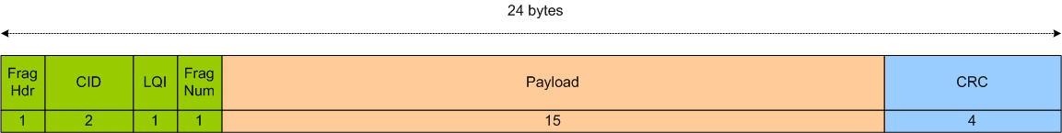
Potential Fragment Size
N = 24 byte PSDU size
  Can be configurable parameter in fragmentation layer
  Just an example
9 bytes of overhead
  1 byte Fragment Header (includes 1 bit MSDU num?)
  2 byte Context ID
  1 byte LQI information = spreading factor selection
  1 byte Fragment Number
  4 bytes of CRC-32
15 bytes of payload

Slide 22
Conclusion
PHY Built for LECIM Applications
Trades off data rate for link budget

Slide 23
Channel Model PreDictions

Slide 24
Channel Model Predictions
Scenario 1: Utility Pole Height Into Basement
  1 km radius of coverage, Suburban
Scenario 2: Rooftop Height into Underground Vault
  200 meters radius of coverage, Suburban
Scenario 3: Mountain Top into Remote Areas
  20 km radius of coverage, Open space
Results generalized to the following power levels:
36 dBm - maximum EIRP allowed in North America
10 dBm – maximum EIRP allowed in many regions
25 dBm – typical EIRP of a battery operated device
Ref: DCN 464

Slide 25
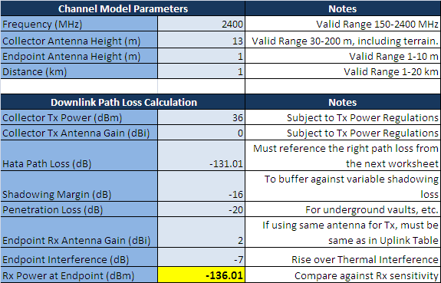
Scenario 1: Utility Pole Height Into Basement 1 km radius
36 dBm EIRP – requires -136 dBm RX sensitivity.,30 dB of processing gain (1024 chips per coding symbol).
25 dBm EIRP – requires -147 dBm RX sensitivity, 42 dB of processing gain (16384 chips per coding symbol).
10 dBm EIRP – requires -162 dBm RX sensitivity, 57 dB of processing gain (oh well…can’t have it all!).

Slide 26
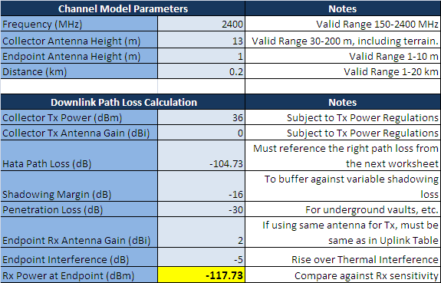
Scenario 2: Rooftop height into underground vault, 200 meters radius
  36 dBm EIRP – requires -118 dBm RX sensitivity, 12 dB of processing gain (16 chips per coding symbol).
  25 dBm EIRP – requires -129 dBm RX sensitivity, 24 dB of processing gain (256 chips per coding symbol).
  10 dBm EIRP – requires -144 dBm RX sensitivity, 39 dB of processing gain (8192 chips per coding symbol).

Slide 27
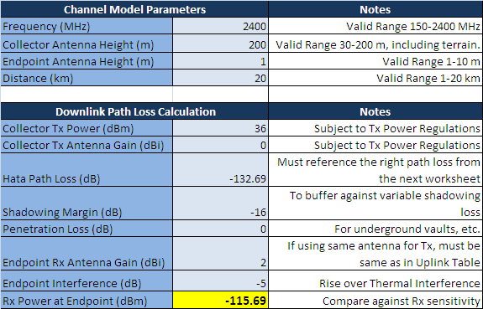
Scenario 3: Mountain top into remote areas, 20 km radius
  36 dBm EIRP – requires -116 dBm RX sensitivity. 12 dB of processing gain (16 chips per coding symbol).
  25 dBm EIRP – requires -127 dBm RX sensitivity. 21 dB of processing gain (128 chips per coding symbol).
  10 dBm EIRP – requires -142 dBm RX sensitivity. 36 dB of processing gain (4096 chips per coding symbol).

