Slide 1
Project: IEEE P802.15 Working Group for Wireless Personal Area Networks (WPANs)
Submission Title: LECIM High Gain DSSS PHY
Date Submitted: September 19, 2011
Source: [Sourav Dey, David Howard, Ted Myers] Company [On-Ramp Wireless, Inc.]
Address [10920 Via Frontera, Suite 200, San Diego, CA 92127, USA]
Voice:[+1(858)592-6008], FAX: [+1(858)592-6009], E-Mail:[sourav.dey@onrampwireless.com, david.a.howard@ieee.org, ted.myers@onrampwireless.com]
Re: [LECIM Call For Proposals, DCN: 0147-02]
Abstract: [Response to LECIM Call For Proposals, DCN: 0147-02]
Purpose: [High Gain DSSS PHY Proposal]
Notice: This document has been prepared to assist the IEEE P802.15. It is offered as a basis for discussion and is not binding on the contributing individual(s) or organization(s). The material in this document is subject to change in form and content after further study. The contributor(s) reserve(s) the right to add, amend or withdraw material contained herein.
Release: The contributor acknowledges and accepts that this contribution becomes the property of IEEE and may be made publicly available by P802.15.

Slide 2
LECIM High Gain DSSS PHY Proposal
9/19/2011

Slide 3
PHY Overview
Bands
2.4 GHz ISM Band
900 MHZ ISM Band
Channels
1 MHz Occupied Bandwidth
2 MHz Channel Spacing

Slide 4
Reference Modulator
Cyclic Redundancy Check
Convolutional Code
Interleaver
Differential BPSK
Preamble
Variable Spreading Factor DSSS

Slide 5
Cyclic Redundancy Check
CRC-32
Generator Polynomial: x^32 + x^26 + x^23 + x^22 + x^16 + x^12 + x^11 + x^10 + x^8 + x^7 + x^5 + x^4 + x^2 + x^1 +1
Industry standard CRC, same as in 802.11, 802.15.4, Ethernet, etc.
Strong error detection so very few false packets sent to MAC layer

Slide 6
Convolutional Code
Rate ½ Convolutional Code
Octal Generators: (133,171), Constraint Length = 7, Free Distance = 10
Industry standard code same as in 802.11 and 802.15.4
Optional tail-biting implementation possible
Tail-biting initialization preserves code rate
Could be important for small LECIM packets sizes
Boosts receiver sensitivity relative to un-coded D-BPSK
Simple Viterbi/MAP algorithm based decoder
Notes:
Row/column, bit-reversed? 16 byte fragment – 20 bytes after (320 bits, bit –reverse punctured) 16 bytes could be ms apart.

Slide 7
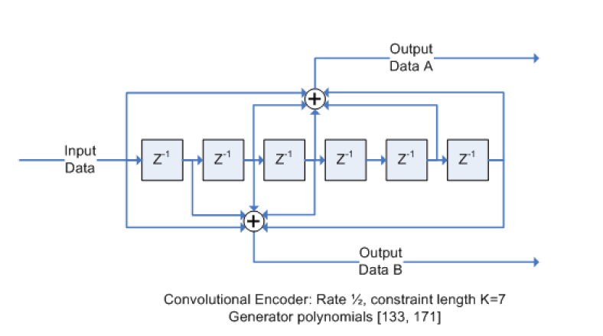
Rate ½ (133,171) Convolutional Code
Zero-Termination
Terminate input with all zeros
Send 1 extra byte to terminate the codeword → reduces rate
Tail-Biting
Initialize shift registers with 7 bits from end of input packet
Don’t need to send extra byte to terminate the codeword

Slide 8
Interleaver
Interleaving
Design of interleaver will depend upon supported PPDU size N
Propose a simple Pruned Bit-Reversal Block Interleaver
No pruning necessary for codeword sizes that are powers of two
Can prune for codeword sizes that are not powers of two
Makes reception robust to bursty interference and channel events

Slide 9
Pruned Bit-Reversal Interleaver
Power of 2 Codeword
Non Power of 2 Codeword

Slide 10
Differential BPSK
Binary Phase Shift Keying (BPSK)
Higher order modulation, like QAM and QPSK, undoes processing gain by requiring much higher SNR
Differential modulation
Allows the option of building a simple non-coherent receiver with a 3dB loss of receiver sensitivity relative to coherent BPSK
Notes:
Get the Es/No vs. Eb/No story down.

Slide 11
BER Curves for Coded BPSK and DBPSK

Slide 12
Preamble
Preamble is fixed proportion of PHY packet
Composed of 16 symbols per PPDU
Need to design a symbol sequence with good auto-correlation properties
Uses of the Preamble
Timing recovery
Frequency recovery
Channel estimation

Slide 13
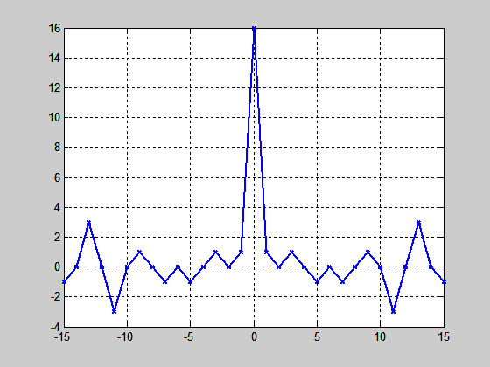
Preamble Design
Brute force search over all 16 symbol BPSK sequences for one with minimum RMS side-lobes (in its autocorrelation function)
x = [-1 -1 1 1 1 1 1 1 -1 1 -1 1 1 -1 -1 1]
Auto-correlation

Slide 14
Direct Sequence Spreading
Gold Codes for PN sequences
Large family of parameterizable spreading codes
Good periodic cross-correlation and off-peak auto-correlation properties
Used for cell separation in WCDMA
Can use different Gold Codes to separate
Different Networks → Network Coexistence
Different Collectors → Multiple Collectors on Network
Different Endpoints → Multiple Endpoints on Collector
Notes:
Each code is another logical channel

Slide 15
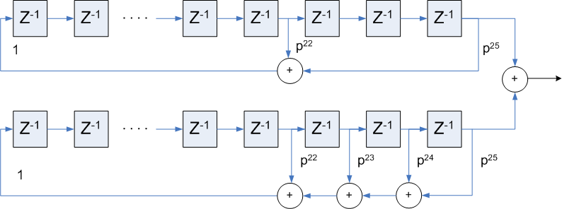
Gold Codes
Derived as the binary addition (XOR) of two “preferred” m-sequences
m = Length of LSFR
n = 2^{m}-1 = Length of Gold Sequence
n+2 = Total Gold Sequences = {a,b,a*b, a*Tb, a*T²b, …}
Can parameterize by the initial state of the lower LFSR = T^{k}b

Slide 16
Gold Codes
Generators:
p1(x) = x²⁵ + x²² + 1
p2(x) = x²⁵ + x²⁴ + x²³ + x²² + 1
m = 25, n = 33,554,431, n+2 = 33,554,433
t(m) = 8193, t(m)/R(0) = 0.000244

Slide 17
More DSSS Benefits
Multipath Mitigation
RAKE receiver with MRC is known to do a good job for DSSS
Advanced receivers can use more sophisticated techniques
Coherence Time Mitigation
As long as symbols on the order of coherence time can get time diversity across a PHY packet
Interference Mitigation
DSSS provides robust co-channel and adjacent channel rejection to all sorts of interference, wideband, narrowband, pulsed

Slide 18
Variable Spreading Factors
Chips per Coding Symbol | Processing Gain (dB) | Required Carrier-to-Noise (dB) | Receiver Sensitivity @ kTb (dBm) | Data Rate
 |  |  |  | bits/sec | (KB/day)
16 | 12 | -9 | -118 | 31000 bps | 340000
32 | 15 | -12 | -121 | 16000 bps | 170000
64 | 18 | -15 | -124 | 8000 ms | 84000
128 | 21 | -18 | -127 | 4000 bps | 42000
256 | 24 | -21 | -130 | 2000 bps | 21000
512 | 27 | -24 | -133 | 1000 bps | 11000
1024 | 30 | -27 | -136 | 500 bps | 5300
2048 | 33 | -30 | -139 | 250 bps | 2600
4096 | 36 | -33 | -142 | 120 bps | 1300
8192 | 39 | -36 | -145 | 60 bps | 660
16384 | 42 | -39 | -148 | 30 bps | 330
32768 | 45 | -42 | -151 | 15 bps | 160
Reference receiver characteristics: Post De-spread SNR = 3 dB, 5 dB Noise Figure
Notes:
Huge link budgets possibel – by giving up data rate.

Slide 19
Variable Spreading Factor Benefits
Link Asymmetry
LECIM links can have asymmetric interference and transmit power between collector and endpoint
Can use spreading factor selection to balance the link budget between uplink and downlink
Varied loss between endpoints
Spreading factor selection can adapt so endpoints use minimum necessary spreading factor
Changing Link Conditions
Spreading factors (and transmit power) can adapt dynamically as channel and interference conditions change
Battery Life
Adaptive spreading factor selection minimizes the Tx time

Slide 20
Fragmentation
802.15.4e “Upper” MAC
Already standardized
MAC
Fragmentation “Lower” MAC
Proposed in 802.15.4k
High Gain DSSS PHY
Proposed in 802.15.4k
PHY
Notes:
Refernce bens document number (use the title of the document in there)

Slide 21
Fragmentation Benefits
Any low data rate PHY, like this one, would be helped by shorter PPDU than current 802.15.4e MAC
Better for coexistence
Better for interference robustness
Better for channel variation tracking
Better for battery life/power consumption
Propose PPDU size of 16 bytes-20 bytes
PHY as presented is currently is agnostic to size of PPDU

Slide 22
Conclusion
Low Throughput
Extremely Low Receiver Sensitivity
High Link Budget

