Slide 1
Project: IEEE P802.15 Working Group for Wireless Personal Area Networks (WPANs)
Submission Title: [LECIM Positive Train Control preliminary proposal]
Date Submitted: [nn September 2011]
Source: [Jon Adams, Shuzo Kato, JiaRu Li] Company [Independent, REIC/Tohuku University, Lilee Systems]
Address [12023 N 62nd St, Scottsdale AZ 85254; REIC Tohuku University; 2905 Stender Way Suite 78, Santa Clara, CA 95054]
Voice:[+1(415) 683-0213], FAX: [+1 FAX], E-Mail:[jon@jonadams.com, shukato@reic.tohuku.ac.jp, jiaruli@lileesystems.com]
Re: [LECIM Call For Proposals, DCN: 0147-02]
Abstract: [Response to LECIM Call For Proposals, DCN: 0147-02]
Purpose: [Positive Train Control Considerations for LECIM]
Notice: This document has been prepared to assist the IEEE P802.15. It is offered as a basis for discussion and is not binding on the contributing individual(s) or organization(s). The material in this document is subject to change in form and content after further study. The contributor(s) reserve(s) the right to add, amend or withdraw material contained herein.
Release: The contributor acknowledges and accepts that this contribution becomes the property of IEEE and may be made publicly available by P802.15.

Slide 2
802.15.4k PHY Proposal
September 2011

Slide 3
Summary
Review of Positive Train Control requirements
PHY Considerations
  Frequency band
  Channelization
  Data rates
  Transmitter and Receiver Characteristics
MAC Considerations
  Time Slotting
Path Loss and Propagation Considerations

Slide 4
What is Positive Train Control?
PTC
  Keeps trains from hitting trains
  Keeps trains from hitting other on-rail equipment
  Keeps trains operating within their authority
  Provides protection for workers on or around the track within their work zones
  Keeps trains from traveling thru misaligned switches or other track elements
Jon Adams, Shuzo Kato, Jia-Ru Li

Slide 5
Why IEEE 802.15?
PTC overview at July 2011 IEEE 802.11 WNG and 802.15 WNG sessions
  Entitled: PTC Radio and System Architecture (11-11-1032-00-0wng-positive-train-control-radio-and-system-architecture.ppt), Jia-Ru Li, Lilee Systems
802.15 voted to approve formation of an interest group to explore further
First step to explore alignment with 15.4k LECIM

Slide 6
Challenging Propagation Environment
In the US, PTC allocated 220 – 222 MHz band (λ = 1.36 m)
High speed mobility environment
  300 km/h locomotive to trackside (600 km/h closing speed)
“Collector” atop locomotive
  Antenna on locomotive “roof”, 5m height above railtop
  Roof 15 – 25 m long, 2.5 m wide, potentially 2km of metal-roofed cars ahead or behind
Endpoints
  Trackside equipment, antennas may be pole-mounted 8-10 m
  Some fixed antennas may be only a few meters above railhead
Track environment – extreme in every direction
  Mountainous terrain, tunnels, open cuts, viaduct with sound walls
  All of above but with horizontal curvature and rain sheeting down walls
  Dead flat straight track, technically line-of-sight between collector/endpoint but very strong Rayleigh fading due to strong reflection from rail/ground surface
  Dense urban, non-line of sight, extreme multipath
Distributed Power Unit (DPU)
  Remote controlled locomotive(s) separated from the crewed lead locomotive, separation up to 3 km

Slide 7
PTC Aspects Relevant to LECIM 1
Train-centric communications (locomotive/train is “center of universe”)
High reliability PHY link, fault-tolerant, error-correcting or at least error-detecting
Intention that data carried may be “vital” (life/safety critical)
Strong link layer security features (flexible encryption, unique identity)
Data rates relatively low, depending on function (9.6k to 100’s of kbps)
Data communication speeds may be asymmetric
Propagation generally non-line of sight or close to ground, fade environment often Rayleigh, exponents 2.6 (fixed to fixed) to 3.2 (fixed to mobile)
Range to 2x braking distance (3 - 10 km) in typical urban/suburban/rural environments
Emitted Radiated Power (ERP) (depending on antenna height, channel #, region)
Operation in licensed US 220 – 222 MHz band (but not excluding others)
  Channel spacing 5 kHz, may be aggregated (by license)
  Can support separate uplink and downlink bands (base and mobile)
  Potential for adjacent/alternate channel interferers
  Frequency agility may be useful

Slide 8
PTC Aspects Relevant to LECIM 2
Absolute need for high-speed node mobility
  Speeds up to 300km/h, closing speeds to 600 km/h
Latencies determined by stopping distance, order of 1 second sufficient
Payloads from a few bytes for control/command to ability to transfer larger files with fragmentation for remote upgrade/maintenance
Selectable QoS or communications priority may be useful
Wayside devices likely extremely power constrained (battery, vibration, pressure, solar, other scavenging)
Current requirements up to 24 locomotives and 30 waysides on one base station, but concept scales to dozens of devices per km of track
Flexible enough to handle very rapidly changing network membership
Time slotted and contention access periods necessary
Slide 8
Notes:
doc.: IEEE 802.15-<doc#>
<month year>
<author>, <company>
Page 8

Slide 9
Other Potential Future Rail Environment Applications of LECIM
Track and track infrastructure
  Switch/turnout operation and position
  Block occupancy
  Damage to rails
  Right of Way fouling
  Perimeter monitoring
  Bridge, viaduct, tunnel, culvert, etc.
  Highway / Rail grade crossing
Rolling Stock Defects
  Defect detection (hot box, dragging equipment, high/wide, etc.)
Signals
  Signal indication
  Signal function
  Grade crossing signaling and warning equipment
Maintenance of Way Vehicle
  On/off rail status
  Position, direction, speed
  Positive control?
Maintenance workers
Rest-of-train car-to-car communication networks
  Hot box, brake line pressure, end of train marker, etc.

Slide 10
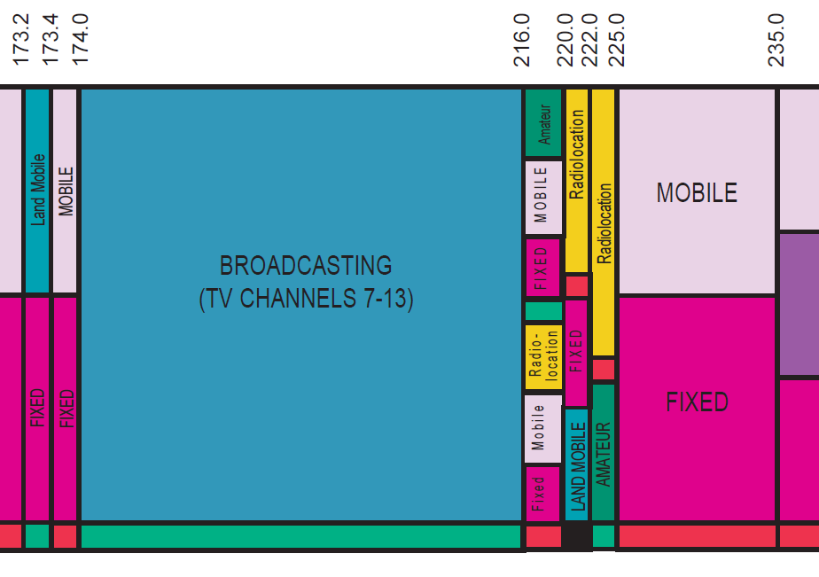
FCC Allocation – Adjacent TV station

Slide 11
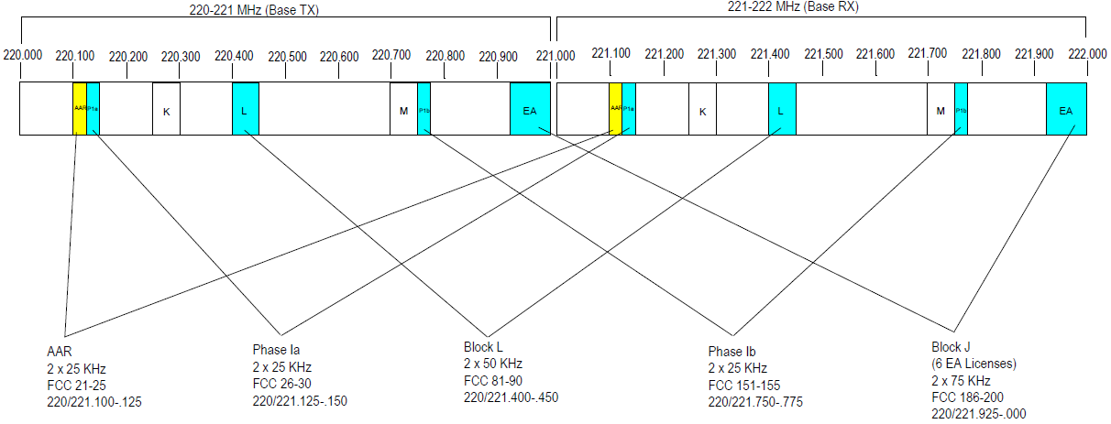
FCC: 220-222 MHz Channel Summary
Summary : 200 kHz (TX ) + 200 kHz (RX)
Total Spectrum nationwide (= 25+25+25+50+75)
Two Nationwide Commercial 5 Channel blocks, (five 5kHz channels)
  Block 1 = 25 kHz + 25 kHz Block 2 = 25 kHz + 25 kHz
AAR = 25khz + 25khz
NWA255 - U.S. and Possessions = 50 kHz + 50 kHz
ALL EAGs in Channel BLOCK J = 75 kHz + 75 kHz

Slide 12
220 MHz Channelization Proposal
Band governed under US CFR 47 Part 90 (T), sections 90.715 – 90.717
Channels on 5 kHz centers, but contiguous channels may be aggregated (FCC part 90.733(d))
Frequencies assigned in pairs
  Base channels: 220.0025 – 220.9975 MHz
  Mobile and control channels: 221.0025 – 221.9975 MHz

Slide 13
Channelization Proposal (2)
Channel designations set by rule
  E.g., channel 1 = 220.0025 MHz
  Fc (MHz) = 220.0025 + 0.005 * (Channel# - 1)
    Channel 1 = 220.0025 MHz
    Channel 201 = 221.0025 MHz
Assumption is that sufficient 5kHz channels may be aggregated to allow 12.5kHz channel separation

Slide 14
Useful Guidance: American Association of Railways S-5904
Specs for “Remote Control Locomotive” Systems operating at 220MHz
May be a useful guideline for general requirements for a PTC communications radio in same band
  Modulation types GMSK, QPSK
  Forward Error Correction (FEC)
  Different channel spacings, different carrier frequencies
  64 time slot/sec (optional to support 128 slots/sec)
  Supports priority-based association (high priority/low priority contention slots)

Slide 15
Extended Superframe Proposal
September 2011
Frame Beacon
Frame Beacon
Optional Extended Beacon
t
CFP
CAP
Frame beacon
  64 equal slot times
  62 full communication slots including 4 CAP (slots 60, 61, 62, 63)
  CAP slots 60, 61 are high priority access, may only be used on a pre-approved basis
  Option to support 128 CFP slots per frame (depends on licensed channel bandwidth and over the air data rate
  Slots may be concatenated for longer messages or slower channel rates
  Slot 32 optional extended beacon may be used for improved time synchronization or provide additional network information

Slide 16
S-5904 Transceiver General Specifications
Receiver Attribute | Spec | ETS-300-113 v1 Reference
Maximum useable sensitivity (normal) at BER <= 10⁻⁴ | -104dBm | 5.2.1
Co-Channel Rejection | -12dB to 0dB | 5.2.4
Adjacent Channel Selectivity (depends on channel spacing) | 60 dBc | 5.2.5
Blocking Desensitization Channel 13 (@ 211 MHz) | 95 dBc | 5.2.8
Spurious Radiation | -57dBm | 5.2.9
Transmitter Attribute
Max Carrier Power vs. Rated (normal conditions) | +/- 1.5dB | 5.1.2
Adjacent Channel Power (vs. Rated) (Note: ETSI standard is more restrictive than FCC by about 5 dB) | -60 dBc | 5.1.4
Spurious Emissions (Transmitting) | -36 dBm | 5.1.5
Intermodulation Attenuation | -40 dBc | 5.1.6
Intermodulation Attenuation at Locations Where Multiple Transmitters are in Service | -70 dBc | 5.1.6

Slide 17
Propagation Considerations
20dB fade margin
Propagation exponents vary with environment
  2.6 for fixed-to-fixed
  3.2 for fixed-to-mobile
Typical antenna heights and TX power levels
  Locomotive: 5 m / 44dBm
  Trackside equipment housing: 3-6 m / 44 dBm
  Trackside control station: 15-18 m / 44 dBm
  Base station: 18m and higher / 44 – 48 dBm
Ranges
  Mobile to Fixed
    Locomotive to wayside equipment: 7 - 20 km
      Note that stopping distance for a HSR passenger train at 300kmph can be 7200m (http://www.railway-technical.com/Infopaper%203%20High%20Speed%20Line%20Capacity%20v3.pdf)
      Stopping distance for a 10000 ton freight train may be 10-12 km
    Locomotive to network infrastructure: 10 - 50km
  Fixed to Fixed
    Wayside equipment to network infrastructure: 10 – 50 km

Slide 18
Channel Models at 220 MHz
PDP Channel model consideration for 220 MHz
  Preliminary analysis so far indicates that Okumura-Hata model will work

Slide 19
Channel Models at 220 MHz
Power delay profile (PDP) channel model
  In the environments of “20 km range at 220 MHz with the train speed of 350 km/h”, closest model will be ITU-R IMT-Advanced with following limitations
    Antenna height
      Train to BS (Network infrastructure)
        BS antenna height must be higher than 10 m
      Train to Wayside
        Wayside antenna height must be higher than 10 m
      Wayside to BS (Network infrastructure)
        BS antenna height must be higher than 10 m
    Frequency
      The lowest frequency supported by IMT-Advanced model is 400 MHz. We assume PDP is not much different in 400 and 220 MHz for the time being to see the PDP impact on our system design and may work as the future work

Slide 20
Transmission Range
IMT-Advanced model is for up to 5 km distance (10 km for rural scenarios). We will extrapolate the distance to 20 km for the time being – may need measurements in real environments
  Reference: ITU-R, “Guidelines for evaluation of radio interface technologies for IMT-Advanced,” Rep. ITU-R M.2135-1, Dec. 2009.
COST 207 model (without Doppler) as the first level estimation
PDP was calculated by COST207 model as shown
  This is the average power delay profile based on COST 207 which was extended to 20 km; and its power is scaled based on the Okumura-Hata path loss at 20 km at 450 MHz (lower frequency limit of COST 207 PDP).
  The results show that we do not need to worry about PDP if the transmission bit rate is not higher than 100 kbps approximately.
ITU-R IMT advanced model – numerical results
  Now working on the IMT-Advanced PDP at 400 MHz (lower frequency limit of IMT-Advanced PDP) extended to 20 km, and incorporating the vehicular speed of 350 km/h
  Basically extracting a SISO model from the IMT-Advanced PDP model for MIMO

Slide 21
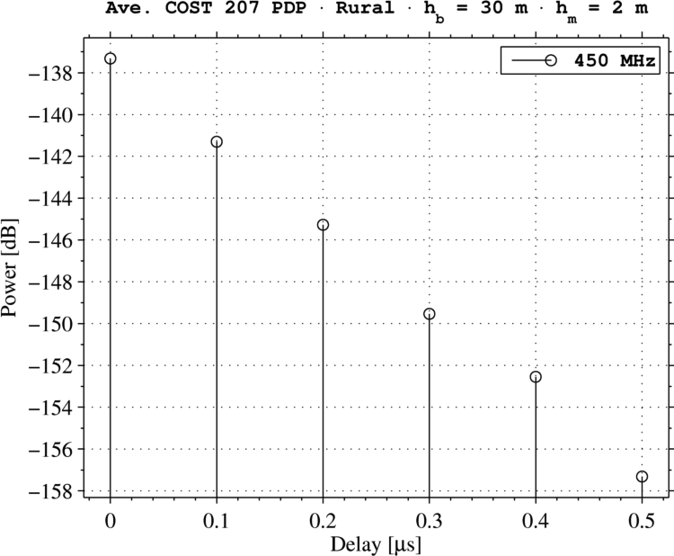
PDP Characteristics

Slide 22
Scenario 1: Locomotive roof to trackside pole-mount antenna (using 15-11-0464-01)
Channel Model Parameters |  | Notes
Frequency (MHz) | 220 | Valid Range 150-2400 MHz
Collector Antenna Height (m) | 10 | Hata Valid Range 30-200 m, including terrain. Erceg Valid Range 10-80m, including terrain
Endpoint Antenna Height (m) | 5 | Hata Valid Range 1-10 m, Erceg Fixed to 2m.
Distance (km) | 15 | Valid Range 1-20 km
Downlink Path Loss Calculation |  | Notes
Collector Tx Power (dBm) | 44 | Subject to Tx Power Regulations
Collector Tx Antenna Gain (dBi) | 3 | Subject to Tx Power Regulations
Path Loss (dB) | -149.69 | Must reference the right path loss from the Hata or Erceg worksheet
Shadowing Margin (dB) | -12 | To buffer against variable shadowing loss
Penetration Loss (dB) | 0 | For underground vaults, etc.
Endpoint Rx Antenna Gain (dBi) | 3 | If using same antenna for Tx, must be same as in Uplink Table
Endpoint Interference (dB) | 1 | Rise over Thermal Interference
Rx Power at Endpoint (dBm) | -111.69 | Compare against Rx sensitivity
Uplink Path Loss Calculation |  | Notes
Endpoint Tx Power (dBm) | 44 | Subject to Tx Power Regulations. Can be different from Collector
Endpoint Tx Antenna Gain (dBi) | 3 | Subject to Tx Power Regulations
Penetration Loss (dB) | 0 | For underground vaults, etc.
Path Loss (dB) | -149.69 | Same as Downlink
Shadowing Margin (dB) | -12 | Same as Downlink
Collector Rx Antenna Gain (dBi) | 3 | If using same antenna for Tx, must be same as in Downlink Table
Collector Interference (dB) | 2 | Rise over Thermal Interference
Rx Power at Collector (dBm) | -109.69 | Compare against Rx sensitivity
Note that collector antenna height is not valid for Hata model, need further investigation

Slide 23
Scenario 2: Network Infrastructure to wayside, 20 km radius
Channel Model Parameters |  | Notes
Frequency (MHz) | 220 | Valid Range 150-2400 MHz
Collector Antenna Height (m) | 18 | Hata Valid Range 30-200 m, including terrain. Erceg Valid Range 10-80m, including terrain
Endpoint Antenna Height (m) | 5 | Hata Valid Range 1-10 m, Erceg Fixed to 2m.
Distance (km) | 20 | Valid Range 1-20 km
Downlink Path Loss Calculation |  | Notes
Collector Tx Power (dBm) | 44 | Subject to Tx Power Regulations
Collector Tx Antenna Gain (dBi) | 3 | Subject to Tx Power Regulations
Path Loss (dB) | -148.78 | Must reference the right path loss from the Hata or Erceg worksheet
Shadowing Margin (dB) | -12 | To buffer against variable shadowing loss
Penetration Loss (dB) | 0 | For underground vaults, etc.
Endpoint Rx Antenna Gain (dBi) | 3 | If using same antenna for Tx, must be same as in Uplink Table
Endpoint Interference (dB) | 1 | Rise over Thermal Interference
Rx Power at Endpoint (dBm) | -109.78 | Compare against Rx sensitivity
Uplink Path Loss Calculation |  | Notes
Endpoint Tx Power (dBm) | 44 | Subject to Tx Power Regulations. Can be different from Collector
Endpoint Tx Antenna Gain (dBi) | 3 | Subject to Tx Power Regulations
Penetration Loss (dB) | 0 | For underground vaults, etc.
Path Loss (dB) | -148.78 | Same as Downlink
Shadowing Margin (dB) | -12 | Same as Downlink
Collector Rx Antenna Gain (dBi) | 3 | If using same antenna for Tx, must be same as in Downlink Table
Collector Interference (dB) | 2 | Rise over Thermal Interference
Rx Power at Collector (dBm) | -108.78 | Compare against Rx sensitivity
Note that collector antenna height is not valid for Hata model, need further investigation

Slide 24
Scenario 3: Moving Train to Network Infrastructure, 20 km radius
Channel Model Parameters |  | Notes
Frequency (MHz) | 220 | Valid Range 150-2400 MHz
Collector Antenna Height (m) | 18 | Hata Valid Range 30-200 m, including terrain. Erceg Valid Range 10-80m, including terrain
Endpoint Antenna Height (m) | 6 | Hata Valid Range 1-10 m, Erceg Fixed to 2m.
Distance (km) | 20 | Valid Range 1-20 km
Downlink Path Loss Calculation |  | Notes
Collector Tx Power (dBm) | 44 | Subject to Tx Power Regulations
Collector Tx Antenna Gain (dBi) | 3 | Subject to Tx Power Regulations
Path Loss (dB) | -147.57 | Must reference the right path loss from the Hata or Erceg worksheet
Shadowing Margin (dB) | -12 | To buffer against variable shadowing loss
Penetration Loss (dB) | 0 | For underground vaults, etc.
Endpoint Rx Antenna Gain (dBi) | 3 | If using same antenna for Tx, must be same as in Uplink Table
Endpoint Interference (dB) | 1 | Rise over Thermal Interference
Rx Power at Endpoint (dBm) | -108.57 | Compare against Rx sensitivity
Uplink Path Loss Calculation |  | Notes
Endpoint Tx Power (dBm) | 44 | Subject to Tx Power Regulations. Can be different from Collector
Endpoint Tx Antenna Gain (dBi) | 3 | Subject to Tx Power Regulations
Penetration Loss (dB) | 0 | For underground vaults, etc.
Path Loss (dB) | -147.57 | Same as Downlink
Shadowing Margin (dB) | -12 | Same as Downlink
Collector Rx Antenna Gain (dBi) | 3 | If using same antenna for Tx, must be same as in Downlink Table
Collector Interference (dB) | 2 | Rise over Thermal Interference
Rx Power at Collector (dBm) | -107.57 | Compare against Rx sensitivity
Note that collector antenna height is not valid for Hata model, need further investigation

Slide 25
Questions?

