Slide 1
Project: IEEE P802.15 Working Group for Wireless Personal Area Networks (WPANs)
Submission Title: [LECIM PHY Proposal for IEEE802.15.4k]
Date Submitted: [September, 2011]
Source: [Xiang Wang¹, Yang Yang¹, Heqing Huang¹, Jie Shen¹, Tao Xing^{1,2} , Haitao Liu¹, Betty Zhao³]
Company: [Wuxi SensingNet Industrialization Research Institute¹ , SIMIT², Huawei³]
Address [No.767, Jinzhong Rd, Shanghai]
Voice:[+86-021-52188899-635], FAX: [+86-021-52182002]
E- Mail:[wilsonwangxiang@gmail.com]
Re: [TG4k Call for Proposals]
Abstract: [A PHY Proposal for LECIM Applications in China]
Purpose: [To be considered in IEEE 802.15.4k]
Notice: This document has been prepared to assist the IEEE P802.15. It is offered as a basis for discussion and is not binding on the contributing individual(s) or organization(s). The material in this document is subject to change in form and content after further study. The contributor(s) reserve(s) the right to add, amend or withdraw material contained herein.
Release: The contributor acknowledges and accepts that this contribution becomes the property of IEEE and may be made publicly available by P802.15.

Slide 2
Outline
LECIM Application in China
TG4g MR-O-QPSK
Scenario Analysis
DSSS
Channel Allocation
Code and Modulation
Summary

Slide 3
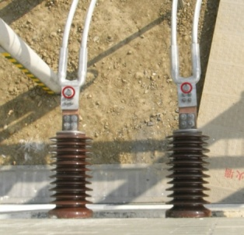
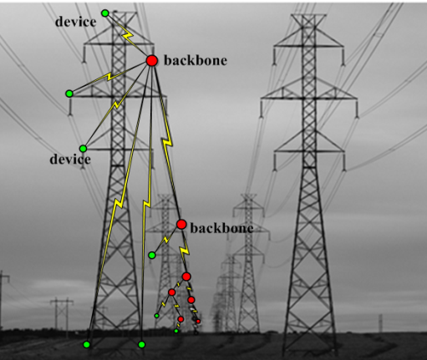
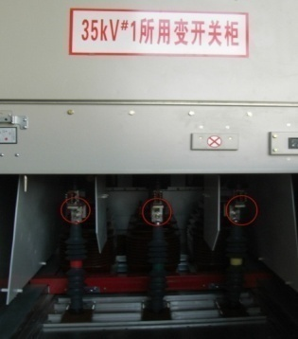
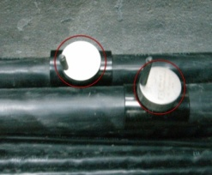
LECIM Application in China
15-11-0207-00-004k-smart-grid-applications-in-china
  Monitor environmental information, like weather, vibration, inclination
  Find fault circuit quickly
  Prevent equipment from stolen or damage
15-10-0307-00-leci-low-energy-critical-infrastructure-monitoring-application-in-china
  Container monitoring
  Pipeline monitoring
  Water leak detection

Slide 4
TG4g SUN
Smart Utility Networks
Enable multiple applications to operate over shared network resources, providing monitoring and control of a utility system
Mesh or peer-to-peer multi-hop techniques to communicate with an access point
MR-FSK
MR-OFDM
MR-O-QPSK

Slide 5
TG4g MR-O-QPSK
470MHz
  Max tx power = 17dBm
  Chip rate = 100 kchip/s
  Data rate = 6.25/12.5/25/50Kbps
  Minimum estimation sensitivity= -125dBm (5dB Noise Figure)
780MHz
  Max tx power = 10dBm
  Chip rate = 1000 kchip/s
  Data rate = 31.25/125/250/500Kbps
  Minimum estimation sensitivity = -118dBm (5dB Noise Figure)

Slide 6
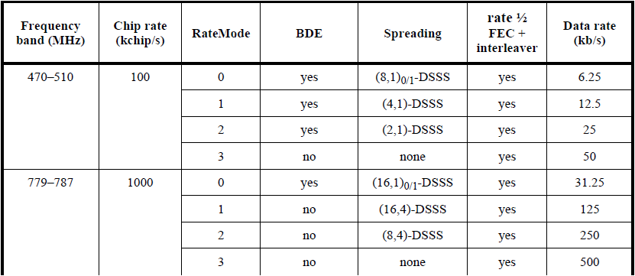
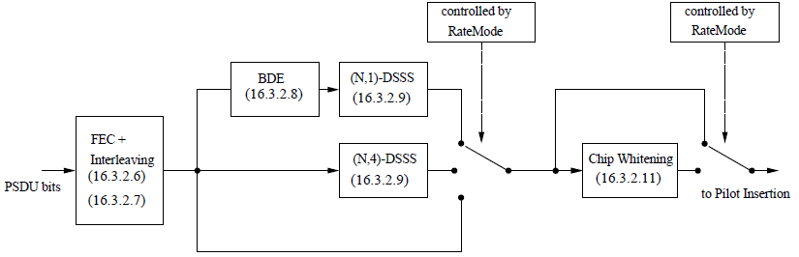
TG4g MR-O-QPSK
PHY Parameter
Reference Block Diagram

Slide 7
Scenario Analysis
Scenario Analysis
  15-11-0511-00-004k-lecim-high-gain-dsss-phy-preliminary-proposal
  15-11-0464-01-004k-tg4k-hata-channel-model-worksheet
  Utility Pole Height Into Basement, 1 km radius
  Rooftop height into underground vault, 200 meters radius
  Mountain top into remote areas, 20 km radius

Slide 8
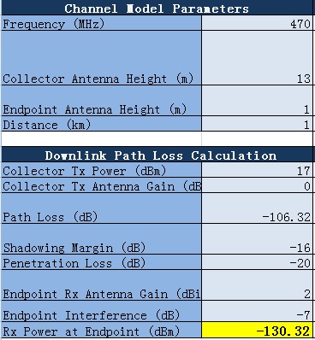
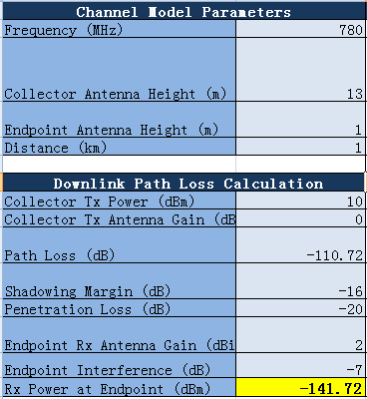
Scenario 1: Utility Pole Height Into Basement 1 km radius
-130.32dBm at rx endpoint with 17dBm tx power in 470MHz band
-141.72dBm at rx endpoint with 10dBm tx power in 780MHz band

Slide 9
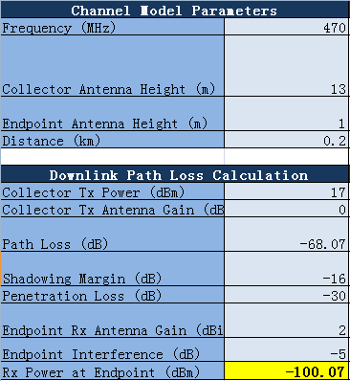

Scenario 2: Rooftop height into underground vault, 200 meters radius
-100.07dBm at rx endpoint with 17dBm tx power in 470MHz band
-111.47dBm at rx endpoint with 10dBm tx power in 780MHz band

Slide 10
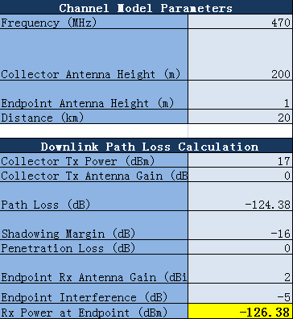
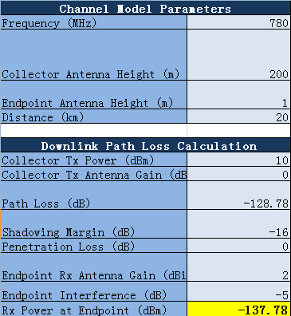
Scenario 3: Mountain top into remote areas, 20 km radius
-126.38dBm at rx endpoint with 17dBm tx power in 470MHz band
-137.78dBm at rx endpoint with 10dBm tx power in 780MHz band

Slide 11
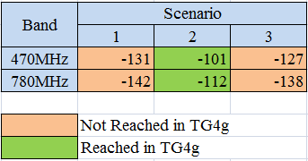
Scenario Analysis
Conclusion
  TG4g can meet the link budge in Scenario 2;
  Sensitivity requirements in 470MHz are moderate;

Slide 12
DSSS
Transmit range is the most important things
  When tx power is limited by regularity, lower data rate can reach larger transmit range
Narrow Band
  Require very narrow band filter, filter challenge is decided by Q value;
  Avoid high pole-Q, Q = IF/BW;
  Reduce IF can ease filter design challenge, but increase flicker noise;
DSSS
  Low data rate can be obtained by using large spread factor;
  BW is fixed for different data rate, simplifies the analog front end design;
  Robust to multi-path fading;
  Robust to carrier frequency offset;

Slide 13
Bands and Channel
470MHz
  470MHz – 510MHz
  Channel center frequency
    f(k) = 470.4+0.4*k; k= 0,…,98
  Chip rate = 100Kchips/s
780MHz
  779MHz – 787MHz
  Channel center frequency
    780/782/784/786MHz
  Chip rate = 1Mchips/s

Slide 14
FEC
Spread spectrum can not reduce the power consumption
  Eb/No keep the same;
  Spread Factor k will extent the bandwidth to introduce k times noise;
Effective channel code
    Channel code provide additional code gain;
    Employ channel code with performance near Shannon limit;
    Consider the encoder and decoder complexity;
Using different channel code scheme in uplink and downlink
    Extreme difference in capabilities and performance between endpoint devices and coordinating devices (collectors)
    End point must be able to conserve energy

Slide 15
FEC
Convolution code in downlink
  (2,1,7) with polynomials [171,133] plus interleave
  Same as TG4g device
LDPC code in uplink
  Large sample clock and low bit rate provides feasible to employ complexity iteration decode;
  Take complex encoder to collector
  Very close performance to Shannon limit
End point view
  Avoid complexity convolution decoder and LDPC encoder to reserve power;

Slide 16
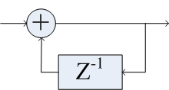
Differential Code
Employ differential encode to interleaved and coded bits
  Support non-coherent to simple the receiver;
  Robust in low SNR environment;

Slide 17
Spread
Spread Factor
  470MHz: SF16- SF128
  780MHz: SF32- SF1024
  Spread factor design should consider frequency offset estimation performance and link budge at the same time
Spread Sequences
  Gold code
  Distinguish different network
  Distinguish different collector
  When the longest PN sequence is applied, the phase shift can be used to support multi-user(end points)

Slide 18
Modulation
O-QPSK
  Compatible with existed standard of IEEE802.15.4c and TG4g
  Nearly constant envelope
  Same demodulation requirement as BPSK and MSK
Shape Filter
  Raised cosine pulse shape with roll-off factor r = 0.8
  Meet the Chinese low power device regularity that spurious emission should be no larger than -36dBm

Slide 19
Reference Block Diagram
Block
  Channel code (Convolution code/LDPC)
  Interleave
  Differential code
  Spread
  Shape and Modulator

Slide 20
Summary
TG4k and TG4g can complement to each other, TG4g can cover some scenario but not enough for others;
PHY proposal on 470MHz and 780MHz Chinese Band;
Wish to Merge with Other DSSS Proposal

Slide 21
Thank you

