Slide 1
Project: IEEE P802.15 Working Group for Wireless Personal Area Networks (WPANs)
Submission Title:[Updated on MPDU Fragmentation Proposal for TG4k]
Date Submitted: [Sept 16, 2011]
Source:[Benjamin Rolfe]
Company [Blind Creek Associates]
Address []
Voice: [+1.408.395.7207], FAX: [None], E-Mail: [ben @ blindcreek.com]
Re:[Follow-on to doc 11-0478-02 and group discussions]
Abstract:[MPDU Fragmentation concept, updated with input from group discussion and contributions, and further detailed and refined]
Purpose:[Final proposal presentation for Sept 2011 meeting]
Notice: This document has been prepared to assist the IEEE P802.15. It is offered as a basis for discussion and is not binding on the contributing individual(s) or organization(s). The material in this document is subject to change in form and content after further study. The contributor(s) reserve(s) the right to add, amend or withdraw material contained herein.
Release: The contributor acknowledges and accepts that this contribution becomes the property of IEEE and may be made publicly available by P802.15.

Slide 2
Content
Progress since July
Questions from September
Recap of fragmentation
Mapping to a NB and a WD PHY example based on proposals

Slide 3
Progress since July (SF)
Worked on open issues and questions from July
Presented “open questions” in SF and had some very lively discussion
Follow-up email discussions with interested people provided some good ideas
Discussed input and ideas on TG4k teleconferences provided more ideas
Applied to the preliminary PHY proposals presented in SF and details provided for this meeting (Sept 2011 Okinawa)

Slide 4
Goals for this presentation
Address questions opened in July:
Fragment context
Parameterized hybrid ACK scheme to support upper layer adaptation
Need to validate each FP
Examples of how it might work
Using characteristics of two PHYs
4k proposed PHY
802.15.4-2011 BPSK
Existence proof, not implementation specification

Slide 5
Recap
Concept presented included ideas shared in May 2011 meeting, teleconference call discussions and email exchanges.
Productive discussion in SF, general interest and support for developing the idea further
Reference documents:
P802-15-11-0478-02
P802.15-11-0395-00
P802.15-11-0348-00

Slide 6
Goals for Fragmentation
Same Goals..we have more info to work with
Adapt LECIM PHYs to operate with existing MAC transparently
Improve apparent reliability of the medium
Fit expected channel conditions, data rates and other PHY characteristics for LECIM
Reduce on the air overhead
Coexistence: reduce interference footprint and improve interference tolerance
Consider generalizations to make useful beyond LECIM PHYs and applications

Slide 7
Overview of Fragmentation Process
MPDU constructed in the normal 15.4 process
Fragment 15.4 MPDU into multiple PHY packets, compress/suppress MHR fields
Establish a “fragment sequence context”
Each fragment validated, acknowledged
Retransmission of failed fragments only

Slide 8
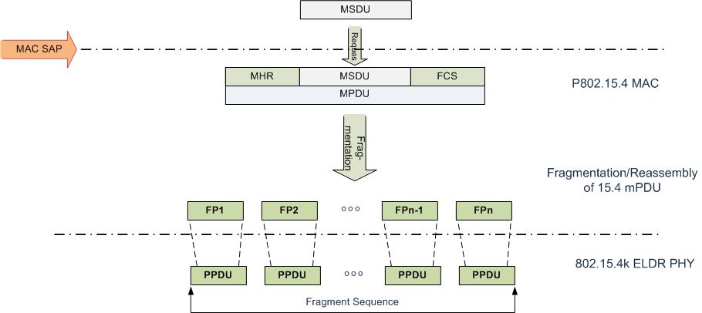
Overview of Fragmentation Process

Slide 9
Fragment Context
Fragment context assumptions (for this example)
Fragment is unicast with one source and one destination (single link)
Fragment belongs to a single fragment sequence
Context == {Context ID, Sequence ID, Fragment number}
Sequence ID <- MPDU being transferred
Fragment number <- by fragmentation process
Context ID (CID) associates device address pairing
Each end knows what a CID means, can be used for directed (unicast) exchange between devices
Notes:
Broadcast possible but not yet addressed – one step at a time!

Slide 10
Getting a CID
Possible methods:
Provisioned
Set by higher layer to set at each device (PIB)
Use existing MAC mechanisms
Provide for non-fragmented transfer
Provide dedicated CIDs for certain exchanges
Other implementation specific?
Notes:
Probably deleting this slide (use it as backup if needed or for next time)

Slide 11
Fragmentation Cell
Frag -hdr | CID | Sequence ID | Fragment Number | Auth | More/end | PHY specific info | MPDU Data Fragment | FCS
Frag-hdr: flags that indicate presence of other fields in fragmentation cell
Allows for suppressing information that may be available from context
CID = 16 bits
Sequence ID assigned when MPDU constructed
Unique within context and some time-frame
15.4-2011 MPDU sequence # (DSN/BSN) for this example (8 bits)
Fragment number (which fragmentation cell is this in sequence)
7 bits would support Ethernet MTU with 16 octet fragment size
Auth flag indicates if FCS field contains a MIC-32 or a CRC-32
More fragments/end of fragment sequence
PHY specific info
Medium quality/status feedback [sync with PHY proposal]
Other PHY parameters that may be used for adaptation
FCS
When Auth == FALSE standard FCS; when Auth == TRUE authenticated MIC

Slide 12
Fragment Acknowledgement
Possible acknowledgement schemes:
Simple per-fragment acknowledge
per-fragment acknowledge with parameters to support fragment by fragment adaptation
Aggregated acknowledgment
Some combination?

Slide 13
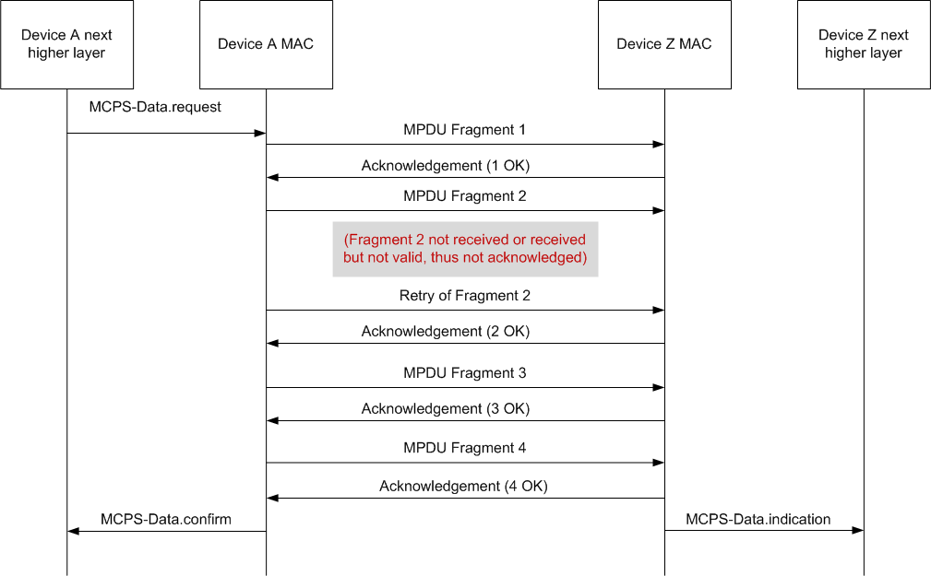
MSC for Data Transfer Example (Simple fragment ACK)

Slide 14
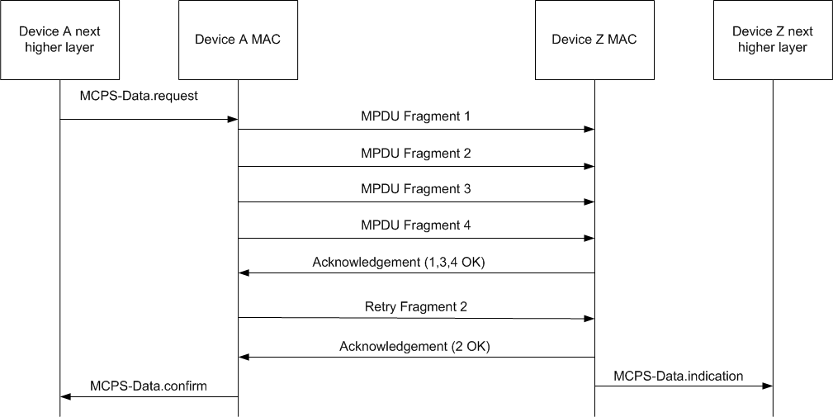
MSC for Data Transfer Example (Aggregate ACK)

Slide 15
Fragment Validation
Simple FCS
Use already defined 16-bit or 32-bit defined in 15.4-2011 + amendment 4g
Secure FCS
Use an authenticated MIC in place of FCS?
Provides validation and authentication
Possibly plugs hole suggested in July (Ed C.)
Use 802.15.4-2011 MIC-32

Slide 16
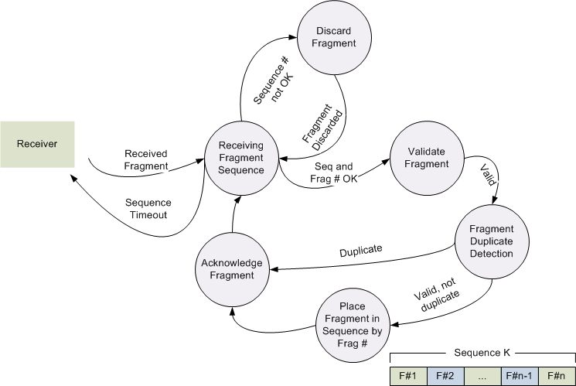
MPDU Reassembly

Slide 17
MPDU Validation
Per 802.15.4-2011
MPDU FCS validation
Address filtering, security validation, etc
Acknowledgement options
Acknowledgement failures and thus MPDU retransmission occurrences greatly reduced

Slide 18
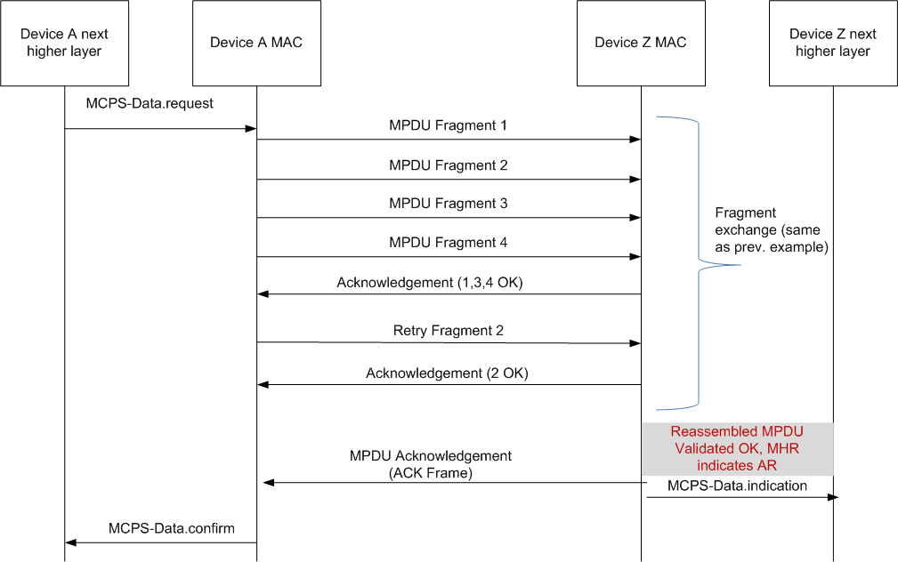
MSC for Data Transfer Example (Aggregated fragment Acknowledge , MPDU Acknowledge)

Slide 19
Consideration with specific PHYs

Slide 20
2 PHYs for example
High Gain DSSS 1 to 30 kbps PHY (802.15-0511-01-004k)
802.15.4-2011 BPSK 20kbps

Slide 21
Sample Messages
Example message: Environment monitor, temperature/humidity, daily reports:
96 measurements per day
32 bits per measurement
384 octets payload

Slide 22
Sample MPDU
Package into 802.15.4 MAC data frame
no security header, MPDU = 405 octets
Security header, MPDU = 419 octets
Octets: 2 | 1 | 8 | 8 | 384 | 2
FCF | DSN | Dest Addr | Source Addr | Payload (MSDU) | FCS
Octets: 2 | 1 | 8 | 8 | 14 | 384 | 2
FCF | DSN | Dest Addr | Source Addr | Aux security hdr | Payload (MSDU) | FCS

Slide 23
Example: LECIM High Gain DSSS PHY
(802.15-0511-01-004k)

Slide 24
PHY Characteristics
For this example:
Rate ½ FEC
SHR 16 symbols = 16 bit times (per PPDU)
PPDU payload size fixed at 24 octets
Zero-length PHR (no size or signaling)
PPDU duration @ 8kbps (after coding) ~ 25ms
 | Octets
16 symbols (32 bit times) | 24
Preamble | PSDU
SHR | PHY Payload

Slide 25
State information associated with MPDU
Context ID: Assigned by upper layer process [provisioned or discovered]
Fragments always acknowledged
Fragment sequence ID
Assigned when MPDU generated by MAC (DSN/BSN)
PHY specific transmit parameters w/service request
Parameter set to use for initial transfer (fragment 1) [TX power, Spreading Factor, FEC]
Parameter set and ranges that can be adjusted fragment to fragment

Slide 26
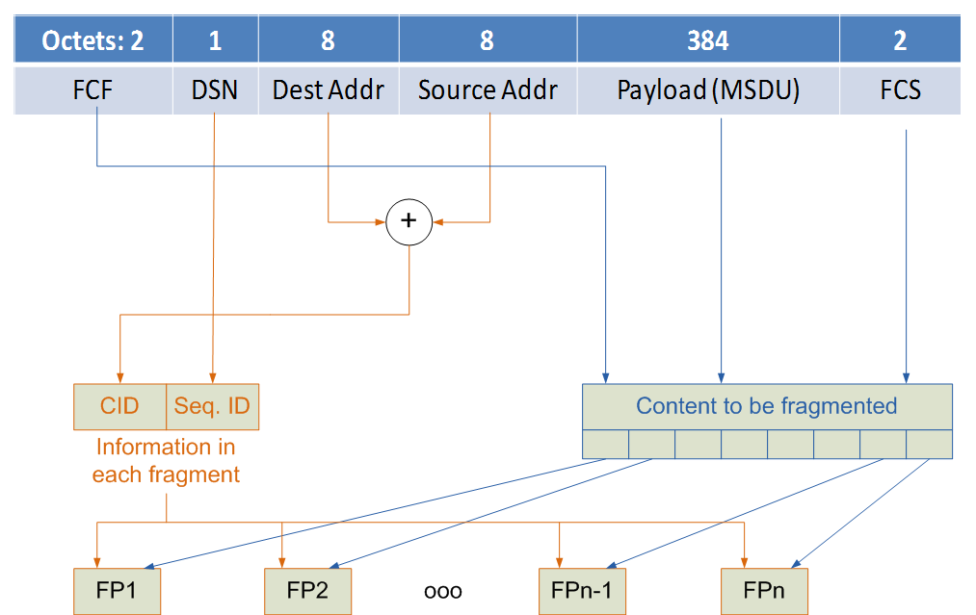
MPDU Construction and Fragmentation

Slide 27
PPDU Construction
Proposed PPDU payload 20 octets
 | Octets
16 symbols (32 bit times) | 24
Preamble | PSDU
Bits:4 | 16 | 4 | 7 | 1 | 1 | 7 | 15*8 | 32
Frag Hdr | CID | Sequ.ID | Fragment Number | Sec | More/end | PHY info | MPDU Data Fragment | FCS /MIC
Octets: 5 |  |  |  |  |  |  | 15 | 4

Slide 28
Fragmentation Cell Construction
Bits:16 | 8 | 7 | 1 | 1 | 15 | 15*8 | 32
CID | Sequence ID | Fragment Number | Sec | More/end | PHY info | MPDU Data Fragment | FCS /MIC
Octets: 6 |  |  |  |  |  | 15 | 4
PHY info (specific to PHY)
Medium quality/status feedback
Spreading factor to use in reply

Slide 29
Adaptation
Per fragment Acknowledgment
Acknowledgment contains receive quality that can be used for adaptation
Lack of acknowledgement (failure) can be used for adaptation
Parameters that can be adjusted
Spreading factor (data rate)
Transmit power

Slide 30
Example: 802.15.4-2011 BPSK 20kbps

Slide 31
PHY Summary
Maximum PPDU payload size 127 octets
BPSK
No FEC
Data rate 20kbps

Slide 32
PPDU
SHR = 4 + 1 = 8 octets
Maximum PPDU duration =
(127 + 8 + 1) * 8 / 20kbps = 54.4ms
Sample message needs at least 4 packets
20ms PPDU duration => 50-8-1 = 41 Octet payload

Slide 33
PPDU
SHR = 4 + 1 = 8 octets
Bits: 4 | 16 | 4 | 6 | 1 | 1 | 8 | 32 * 8 | 32
 | CID | Sequence ID | Fragment Number | Sec | More/end | LQI | MPDU Data Fragment | FCS /MIC
 | Octets: 5 |  |  |  |  |  | 32 | 4

Slide 34
Conclusion

Slide 35
Next Steps
Agree to move forward (include in baseline)
Explore and validate
CID establishment (transition cases)
Fragment validation methods
Fragment acknowledge/retry methods
Begin drafting

Slide 36
Thanks for Listening

