Slide 1
Project: IEEE P802.15 Working Group for Wireless Personal Area Networks (WPANs)
Submission Title: [A Preliminary Proposal for Low Energy Wide Area Wireless Networks – Low Energy MAC protocol proposal for scenarios of very low frequency packet transmissions]
Date Submitted: [18 July 2011]
Source: [Jussi Haapola, Shuzo Kato] Company [Tohoku University]
Address [2-1-1 Katahira Sendai 980-8577, Japan]
Voice:[+81-22-217-5477], FAX: [+81-217-5476], E-Mail:[jussi.haapola@riec.tohoku.ac.jp, shukato@riec.tohoku.ac.jp]
Re: [Call for Proposals (15-11-0147-02) 10 May, 2011]
Abstract: [This document proposes a star-topology MAC protocol that operates extremely energy-efficiently under very low packet generation frequencies and with thousands of devices.]
Purpose: [Bring the potential a new MAC concept to the attention of TG4k system design.]
Notice: This document has been prepared to assist the IEEE P802.15. It is offered as a basis for discussion and is not binding on the contributing individual(s) or organization(s). The material in this document is subject to change in form and content after further study. The contributor(s) reserve(s) the right to add, amend or withdraw material contained herein.
Release: The contributor acknowledges and accepts that this contribution becomes the property of IEEE and may be made publicly available by P802.15.

Slide 2
Summary
This presentation focuses on low energy consumption MAC as part of the proposal
Proposed low energy MAC will lower energy consumption to 1/3 from the IEEE 802.15.4 MAC (2006)
The full proposal will be presented in Okinawa meeting in September 2011

Slide 3
Agenda
Why change the MAC
Message Sequence Chart
Frame Formats
Some existing solutions
Energy and Reliability Performance

Slide 4
Why Change the MAC
Extremely low traffic per device
  Only a few packets per day
  Need to minimize the activity of a node
Data payloads very small in size
  Frame overhead becomes a dominating factor even at MAC layer

Slide 5

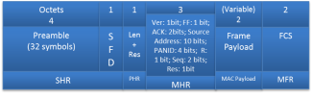

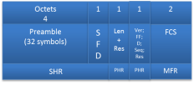
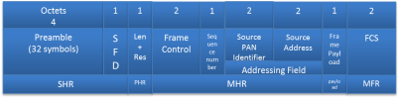
Message Sequence Chart
Devices mainly target uplink communications, but support for downlink communications is required.
Non-Beacon enabled, networks
Coordinator
DEV
Coordinator
DEV
Data
Data (Imp-Ack)
Acknowledgment
Contention
Data (if exists) or
Acknowledgment
or
Data Request
Acknowledgment (if Data sent)
Acknowledgment
Data (if exists)
Our Proposal MAC
Acknowledgment (if Data sent)
IEEE 802.15.4 with data polling

Slide 6
Data Frame Format Comparison
IEEE 802.15.4-2006 Data Frame in the scenario: MHR + MAC payload efficiency 2/9 = 22.2%
Octets
4
1
1
2
1
2
2
(Variable)
2
2
Preamble
(32 symbols)
S F D
Len + Res
Frame Control
Sequence number
Source PAN Identifier
Source Address
Frame Payload
FCS
Addressing Field
2
SHR
PHR
MHR
MAC Payload
MFR
Our proposal MAC Data Frame in the scenario: MHR + MAC payload efficiency 2/5 = 40%
Octets
4
1
1
3
(Variable)
2
2
Ver: 1bit; FF: 1 bit; ACK: 2bits; Source Address: 8 bits; PANID: 6 bits; R: 1 bit; Seq: 2 bits; Res: 1bit
Preamble
(32 symbols)
S F D
Len + Res
Frame Payload
FCS
SHR
PHR
MHR
MAC Payload
MFR
Ver = Version, FF = frame format, ACK = Ack policy (Imp-Ack for data frames, can be responded to either by data frame or by Imm-Ack frame), Source Address = Source DEV PAN MAC address assigned by PNC, PANID = PAN identifier, R = Retransmission, Seq = Sequence number, Res = reserved

Slide 7
Ack Frame Format Comparison
IEEE 802.15.4-2006 ACK Frame in the scenario
Octets
4
1
1
2
1
2
Preamble
(32 symbols)
S F D
Len + Res
Frame Control
Sequence number
FCS
SHR
PHR
MHR
MFR
Our proposal MAC ACK Frame in the scenario
Octets
4
1
1
1
2
Preamble
(32 symbols)
S F D
Len + Res
Ver; FF; D; Seq; Res
FCS
SHR
PHR
MHR
MFR
Ver = Version (1 bit), FF = frame format (3 bits), D = Data pending (1 bit), Seq = Sequence number (2 bits), Res = reserved (1 bit)

Slide 8
Data Request Frame Structure
IEEE 802.15.4 Data Request Command Frame in the scenario
Octets
4
1
1
2
1
2
2
1
2
Preamble
(32 symbols)
S F D
Len + Res
Frame Control
Sequence number
Source PAN Identifier
Source Address
Frame Payload
FCS
Addressing Field
2
SHR
PHR
MHR
payload
MFR

Slide 9
Some Existing Solutions
And why they do not work well…
SCP-MAC [1]:
  Brings together the positive aspects of the two most popular (academic) sensor MAC protocols, namely S-MAC [3] and B-MAC [4].
  Similar to TG4e Coordinated Sampled Listening (CSL)
  Contains a periodic structure that becomes a dominant factor in energy consumption when considering quiet networks
WiseMAC [2]:
  Designed for infrastructure downlink sensor networks.
  Lets devices to sleep most of the time by having them periodically use LPL.
  The coordinator keeps track of each devices schedules
  Easily modified to include uplink transmissions -> TG4e Receiver Initiated Transmission (RIT)
  Contains a periodic structure that becomes a dominant factor in energy consumption when considering quiet networks

Slide 10
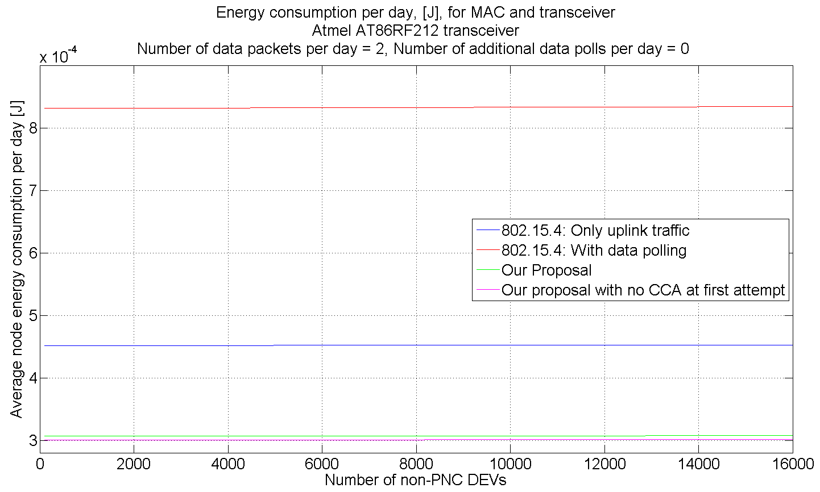
Energy Consumption per day

Slide 11
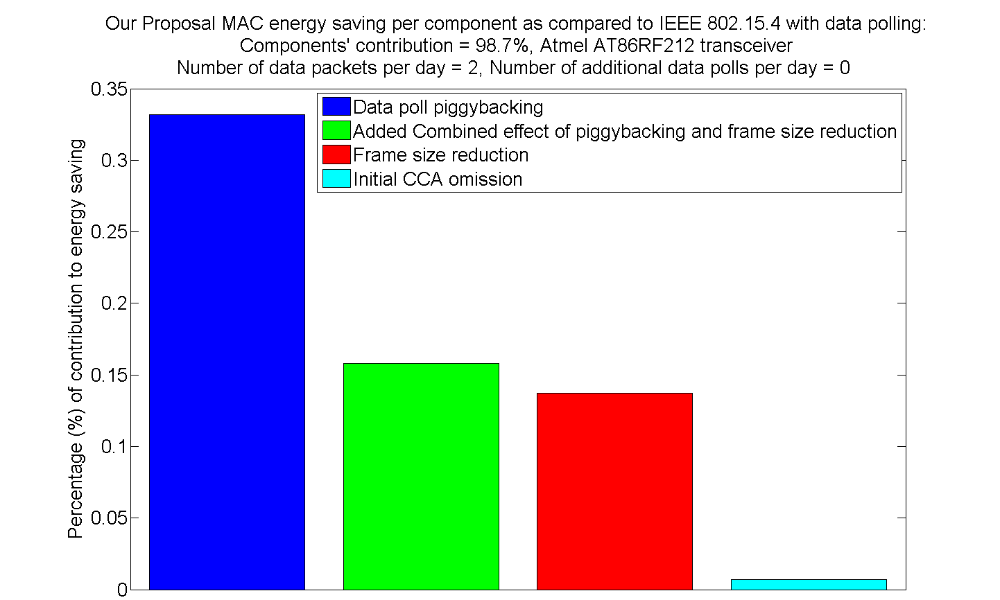
Energy Improvement breakdown of our proposal

Slide 12
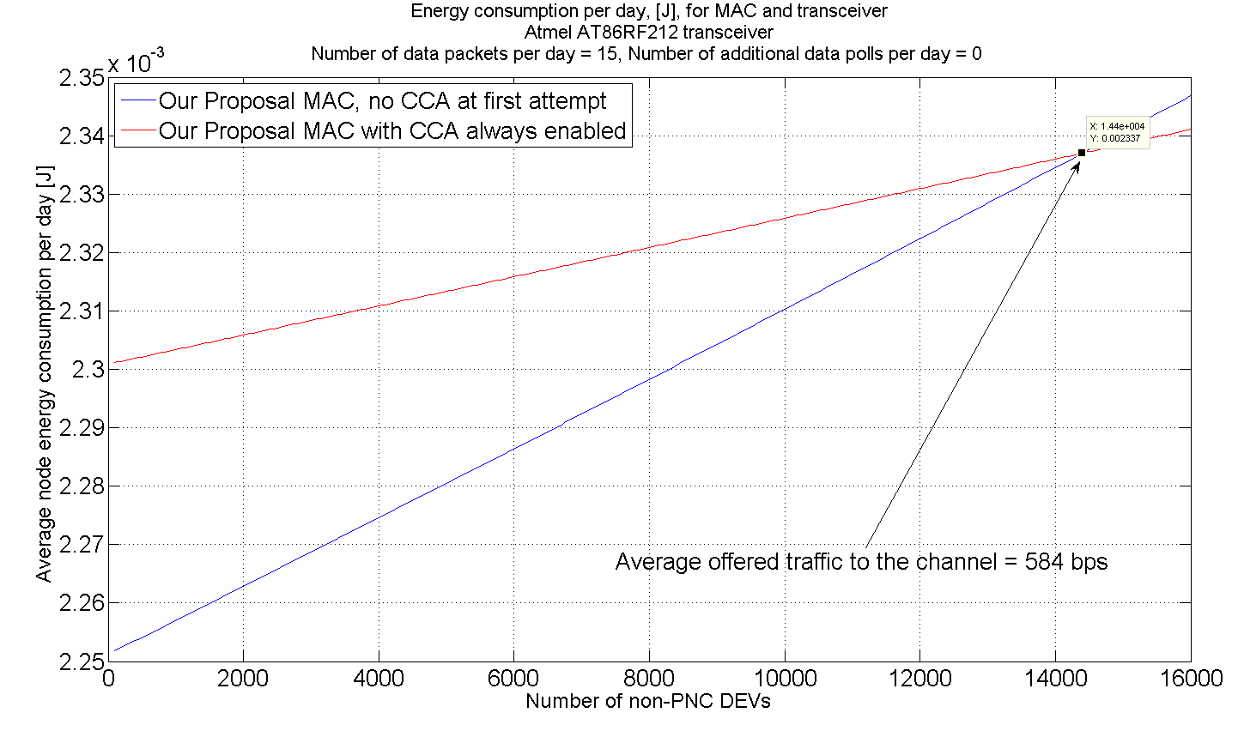
Range of Energy Performance Improve-ment if CCA not used at first Attempt

Slide 13
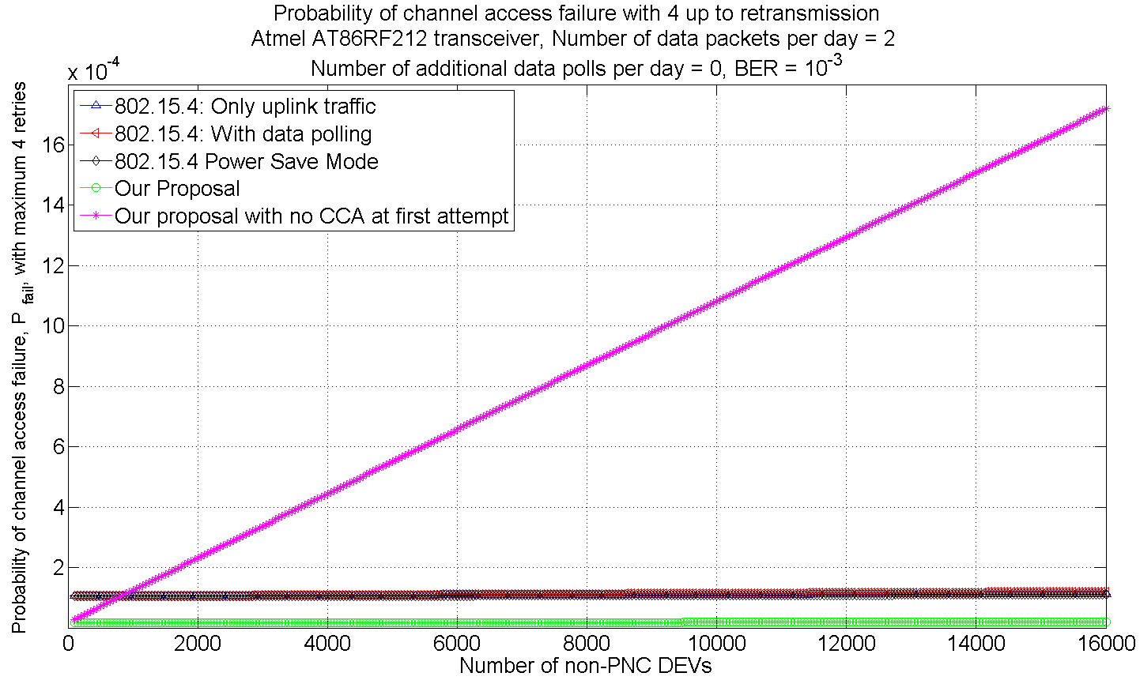
Probability of Channel Access Failure with Maximum 4 Retries

Slide 14
Conclusions -1
Reduction in messages exchanged in non-beacon enabled and bi-directional communications mode
  Number of messages exchanged: reduced from 4 to 2 frames if No Downlink data
  Number of messages exchanged: reduced from 6 to 3 frames if Downlink data exist
Overhead reduction is MUST for very small payloads
  Overhead reduction for Data frame: from 9 to 5 octets (to support > 10000 devices)
  Overhead reduction for Ack frame: from 2 to 1 octet
Overall Result:
  Significant savings in energy consumption
  Does not compromise functionality
  Scalable to 16000 devices in spatially overlapping area

Slide 15
Conclusion -2
Proposed low energy MAC will lower energy consumption significantly from the IEEE 802.15.4 MAC (2006)
This presentation focused on low energy consumption MAC as part of the proposal
The full proposal will be presented in Okinawa meeting in September 2011

Slide 16
References
[1] W. Ye, F. Silva and J. Heidemann, “Ultra-low duty cycle MAC with scheduled channel polling,” SenSys '06: Proceedings of the 4th international conference on Embedded networked sensor systems, DOI: http://doi.acm.org/10.1145/1182807.1182839, 2006.
[2] A. El-Hoiydi, J.-D. Decotignie and J. Hernandez, “Low Power MAC Protocols for Infrastructure Wireless Sensor Networks,” Proc. of the 5th European Wireless Conference, 2004.
[3] W. Ye, J. Heidemann and D. Estrin, “Medium Access Control with Coordinated Adaptive Sleeping for Wireless Sensor Networks,” IEEE/ACM Transactions on Networking, Vol. 12, pp. 493-506, 2004.
[4] J. Polastre, J. Hill and D. Culler, “Versatile Low Power Media Access for Wireless Sensor Networks,” Proc. of the 2nd international conference on Embedded networked sensor systems, pp. 95-107, 2004.

