Slide 1
Project: IEEE P802.15 Working Group for Wireless Personal Area Networks (WPANs)
Submission Title: [A IEEE802.15.4 Legacy based Design for IEEE802.15.4k PHY]
Date Submitted: [July, 2011]
Source: [Kyung Sup Kwak, Shen Bin, Yongnu Jin, Kyeong Jin Kim, Jaewoong Song] and [Hyungsoo Lee, Jaedoo Huh]
Company: [Inha University] and [ETRI]
Address [428 Hi-Tech, Inha University, 253 Yonghyun-dong, Nam-gu, Incheon, 402-751, Republic of Korea]
Voice: [+82-32-860-7416], FAX: [+82-32-876-7349],
E-Mail: [kskwak@inha.ac.kr (other contributors are listed in “Contributors” slides)]
Re: []
Abstract: [A PHY Proposal for Low Energy Critical Infrastructure Networks Applications TG4k]
Purpose: [To be considered in IEEE 802.15.4k]
Notice: This document has been prepared to assist the IEEE P802.15. It is offered as a basis for discussion and is not binding on the contributing individual(s) or organization(s). The material in this document is subject to change in form and content after further study. The contributor(s) reserve(s) the right to add, amend or withdraw material contained herein.
Release: The contributor acknowledges and accepts that this contribution becomes the property of IEEE and may be made publicly available by P802.15.

Slide 2
Contributors
Name | E-mail | Affiliation
Kyung Sup Kwak | kskwak@inha.ac.kr | Inha University
Shen Bin | shenbinem@gmail.com | Inha University
Yongnu Jin | jyn4941@163.com | Inha University
Kyung Jin Kim | kyeong.j.kim@hotmail.com | Inha University
Jaewoong Song | Jaewoong.song@gmail.com | Inha University
Hyungsoo Lee | hsulee@etri.re.kr | ETRI, Korea
Jaedoo Huh | jdhuh@etri.re.kr | ETRI, Korea

Slide 3
Outline
Introduction
Environmental Considerations
Operating Bands in ISM
Modulation and Data Rates
PHY frame structure
Co-Existence Features
Coding Schemes
Link Budgets
Conclusion

Slide 4
IEEE 802.15 Low Energy Critical Infrastructure (LECIM) Task Group 4k (TG4k)
The purpose is to facilitate point to multi-thousands of points communications for critical infrastructure monitoring devices.
It addresses the application's user needs of minimal network infrastructure, and enables the collection of scheduled and event data from a large number of non-mains powered end points that are widely dispersed, or are in challenging propagation environments.
To facilitate low energy operation necessary for multi-year battery life, the amendment minimizes network maintenance traffic and device wake durations.
In addition, the amendment addresses the changing propagation and interference environments.
Introduction

Slide 5
Environmental Considerations
Simultaneous operation for at least 8 co-located orthogonal networks
MAC level orthogonal networks
-- Addressing/Scheduling mechanism in MAC frame
PHY level orthogonal networks
-- Addressing in PHY frame (Broadcasting Beacon Vector )
-- Multi-Slots (8 TDMA channel sets): Time Division
-- Multi-Bands (8 FDMA channel sets): Frequency Division
-- Multi-Codes (8 m-Sequence sets: Long and Short codes): Code Division
For narrowband systems, “Non-coherent MLSE Detection of M-DPSK for DS-CDMA Wireless Systems” has been proposed as one MUA scheme.
Long Codes with different Mask can be used for multiple-users within a network;
Short Codes can be used to distinguish the 8 co-located orthogonal networks. (IS-95 and CDMA2000)

Slide 6
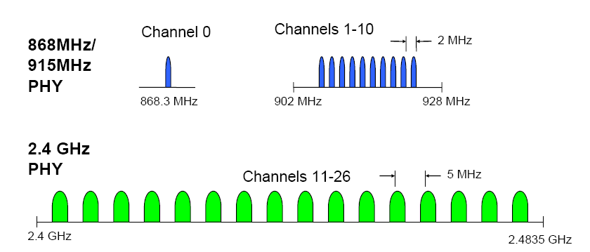
Operating Bands (Narrowband) in ISM
802.15.4 LR-WPAN

Slide 7
Modulation and Date rates (1)
Application data rate of less than 40 kbits per second
Low Data Rate applications (LR-WPAN)
Range of data rates (Long symbol periods: robust against multipath fading)
40 kbps,
20 kbps
10 kbps
Minimum Nyquist Bandwidth
40 KHz for OOK/BPSK/2FSK modulation
20 KHz for MSK modulation
Spectrum efficiency may not be the most important issues for 15.4k applications, but the system BER performance.

Slide 8
Modulation and Date rates (2)
Application data rate of less than 40 kbits per second
R: the data rate (bps)
W: bandwidth occupied by the modulated RF signal
 | MSK | 2FSK* | OOK/BPSK | QPSK/OQPSK
Nyquist BW | 2 | 1 | 1 | 2
20dB BW | 0.767 | 0.384 | 0.186 | 0.372
Null-to-Null BW | 0.667 | 0.333 | 0.5 | 1
30dB BW | 0.438 | 0.352 | 0.052 | 0.104
Power spectrum densities of modulation schemes.

Slide 9
Modulation and Date rates (3)
Application data rate of less than 40 kbits per second
PSK outperforms FSK/OOK;
Processing gain loss is large
due to non-coherent reception;
Under coherent reception
OQPSK, MSK and BPSK have
the same performance

Slide 10
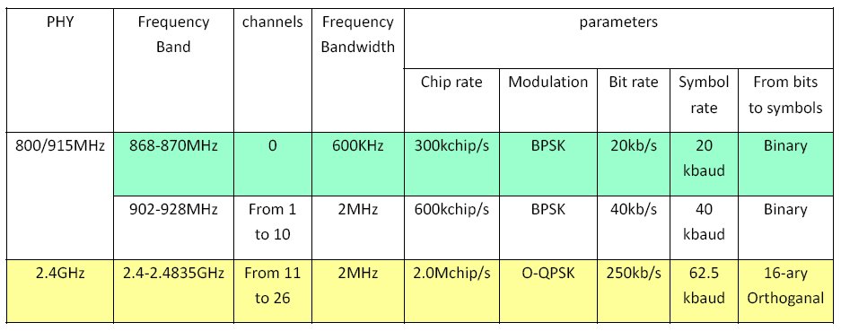
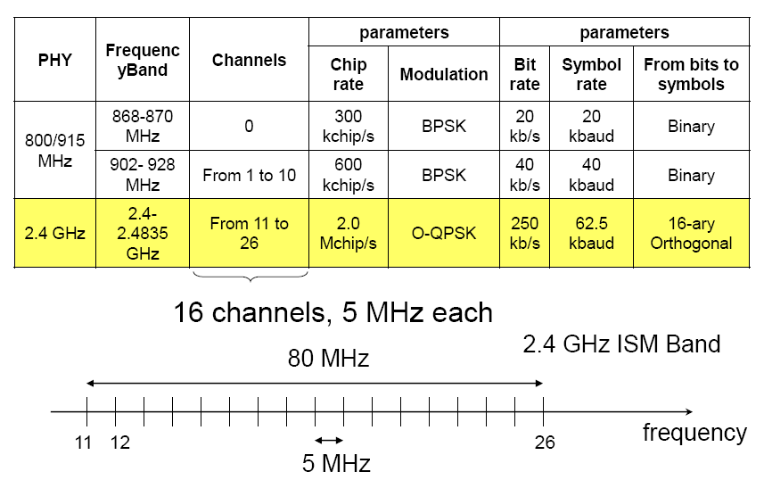
Modulation and Date rates (4)
Application data rate of less than 40 kbits per second
802.15.4 LR-WPAN

Slide 11
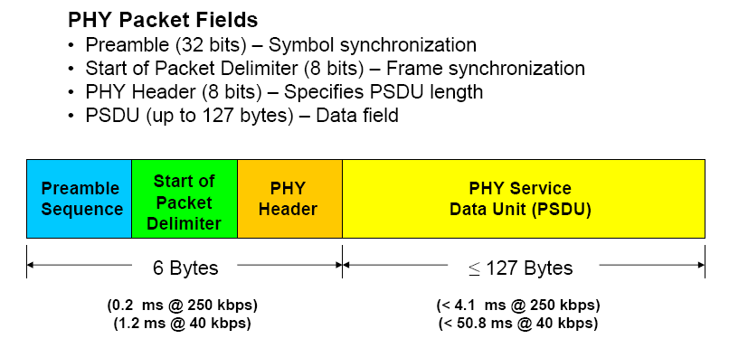
PHY frame structure
Application data rate of less than 40 kbits per second
802.15.4 LR-WPAN
Modification may be necessary for 15.4k
PHY frame Head: 1.2 ms@ 40 kbps

Slide 12
Co-Existence Features
Mechanisms that enable coexistence with other systems in the same band
Intra-Network Interference mitigation (Homogeneous)
Using m-sequence as an anti-interference method.
Enhanced methods for Clear Channel Assessment and Link Quality Indicator.
Inter-Network Interference mitigation (Heterogeneous)
Using m-sequence as an anti-interference method.
Using non-overlapping channels in the frequency domain.

Slide 13
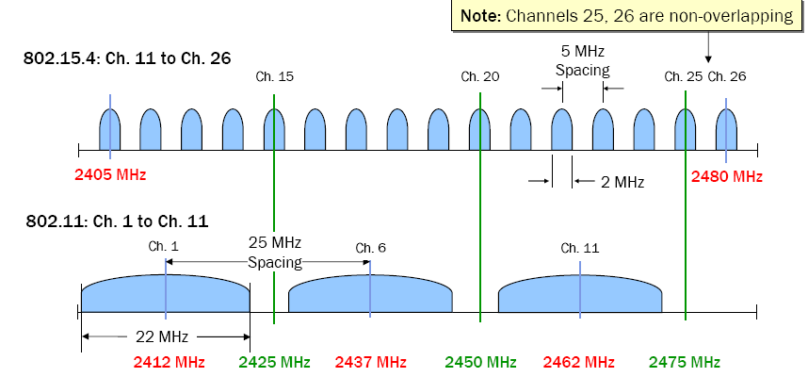
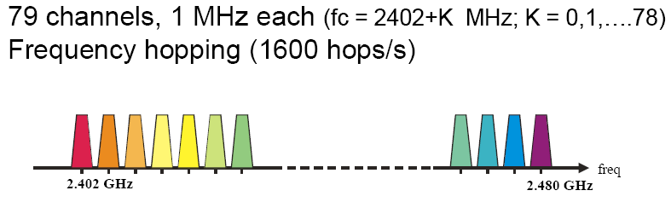

Co-Existence Features
Co-Existence of IEEE 15.4 systems with WiFi and bluetooth

Slide 14
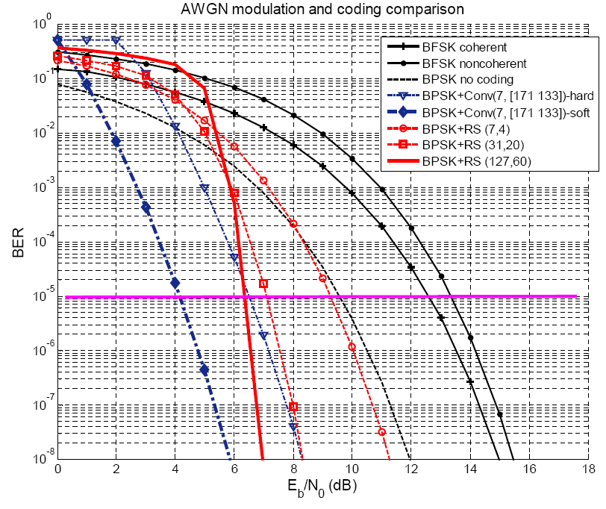
Coding Schemes
Under the BPSK Scheme
Convolutional code>
RS code>
BCH code

Slide 15
Link Budgets
Propagation path loss of at least 120 dB
802.15.4 LR-WPAN
Standard specifies that each device shall be capable of transmitting at least 1 mW
Typical devices (1mW) are expected to cover a 10~20m range
The defined transmit power steps are -25 dBm, -15 dBm, -10 dBm, -7 dBm, -5 dBm, -3 dBm, -1 dBm and 0 dBm
Receiver sensitivities are -85dBm for 2.4GHz and -92dBm for 868/915MHz.

Slide 16
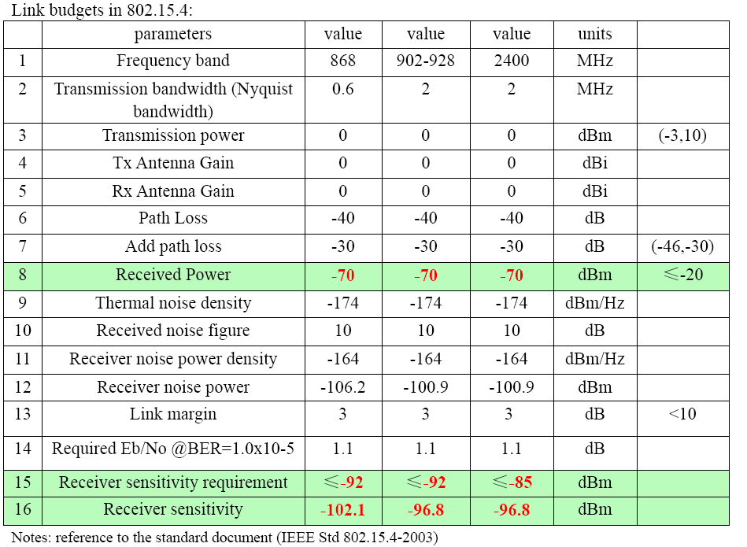
Link Budget: Reference

Slide 17
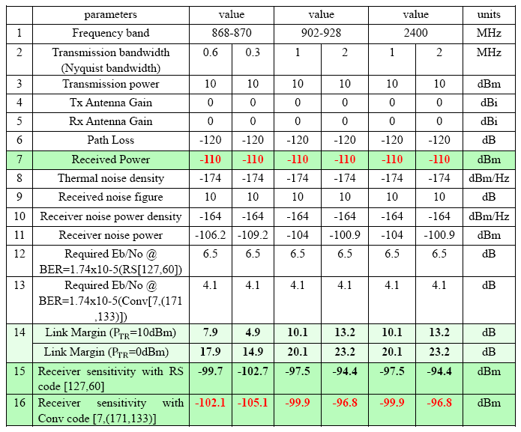
Link Budget: 4k Application
Link budget in 802.15.4k applications:

Slide 18
Notes about the Link budget in 802.15.4k applications:
The transmission power in item 3 is referenced to the 802.15.4, where the maximum transmission power is 10mW and equivalent to 10 x log10 (10) =10dBm
The transmit and receive antenna are assumed as isotropic. But according the requirements in PAR, for the coordinator in 802.15.4k, they can be designed to support high processing factor(SF) channel coding, antenna beam steering or antenna diversity techniques to improve the received signal power.
The Link margin needed is calculated based on Receiver sensitivity with Convolutional code(171 133) with BPSK.
Required Eb/N0 comes from corresponding simulation in AWGN channel.

Slide 19
Conclusions
From the Link margin in item 14, we can find that without performance improved techniques, the receiver can’t receive the desired signal due to the large propagation path loss requirement.
Also according to the Technique requirements, there are still other PHY parameters need to be considered, such as MAC Dependencies/ Support Required, Synchronization and Timing, etc.
We need efficient diversity techniques, efficient modulation and higher SF channel coding methods to cover large path loss requirement.

