Slide 1
Project: IEEE P802.15 Working Group for Wireless Personal Area Networks (WPANs)
Submission Title: [Preliminary PHY Technical Proposal for TG4k]
Date Submitted: [July, 2011]
Source: [Hyungsoo Lee, Jaedoo Huh, Kyungsup Kwak*]
Company: [ETRI, INHA univ.*]
Address [161 Gajung-dong,Yuseong-gu, Daejeon, Rep. Korea]
Voice:[+82-42-860-5625], FAX: NA], E-Mail:[hsulee@etri.re.kr]
Re: []
Abstract: [Requirements of ISM bands, Data rate, Sensitivity and Transmit Power for TG4k]
Purpose: [To be considered in IEEE 802.15.4k]
Notice: This document has been prepared to assist the IEEE P802.15. It is offered as a basis for discussion and is not binding on the contributing individual(s) or organization(s). The material in this document is subject to change in form and content after further study. The contributor(s) reserve(s) the right to add, amend or withdraw material contained herein.
Release: The contributor acknowledges and accepts that this contribution becomes the property of IEEE and may be made publicly available by P802.15.

Slide 2
Preliminary PHY Technical
Proposal for TG4k
21-Jul-2011

Slide 3
Outline
Requirements
  - ISM bands, Data rate, Sensitivity, Tx Power
Band Plan & Channelization
Transmit Architecture
  - Modulation, System Parameters
Analysis of Link Budget
Conclusion

Slide 4
Requirements
<July 2011>
Data rate
  40 kbit/s per channel
Band
  900 MHz ISM band used
  Many channels that can support more than 1000 endpoints
Sensitivity
  Propagation path loss of at least 120 dB
  Coordinator should support antenna diversity to increase channel capacity and reduce interference from adjacent channels
Transmit power
  Up to 10 mW

Slide 5
Band plan and channelization
<July 2011>
Proposed Band Plan
  902-928 MHz (US) : 131 channels of 200 kHz spacing apart at each channel
Band Plan met the regulation of Korea
  Frequency range : 917~923.5 MHz
  32 channels of 200kHz spacing apart in the band
  Transmission power limited to 10mW EIRP for USN utilizations
* USN : Ubiquitous Sensor Network
For example 15.4, 15.4a, 15.4g, 15.6 and 15.4k
CH | Freq.(㎒) | CH | Freq.(㎒) | CH | Freq.(㎒) | CH | Freq.(㎒)
1 | 917.1 | 9 | 918.7 | 17 | 920.3 | 25 | 921.9
2 | 917.3 | 10 | 918.9 | 18 | 920.5 | 26 | 922.1
3 | 917.5 | 11 | 919.1 | 19 | 920.7 | 27 | 922.3
4 | 917.7 | 12 | 919.3 | 20 | 920.9 | 28 | 922.5
5 | 917.9 | 13 | 919.5 | 21 | 921.1 | 29 | 922.7
6 | 918.1 | 14 | 919.7 | 22 | 921.3 | 30 | 922.9
7 | 918.3 | 15 | 919.9 | 23 | 921.5 | 31 | 923.1
8 | 918.5 | 16 | 920.1 | 24 | 921.7 | 32 | 923.3
[Center frequency of 900 MHz band in Korea]

Slide 6
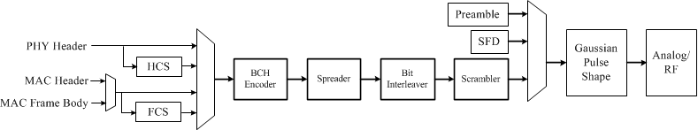
Transmitter Architecture
<July 2011>
[Transmitter structure]
HCS : CRC-4 ITU header check sequence
CRC-16 CCITT standard
Preamble
  4 octets “01010101”(0x55) Multiple strings
SFD : Start Frame Delimiter
  8 bits , for example “01101111”(0x6F)

Slide 7
Modulation(1)
<July 2011>
Gaussian Mean Shift Keying (GMSK)
  BT=0.3, modulation depth(h) =0.5
  Simple low Complexity
  Low Power consumption for constant envelop characteristic
  Data can be differentially encoded
  Band limited Gaussian pulse shaping
Rx Options
  Full coherent detection for high performance
  Semi-coherent detection is also possible
[GMSK power spectral density]

Slide 8
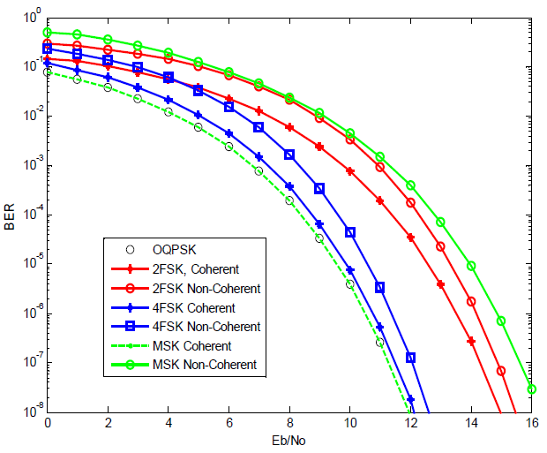
Modulation(2)
<July 2011>
BER performance of MSK is about 3dB better than that of FSK
Non-coherent demodulation of MSK is similar to that of FSK

Slide 9
System Parameters(1)
<July 2011>
Frame Structure
  Preamble : Time Synchronization
  SFD : Marking the end of the preamble
  Header : Information about PHY and MAC parameters
  PSDU : MAC header, payload (256 bytes), FCS
16-bit CCITT CRC
Data Rate Parameters
  CR(chip rate) = SR(symbol rate) / CR (code rate) * SF(spreading)
  CR = 40 kbps / (51/63) * 4 = 197.6 kbps
[Frame Format]

Slide 10
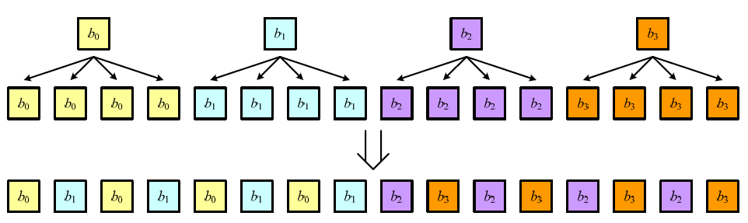
System Parameters(2)
<July 2011>
FEC
  BCH[63,51] code
  Generator polynomial :
  Simple, low-complexity binary BCH code
Scrambling
Spreading and interleaving
  Spreading is implemented by repeating the bits 4 times

Slide 11
Link Analysis
<July 2011>
GMSK Link Budget Analysis
No | Parameters | Unit | Value
1) | Bit rate [R] | kbps | 40
2) | Symbol Period [Tb] | uS | 25
3) | Spreading Factor [SF] | . | 4
4) | Code Rate [CR]* | . | 0.81
5) | Chip rate [Rc] | kbps | 197.6
6) | Channel Bandwidth [BW] | kHz | 200
7) | Peak TX Power [Pt] | dBm | 10.0
8) | TX antenna gain [Gt] | dBi | 0.0
9) | Path Loss [PL] | dB | 120.0
10) | RX antenna gain [Gr] | dBi | 10.0
11) | RX power [Pr=Pt+Gt+Gr-PL] | dBm | -100.0
12) | Receiver AWGN noise floor [N=-174+10log(BW)] | dBm | -121.0
13) | RF noise figure [Nf] | dB | 5.0
14) | Average noise power [Pn=N+Nf] | dBm | -116.0
15) | Processing gain [PG=10log(Nc)] | dB | 6.0
16) | Minimum EbNo [EN] | dB | 10.0
17) | Minimum SNR [S=EbNo+10log10(R/BW)] | dB | 9.9
18) | Coding gain (CG) | dB | 3.0
19) | Implementation loss [I] | dB | 3.0
20) | Link Margin [LM=Pr-Pn-S-I+PG+CG] | dB | 12.1
21) | Proposed Min. Rx Sensitivity Level [Pmin] | dBm | -112.1
* FEC : BCH(63,51)

Slide 12
Conclusion
<July 2011>
We propose a PHY technical requirements for TG4k.
We analyzed one of band plan with channelization, sensitivity and Tx power.
We will extend the proposal and hopefully present in next meeting.

Slide 13
<July 2011>
Thank You

