Slide 1
Project: IEEE P802.15 Working Group for Wireless Personal Area Networks (WPANs)
Submission Title: 802.15.4k Channel Model Proposal
Date Submitted: July 19, 2011
Source: Sourav Dey, On-Ramp Wireless
Re: 802.15.4k
Abstract: This presentation summarizes the discussions of channel model subgroup since the April, 2011 802.15.4k meeting in Palm Springs. It addresses various channel characteristics that should be addressed by LECIM PHY proposals. In addition, it proposes a potential RF path loss model.
Purpose: Propose a LECIM channel model for use in evaluating PHY proposals.
Notice: This document has been prepared to assist the IEEE P802.15. It is offered as a basis for discussion and is not binding on the contributing individual(s) or organization(s). The material in this document is subject to change in form and content after further study. The contributor(s) reserve(s) the right to add, amend or withdraw material contained herein.
Release: The contributor acknowledges and accepts that this contribution becomes the property of IEEE and may be made publicly available by P802.15.

Slide 2
802.15.4k LECIM Channel Model Update
7/19/2011

Slide 3
Purpose
Summarize current state of channel model
Identify key characteristics of LECIM channel
Ideas shared on TG4k conference calls
Ideas shared on TG4k Reflector
References
DCN-802.15-11-0464-00-004k
DCN-802.15-11-0465-00-004k
DCN-802.15-11-0507-00-004k

Slide 4
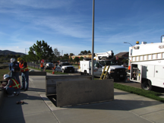
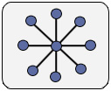
Basic Assumptions
Focus on star topology, e.g. endpoint <-> collector
Focus on outdoor propagation with (optional) additional loss due to penetration into underground vaults, etc.

Slide 5
RF Path Loss Model
Range is king!
Coverage into difficult locations is stated goal of LECIM PHY.
PHY proposals will be evaluated in part on the coverage they can get which still supporting the desired bit-rate (< 40 kbps)
Possible Scenarios
Underground vault from utility-pole height antenna
Pad mount transformer from a cell-tower antenna
Backcountry sensor from mountaintop antenna farm

Slide 6
RF Path Loss Model
Frequency
Dependent on PHY proposal
Transmit Power
Dependent on regional regulations for frequency band
Antenna Gain
Dependent on regional regulations for frequency band
Uplink and Downlink
Separate path loss calculations for each direction
Potentially different impairments, antennas, etc.

Slide 7
RF Path Loss Line Items
Penetration Loss
Underground Vaults = ~40 dB
Indoor Sensor Locations = ~20 dB
Shadowing Margin
Nominal margin of 2σ = 16 dB to account for clutter variation
See DCH 15-11.0375-00-004k for more info
Propagation Loss
Okamura-Hata Model for 150-1500 MHz
Cost 231-Hata Model for 1500-2400 MHz
Interference
Due to out of system interference at advantaged collector
See DCN 15-11-0074-00-004k for more info

Slide 8
RF Path Loss Excel Spreadsheet
Channel Model Parameters |  | Notes
Frequency (MHz) | 2400 | Valid Range 150-2400 MHz
Collector Antenna Height (m) | 30 | Valid Range 30-200 m, including terrain.
Endpoint Antenna Height (m) | 1 | Valid Range 1-10 m
Distance (km) | 4 | Valid Range 1-20 km
Downlink Path Loss Calculation |  | Notes
Collector Tx Power (dBm) | 30 | Subject to Tx Power Regulations
Collector Tx Antenna Gain (dBi) | 6 | Subject to Tx Power Regulations
Hata Path Loss (dB) | -162.99 | Must reference the right path loss from the next worksheet
Shadowing Margin (dB) | -16 | To buffer against variable shadowing loss
Penetration Loss (dB) | -10 | For underground vaults, etc.
Endpoint Rx Antenna Gain (dBi) | 2 | If using same antenna for Tx, must be same as in Uplink Table
Endpoint Interference (dB) | 1 | Rise over Thermal Interference
Rx Power at Endpoint (dBm) | -149.99 | Compare against Rx sensitivity
Uplink Path Loss Calculation |  | Notes
Endpoint Tx Power (dBm) | 20 | Subject to Tx Power Regulations. Can be dif from Collector
Endpoint Tx Antenna Gain (dBi) | 2 | Subject to Tx Power Regulations
Penetration Loss (dB) | -10 | For underground vaults, etc.
Hata Path Loss (dB) | -162.99 | Same as Downlink
Shadowing Margin (dB) | -16 | Same as Downlink
Collector Rx Antenna Gain (dBi) | 2 | If using same antenna for Tx, must be same as Downlink
Collector Interference (dB) | 10 | Rise over Thermal Interference
Rx Power at Collector (dBm) | -154.99 | Compare against Rx sensitivity

Slide 9
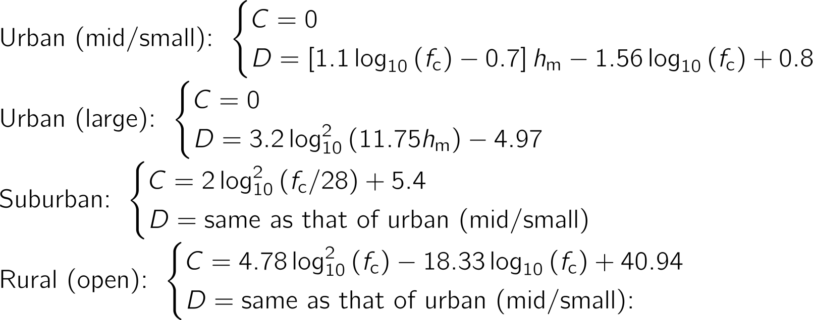
Okamura-Hata Propagation Model
Frequencies: 150-1500 MHz
Terrain: Urban, Suburban, Rural
Valid Collector Antenna Height: 30-200m
Valid Endpoint Antenna Height: 1-10m
Distance: 1-20 km
Equations courtesy of DCN-802.15-11-0507-00-004k

Slide 10
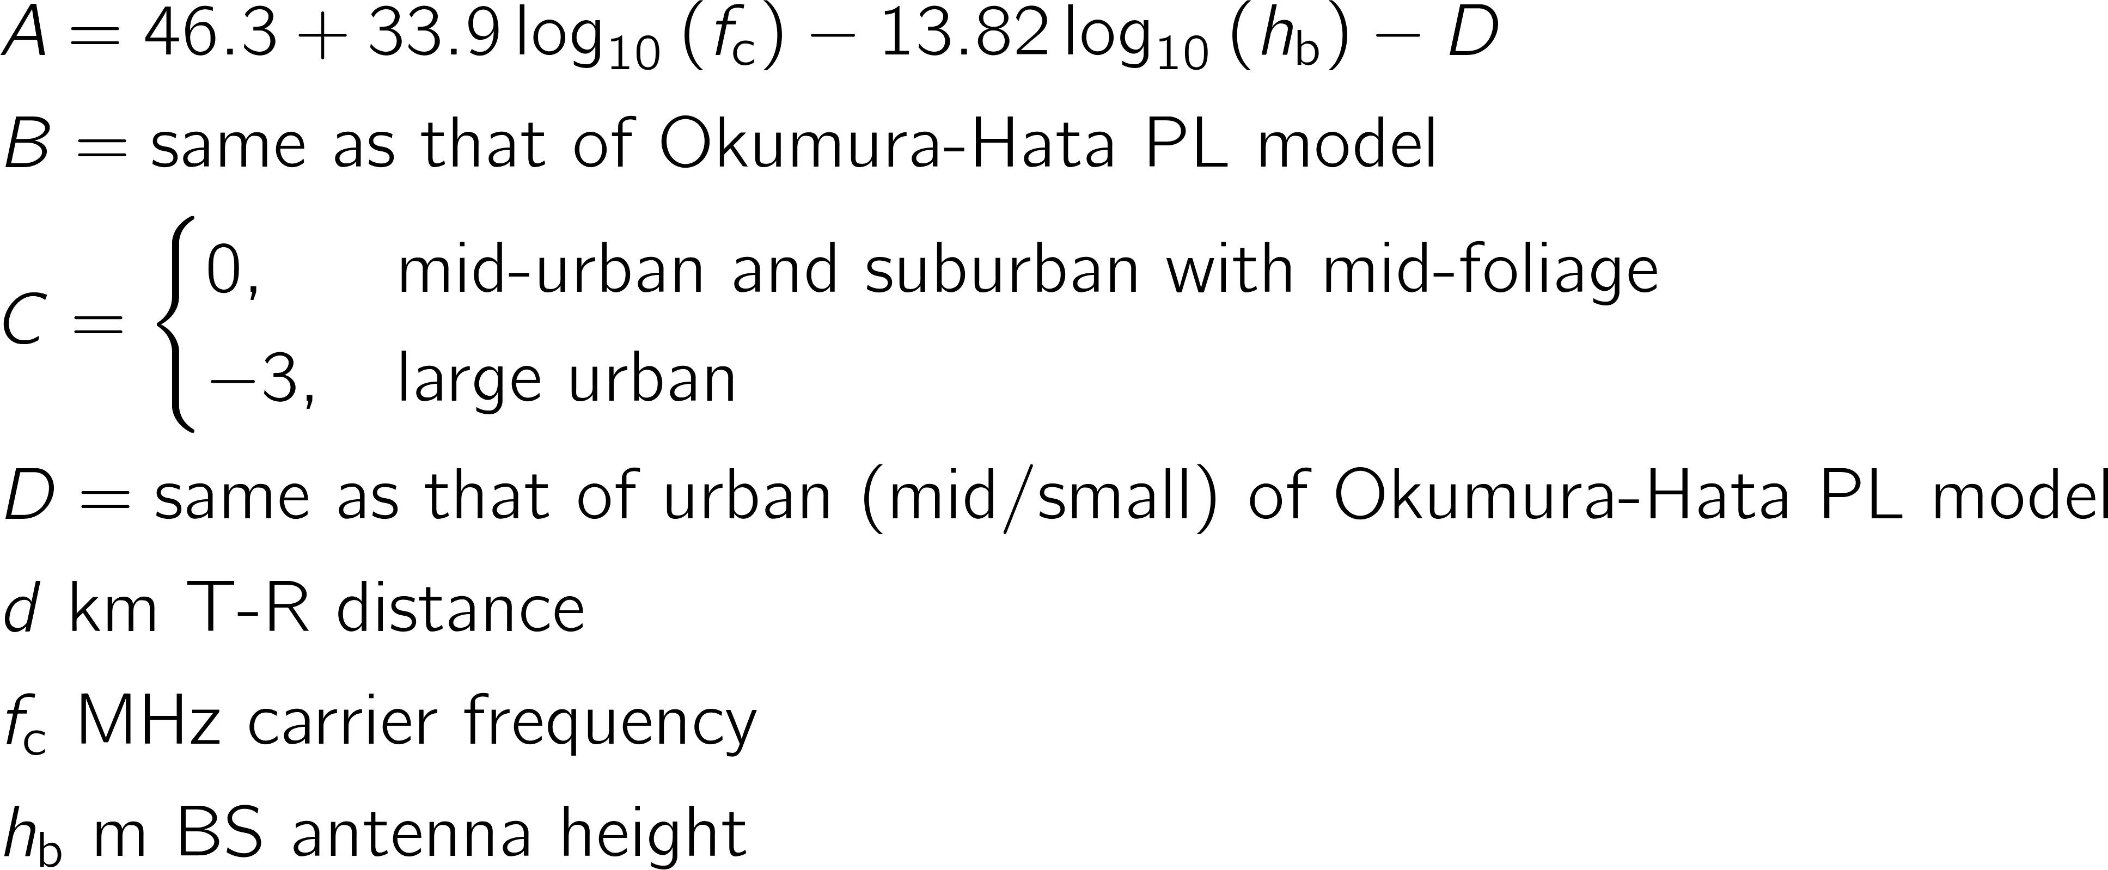
Cost 231-Hata Model
Frequencies: 1500-2400 MHz
Terrain: Urban, Suburban
Valid Collector Antenna Height: 30-200m
Valid Endpoint Antenna Height: 1-10m
Distance: 1-20 km
Equations courtesy of DCN-802.15-11-0507-00-004k

Slide 11
RF Path Loss Excel Spreadsheet
 | City |  |  |  | Suburban |  |  | Open Space
 | Hata Medium City (150-1500 MHz) | Hata Large City (150-200 MHz) | Hata Large City (200-1500 MHz) | COST Hata Large City (1500-2400 MHz) | Hata Suburban (150-200 MHz) | Hata Suburban (200-1500 MHz) | COST Hata Medium City/Suburban (1500-2400 MHz) | Hata Open Space (150-200 MHz) | Hata Open Space (200-1500 MHz) | Free Space
Antenna Height Correction Factor | -1.45 | -0.81 | -1.31 | -1.31 | x | x | -1.31 | x | x | x
Cost Correction Factor | x | x | x | 3.00 | x | x | 0.00 | x | x | x
Hata Path Loss | 160.22 | 159.58 | 160.08 | 165.99 | 146.71 | 147.20 | 162.99 | 125.98 | 126.48 | 93.58

Slide 12
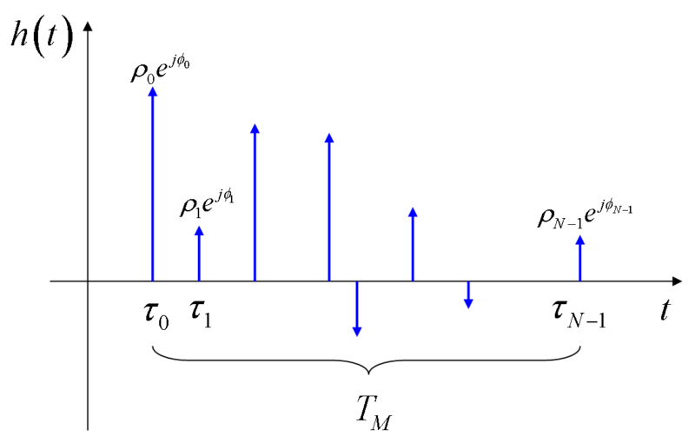
Channel Power Delay Profile
Multipath exists in any wireless system, but low data rate means long symbols which means delay spread << symbol duration
From analysis in DCN-802.15-11-0507-00-004k propose that PHYs need to be robust to delay spread up to 5 usec
Robustness can be left qualitative
E.g. long symbol times for narrowband modulation
E.g. RAKE receiver for DSSS

Slide 13
Channel Coherence Time
Coherence time is defined as the time over which the channel auto-correlation is non-zero, i.e. measures time-varying nature of channel
A robust PHY with low data rate will have long symbols, so it will not be expected that the channel is stationary over a PHY packet.
Symbol times should be < coherence time
Each packet should have some protection for this channel variation
It will be assumed that packets will be lost due to deep fades
There should be mechanisms at the MAC (or adaptation) layer to mitigate the loss of packets
Need to characterize the channel coherence times for the bands of interest, e.g. 900 MHz, 2.4 MHz, etc.
Coherence times for the LECIM channel are similar to stationary cellular channels.

Slide 14
Interference
Interference is problem at both the endpoint and collector sites (especially if elevated).
Interference is mostly caused from other closely located transmitters in or near the same band.
This is particularly true in unlicensed bands.
See DCN 15-11-0074-00-004k for more details for the US 2.4 GHz band
Proposals should consider the rejection of co-channel, adjacent channel, and broadband interference sources.
Potential Models
1 MHz broadband noise source with 10 dB Rise over thermal
100 KHz noise source with 10 dB rise over thermal
10 KHz noise source with 10 dB rise over thermal
Pulse jammers with a 250 usec duty cycle

Slide 15
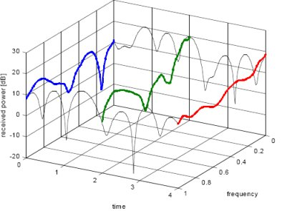
Changing Link Conditions
The wireless conditions change over time and this needs to be communicated between the collector and the endpoint.
Channel characteristics
Interference conditions
PHY proposals should be robust to dynamic wireless conditions
That robustness can be left qualitative
e.g. adaptation of modulation to changing link conditions, etc.

Slide 16
Varied Path Loss Between Endpoints
LECIM devices scattered over a large area
Possible loss range up to 80 dB between devices
Difference between devices close to the collector and the disadvantaged devices far from the collector
Proposals must be robust to large range of path losses
Robustness can be left qualitative
Robustness includes dealing with the near-far problem and potential hidden node problems

Slide 17
Conclusions
Identified Key Characteristics of LECIM Channel
Quantitative where necessary, qualitative where possible
Next Steps
Need to better understand power delay profiles for longer ranges and particular environments
Need to better understand channel coherence time
PHY proposals should address these characteristics for their particular design

