Slide 1
Project: IEEE P802.15 Working Group for Wireless Personal Area Networks (WPANs)
Submission Title: [LECIM High Gain DSSS PHY (preliminary proposal)]
Date Submitted: [19 July, 2011]
Source: [Ted Myers, David Howard, Sourav Dey] Company [On-Ramp Wireless, Inc.]
Address [10920 Via Frontera, Suite 200, San Diego, CA 92127, USA]
Voice:[+1(858)592-6008], FAX: [+1(858)592-6009], E-Mail:[ted.myers@onrampwireless.com, david.a.howard@ieee.org, sourav.dey@onrampwireless.com]
Re: [LECIM Call For Proposals, DCN: 0147-02]
Abstract: [Response to LECIM Call For Proposals, DCN: 0147-02]
Purpose: [Introduce a High Gain DSSS PHY proposal]
Notice: This document has been prepared to assist the IEEE P802.15. It is offered as a basis for discussion and is not binding on the contributing individual(s) or organization(s). The material in this document is subject to change in form and content after further study. The contributor(s) reserve(s) the right to add, amend or withdraw material contained herein.
Release: The contributor acknowledges and accepts that this contribution becomes the property of IEEE and may be made publicly available by P802.15.

Slide 2
802.15.4k PHY Proposal
7/19/2011

Slide 3
Outline
LECIM Optimizes for Connectivity not Throughput
Direct Sequence Spread Spectrum to get Link Budget
Block Diagram of Proposed PHY

Slide 4
Example LECIM Applications
Structural Integrity Monitoring
  Bridge Strain Gauge
  Dams
  Pipelines
High value asset location monitoring
  Container Tracking
  Nuclear Detection Sensor
  Construction equipment
Utility distribution/transmission monitoring
  Gas distribution
  Fault Circuit Indicator
  Transformer Monitor

Slide 5
LECIM Application Requirements
Hard to Reach Locations
  Underground Vaults, Basements, etc.
Need Low Cost Network
  Long range covering many devices
  Small collector to endpoint ratio
Small Daily Payload Requirements
  The “hope” is that you never hear from these devices in the first place.
  Even the 160 KB/day is adequate heart-beat and alarm messaging
Latency Tolerant
  Latency on order of 10s of seconds is sufficient
Infrequent Communications
  These devices are not very “chatty” – duty cycle is very low
  Closing the link reliably is more important than data rate

Slide 6
LECIM Priorities
Optimized for connectivity not throughput!
  Giving up data rate for link reliability
  Different direction than most other communication technologies which are optimized for throughput
Two obvious ways to optimize for connectivity
  Narrowband, Long symbols
  Spread Spectrum Wideband, Long symbols

Slide 7
Outline
LECIM Optimizes for Connectivity not Throughput
Direct Sequence Spread Spectrum to get Link Budget
Block Diagram of Proposed PHY

Slide 8

DSSS for LECIM
DSSS processing gain trades off data rate for link budget
Processing gain is equivalent to Tx power
Can demodulate signals with negative signal to noise ratio, e.g. GPS
General DSSS References
  Digital Communications: Fundamentals and Applications, Bernard Sklar.
  Wireless Communications, Andrea Goldsmith.
  Digital Communications, John G. Proakis.
E =$\int_{0}^{T}{P\left(t\right)dt}$

Slide 9
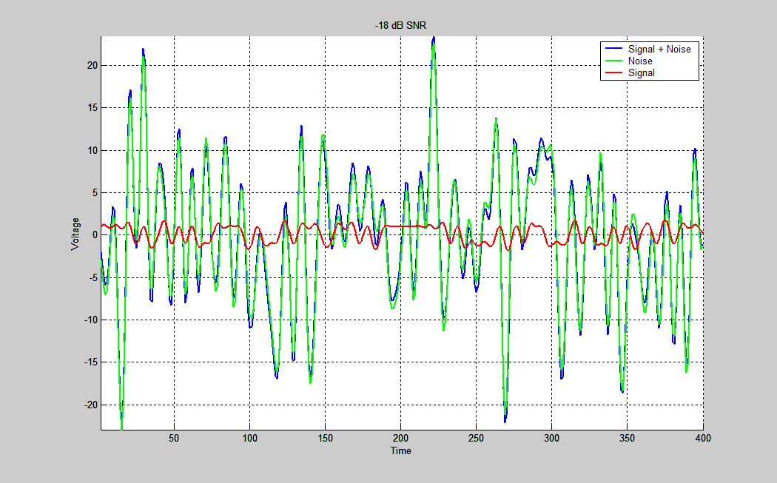
Visualization of Processing Gain -18dB SNR

Slide 10
Proposed Spreading Factors
Chips per Coding Symbol | Processing Gain (dB) | Required Carrier-to-Noise (dB) | Receiver Sensitivity @ kTb (dBm) | Data Rate
 |  |  |  | bits/sec | (KB/day)
16 | 12 | -9 | -118 | 31000 bps | 340000
32 | 15 | -12 | -121 | 16000 bps | 170000
64 | 18 | -15 | -124 | 8000 ms | 84000
128 | 21 | -18 | -127 | 4000 bps | 42000
256 | 24 | -21 | -130 | 2000 bps | 21000
512 | 27 | -24 | -133 | 1000 bps | 11000
1024 | 30 | -27 | -136 | 500 bps | 5300
2048 | 33 | -30 | -139 | 250 bps | 2600
4096 | 36 | -33 | -142 | 120 bps | 1300
8192 | 39 | -36 | -145 | 60 bps | 660
16384 | 42 | -39 | -148 | 30 bps | 330
32768 | 45 | -42 | -151 | 15 bps | 160
Reference receiver characteristics: Post De-spread SNR = 3 dB, 5 dB Noise Figure

Slide 11
15.4k Channel Model Prediction for
3 Scenarios at 2.4 GHz ISM Band using Hata
Scenario 1: Utility Pole Height Into Basement
  1 km radius of coverage, Suburban
Scenario 2: Rooftop Height into Underground Vault
  200 meters radius of coverage, Suburban
Scenario 3: Mountain Top into Remote Areas
  20 km radius of coverage, Open space
Results generalized to the following power levels:
36 dBm - maximum EIRP allowed in North America
10 dBm – maximum EIRP allowed in many regions
25 dBm – typical EIRP of a battery operated device
Ref: https://mentor.ieee.org/802.15/dcn/11/15-11-0464-00-004k-tg4k-hata-channel-model-worksheet.xlsx

Slide 12
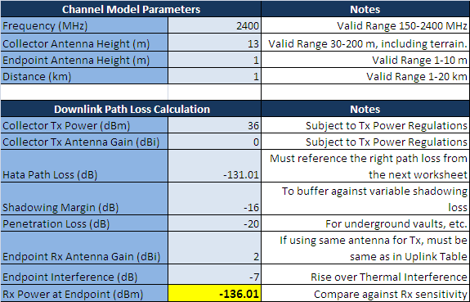
Scenario 1: Utility Pole Height Into Basement 1 km radius
36 dBm EIRP – requires -136 dBm RX sensitivity.,30 dB of processing gain (1024 chips per coding symbol).
25 dBm EIRP – requires -147 dBm RX sensitivity, 42 dB of processing gain (16384 chips per coding symbol).
10 dBm EIRP – requires -162 dBm RX sensitivity, 57 dB of processing gain (oh well…can’t have it all!).

Slide 13
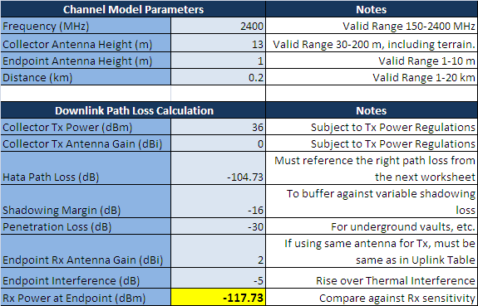
Scenario 2: Rooftop height into underground vault, 200 meters radius
  36 dBm EIRP – requires -118 dBm RX sensitivity, 12 dB of processing gain (16 chips per coding symbol).
  25 dBm EIRP – requires -129 dBm RX sensitivity, 24 dB of processing gain (256 chips per coding symbol).
  10 dBm EIRP – requires -144 dBm RX sensitivity, 39 dB of processing gain (8192 chips per coding symbol).

Slide 14
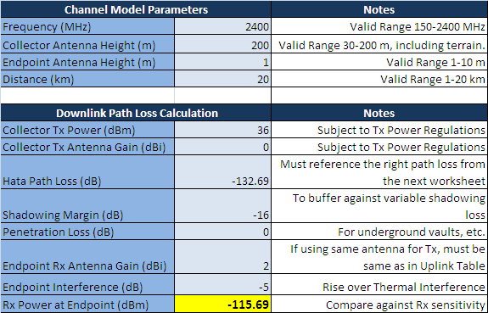
Scenario 3: Mountain top into remote areas, 20 km radius
  36 dBm EIRP – requires -116 dBm RX sensitivity. 12 dB of processing gain (16 chips per coding symbol).
  25 dBm EIRP – requires -127 dBm RX sensitivity. 21 dB of processing gain (128 chips per coding symbol).
  10 dBm EIRP – requires -142 dBm RX sensitivity. 36 dB of processing gain (4096 chips per coding symbol).

Slide 15
Outline
LECIM Optimizes for Connectivity not Throughput
Direct Sequence Spread Spectrum to get Link Budget
Block Diagram of Proposed PHY

Slide 16
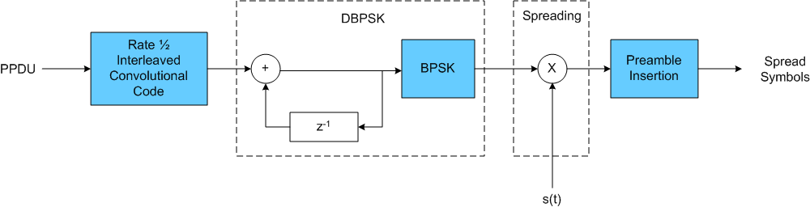
Modulator Block Diagram
1 MHz Chip Rate
Spreading Factors from SF16-SF32768
Agnostic to any frequency band with 1MHz of spectrum

Slide 17
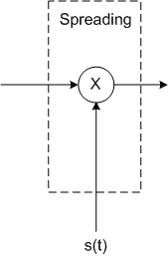
Spreading Codes
Large space of parameterized PN sequences
  e.g. Gold Code
Can use different PN sequences to separate
  Different Networks → Network Coexistence
  Different Collectors → Multiple Collectors on Network
  Different Endpoints → Multiple Endpoints on Collector
  Different Spreading Factors →
Mitigates hidden node problem
  Receiver isn’t constantly locking onto and missing it’s own signal by mistakenly trying to demodulate other system’s signals.

Slide 18
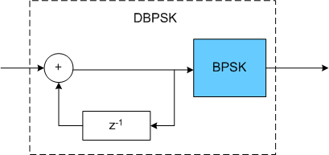
Differential Demodulation
Binary Phase Shift Keying (BPSK)
  Higher order modulation, like QAM, undoes processing gain by requiring much higher SNR
Differential modulation
  Allows the option of building a simple non-coherent receiver with a 3dB loss of receiver sensitivity relative to coherent BPSK
  Advanced receivers can implement coherent demodulation to get back 3dB

Slide 19

Rate ½ Convolutional Code with Interleaving
Rate ½ Convolutional Code
  Boosts receiver sensitivity relative to un-coded D-BPSK
  Standard code that has simple Viterbi decoder
Interleaving + Coding
  Makes reception robust to bursty interference events
  Makes reception robust to brief channel nulls

Slide 20

Preamble
Spread Preamble
  The preamble is spread with PN code
  Can be same PN code as PPDU or completely different
  Composed of same number of un-spread symbols
  Gets proportionally longer with larger spreading factors
Uses of the Preamble
  Frequency recovery
  Timing recovery
  Channel estimation
  Can be used to implement synchronous network

Slide 21
Other LECIM Considerations
Multipath Mitigation
  RAKE receiver with MRC is known to do a good job for DSSS
  Advanced receivers can use more sophisticated techniques
Coherence Time Mitigation
  Interleaved FEC provides each PPDU with protection
  Fragmentation and reassembly at next layer can help
Interference
  DSSS provides robust co-channel and adjacent channel rejection to all sorts of interference, wideband, narrowband, pulsed

Slide 22
Other LECIM Considerations
Link Asymmetry
  LECIM links can have asymmetric interference and transmit power between collector and endpoint
  Can use spreading factor selection to balance the link budget between uplink and downlink
Changing Link Conditions
  Spreading factors (and transmit power) can adapt dynamically as channel and interference conditions change
  Need a mechanism to communicate local channel and interference conditions
  Channel reciprocity can help, i.e. at any time the TX->RX channel is the same as the RX->TX channel
Varied loss between endpoints
  Spreading factor selection can adapt so endpoints use minimum necessary spreading factor
Battery Life
  Adaptive spreading factor selection minimizes the Tx time
  Synchronization of powered collectors to battery powered end-points can further help

Slide 23
Thanks for your Attention!
Any Questions?

