Slide 1
Project: IEEE P802.15 Working Group for Wireless Personal Area Networks (WPANs)
Submission Title: [Current situation in 2.4GHz ISM band]
Date Submitted: [20 July, 2011]
Source: [Shoichi Kitazawa] Company [ATR]
Address [2-2-2 Hikaridai Seika, Kyoto 619-0288 Japan]
Voice:[+81-774-95-1511], FAX: [+81-774-95-1508], E-Mail:[kitazawa@atr.jp]
Re: []
Abstract: [In order to understand congestion situation in 2.4GHz ISM band, spectrum use at Airport and home environment has been taken.]
Purpose: [For discussion]
Notice: This document has been prepared to assist the IEEE P802.15. It is offered as a basis for discussion and is not binding on the contributing individual(s) or organization(s). The material in this document is subject to change in form and content after further study. The contributor(s) reserve(s) the right to add, amend or withdraw material contained herein.
Release: The contributor acknowledges and accepts that this contribution becomes the property of IEEE and may be made publicly available by P802.15.

Slide 2
Current situation in 2.4 GHz ISM band
Authors:

Slide 3
Introduction
2.4GHz ISM band is getting more and more crowded.
We have reported how the high load traffic situation conflict and make unused spectrum resources, that was measured in anechoic chamber. (15-10-0886 )
In this presentation we show how the 2.4GHz ISM band is crowded in following places.
  typical transportation facilities
  conference room at IEEE802 meeting room
  residential environment in Japan.

Slide 4
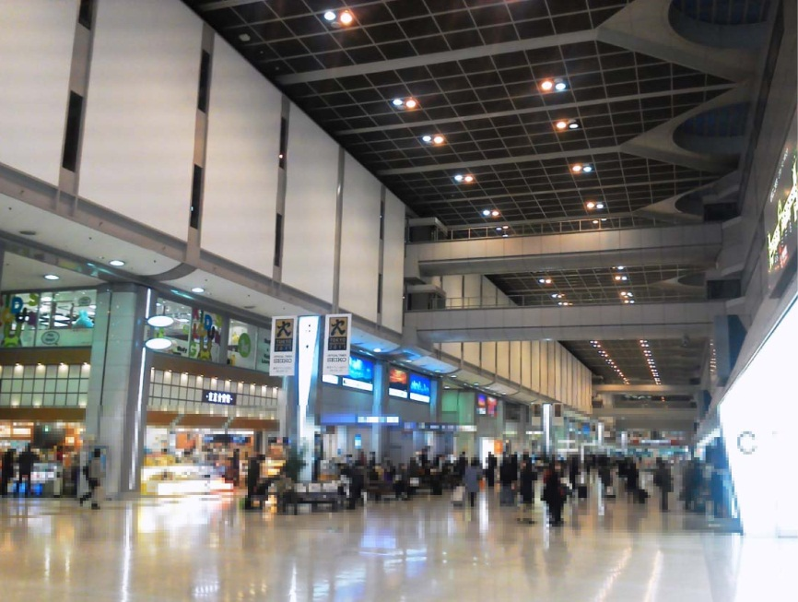
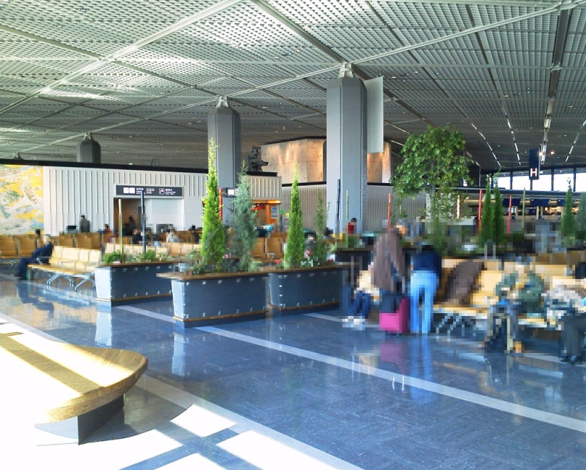
Airport environment
Haneda and Narita Airport were selected.
  Haneda 61million passengers/Year
  Narita 30million passengers/Year
Haneda Departure Lobby
Narita Departure Lobby

Slide 5
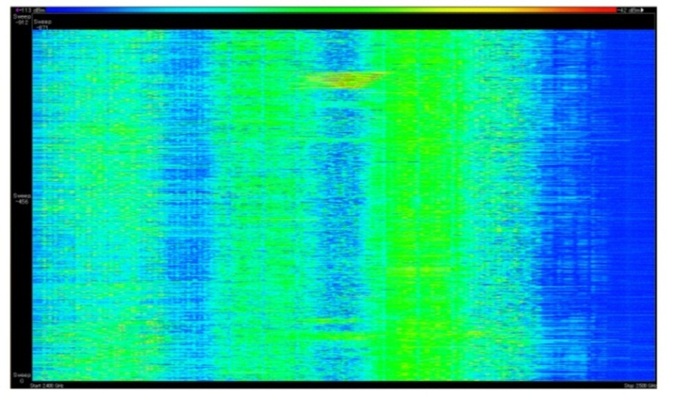
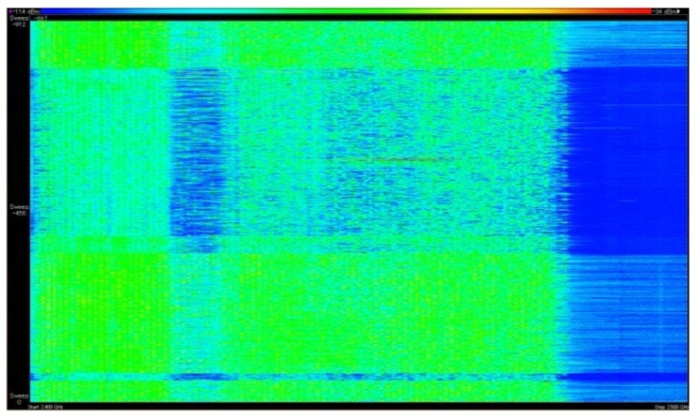
Measurement results at Airport
Number of AP and STA counted in 15 minutes
  In Haneda, 150 AP’s and 220 STA’s
  In Narita 50 AP’s and 400 STA’s
-114dBm
Signal strength
-34dBm
-114dBm
Signal strength
-34dBm
10:00
16:00
Time
Time
10:15
16:15
2.4GHz
Frequency
2.5GHz
2.4GHz
Frequency
2.5GHz
Haneda Departure Lobby
Narita Departure Lobby

Slide 6
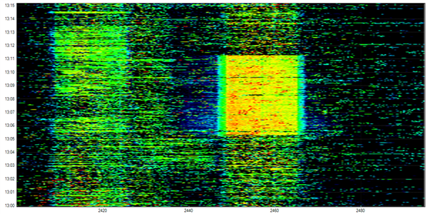
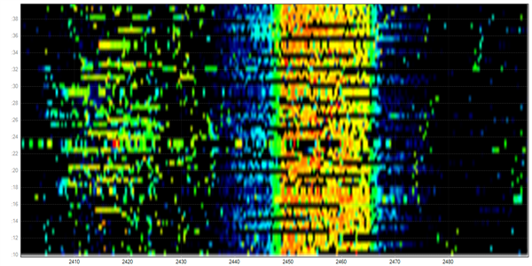
Measurement results at Airport lounge
Lounge at boarding area was measured.
  21 AP’s were counted
  CH 1, 2, 4, 6, 9,10, 11
13:15
30 sec
13:00
2.4GHz
Frequency
2.48GHz
2.4GHz
Frequency
2.48GHz

Slide 7
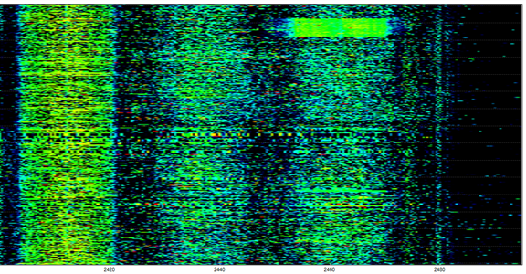
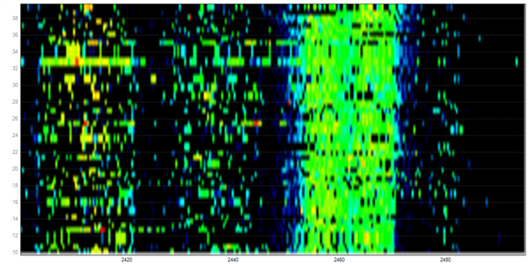
Measurement results at the conference room
WG15 opening plenary meeting was measured.
  19AP’s were counted
  CH 1, 6, 7,11
11:47
11:32
2.4GHz
Frequency
2.48GHz
2.4GHz
Frequency
2.48GHz

Slide 8
Residential area
There are about 20 houses and apartment houses within a 50-meters radius.

Slide 9
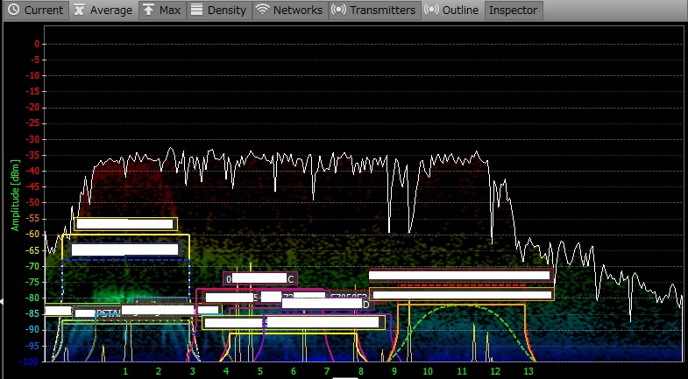
Measurement results at
Home environment
There was not high traffic load at this time.
Various systems were observed.
  FH systems (codeless telephone and other system)
  WLAN 15 AP’s at CH1, 2, 5, 6, 7, 11.
Max Hold
20 minutes of density

Slide 10
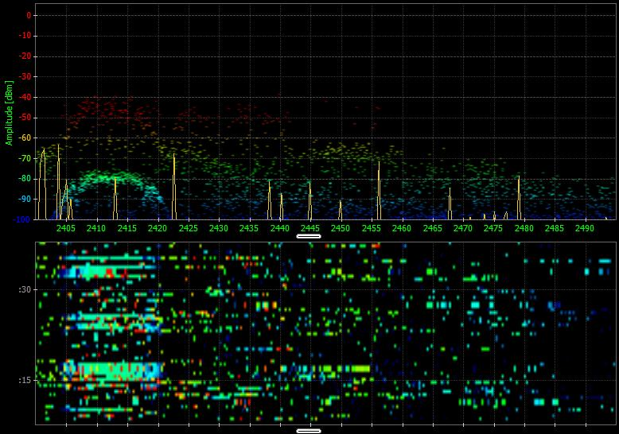
Measurement results at
Home environment (cnt’d)
30 sec
2.4GHz
Frequency
2.48GHz
30 second spectrum use

Slide 11
Conclusions
High traffic situation was observed in airport area and IEEE 802 conference room.
In a residential area, many AP’s and other system can be found.
  This result suggest that ISM band at residential area will be more crowded near future.
Acknowledgment
This work is supported by the Ministry of Internal Affairs and Communications under a grant “Research and development on radio resource control technologies among multiple radio systems on same frequency band.”

