Slide 1
Project: IEEE P802.15 Working Group for Wireless Personal Area Networks (WPANs)
Submission Title: [Path loss and Power Delay Profile Models for 802.15 TG4k]
Date Submitted: [18 July, 2011]
Source: [Lawrence Materum, Hirokazu Sawada, and Shuzo Kato] Company [RIEC, Tohoku University]
Address [2-1-1 Katahira, Aoba-ku, Sendai 980-8577, Japan]
Voice:[:[+81-22-217-5477], FAX: [+81-22-217-5476], E-Mail:[lawrence@riec.tohoku.ac.jp]
Re: [Call for Proposals (15-11-0147-02) 10 May, 2011]
Abstract: [Applicable channel models for TG4k are proposed to be adopted for system evaluations.]
Purpose: [Bring the channel modeling information to the attention of TG4k for discussion and adoption for system evaluations.]
Notice: This document has been prepared to assist the IEEE P802.15. It is offered as a basis for discussion and is not binding on the contributing individual(s) or organization(s). The material in this document is subject to change in form and content after further study. The contributor(s) reserve(s) the right to add, amend or withdraw material contained herein.
Release: The contributor acknowledges and accepts that this contribution becomes the property of IEEE and may be made publicly available by P802.15.

Slide 2
Summary (1)
Proposed channel models for 802.15.4k system evaluations as first cut:
For the 900 MHz band:
Path loss: Okumura-Hata
Power delay profile: Modified COST 207
For the 2.4 GHz band:
Path loss:
COST 231-Hata for 30-200 m BS antenna height
Erceg for 10-80 m BS antenna height; 8 km range limitation
Power delay profile: Modified IMT-Advanced

Slide 3
Summary (2)
Transmission range limitation of the power delay profile models based on the published measurements:
~10 km for the 900 MHz band
~5 km for the 2.4 GHz band
Power delay profile models would be important in designing preamble/synchronization of spread spectrum systems
Much higher clock signals must be used for synchronization
Robust synchronization/preamble design may take longer preamble and result in poor throughput in TG4k applications, in which very short data are transmitted intermittently

Slide 4
Contents
Path loss and power delay profile models
For the 900 MHz band
For the 2.4 GHz band
Things to consider
Conclusion
References

Slide 5
1. Path loss and power delay profile models for the 900 MHz band

Slide 6
Survey of applicable range of path loss models for the 900 MHz band

Slide 7
Okumura-Hata Path Loss Model (for the 900 MHz band)
Components/inputs:
Frequency, distance, antenna heights
Correction factor for MS antenna height:
For large or medium-to-small cities
Scenario types:
Urban, suburban, open
Unsuitable for hilly &/or full foliage terrains

Slide 8
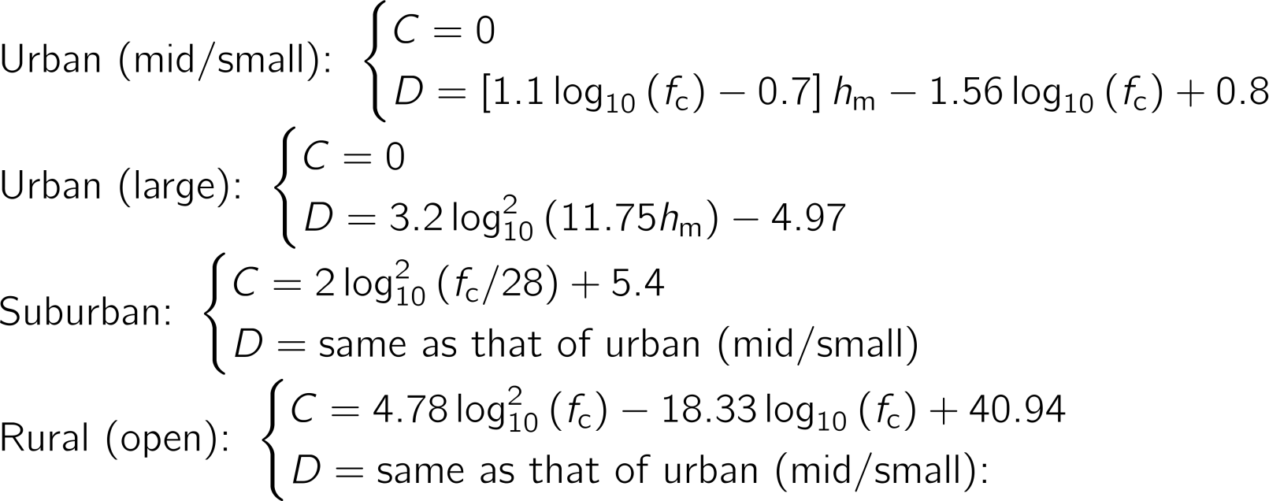
Okumura-Hata Path Loss Parameters (for the 900 MHz band)

Slide 10
Survey of applicable range of power delay profile models for the 900 MHz band

Slide 11
COST 207 GSM typical continuous power delay profile (PDP) models
Rural Area:
Hilly Terrain:
Typical Urban:
Bad Urban:

Slide 12
COST 207 PDP Model with Doppler spectrum for fixed wireless links
The time varying channel is implemented through a tapped delay line filter:
The PDP tap settings are obtained in COST 207 [10] based on the scenario (example in next slide)
Instead of using the Jakes spectrum (uniform scattering), the following is usable for fixed links [7]

Slide 13
COST 207 typical case PDP for rural (non-hilly) area [10]
Tap No. | Delay (τ) [μs] | Power [dB]
1 | 0 | 0
2 | 0.2 | -2
3 | 0.4 | -10
4 | 0.6 | -20
Next slide shows the fading coefficients of each delay assuming 2 m/s wind speed
Maximum Doppler frequency ( ): 6 Hz
Carrier frequency: 900 MHz

Slide 15
2. Path loss and power delay profile models for the 2.4 GHz band

Slide 16
Survey of applicable range of path loss models for the 2.4 GHz band

Slide 17
Adoptable path loss models for the 2.4 GHz band
COST 231-Hata for 30 to 200 m BS antenna height
Erceg for 10 to 80 m BS antenna height

Slide 18
COST 231-Hata Path Loss Model (for the 2.4 GHz band, 30-200 m BS antenna height)
Components/inputs:
Frequency, distance, antenna heights
Includes constant (3 dB for metropolitan areas)
Based on extensive measurement campaigns in European cities
Mostly for flat urban scenarios
BS antenna heights above roof-top levels adjacent to the BS

Slide 19
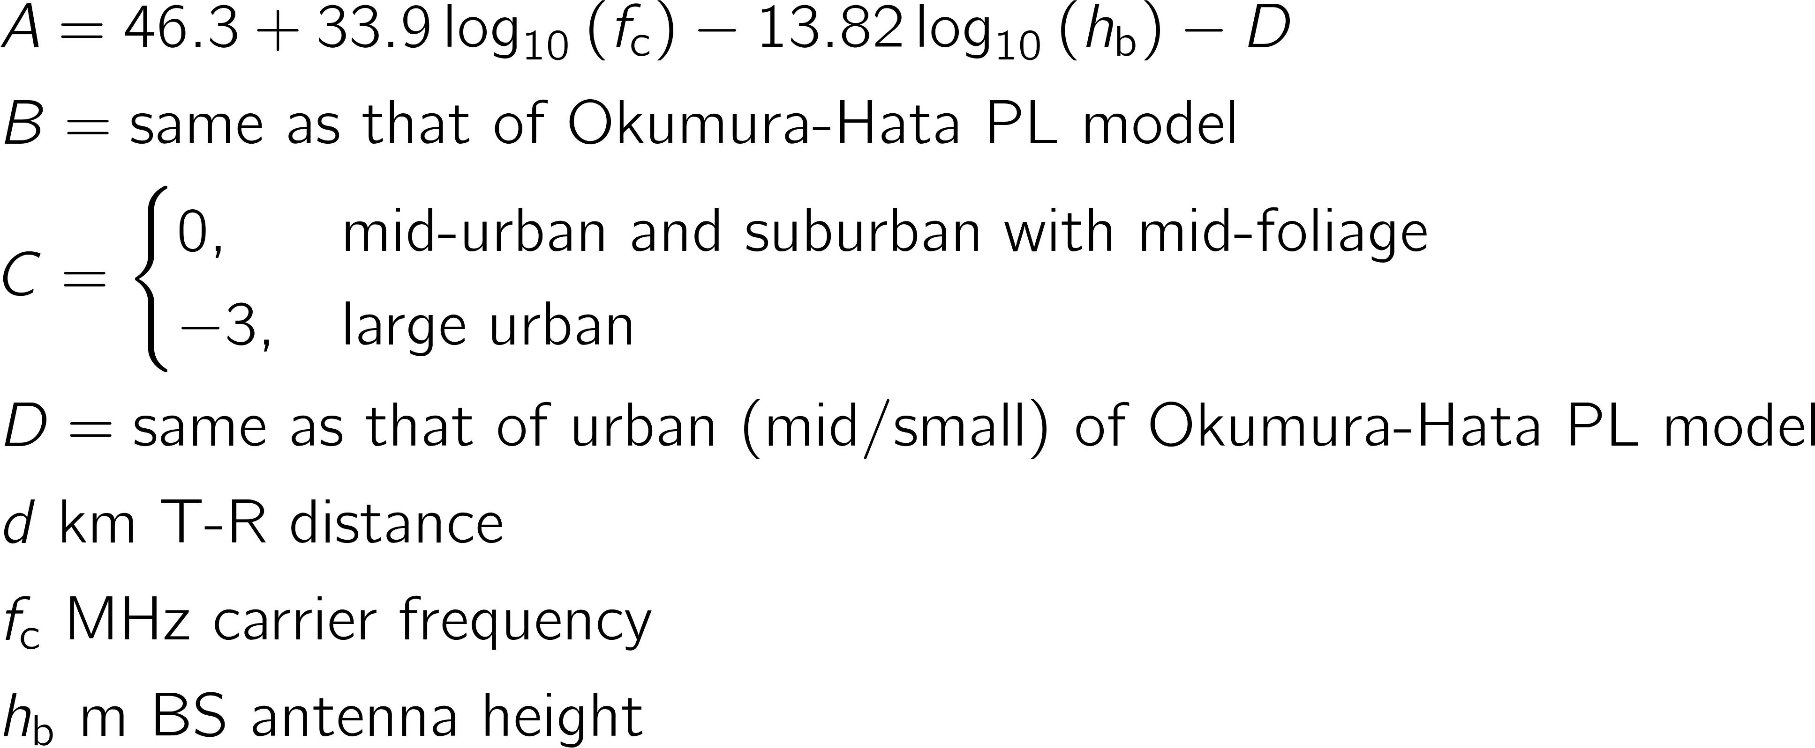
COST 231-Hata (for the 2.4 GHz band) Path Loss Model Parameters

Slide 20
Erceg Path Loss Model (for the 2.4 GHz band, 10-80 m BS antenna height)
Components/inputs:
Frequency, distance, antenna heights
Has a correction for between 2-10 m MS height
Shadowing
Scenarios according to PL condition:
Max. (hilly), mid, min. (light foliage, flat area)
Represents median path loss + variation

Slide 21
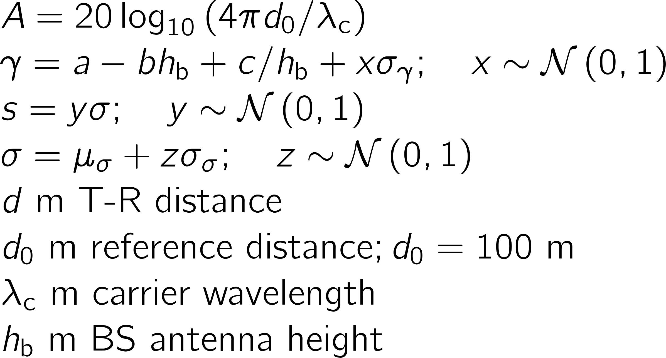
Erceg (for the 2.4 GHz band) Path Loss Model Parameters

Slide 22
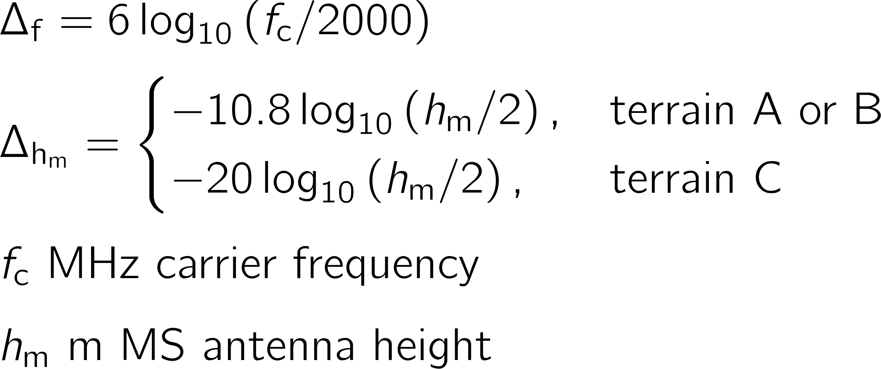
Path Loss Correction [7] for between 2 to 10 m MS antenna height of the Erceg Path Loss Model

Slide 23
COST 231-Hata Suburban Model is close to the Erceg Terrain A Model (h_{b} = 30 m)

Slide 24
h_{b} = 80 m

Slide 25
Survey of applicable range of power delay profile models for the 2.4 GHz band

Slide 26
ITU-R IMT-Advanced Power Delay Profile Models
Primary module PDP is a single slope exponential
Extension module PDP additionally accounts for:
Bandwidth
Street width
Building height

Slide 27
Things to consider

Slide 28
Lacking Power Delay Profile Models: underground endpoint and longer transmission range for TG4K scenarios
Power delay profile models for underground endpoint scenarios
The power delay profile models have a transmission range limitation based on the published measurements:
~10 km for the 900 MHz band
~5 km for the 2.4 GHz band

Slide 29
1. Channel modeling for underground endpoints
Most of the surveyed channel models are for mobile communications, and can be applied for TG4k: needs clarification
Scenario conditions:
Shadowing and scattering due to vehicular traffic
Seasonal conditions such as
Snow on top of man hole/underground meter
Light or full foliage

Slide 30
2. Extending the existing PDP models to longer transmission range
Existing literature appears to have not addressed the range dependency of power delay profile models
Could the delay could be scaled in order to accommodate the transmission range of ~16 km?
Assuming the scaling is physically meaningful/correct, the following slides show the simulation of the delay spread

Slide 31
Delay spread simulation (1)
Modified power delay profile models were scaled to cover the ~16 km transmission range and implemented as tapped delay line
For the 900 MHz band: COST 207 Typical Urban and Typical Rural Area PDPs
For the 2.4 GHz band: IMT-Advanced NLoS Urban Macrocell and NLoS Rural Macrocell PDPs
A Doppler spectrum for fixed links [7] was used, assuming 2 m/s wind speed

Slide 32
Delay spread simulation (2)
 | Maximum delay spread [μs]
 | At 5 km | At 11 km | At 16 km
900 MHz | 1.2 | 3.5* | 5.1*
2.4 GHz | 0.8 | 3.3* | 4.7*
* Extended PDP model to accommodate longer transmission range
Transmission range limitation of the PDP models:
COST 207 for the 900 MHz band: up to 10 km
IMT-Advanced for the 2.4 GHz band: ~5 km

Slide 33
A comparison with the channel model proposal [15, 16]
900 MHz band
2.4 GHz band
Channel Model | [15, 16] | RIEC
Path loss | Okumura-Hata | Okumura-Hata
Power delay profile | - | Modified COST 207
Channel Model | [15, 16] | RIEC
Path loss | COST 231-Hata | COST 231-Hata and Erceg
Power delay profile | - | Modified ITU-R IMT-Advanced

Slide 34
Conclusion (1)
The following channel models can be adopted for TG4k system evaluations:
900 MHz band
Path loss : Okumura-Hata
Power delay profile : Modified COST 207 GSM
2.4 GHz band
Path loss :
- COST 231-Hata for 30-200 m collector antenna height
- Erceg for 10-80 m collector antenna height; 8 km range
Power delay profile : Modified ITU-R IMT-Advanced

Slide 35
Conclusion (2)
Existing power delay profile models have transmission range limitations:
~10 km for the 900 MHz band
~5 km for the 2.4 GHz band
Power delay profile models: important in designing robust preamble/synchronization of TG4k spread spectrum systems
Robust preamble design may take longer preamble and result in poor throughput in TG4k applications, wherein very short data are transmitted intermittently

Slide 36
References (1)
[1] G. A. Hufford, A. G. Longley, and W. A. Kissick, “A guide to the use of the its irregular terrain model in the area prediction model,” NTIA Rep. 82-100, Apr. 1982
[2] M. Hata, “Empirical formula for propagation loss in land mobile radio services,” IEEE Trans. Veh. Technol., vol. 29, pp. 317–325, Aug. 1980.
[3] W. C. Y. Lee, Mobile Communications Engineering. New York: McGraw-Hill, 1982.
[4] ITU-R, “Guidelines for evaluation of radio interface technologies for IMT-2000,” Recommendation ITU-R M.1225, Feb. 1997.
[5] E. Damosso and L. M. Correia, Eds., COST Action 231–Digital Mobile Radio Towards Future Generation Systems. Luxembourg: European Communities, 1999.
[6] V. Erceg et al., “An empirically based path loss model for wireless channels in suburban environments,” IEEE J. Sel. Areas Commun., vol. 17, pp. 1205–1211, Jul. 1999.
[7] ——, “Channel models for fixed wireless applications,” IEEE 802.16a-03/01, Jun. 2003.
[8] ITU-R, “Guidelines for evaluation of radio interface technologies for IMT-Advanced,” Rep. ITU-R M.2135-1, Dec. 2009.
[9] ETSI, “UMTS; Spacial channel model for MIMO simulations,” ETSI TR-125-996-V9.0.0, Jan. 2010.
[10] M. Failli, Ed., COST 207–Digital Land Mobile Radio Communications. Luxembourg: European Communities, 1989.
[11] V. Erceg et al., “A model for the multipath delay profile of fixed wireless channels,” IEEE J. Sel. Areas Commun., vol. 17, pp. 399–410, Mar. 1999.

Slide 37
References (2)
[12] L. Correia, Ed., Wireless Flexible Personalised Communications. Chichester: Wiley, 2001.
[13] A. Molisch, H. Asplund, R. Heddergott, M. Steinbauer, and T. Zwick, “The COST 259 directional channel model—part I: Overview and methodology,” IEEE Trans. Wireless Commun., vol. 5, pp. 3421–3433, Dec. 2006.
[14] H. Asplund, A. Glazunov, A. Molisch, K. Pedersen, and M. Steinbauer, “The COST 259 directional channel model—part II: macrocells,” IEEE Trans. Wireless Commun., vol. 5, pp. 3434–3450, Dec. 2006.
[15] S. Dey, “802.15.4k LECIM channel characteristics,” IEEE 15-11-0465-00-004k, Jul. 2011.
[16] ——, “TG4k Hata channel model worksheet,” IEEE 15-11-0464-00-004k, Jul. 2011

