Slide 1
Project: IEEE P802.15 Working Group for Wireless Personal Area Networks (WPANs)
Submission Title: [Simulation Resultsfor Adjacent Channel Interference on MBAN bands]
Date Submitted: [7-Nov−2011]
Source: [Liang Li, Zhang Liang, Ning Li, ShaiTu ] Company: [Vinno Technologies Inc., BUPT]
Address: [Suite 202, Building D, No.2 Shangdi Xinxi Lu, Beijing 100085, China]
Voice:[86 25 83794525 8610-82782373, ], FAX: [8610-82893004]
E−Mail: xpp@seu.edu.cn[liangli@vinnotech.com，xpp@seu.edu.cn]
Re: [802.15.4J]
Abstract: [ ]
Purpose: [To encourage discussion in 802.15.4J]
Notice: This document has been prepared to assist the IEEE P802.15. It is offered as a basis for discussion and is not binding on the contributing individual(s) or organization(s). The material in this document is subject to change in form and content after further study. The contributor(s) reserve(s) the right to add, amend or withdraw material contained herein.
Release: The contributor acknowledges and accepts that this contribution becomes the property of IEEE and may be made publicly available by P802.15.

Slide 2
Physical Layer
Channelization Plan
2360.5
2360 MHz
For in-hospital deployment
  14 channels defined to promote coexistence with AMT
  Non-overlapping channels will be used in 2360-2390 MHz band
For out-of-hospital deployment
  Overlapping channels in 2390–2400 MHz band offers flexibility to avoid interference
  Low deployment density and low duty cycle will assist MBANS coexistence
2400
2399.5 MHz
7 (2367)
8(2372)
9 (2377)
10 (2382)
11 (2387)
12 (2392)
13 (2397)
14 (2395)
0 (2363)
1 (2368)
2 (2373)
3 (2378)
4 (2383)
5 (2388)
6 (2393)
2360 MHz
2390 MHz
2400 MHz
Guard bands
AMT spectrum
15.4j channels
Amateur radio spectrum

Slide 3
Adjacent channel Inference
For home (or out-of-hospital) deployment, since only 10MHz (2390-2400 MHz) spectrum is available and some guard band is needed at band edge. Since there is 1 MHz overlap between Channel 14 and 12,and 3 MHz overlap between 13, 6 and 14. There might be some performance loss due to such overlap.

Slide 4
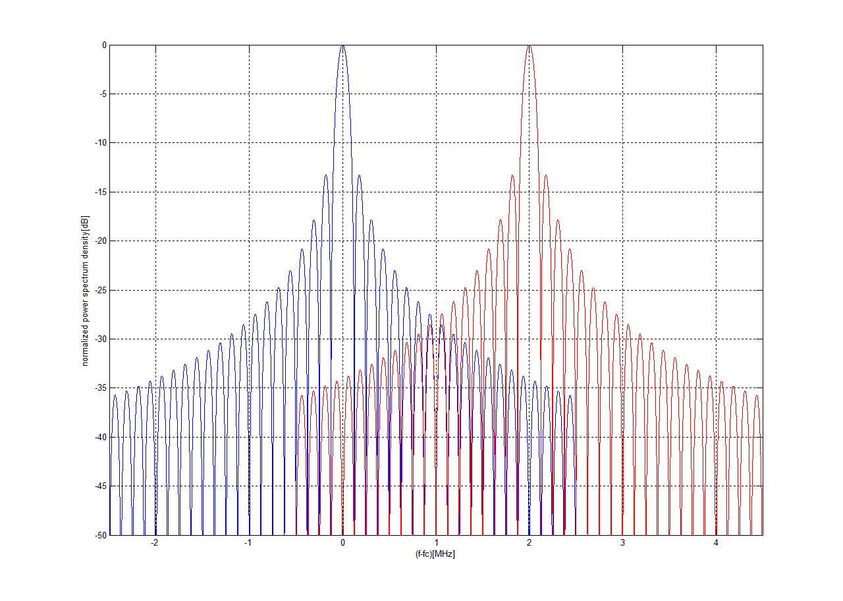
SIR according to overlapping channels
On both of channel transceivers transmit on same power level.
Adjacent channel ：channel 6, or 13 (left)
Interference
Channel 14 (right)
Desired Signal
SIR(dB)= P_{s}/P_{i}(dB)
=~0.022(dB)
P_{i}
P_{s}

Slide 5
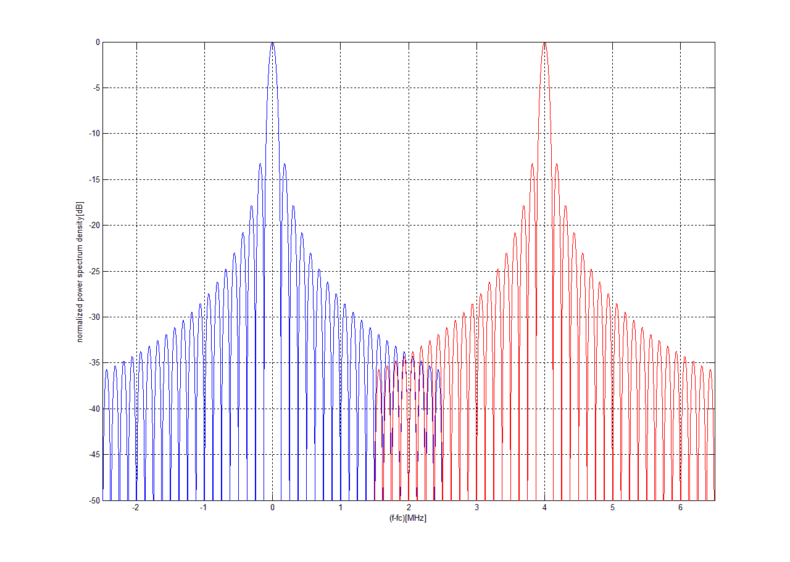
SIR according to overlapping channels
On both of channel transceivers transmit on same power level.
Adjacent channel ：channel 12 (left)
Interference
Channel 14 (right)
Desired Signal
SIR(dB)=P_{s}/P_{i}(dB)
=~28.539(dB)
P_{i}
P_{s}

Slide 6
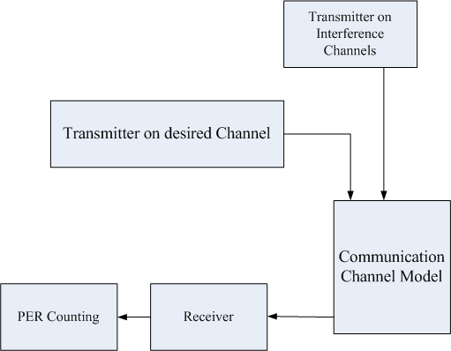
Communication Analysis of Desired Channel (PER) with the Adjacent Inferences
Simulation :
    On Channel 14, one desired signal is transmitted, and the PER is counted and analyzed on receiver.
    The individual transmitter operates on Channel 6,13 and 12. All of transmitters keep the same power levels.

Slide 7
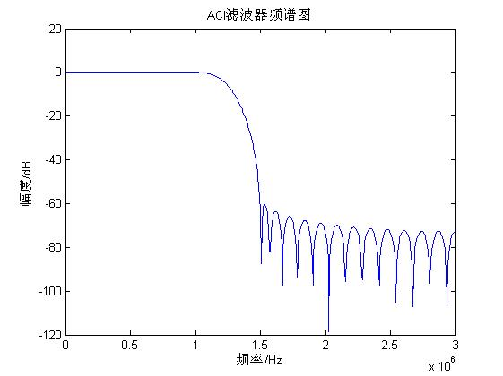
ACI Simulation Model
    One 44-tap FIR filter moves out the parts of Tx ( from Adj Channel) beyond major Channel

Slide 8
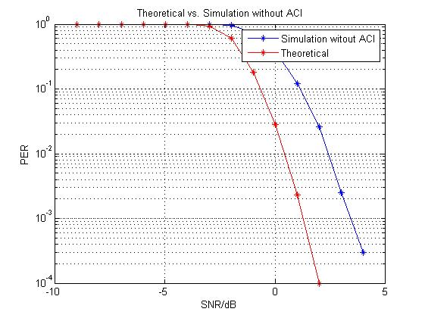
Simulation Results
Without Channel Inference.

Slide 9
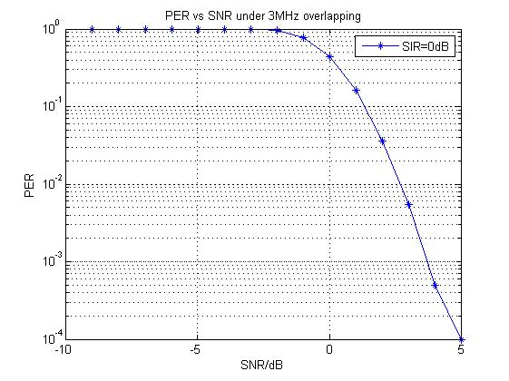
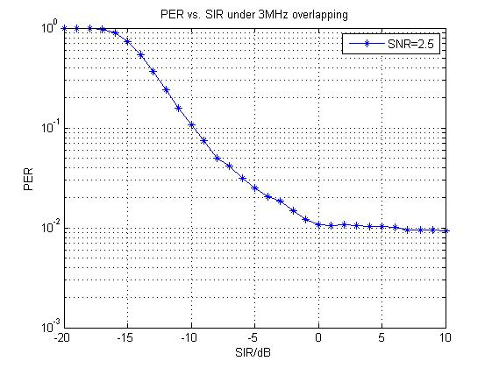
Simulation Results
Add the interference from Adjacent Channel (such as on Chn 6, 13)
Suppose the receiver on Channel 14, as SIR=0dB, the PER vs SNR is on left Figure. As SNR=2.5dB, the Per = 10^-2.
Set SNR=2.5dB, the right picture is the PER vs SIR.

Slide 10
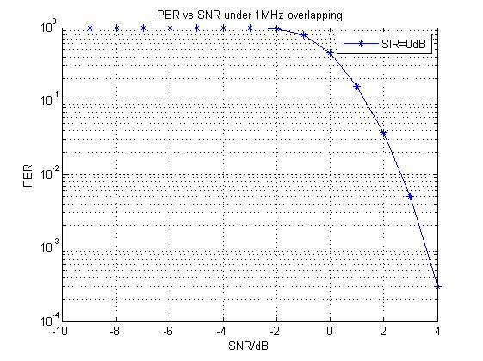
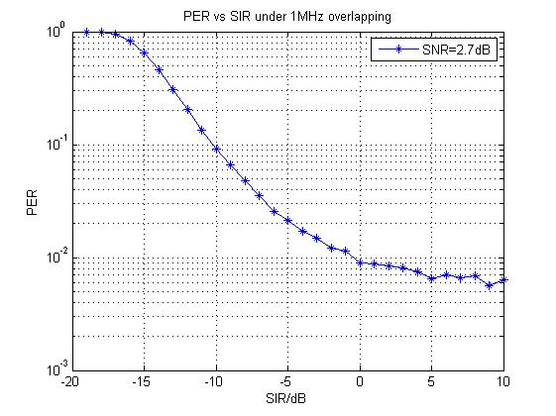
Simulation Results
Add the interference from Adjacent Channel (such as on Chn 12)
Suppose the receiver on Channel 14, as SIR=0dB, the PER vs SNR is on left Figure. As SNR=2.7dB, the Per = 10^-2.
Set SNR=2.7dB, the right picture is the PER vs SIR.

Slide 11
Questions

