Slide 1
Project: IEEE P802.15 Working Group for Wireless Personal Area Networks (WPANs)
Submission Title: [Issue and Challenges for LED-ID]
Date Submitted: [11 July, 2010]
Source: Yeong Min Jang, Sunwoong Choi, Nam Tuan Le, Muhammad Shahin Uddin, Bui Minh Trung, Jin Young Kim, Jaesang Cha, Kyesan Lee]
[Kookmin University, Kwangwoon University, Seoul National University of Technology, Kyunghee University]
Address [Kookmin University, Seoul, Korea]
Voice:[82-2-910-5068], FAX: [82-2-910-5068], E-Mail:[ yjang@kookmin.ac.kr]
Re: []
Abstract: [Issue and Challenges for LED-ID]
Purpose: []
Notice: This document has been prepared to assist the IEEE P802.15. It is offered as a basis for discussion and is not binding on the contributing individual(s) or organization(s). The material in this document is subject to change in form and content after further study. The contributor(s) reserve(s) the right to add, amend or withdraw material contained herein.
Release: The contributor acknowledges and accepts that this contribution becomes the property of IEEE and may be made publicly available by P802.15.
Slide 1
Notes:
doc.: IEEE 802.15-09-0117-00-0007
<month year>

Slide 2
Contents
Hidden Node Problem in LED-ID
LED-ID MAC Protocol for LED-ID
Cooperative MAC
Fast Link Switching
Site Diversity
Conclusion

Slide 3
What is the Hidden Terminal Problem?
Hidden terminal problem.
Hidden terminal problem in IEEE 802.15.4 occurs, but not frequently affect the performance.
  Low-rate wireless personal area networks
  CSMA-CA
  IEEE 802.15.4e CTS/RTS for star network topology

Slide 4
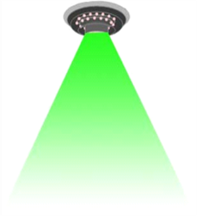

Hidden Terminal Problem in LED-ID
LED-ID Characteristics
  Limited of Field Of View (FOV)
  Inefficient of CSMA-CA
Proposed MAC protocol
  RTS/CTS (802.15.4e)
  NAV (802.11)
A
A, B, C can sense together
C can’t sense B’s signal
FOV
B
C
RF
LED-ID

Slide 5
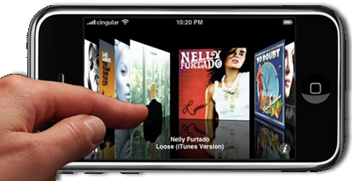
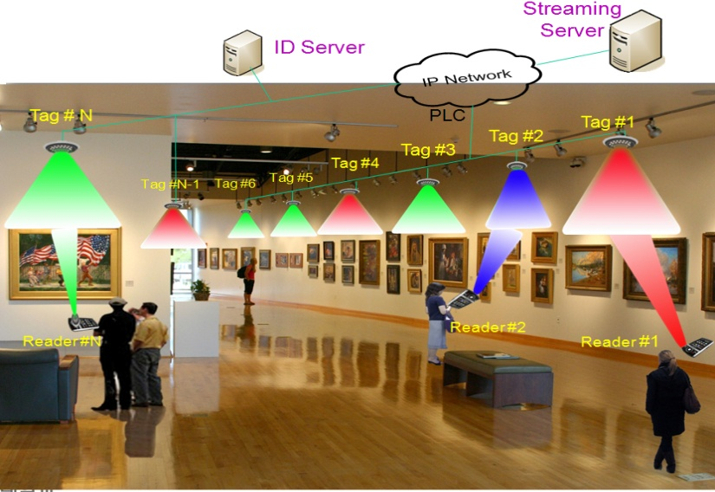
LED-ID MAC approach
Non-QoS Guarantee
  Identification application
  Peer to Peer topology
QoS Guarantee
  Real time applications, Exhibition, Museum
  Star topology

Slide 6
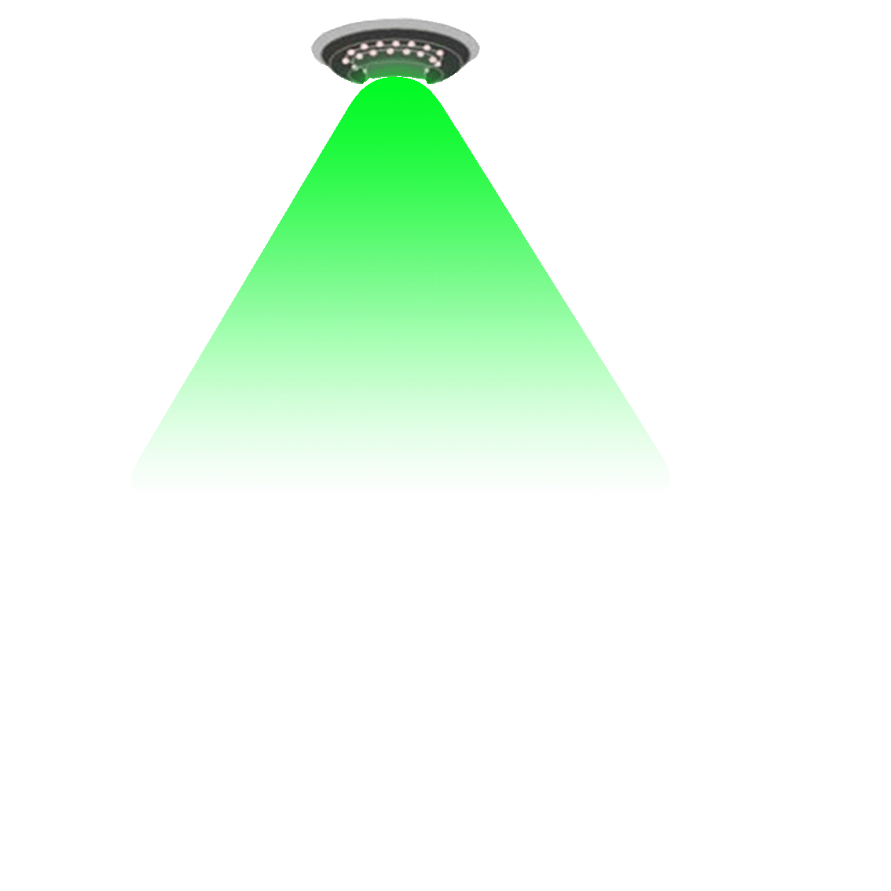


LED-ID MAC approach (Non-QoS Guarantee)
Limited of FOV
  Readers can not sense signal together
Reader #3
Reader #2
Reader #1
Reader #2 and Reader #1 are deaf with Reader #3
  CSMA-CA is not perfect for LED-ID

Slide 7
LED-ID MAC approach (Non-QoS Guarantee)
MAC mechanism
  Random Access Algorithm
  CTS/RTS
  NAV
Tag
Reader
RTS
CTS
Data request
ACK
Data
ACK

Slide 8
LED-ID MAC Approach (QoS Guaranteed)
Processing phases of LED-ID
  Idle
  Wake up
  Synchronization
  Identification
  Allocation
  Transmission

Slide 9
LED-ID MAC approach (QoS Guarantee)
Processing states of LED-ID
Reader
Tag
Working
Ready
Wake up
Start
Request traffic
Request
Synchronize
Generate beacon
Acknowledgement
Acknowledged
Acknowledged
Receive request and data
Send/ receive data
Access
Allocate traffic
Allocate slots
Stop
Kill
Access
Send/ receive data
Kill
Sleep

Slide 10
LED-ID MAC Approach (QoS Guaranteed)
Combined approach from RFID and IEEE 802.15.7 (VLC)
  Identification process of RFID
    Slotted ALOHA
  GTS allocation of IEEE 802.15.7
    QoS guaranteed
Beacon
Identification
Data transmission

Slide 11

LED-ID MAC Approach (QoS Guaranteed)
Identification packet
  Structure of 802.15.7 GTS request command
  GTS characteristics field
MHR fields
Command Frame Identifier
GTS Characteristics
GTS Length
GTS Direction
Characteristics Type
Reserved
Beacon
Identification
Data transmission
Reader #1
Reader #2
Reader #3

Slide 12

LED-ID MAC approach (QoS Guarantee)
Data transmission
Beacon
Identification
Data transmission
Reader #1
Reader #2
Reader #3

Slide 13
Cooperative MAC

Slide 14




Direct, Multi-hop, Cooperative Network
Multi-hop
Cooperative
Direct
Tag
Tag
Tag
Reader #2
Reader #2
Reader #3
Reader #3
Reader #3

Slide 15
Direct, Multi-hop, Cooperative Network
Direct communication
  Less delay
  High packet loss
Multi-hop communication
  More delay
  Low packet loss

Slide 16

LED-ID Cooperative and Relay Network
  Improve the performance of LED-ID network
    Delay
    Throughput
    Loss probability
  Increase coverage
Tag
Reader #2
Reader #3

Slide 17
LED-ID Cooperative MAC Protocol
Tag
Reader 3 ⬄ Tag
Bad channel condition
Packet loss threshold
OSSI threshold
Discover Relay node
Cooperative Communication
Reader #2
Cooperative MAC
Reader #3

Slide 18
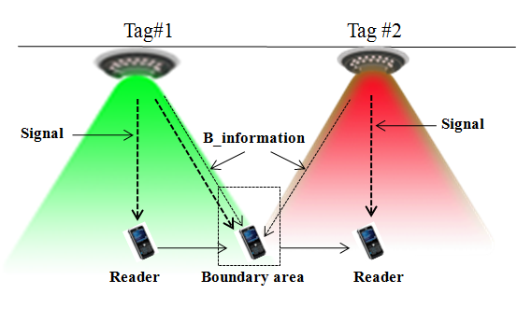
What is Link Switching?
The procedure whereby a reader change its communication link within a coverage area of tag or from one tag to another tag via an alternative link when this is necessary and appropriate to maintain or improve communications

Slide 19
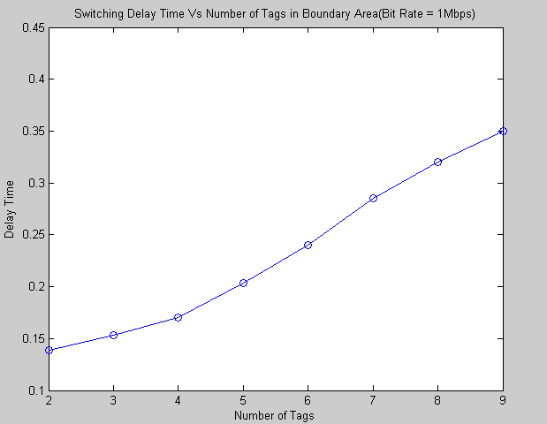
Link Switching in Multi-tags Scenarios

Slide 20
Proposed Scheme to Reducing Latency

Slide 21
Site Diversity
  The transmitter provides the receiver with several independent replicas of the same signal over independently faded channels, in order to achieve redundancy
  Diversity scheme provides two or more uncorrelated inputs at the receiver
If one or more LOS path undergoes a blockage at a particular point in time, another independent (or at least highly uncorrelated) path may have a strong signal
M different photo-detectors are used at the receiver to obtain independent signals.
If probability of a blockage in one channel is p, then the probability for M channels is p^{M}

Slide 22

Site Diversity
Link blockage is the key problem in indoor application of LED-ID
This Link blockage can happen in random manner
Difficult to avoid random blockage
Receiver with wide FOV is the one solution but
single element receiver with wide FOV combines the following into a single electrical signal
  - Desired signal
  - Delayed multipath components
  Ambient light noise
  Site diversity is the optimum solution
Tag1
Tag2
Tag3
Reader

Slide 23
Site Diversity
The principle of diversity is to provide the receiver with several replicas of the same signal.
Diversity techniques improve the time availability of signals without any increase in the transmitted power.
Diversity techniques work best when the different replicas of the signal are transmitted through independently faded channels.
Signal combining is a very important part of a diversity system.
Correlation between the different branches reduces the diversity gain.
More receiver elements give more gain but consume more power at receiver
Therefore we propose location based reconfigurable cell site diversity with minimum branch MRC(Maximal Ratio Combining)

Slide 24
Location Based Reconfigurable Cell
Cell
Tag
1
2
Reader
3
4
Reader
5
6
7
8
9
10
11
12
13
14
15
16
Cell for each reader depends on its location
  Reduce the power consumption
  Increase the capacity of the system

Slide 25
Location Based Minimum Branch MRC
Site Diversity

Slide 26
Location Based Reconfigurable Cell Site Diversity using minimum branch MRC
Advantages
  Increase the capacity of the system
  Reduce the outage probability
  Improve the link performance and Coverage
  Reduce the power consumption
  No efficiency loss
  Improve the link quality

Slide 27
Conclusion
Hidden node problem in LED-ID system
LED-ID MAC
Cooperative MAC
Fast link switching
Location based reconfigurable cell site diversity using
minimum branch MRC technique

