Slide 1
Project: IEEE P802.15 Working Group for Wireless Personal Area Networks (WPANs)
Submission Title: [Issue and Challenges for LED-ID]
Date Submitted: [11 July, 2010]
Source: Yeong Min Jang, Sunwoong Choi, Nam Tuan Le, Muhammad Shahin Uddin, Bui Minh Trung]
[Kookmin University]
Address [Kookmin University, Seoul, Korea]
Voice:[82-2-910-5068], FAX: [82-2-910-5068], E-Mail:[ yjang@kookmin.ac.kr]
Re: []
Abstract: [Issue and Challenges for LED-ID]
Purpose: []
Notice: This document has been prepared to assist the IEEE P802.15. It is offered as a basis for discussion and is not binding on the contributing individual(s) or organization(s). The material in this document is subject to change in form and content after further study. The contributor(s) reserve(s) the right to add, amend or withdraw material contained herein.
Release: The contributor acknowledges and accepts that this contribution becomes the property of IEEE and may be made publicly available by P802.15.
Slide 1
Notes:
doc.: IEEE 802.15-09-0117-00-0007
<month year>

Slide 2
Contents
Hidden Node Problem in VLC and LED-ID
LED-ID MAC Protocol for LED-ID
Cooperative MAC
Fast Link Switching
Site Diversity
Conclusion

Slide 3
What is the Hidden Terminal Problem?
Hidden terminal problem.
Hidden terminal problem in IEEE 802.15.4 occurs, but not frequently affect the performance.
Low-rate wireless personal area networks
CSMA-CA
IEEE 802.15.4e CTS/RTS for star network topology

Slide 4
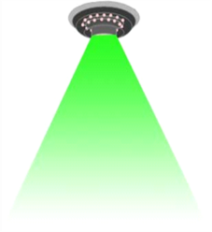
Hidden Terminal Problem in VLC
VLC Characteristics
Limited of Field Of View (FOV)
Inefficient of CSMA-CA
Proposed MAC protocol
RTS/CTS (802.15.4e)
NAV (802.11)
A
A, B, C can sense together
C can’t sense B’s signal
FOV
B
C
RF
VLC

Slide 5
Discussion
Current draft VLC specification bases on IEEE 802.15.4
Current draft VLC specification may consider hidden terminal problem.

Slide 6
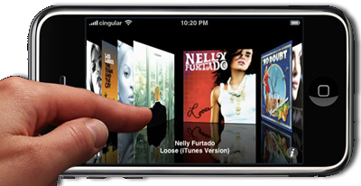
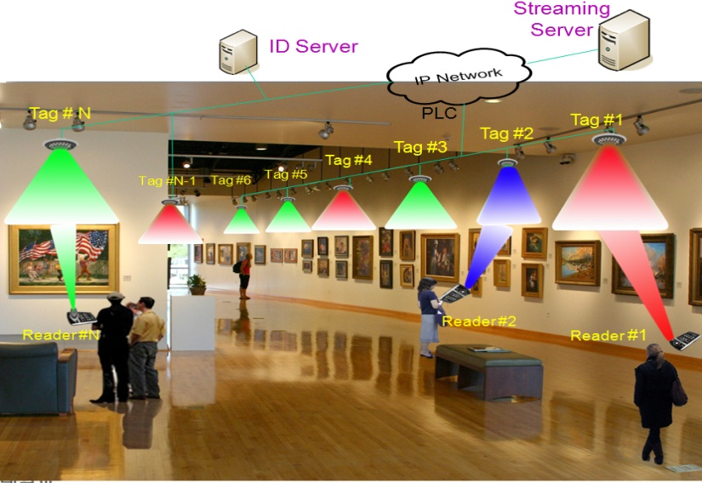
LED-ID MAC approach
Non-QoS Guarantee
Identification application
Peer to Peer topology
QoS Guarantee
Real time applications, Exhibition, Museum
Star topology

Slide 7
LED-ID MAC approach (Non-QoS Guarantee)
Limited of FOV
Readers can not sense signal together
Reader #3
Reader #2
Reader #1
Reader #2 and #1 are deaf with Reader #3
CSMA-CA is not perfect for LED-ID

Slide 8
LED-ID MAC approach (Non-QoS Guarantee)
MAC mechanism
Random Access Algorithm
CTS/RTS
NAV
Tag
Reader
RTS
CTS
Data request
ACK
Data
ACK

Slide 9
LED-ID MAC Approach (QoS Guaranteed)
Processing phases of LED-ID
Idle
Wake up
Synchronization
Identification
Allocation
Transmission

Slide 10
LED-ID MAC approach (QoS Guarantee)
Processing states of LED-ID
Reader
Tag
Working
Ready
Wake up
Start
Request traffic
Request
Synchronize
Generate beacon
Acknowledgement
Acknowledged
Acknowledged
Receive request and data
Send/ receive data
Access
Allocate traffic
Allocate slots
Stop
Kill
Access
Send/ receive data
Kill
Sleep

Slide 11
LED-ID MAC Approach (QoS Guaranteed)
Combined approach using RFID and IEEE 802.15.7 (VLC)
Identification process of RFID
Slotted ALOHA
GTS allocation of IEEE 802.15.7
QoS guaranteed
Beacon
Identification
Data transmission

Slide 12
LED-ID MAC Approach (QoS Guaranteed)
Identification packet
~ structure of 802.15.7 GTS request command
GTS characteristics field
MHR fields
Command Frame Identifier
GTS Characteristics
GTS Length
GTS Direction
Characteristics Type
Reserved
Beacon
Identification
Data transmission
Reader #1
Reader #2
Reader #3

Slide 13
LED-ID MAC approach (QoS Guarantee)
Data transmission
Beacon
Identification
Data transmission
Reader #1
Reader #2
Reader #3

Slide 14
Cooperative MAC

Slide 15
Direct, Multi-hop, Cooperative Network
Multi-hop
Cooperative
Direct
Tag
Tag
Tag
Reader #2
Reader #2
Reader #3
Reader #3
Reader #3

Slide 16
Direct, Multi-hop, Cooperative Network
Direct communication
Less delay
High packet loss
Multi-hop communication
More delay
Low packet loss

Slide 17
LED-ID Cooperative and Relay Network
Improve the performance of LED-ID network
Delay
Throughput
Loss probability
Increase coverage
Tag
Reader #2
Reader #3

Slide 18
LED-ID Cooperative MAC Protocol
Tag
Reader 3 ⬄ Tag
Bad channel condition
Packet loss Threshold
OSSI Threshold
Discover Relay node
Reader #2
Cooperative Communication
Cooperative MAC
Reader #3

Slide 19
LED-ID Cooperative MAC protocol
S broadcast packet
(S →D, R)
D stores backup packet
Receive ACK from D?
Y
R deletes backup packet
N
Receive ACK from D?
R relay backup packet
Y
N
N
Retry limit
Y
Transmission fail

Slide 20
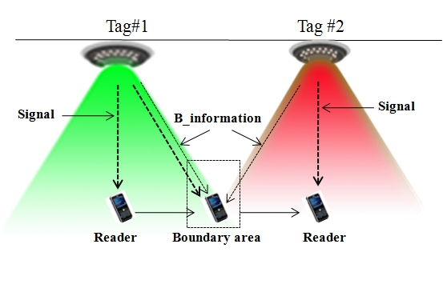
What is Link Switching?
The procedure whereby a reader change its communication link within a coverage area of tag or from one tag to another tag via an alternative link when this is necessary and appropriate to maintain or improve communications

Slide 21
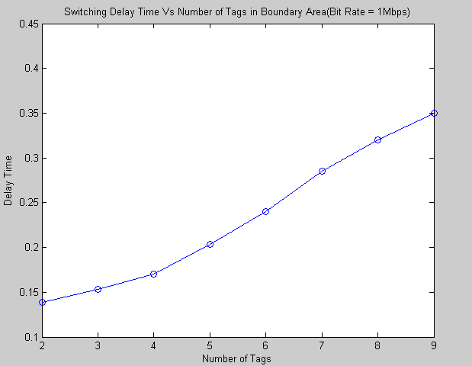
Link Switching in Multi-tags Scenarios

Slide 22
Proposed Scheme to Reducing Latency

Slide 23
Site Diversity
The transmitter provides the receiver with several independent replicas of the same signal over independently faded channels, in order to achieve redundancy
Diversity scheme provides two or more uncorrelated inputs at the receiver
If one or more LOS path undergoes a blockage at a particular point in time, another independent (or at least highly uncorrelated) path may have a strong signal
M different photo-detectors are used at the receiver to obtain independent signals.
If probability of a blockage in one channel is p, then the probability for M channels is p^{M}

Slide 24
Site Diversity
Link blockage is the key problem in indoor application of LED-ID
This Link blockage can happen in random manner
Difficult to avoid random blockage
Receiver with wide FOV is the one solution but
single element receiver with wide FOV combines the following into a single electrical signal
- Desired signal
- Delayed multipath components
Ambient light noise
Site diversity is the optimum solution
Tag1
Tag2
Tag3
Reader

Slide 25
Site Diversity
The principle of diversity is to provide the receiver with several replicas of the same signal.
Diversity techniques improve the time availability of signals without any increase in the transmitted power.
Diversity techniques work best when the different replicas of the signal are transmitted through independently faded channels.
Signal combining is a very important part of a diversity system.
Correlation between the different branches reduces the diversity gain.
More receiver elements give more gain but consume more power at receiver
Therefore we propose location based reconfigurable cell site diversity with minimum branch MRC

Slide 26
Location Based Reconfigurable Cell
Cell
Tag
1
2
Reader
3
4
Reader
5
6
7
8
9
10
11
12
13
14
15
16
Cell for each reader depends on its location
Reduce the power consumption
Increase the capacity of the system

Slide 27
Location Based Minimum Branch MRC Site Diversity

Slide 28
Location Based Reconfigurable Cell Site Diversity using minimum branch MRC
Advantages
Increase the capacity of the system
Reduce the outage probability
Improve the link performance and Coverage
Reduce the power consumption
No efficiency loss
Improve the link quality

Slide 29
Conclusion
Hidden node problem in VLC system
LED-ID MAC
Cooperative MAC
Fast link switching
Location based reconfigurable cell site diversity using
minimum branch MRC technique

