Slide 1
Project: IEEE P802.15 Working Group for Wireless Personal Area Networks (WPANs)
Submission Title: [Overview of LED-ID]
Date Submitted: [11 July, 2010]
Source: [Yeong Min Jang, Sunwoong Choi, Muhammad Shahin Uddin, Nam Tuan Le, Jin Young Kim, Jaesang Cha, Kyesan Lee]
[Kookmin University, Kwangwoon University, Seoul National University of Technology, Kyunghee University]
Address [Kookmin University, Seoul, Korea]
Voice:[82-2-910-5068], FAX: [82-2-910-5068], Email:[ yjang@kookmin.ac.kr]
Re: []
Abstract: [LED-ID Technology is the new paradigm in the identification technology environment. Illumination, identification and communications are simultaneously possible in LED-ID system. In this contribution we introduce the LED-ID system and its overview ]
Purpose: []
Notice: This document has been prepared to assist the IEEE P802.15. It is offered as a basis for discussion and is not binding on the contributing individual(s) or organization(s). The material in this document is subject to change in form and content after further study. The contributor(s) reserve(s) the right to add, amend or withdraw material contained herein.
Release: The contributor acknowledges and accepts that this contribution becomes the property of IEEE and may be made publicly available by P802.15.
Slide 1
Notes:
doc.: IEEE 802.15-09-0117-00-0007
<month year>

Slide 2
Contents
What is LED-ID ?
Components and Characteristics of LED-ID
Frequency Band
Superframe Structure
Comparison between LED-ID and RFID
Candidate Application/ Service Scenario
Conclusion

Slide 3
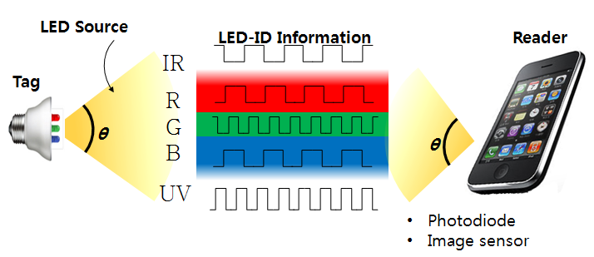
Definition of LED-ID
Light Emitting Diode Identification (LED-ID) is a technology that uses communication via LED light (IR / Visible light/ UV) to exchange voice/video/data among one Tag (or Reader) to one or more identified Readers (or Tags).

Slide 4
Components of LED-ID
The main components of the LED-ID system are Reader and Tag
Each Reader and Tag of LED-ID has at least one LED and Rx Module (PD/ Image sensor etc.)
Characteristics of LED-ID
Low power consumption
Harmless to human
Green environment
High security
High speed read and write capability
No interference with RF
Support QoS

Slide 5
Classification of LED-ID Tag
Active tag (ex. PD based)
Semi-active/passive tag (ex. Image Sensor based)
Active tag (ex. PD based)
Each Tag has LED and Photo-detector
Internal power source
Always energized in dimming mode
Emits light using low power
Life time depend upon mainly LED, Photo-detector and power source
Semi-active/passive tag (ex. Image Sensor based)
Each Tag has LED and Photo-detector
Power source only for local circuitry
For communication purpose use energy comes from Reader
Life time depend upon mainly LED, Photo-detector and power source

Slide 6
Frequency Band
UV (nm) | 10-380 | Solar blind (200~280 nm) High SNR High scattering > NLOS , penetration to fog High absorption > secure, covert and anti-jamming (to RF)
Visible Light (nm) | 380-780 | Visible to human eye Visible Light can be used every where Existing home network Infrastructure (Light etc.) Three dimensional positioning with accuracy up to several mm
IR (nm) | 780-1000 | Invisible to human eye Unregulated

Slide 7
Superframe Structure for LED-ID MAC
BI=aBaseSuperFrameDuration x 2^{BO}
IDD=aBaseSuperFrameDuration x 2^{IO}
CAP: Contention Access Period
IDP: Identification Period
CFP: Contention Free Period
GTS: Guaranteed Time Slots
BI: Beacon Interval
BO: Beacon Order
IDD: Identification Duration
IO: Identification Order
CAP(IDP)
CFP(GTS)
Beacon
Reserve timeslot for identified Readers
Discover ID of Readers
Candidate Protocols:
Protocols for CAP: Frame Slotted ALOHA, Query Tree
Protocols for CFP: TDMA

Slide 8
Comparison of ID Technologies
 | Bar Code | RFID (Passive) | LED-ID
Signal Format (Transmission medium) | Printed image | RF | LED light (Visible Light, IR UV, etc
Reliability | Wrinkled or smeared labels will not be read | Nearly flawless read rate | Flawless read rate
Readable through objects | No, must be line of sight | Yes | Depend on FOV
Security | No | Strong | Very Strong
Read speed | Slow | Fast | Variable Speed
Multiple tags | No | Yes | Yes
Updateable | No | Yes | Yes
Data type | Non real-time | Non real-time | Non real-time and real-time
Tag and reader position | Scanner needs to see the bar code to read it | No need to bring the tag near the reader | Need to bring within the FOV
QoS | No need | Not support QoS | Support QoS
Communication | Half-duplex | Duplex | Duplex
Possibility to use Existing Infrastructure | No, New setup | No, New setup | Yes Existing infrastructure may be used

Slide 9
Candidate of Applications and Service Scenario
Museum
Product expo
Advertisement
Intelligent menu system (airplane, restaurant)
Sign board
Kiosk
Indoor localization (LBS applications)
Inventory management system
Car parking
Mobile cleaning robot
Guiding system for blind person
Supermarket/Department store
Entertainment /Movie/Amusement Park

Slide 10
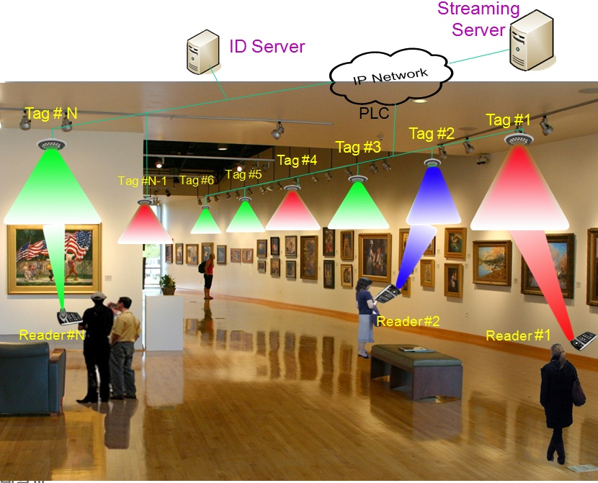
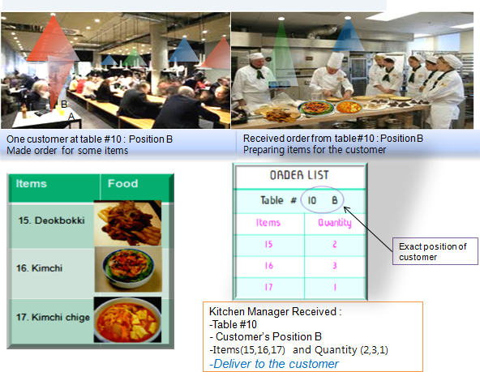
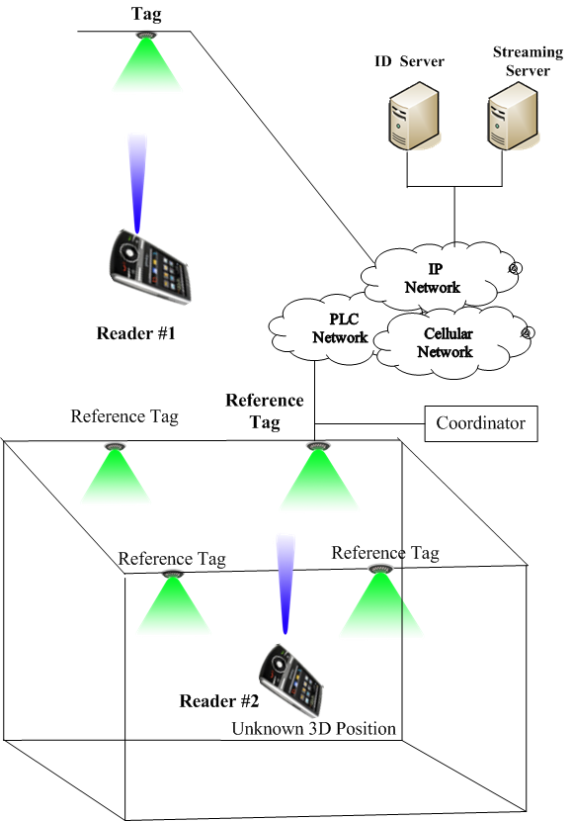
Museum Scenario
Mobile Cleaning Robots control
Restaurant Scenario
Indoor 3D Positioning

Slide 11
Air Plane Scenario

Slide 12
Recent Research Activities
LED-ID MAC approach
Identification technique combine with QoS data transmission
Priority MAC
Cooperative MAC
Fast efficient Anti-collision protocol
Anti-collision protocol
Others
Method to overcome the limitation of FOV
Site diversity technique
Fast link switching
Enhance the coverage
Fast and energy efficient link recovery

Slide 13
Conclusion
LED-ID system is the new paradigm in the identification world
LED-ID system is support non QoS and QoS application
This system can be used for identification communication and illumination as well
LED-ID system may coexist with RFID, Barcode, QR code and Hollogram ID instead of replacement

